Slide 1
Pattern Matching
Boyer-Moore substring search
Rabin-Karp fingerprint search

Slide 2
Boyer-Moore Substring Search
The algorithm
preprocesses the pattern
matches on the tail of the pattern
uses preprocessed information to skip sections of text

Slide 3
Preprocess the Pattern
Each time we will overwrite one entry
The final array would contain just 3,5,4,0 for D,E,L,N, and -1 for any of the other 252 entries
…
A | -1
…
D | -1
E | -1
…
L | -1
M | -1
N | -1
… | -1
Mismatched character heuristic
record each character’s rightmost position
Preprocess
int R=256; int M=pattern.length();
right = new int[R];
for (int c = 0; c < R; c++)
right[c] = -1;
for (int j = 0; j < M; j++)
right[pattern.charAt(j)] = j;
Example
‘NEEDLE’
256 entries array for ascii
3
1
2
5
4
0

Slide 4
Search for Pattern
Search
int skip; int M=pattern.length(); int N = text.length();
for (int i = 0; i <= N – M; i+=skip)
{
skip = 0;
for (int j = M – 1; j >= 0; j--) {
if (pattern.charAt(j) != text.charAt(i + j)) {
skip = j – right[text.charAt(i + j)];
If (skip < 1) skip = 1;
break;
}
}
If (skip == 0) return i; // found
}
return -1; //not found

Slide 5
An Example
i=0
i+=j–right[‘N’]
0 | 1 | 2 | 3 | 4 | 5 | 6 | 7 | 8 | 9 | 10 | 11 | 12 | 13 | 14 | 15 | 16 | 17 | 18 | 19 | 20 | 21 | 22 | 23
F | I | N | D | I | N | A | H | A | Y | S | T | A | C | K | N | E | E | D | L | E | I | N | A
N | E | E | D | L | E
j=5
D | 3
E | 1 | 2 | 5
L | 4
N | 0
N | E | E | D | L | E

Slide 6
An Example
i=5
i+=j-right[‘S’]
0 | 1 | 2 | 3 | 4 | 5 | 6 | 7 | 8 | 9 | 10 | 11 | 12 | 13 | 14 | 15 | 16 | 17 | 18 | 19 | 20 | 21 | 22 | 23
F | I | N | D | I | N | A | H | A | Y | S | T | A | C | K | N | E | E | D | L | E | I | N | A
N | E | E | D | L | E
N | E | E | D | L | E
D | 3
E | 1 | 2 | 5
L | 4
N | 0
j=5
N | E | E | D | L | E

Slide 7
An Example
i=11
0 | 1 | 2 | 3 | 4 | 5 | 6 | 7 | 8 | 9 | 10 | 11 | 12 | 13 | 14 | 15 | 16 | 17 | 18 | 19 | 20 | 21 | 22 | 23
F | I | N | D | I | N | A | H | A | Y | S | T | A | C | K | N | E | E | D | L | E | I | N | A
N | E | E | D | L | E
N | E | E | D | L | E
D | 3
E | 1 | 2 | 5
L | 4
N | 0
N | E | E | D | L | E
j=5

Slide 8
An Example
i=11
i+=j-right[‘N’]
0 | 1 | 2 | 3 | 4 | 5 | 6 | 7 | 8 | 9 | 10 | 11 | 12 | 13 | 14 | 15 | 16 | 17 | 18 | 19 | 20 | 21 | 22 | 23
F | I | N | D | I | N | A | H | A | Y | S | T | A | C | K | N | E | E | D | L | E | I | N | A
N | E | E | D | L | E
N | E | E | D | L | E
D | 3
E | 1 | 2 | 5
L | 4
N | 0
N | E | E | D | L | E
j=4
N | E | E | D | L | E

Slide 9
An Example
i=15
0 | 1 | 2 | 3 | 4 | 5 | 6 | 7 | 8 | 9 | 10 | 11 | 12 | 13 | 14 | 15 | 16 | 17 | 18 | 19 | 20 | 21 | 22 | 23
F | I | N | D | I | N | A | H | A | Y | S | T | A | C | K | N | E | E | D | L | E | I | N | A
N | E | E | D | L | E
N | E | E | D | L | E
D | 3
E | 1 | 2 | 5
L | 4
N | 0
N | E | E | D | L | E
N | E | E | D | L | E
j=4

Slide 10
An Example
i=15
0 | 1 | 2 | 3 | 4 | 5 | 6 | 7 | 8 | 9 | 10 | 11 | 12 | 13 | 14 | 15 | 16 | 17 | 18 | 19 | 20 | 21 | 22 | 23
F | I | N | D | I | N | A | H | A | Y | S | T | A | C | K | N | E | E | D | L | E | I | N | A
N | E | E | D | L | E
N | E | E | D | L | E
D | 3
E | 1 | 2 | 5
L | 4
N | 0
N | E | E | D | L | E
N | E | E | D | L | E
j=3

Slide 11
An Example
i=15
0 | 1 | 2 | 3 | 4 | 5 | 6 | 7 | 8 | 9 | 10 | 11 | 12 | 13 | 14 | 15 | 16 | 17 | 18 | 19 | 20 | 21 | 22 | 23
F | I | N | D | I | N | A | H | A | Y | S | T | A | C | K | N | E | E | D | L | E | I | N | A
N | E | E | D | L | E
N | E | E | D | L | E
D | 3
E | 1 | 2 | 5
L | 4
N | 0
N | E | E | D | L | E
N | E | E | D | L | E
j=2

Slide 12
An Example
i=15
0 | 1 | 2 | 3 | 4 | 5 | 6 | 7 | 8 | 9 | 10 | 11 | 12 | 13 | 14 | 15 | 16 | 17 | 18 | 19 | 20 | 21 | 22 | 23
F | I | N | D | I | N | A | H | A | Y | S | T | A | C | K | N | E | E | D | L | E | I | N | A
N | E | E | D | L | E
N | E | E | D | L | E
D | 3
E | 1 | 2 | 5
L | 4
N | 0
N | E | E | D | L | E
N | E | E | D | L | E
j=1

Slide 13
An Example
i=15
0 | 1 | 2 | 3 | 4 | 5 | 6 | 7 | 8 | 9 | 10 | 11 | 12 | 13 | 14 | 15 | 16 | 17 | 18 | 19 | 20 | 21 | 22 | 23
F | I | N | D | I | N | A | H | A | Y | S | T | A | C | K | N | E | E | D | L | E | I | N | A
N | E | E | D | L | E
N | E | E | D | L | E
D | 3
E | 1 | 2 | 5
L | 4
N | 0
N | E | E | D | L | E
N | E | E | D | L | E
j=0

Slide 14
Heuristic is No Help
i+=j-right[‘E’]
i
. | . | . | . | . | . | E | L | E | .
x
N | E | E | D | L | E
j=3
D | 3
E | 1 | 2 | 5
L | 4
N | 0
N | E | E | D | L | E

Slide 15
Heuristic is No Help
Ensure that the pattern always slides at least one position to the right
for (int i = 0; i <= text.length() – pattern.length(); i+=skip)
{
skip = 0;
for (int j = pattern.length(); j >= 0; j--) {
if (pattern.charAt(j) != text.charAt(i + j)) {
skip = j – right[text.charAt(i + j)];
If (skip < 1) skip = 1;
break;
}
}
If (skip == 0) return i; // found
}
return -1; //not found

Slide 16
Rabin-Karp Fingerprint Search
The algorithm
is based on efficiently computing the hash function
follows directly from a simple mathematical formulation

Slide 17
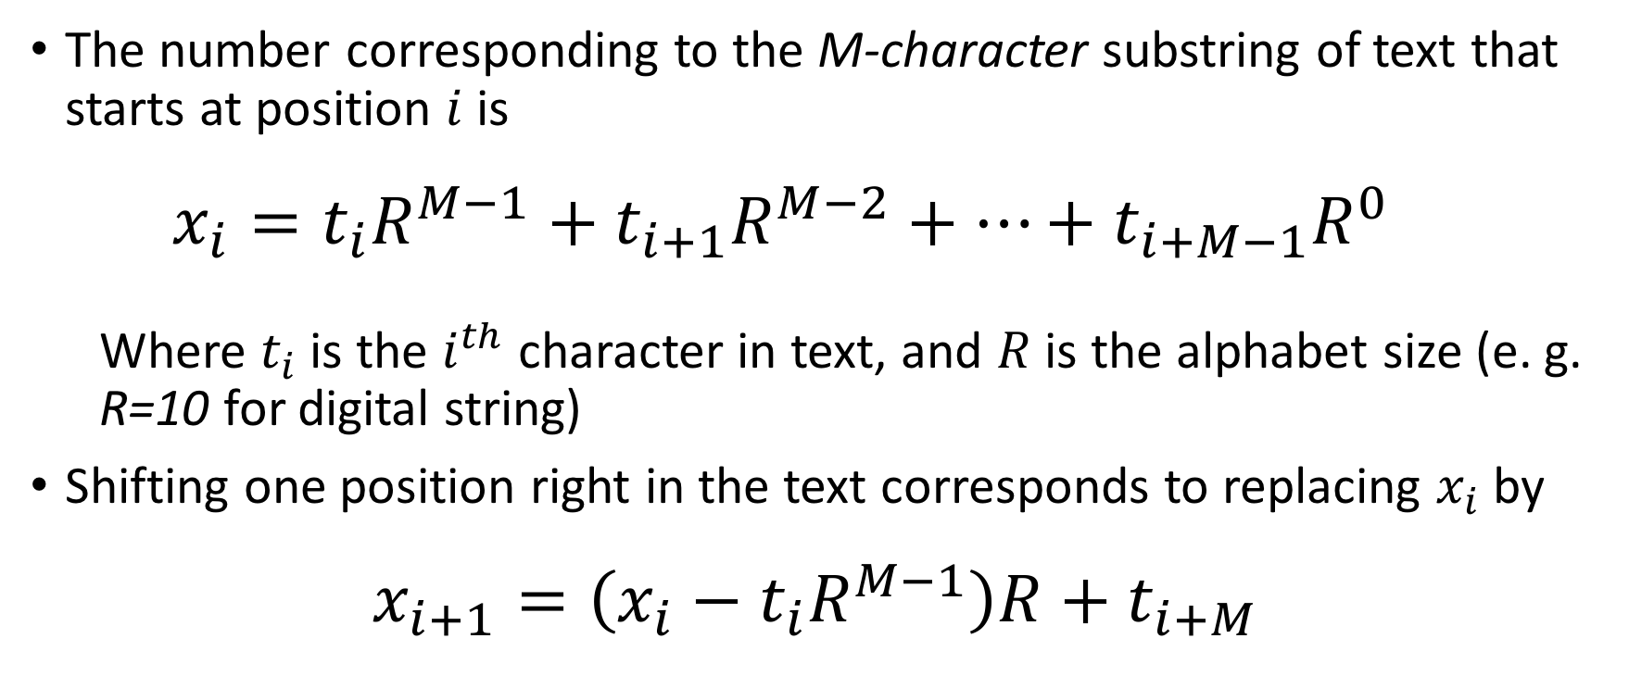
Mathematical Formulation
The number corresponding to the M-character substring of text that starts at position $i$ is
$$x_{i}=t_{i}R^{M−1}+t_{i+1}R^{M−2}+…+t_{i+M−1}R^{0}$$
Where $t_{i}$ is the $i^{th}$ character in text, and $R$ is the alphabet size (e. g. R=10 for digital string)
Shifting one position right in the text corresponds to replacing $x_{i}$ by
$$x_{i+1}=\left(x_{i}−t_{i}R^{M−1}\right)R+t_{i+M}$$

Slide 18
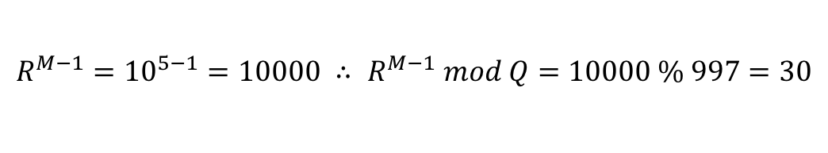
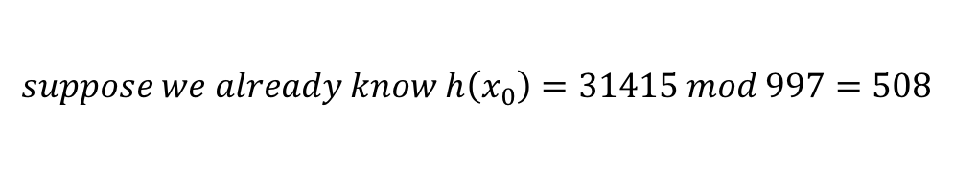
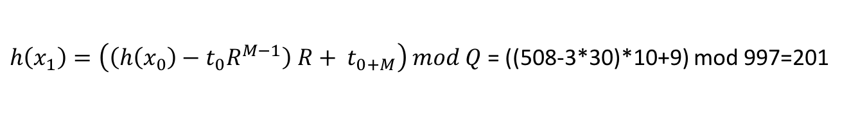
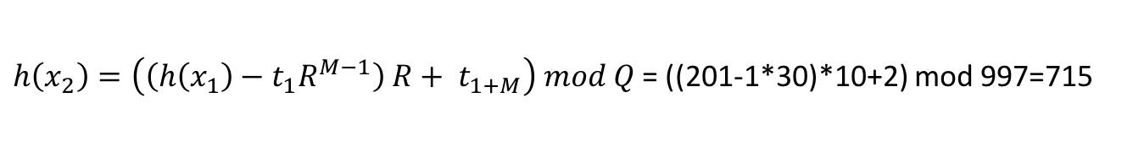

An Example
Computing $h\left(x_{i+1}\right)$
Suppose $h\left(x_{i+1}\right)=x_{i} mod Q$, where $Q=997$ in the example
$x_{i+1}=\left(x_{i}−t_{i}R^{M−1}\right)R+t_{i+M}$, where $R=10, M=5$
$$R^{M−1}={10}^{5−1}=10000 ∴ R^{M−1} mod Q=10000 \% 997=30$$
0 | 1 | 2 | 3 | 4 | 5 | 6 | 7 | 8 | 9 | 10 | 11 | 12 | 13 | 14 | 15
3 | 1 | 4 | 1 | 5 | 9 | 2 | 6 | 5 | 3 | 5 | 8 | 9 | 7 | 9 | 3
…
3 | 1 | 4 | 1 | 5
 | 1 | 4 | 1 | 5 | 9
 |  | 4 | 1 | 5 | 9 | 2
$$suppose we already know h\left(x_{0}\right)=31415 mod 997=508$$
$h\left(x_{1}\right)=\left(\left(h\left(x_{0}\right)−t_{0}R^{M−1}\right) R+ t_{0+M}\right) mod Q$= ((508-3*30)*10+9) mod 997=201
$h\left(x_{2}\right)=\left(\left(h\left(x_{1}\right)−t_{1}R^{M−1}\right) R+ t_{1+M}\right) mod Q$= ((201-1*30)*10+2) mod 997=715

Slide 19







An Example
0 | 1 | 2 | 3 | 4 | 5 | 6 | 7 | 8 | 9 | 10 | 11 | 12 | 13 | 14 | 15
3 | 1 | 4 | 1 | 5 | 9 | 2 | 6 | 5 | 3 | 5 | 8 | 9 | 7 | 9 | 3
…
3 | 1 | 4 | 1 | 5
 | 1 | 4 | 1 | 5 | 9
 |  | 4 | 1 | 5 | 9 | 2
 |  |  | 1 | 5 | 9 | 2 | 6
 |  |  |  | 5 | 9 | 2 | 6 | 5
 |  |  |  |  | 9 | 2 | 6 | 5 | 3
 |  |  |  |  |  | 2 | 6 | 5 | 3 | 5
Match ‘26535’
Precompute hash
Goal = 613
$$h\left(x_{0}\right)=508$$
$$h\left(x_{1}\right)=201$$
$$h\left(x_{2}\right)=715$$
$$h\left(x_{3}\right)=971$$
$$h\left(x_{4}\right)=442$$
$$h\left(x_{5}\right)=929$$
$h\left(x_{6}\right)=613$, match!

Slide 20

Implementation
Preprocess
PM = 1; M = pattern.length();
For (int i = 1; i <= M – 1; i++)
PM = (R * PM) % Q;
patHash = hash(pat, M);
$x_{i+1}=\left(x_{i}−t_{i}R^{M−1}\right)R+t_{i+M}$, where $R=10, M=5$
For goal test
$$R^{M−1}={10}^{5−1}=10000 ∴ R^{M−1} mod Q=10000 \% 997=30$$

Slide 21
Implementation
int N = text.length();
long txtHash = hash(text, M);
If (patHash == txtHash && check(0)) return 0; // match
For (int i = M; I < N; i++)
{
txtHash = (txtHash + Q – RM * text.charAt(i – M) % Q) % Q;
txtHash = (txtHash * R + text.charAt(i)) % Q;
if (patHash == txtHash) if (check(i – M + 1)) return i – M + 1;
}
Search
0 | 1 | 2 | 3 | 4 | 5 | 6 | 7 | 8 | 9 | 10 | 11 | 12 | 13 | 14 | 15
3 | 1 | 4 | 1 | 5 | 9 | 2 | 6 | 5 | 3 | 5 | 8 | 9 | 7 | 9 | 3
…
3 | 1 | 4 | 1 | 5
 | 1 | 4 | 1 | 5 | 9
 |  | 4 | 1 | 5 | 9 | 2
$$suppose we already know h\left(x_{0}\right)=31415 mod 997=508$$
$h\left(x_{1}\right)=\left(\left(h\left(x_{0}\right)−t_{0}R^{M−1}\right) R+ t_{0+M}\right) mod Q$= ((508-3*30)*10+9) mod 997=201
$h\left(x_{2}\right)=\left(\left(h\left(x_{1}\right)−t_{1}R^{M−1}\right) R+ t_{1+M}\right) mod Q$= ((201-1*30)*10+2) mod 997=715

Slide 22
Implementation
Probbability Theory? Collision?
Las Vegas
Monte Carlo
int N = text.length();
long txtHash = hash(text, M);
If (patHash == txtHash && check(0)) return 0; // match
For (int i = M; I < N; i++)
{
txtHash = (txtHash + Q – RM * text.charAt(i – M) % Q) % Q;
txtHash = (txtHash * R + text.charAt(i)) % Q;
if (patHash == txtHash) if (check(i – M + 1)) return i – M + 1;
}

Slide 23
Discussion: Pros && Cons
Brute-force
Knuth-Morris-Pratt
Boyer-Moore
Rabin-Karp

