Slide 1
Compression
Review GitHub
Project Guide
Huffman Coding

Slide 2
Review GitHub
Make sure you know how to clone from website
Make sure you know how to submit your homework
Make sure you know how to push

Slide 3
Using cmd
find URL like https://github.com/…/…/*.git
Clone command: git clone <repository>
*Cloned repository should be in local git directory
Add files to local: git add <filepattern>
Commit: git commit –m <msg>
Push: git push
*push follows commit
*BESURE TO PUSH
*write comments

Slide 4
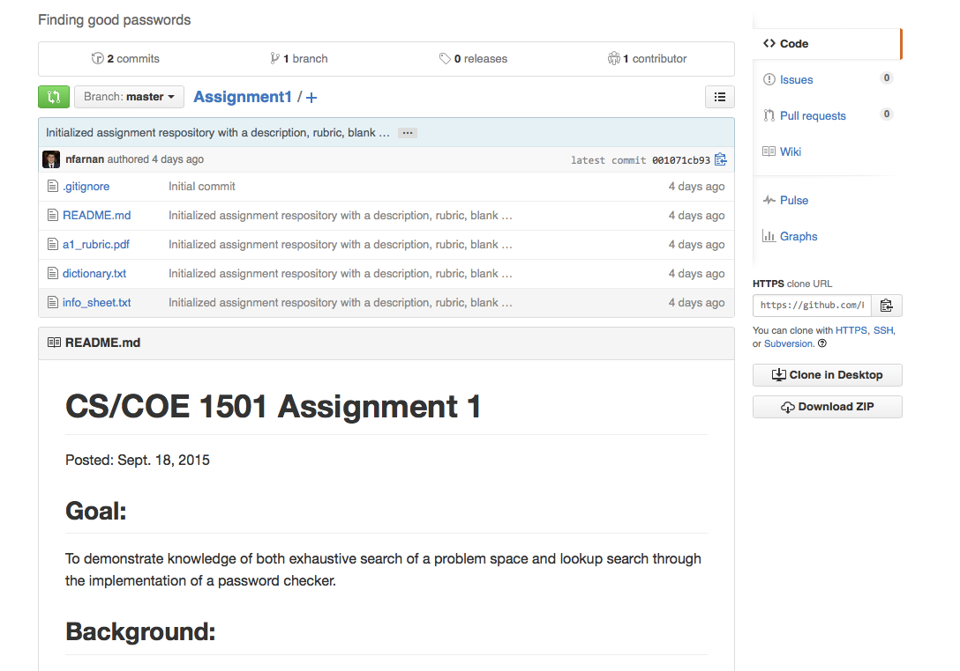

Slide 5
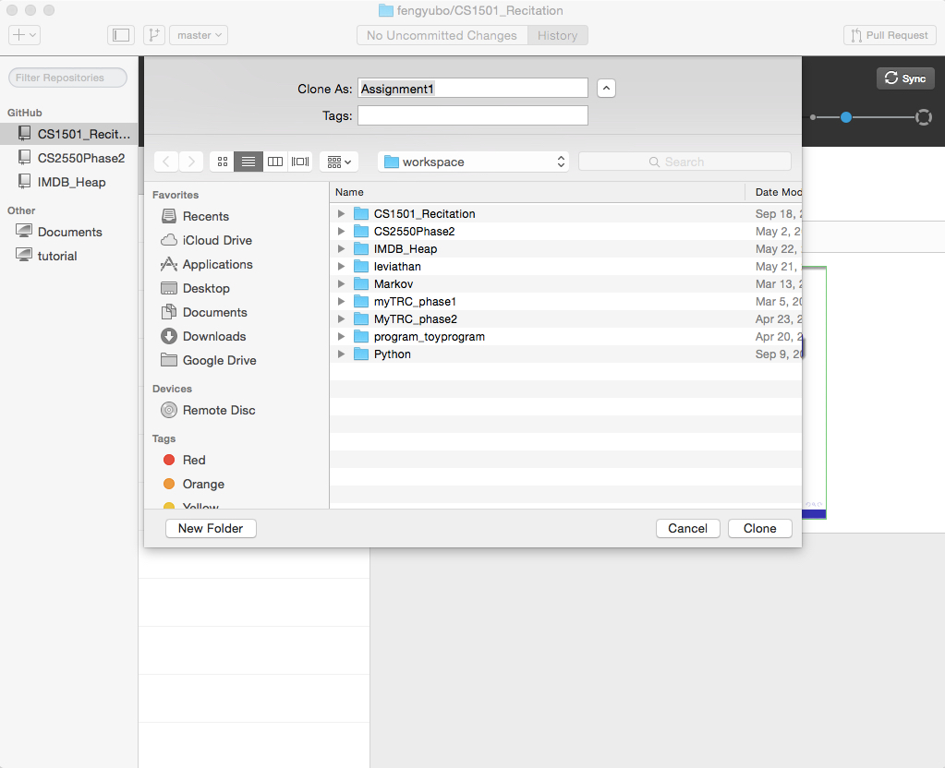

Slide 6
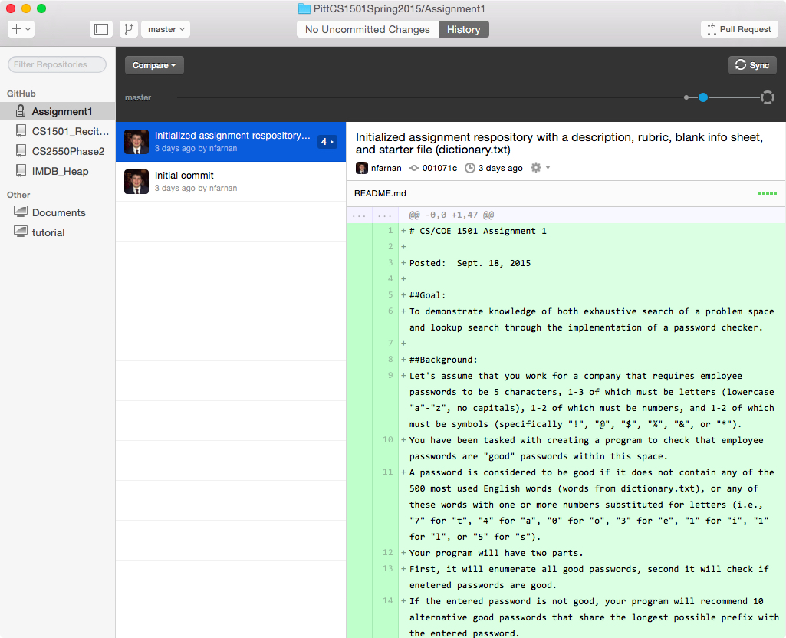

Slide 7
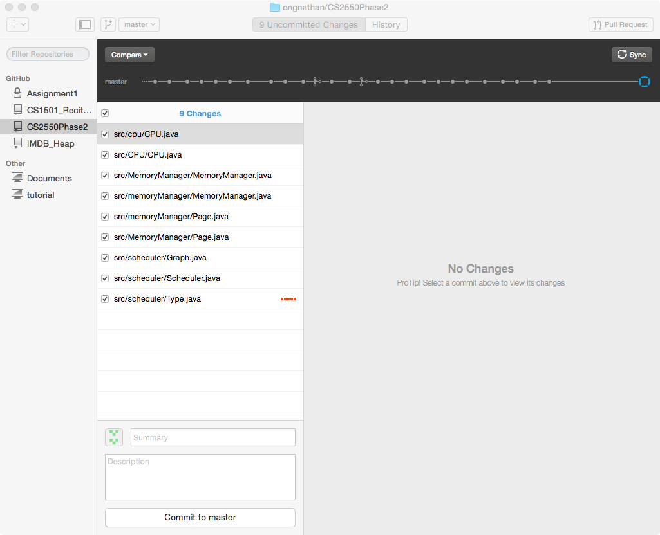

Slide 8
Project Guide
2 Part
enumerate all good passwords
determine entered passwords are good, recommend if necessary
Notice:
Considering what is input/output exactly before your design
Considering how to test your program before your design
Considering pruning rules in your design
Questions?

Slide 9
Huffman Coding
Variable bit widths coding
Idea: not all encoding unit share same frequency
If unit frequency is inverse proportion to bit width, can we save space?
Practical consideration:
encode string is large relative to the code table
table is known

Slide 10
Eerie eyes seen near lake.
Contain letters:
‘E’ ‘e’ ‘r’ ‘i’ ‘ ’ ‘y’ ‘s’ ‘n’ ‘a’ ‘r’ ‘l’ ‘k’ ‘.’
Char Freq
E 1 y 1 k 1
e 8 s 2 . 1
r 2 n 2
i 1 a 2
‘ ’ 4 l 1

Slide 11
Data Structure
Priority Queue: lower frequency -> higher priority
Node:
Node{
Char letter
int frequency
Node Left Node right
}

Slide 12
E
1
i
1
y
1
l
1
k
1
.
1
r
2
s
2
n
2
a
2
sp
4
e
8

Slide 13
y
1
l
1
k
1
.
1
r
2
s
2
n
2
a
2
sp
4
e
8
2
E
1
i
1

Slide 14
y
1
l
1
k
1
.
1
r
2
s
2
n
2
a
2
2
sp
4
e
8
E
1
i
1

Slide 15
k
1
.
1
r
2
s
2
n
2
a
2
2
sp
4
e
8
E
1
i
1
2
y
1
l
1

Slide 16
k
1
.
1
r
2
s
2
n
2
a
2
2
2
sp
4
e
8
y
1
l
1
E
1
i
1

Slide 17
r
2
s
2
n
2
a
2
2
2
sp
4
e
8
y
1
l
1
E
1
i
1
2
k
1
.
1

Slide 18
r
2
s
2
n
2
a
2
2
2
sp
4
e
8
2
E
1
i
1
y
1
l
1
k
1
.
1

Slide 19
n
2
a
2
2
sp
4
e
8
2
2
E
1
i
1
y
1
l
1
k
1
.
1
4
r
2
s
2

Slide 20
n
2
a
2
2
sp
4
e
8
2
2
4
E
1
i
1
y
1
l
1
k
1
.
1
r
2
s
2

Slide 21
2
4
e
8
2
2
sp
4
y
1
l
1
k
1
.
1
r
2
s
2
E
1
i
1
4
n
2
a
2

Slide 22
2
4
4
e
8
2
2
sp
4
y
1
l
1
k
1
.
1
r
2
s
2
n
2
a
2
E
1
i
1

Slide 23
4
4
e
8
2
sp
4
k
1
.
1
r
2
s
2
n
2
a
2
4
2
2
E
1
i
1
y
1
l
1

Slide 24
2
4
4
4
sp
4
e
8
2
2
k
1
.
1
r
2
s
2
n
2
a
2
E
1
i
1
y
1
l
1

Slide 25
4
4
4
e
8
2
2
r
2
s
2
n
2
a
2
E
1
i
1
y
1
l
1
6
2
sp
4
k
1
.
1

Slide 26
4
4
4
6
e
8
2
sp
4
r
2
s
2
n
2
a
2
2
2
k
1
.
1
E
1
i
1
y
1
l
1
What is happening to the characters with a low number of occurrences?

Slide 27
4
6
e
8
2
2
2
sp
4
E
1
i
1
y
1
l
1
k
1
.
1
8
4
4
r
2
s
2
n
2
a
2

Slide 28
4
6
e
8
8
2
2
2
sp
4
4
4
E
1
i
1
y
1
l
1
k
1
.
1
r
2
s
2
n
2
a
2

Slide 29
e
8
8
4
4
10
r
2
s
2
n
2
a
2
4
6
2
2
2
sp
4
E
1
i
1
y
1
l
1
k
1
.
1

Slide 30
e
8
8
10
4
4
4
6
n
2
a
2
2
2
2
r
2
s
2
sp
4
E
1
i
1
y
1
l
1
k
1
.
1

Slide 31
10
16
4
6
2
2
2
e
8
8
sp
4
E
1
i
1
y
1
l
1
k
1
.
1
4
4
r
2
s
2
n
2
a
2

Slide 32
10
16
4
6
e
8
8
2
2
2
sp
4
4
4
E
1
i
1
y
1
l
1
k
1
.
1
r
2
s
2
n
2
a
2

Slide 33
26
16
10
4
e
8
8
6
2
2
2
sp
4
4
4
E
1
i
1
y
1
l
1
k
1
.
1
r
2
s
2
n
2
a
2

Slide 34
26
16
10
4
e
8
8
6
2
2
2
sp
4
4
4
E
1
i
1
y
1
l
1
k
1
.
1
r
2
s
2
n
2
a
2

Slide 35
Code Generate
Perform a traversal of the tree to obtain new code words
Going left is a 0 going right is a 1
code word is only completed when a leaf node is reached

Slide 36
Get the code book
Char Code
E 0000
i 0001
y 0010
l 0011
k 0100
. 0101
space 011
e 10
r 1100
s 1101
n 1110
a 1111
26
16
10
4
e
8
8
6
2
2
2
sp
4
4
4
E
1
i
1
y
1
l
1
k
1
.
1
r
2
s
2
n
2
a
2

Slide 37
Generate the result
Eerie eyes seen near lake.
0000101100000110011100010101101101001111101011111100011001111110100100101

Slide 38
Decode message
Scan the bit string while traversal the tree: 0 go left, 1 go right
end at leaf node

