Slide 1
CS/COE 1501 Recitation
Extended Euclidean Algorithm + Digital Signatures

Slide 2
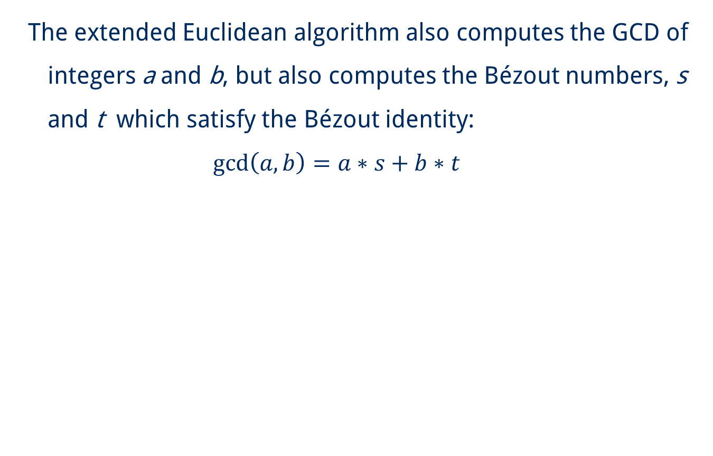
Extended Euclidean Algorithm

Slide 3
Find the Bézout numbers and GCD of 99 and 78
Row | a | b | a/b | a%b | d | s | t
1 | 99 | 78
2
3
4
5
6

Slide 4
Find the Bézout numbers and GCD of 99 and 78
Row | a | b | a/b | a%b | d | s | t
1 | 99 | 78 | 1
2
3
4
5
6

Slide 5
Find the Bézout numbers and GCD of 99 and 78
Row | a | b | a/b | a%b | d | s | t
1 | 99 | 78 | 1 | 21
2
3
4
5
6

Slide 6
Find the Bézout numbers and GCD of 99 and 78
Row | a | b | a/b | a%b | d | s | t
1 | 99 | 78 | 1 | 21
2
3
4
5
6

Slide 7
Find the Bézout numbers and GCD of 99 and 78
Row | a | b | a/b | a%b | d | s | t
1 | 99 | 78 | 1 | 21
2 | 78 | 21
3
4
5
6

Slide 8
Find the Bézout numbers and GCD of 99 and 78
Row | a | b | a/b | a%b | d | s | t
1 | 99 | 78 | 1 | 21
2 | 78 | 21 | 3
3
4
5
6

Slide 9
Find the Bézout numbers and GCD of 99 and 78
Row | a | b | a/b | a%b | d | s | t
1 | 99 | 78 | 1 | 21
2 | 78 | 21 | 3 | 15
3
4
5
6

Slide 10
Find the Bézout numbers and GCD of 99 and 78
Row | a | b | a/b | a%b | d | s | t
1 | 99 | 78 | 1 | 21
2 | 78 | 21 | 3 | 15
3 | 21 | 15
4
5
6

Slide 11
Find the Bézout numbers and GCD of 99 and 78
Row | a | b | a/b | a%b | d | s | t
1 | 99 | 78 | 1 | 21
2 | 78 | 21 | 3 | 15
3 | 21 | 15 | 1
4
5
6

Slide 12
Find the Bézout numbers and GCD of 99 and 78
Row | a | b | a/b | a%b | d | s | t
1 | 99 | 78 | 1 | 21
2 | 78 | 21 | 3 | 15
3 | 21 | 15 | 1 | 6
4
5
6

Slide 13
Find the Bézout numbers and GCD of 99 and 78
Row | a | b | a/b | a%b | d | s | t
1 | 99 | 78 | 1 | 21
2 | 78 | 21 | 3 | 15
3 | 21 | 15 | 1 | 6
4 | 15 | 6
5
6

Slide 14
Find the Bézout numbers and GCD of 99 and 78
Row | a | b | a/b | a%b | d | s | t
1 | 99 | 78 | 1 | 21
2 | 78 | 21 | 3 | 15
3 | 21 | 15 | 1 | 6
4 | 15 | 6 | 2
5
6

Slide 15
Find the Bézout numbers and GCD of 99 and 78
Row | a | b | a/b | a%b | d | s | t
1 | 99 | 78 | 1 | 21
2 | 78 | 21 | 3 | 15
3 | 21 | 15 | 1 | 6
4 | 15 | 6 | 2 | 3
5
6

Slide 16
Find the Bézout numbers and GCD of 99 and 78
Row | a | b | a/b | a%b | d | s | t
1 | 99 | 78 | 1 | 21
2 | 78 | 21 | 3 | 15
3 | 21 | 15 | 1 | 6
4 | 15 | 6 | 2 | 3
5 | 6 | 3
6

Slide 17
Find the Bézout numbers and GCD of 99 and 78
Row | a | b | a/b | a%b | d | s | t
1 | 99 | 78 | 1 | 21
2 | 78 | 21 | 3 | 15
3 | 21 | 15 | 1 | 6
4 | 15 | 6 | 2 | 3
5 | 6 | 3 | 2
6

Slide 18
Find the Bézout numbers and GCD of 99 and 78
Row | a | b | a/b | a%b | d | s | t
1 | 99 | 78 | 1 | 21
2 | 78 | 21 | 3 | 15
3 | 21 | 15 | 1 | 6
4 | 15 | 6 | 2 | 3
5 | 6 | 3 | 2 | 0
6

Slide 19
Find the Bézout numbers and GCD of 99 and 78
Row | a | b | a/b | a%b | d | s | t
1 | 99 | 78 | 1 | 21
2 | 78 | 21 | 3 | 15
3 | 21 | 15 | 1 | 6
4 | 15 | 6 | 2 | 3
5 | 6 | 3 | 2 | 0
6 | 3 | 0

Slide 20
Find the Bézout numbers and GCD of 99 and 78
Row | a | b | a/b | a%b | d | s | t
1 | 99 | 78 | 1 | 21
2 | 78 | 21 | 3 | 15
3 | 21 | 15 | 1 | 6
4 | 15 | 6 | 2 | 3
5 | 6 | 3 | 2 | 0
6 | 3 | 0 | NaN | NaN

Slide 21
Find the Bézout numbers and GCD of 99 and 78
Row | a | b | a/b | a%b | d | s | t
1 | 99 | 78 | 1 | 21
2 | 78 | 21 | 3 | 15
3 | 21 | 15 | 1 | 6
4 | 15 | 6 | 2 | 3
5 | 6 | 3 | 2 | 0
6 | 3 | 0 | NaN | NaN

Slide 22
Find the Bézout numbers and GCD of 99 and 78
Row | a | b | a/b | a%b | d | s | t
1 | 99 | 78 | 1 | 21
2 | 78 | 21 | 3 | 15
3 | 21 | 15 | 1 | 6
4 | 15 | 6 | 2 | 3
5 | 6 | 3 | 2 | 0
6 | 3 | 0 | NaN | NaN | 3 | 1 | 0

Slide 23
Find the Bézout numbers and GCD of 99 and 78
Row | a | b | a/b | a%b | d | s | t
1 | 99 | 78 | 1 | 21 | 3
2 | 78 | 21 | 3 | 15 | 3
3 | 21 | 15 | 1 | 6 | 3
4 | 15 | 6 | 2 | 3 | 3
5 | 6 | 3 | 2 | 0 | 3
6 | 3 | 0 | NaN | NaN | 3 | 1 | 0

Slide 24
Find the Bézout numbers and GCD of 99 and 78
Row | a | b | a/b | a%b | d | s | t
1 | 99 | 78 | 1 | 21 | 3
2 | 78 | 21 | 3 | 15 | 3
3 | 21 | 15 | 1 | 6 | 3
4 | 15 | 6 | 2 | 3 | 3
5 | 6 | 3 | 2 | 0 | 3
6 | 3 | 0 | NaN | NaN | 3 | 1 | 0

Slide 25
Find the Bézout numbers and GCD of 99 and 78
Row | a | b | a/b | a%b | d | s | t
1 | 99 | 78 | 1 | 21 | 3
2 | 78 | 21 | 3 | 15 | 3
3 | 21 | 15 | 1 | 6 | 3
4 | 15 | 6 | 2 | 3 | 3
5 | 6 | 3 | 2 | 0 | 3 | 0
6 | 3 | 0 | NaN | NaN | 3 | 1 | 0

Slide 26
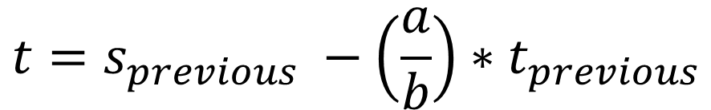
Find the Bézout numbers and GCD of 99 and 78
Row | a | b | a/b | a%b | d | s | t
1 | 99 | 78 | 1 | 21 | 3
2 | 78 | 21 | 3 | 15 | 3
3 | 21 | 15 | 1 | 6 | 3
4 | 15 | 6 | 2 | 3 | 3
5 | 6 | 3 | 2 | 0 | 3 | 0
6 | 3 | 0 | NaN | NaN | 3 | 1 | 0

Slide 27
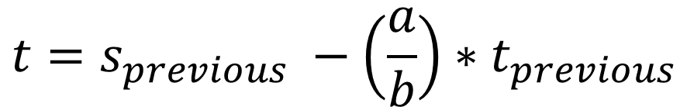
Find the Bézout numbers and GCD of 99 and 78
Row | a | b | a/b | a%b | d | s | t
1 | 99 | 78 | 1 | 21 | 3
2 | 78 | 21 | 3 | 15 | 3
3 | 21 | 15 | 1 | 6 | 3
4 | 15 | 6 | 2 | 3 | 3
5 | 6 | 3 | 2 | 0 | 3 | 0 | 1
6 | 3 | 0 | NaN | NaN | 3 | 1 | 0

Slide 28
Find the Bézout numbers and GCD of 99 and 78
Row | a | b | a/b | a%b | d | s | t
1 | 99 | 78 | 1 | 21 | 3
2 | 78 | 21 | 3 | 15 | 3
3 | 21 | 15 | 1 | 6 | 3
4 | 15 | 6 | 2 | 3 | 3
5 | 6 | 3 | 2 | 0 | 3 | 0 | 1
6 | 3 | 0 | NaN | NaN | 3 | 1 | 0

Slide 29
Find the Bézout numbers and GCD of 99 and 78
Row | a | b | a/b | a%b | d | s | t
1 | 99 | 78 | 1 | 21 | 3
2 | 78 | 21 | 3 | 15 | 3
3 | 21 | 15 | 1 | 6 | 3
4 | 15 | 6 | 2 | 3 | 3 | 1
5 | 6 | 3 | 2 | 0 | 3 | 0 | 1
6 | 3 | 0 | NaN | NaN | 3 | 1 | 0

Slide 30
Find the Bézout numbers and GCD of 99 and 78
Row | a | b | a/b | a%b | d | s | t
1 | 99 | 78 | 1 | 21 | 3
2 | 78 | 21 | 3 | 15 | 3
3 | 21 | 15 | 1 | 6 | 3
4 | 15 | 6 | 2 | 3 | 3 | 1 | -2
5 | 6 | 3 | 2 | 0 | 3 | 0 | 1
6 | 3 | 0 | NaN | NaN | 3 | 1 | 0

Slide 31
Find the Bézout numbers and GCD of 99 and 78
Row | a | b | a/b | a%b | d | s | t
1 | 99 | 78 | 1 | 21 | 3
2 | 78 | 21 | 3 | 15 | 3
3 | 21 | 15 | 1 | 6 | 3 | -2
4 | 15 | 6 | 2 | 3 | 3 | 1 | -2
5 | 6 | 3 | 2 | 0 | 3 | 0 | 1
6 | 3 | 0 | NaN | NaN | 3 | 1 | 0

Slide 32
Find the Bézout numbers and GCD of 99 and 78
Row | a | b | a/b | a%b | d | s | t
1 | 99 | 78 | 1 | 21 | 3
2 | 78 | 21 | 3 | 15 | 3
3 | 21 | 15 | 1 | 6 | 3 | -2 | 3
4 | 15 | 6 | 2 | 3 | 3 | 1 | -2
5 | 6 | 3 | 2 | 0 | 3 | 0 | 1
6 | 3 | 0 | NaN | NaN | 3 | 1 | 0

Slide 33
Find the Bézout numbers and GCD of 99 and 78
Row | a | b | a/b | a%b | d | s | t
1 | 99 | 78 | 1 | 21 | 3
2 | 78 | 21 | 3 | 15 | 3 | 3
3 | 21 | 15 | 1 | 6 | 3 | -2 | 3
4 | 15 | 6 | 2 | 3 | 3 | 1 | -2
5 | 6 | 3 | 2 | 0 | 3 | 0 | 1
6 | 3 | 0 | NaN | NaN | 3 | 1 | 0

Slide 34
Find the Bézout numbers and GCD of 99 and 78
Row | a | b | a/b | a%b | d | s | t
1 | 99 | 78 | 1 | 21 | 3
2 | 78 | 21 | 3 | 15 | 3 | 3 | -11
3 | 21 | 15 | 1 | 6 | 3 | -2 | 3
4 | 15 | 6 | 2 | 3 | 3 | 1 | -2
5 | 6 | 3 | 2 | 0 | 3 | 0 | 1
6 | 3 | 0 | NaN | NaN | 3 | 1 | 0

Slide 35
Find the Bézout numbers and GCD of 99 and 78
Row | a | b | a/b | a%b | d | s | t
1 | 99 | 78 | 1 | 21 | 3 | -11
2 | 78 | 21 | 3 | 15 | 3 | 3 | -11
3 | 21 | 15 | 1 | 6 | 3 | -2 | 3
4 | 15 | 6 | 2 | 3 | 3 | 1 | -2
5 | 6 | 3 | 2 | 0 | 3 | 0 | 1
6 | 3 | 0 | NaN | NaN | 3 | 1 | 0

Slide 36
Find the Bézout numbers and GCD of 99 and 78
Row | a | b | a/b | a%b | d | s | t
1 | 99 | 78 | 1 | 21 | 3 | -11 | 14
2 | 78 | 21 | 3 | 15 | 3 | 3 | -11
3 | 21 | 15 | 1 | 6 | 3 | -2 | 3
4 | 15 | 6 | 2 | 3 | 3 | 1 | -2
5 | 6 | 3 | 2 | 0 | 3 | 0 | 1
6 | 3 | 0 | NaN | NaN | 3 | 1 | 0

Slide 37

Find the Bézout numbers and GCD of 99 and 78
Row | a | b | a/b | a%b | d | s | t
1 | 99 | 78 | 1 | 21 | 3 | -11 | 14
2 | 78 | 21 | 3 | 15 | 3 | 3 | -11
3 | 21 | 15 | 1 | 6 | 3 | -2 | 3
4 | 15 | 6 | 2 | 3 | 3 | 1 | -2
5 | 6 | 3 | 2 | 0 | 3 | 0 | 1
6 | 3 | 0 | NaN | NaN | 3 | 1 | 0

Slide 38
Find the Bézout numbers and GCD of 99 and 78
Row | a | b | a/b | a%b | d | s | t
1 | 99 | 78 | 1 | 21 | 3 | -11 | 14
2 | 78 | 21 | 3 | 15 | 3 | 3 | -11
3 | 21 | 15 | 1 | 6 | 3 | -2 | 3
4 | 15 | 6 | 2 | 3 | 3 | 1 | -2
5 | 6 | 3 | 2 | 0 | 3 | 0 | 1
6 | 3 | 0 | NaN | NaN | 3 | 1 | 0

Slide 39
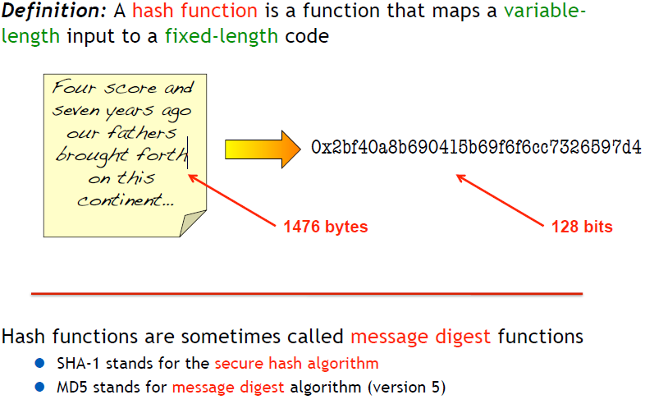
Hash Functions

Slide 40
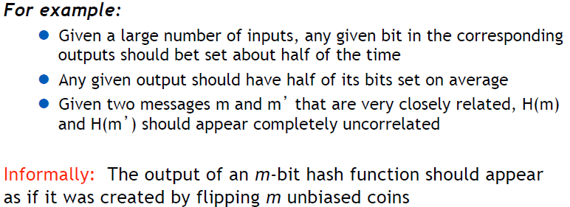
For Crypto Hash Functions, Output Should Appear Random

Slide 41
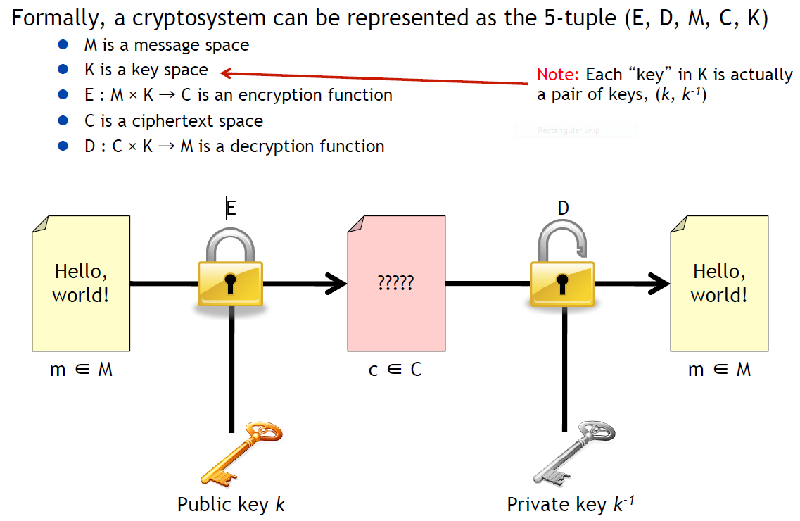
Digital Signatures – Public Key Cryptography

Slide 42
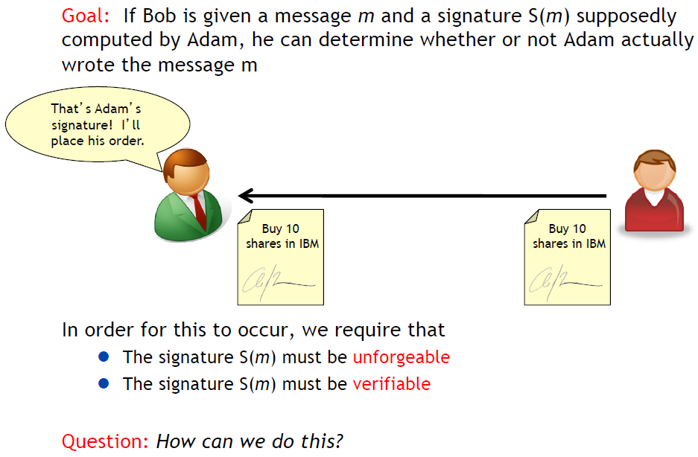
Creating a Digital Signature

Slide 43
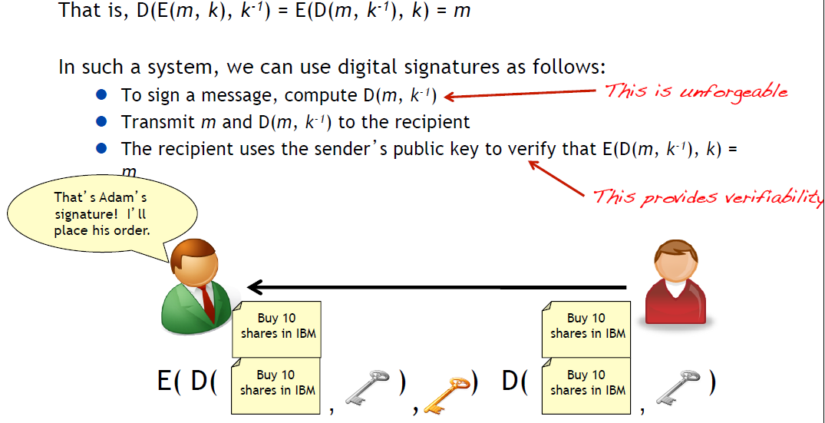
Digital Signatures Often Use Commutative Operations

Slide 44
Acknowledgements
Adam J. Lee’s slides from CS 1653
http://www.csee.umbc.edu/~chang/cs203.s09/exteuclid.shtml

