Slide 1
CS/COE 1501
Minimum edit distance

Slide 2
Questions to ask in finding dynamic programming solutions
Does the problem have optimal substructure?
Can solve the problem by splitting it into smaller problems?
Can you identify subproblems that build up to a solution?
Does the problem have overlapping subproblems?
Where would you find yourself recomputing values?
How can you save and reuse these values?

Slide 3
Minimum edit distance
Given two strings of size m, n and set of operations (replace (R), insert (I) and delete (D) all at equal cost) find the minimum number of edits (operations) required to convert one string into another.
probably and probability probab*l**y probability
sitting and kitten sitting kitten*

Slide 4
Code
int minDistance(string word1, string word2) {
int len1 = word1.length(), len2 = word2.length();
vector<vector<int> > dp(len1+1, vector<int>(len2+1,0));
for(int i = 0; i <= len1; ++i )
dp[i][0] = i;
for(int i = 0; i <= len2; ++i )
dp[0][i] = i;
for(int i = 1; i <= len1; ++i) {
for(int j = 1; j <= len2; ++j) {
int min_distance = 1 + dp[i-1][j];//delete
min_distance = min(min_distance, dp[i][j-1] + 1);//insert
min_distance = min(min_distance, dp[i-1][j-1] + 1);//replace
if( word1[i-1] == word2[j-1] ) {
min_distance = min(min_distance, dp[i-1][j-1]);
}
dp[i][j] = min_distance;
}
}
return dp[len1][len2];
}

Slide 5
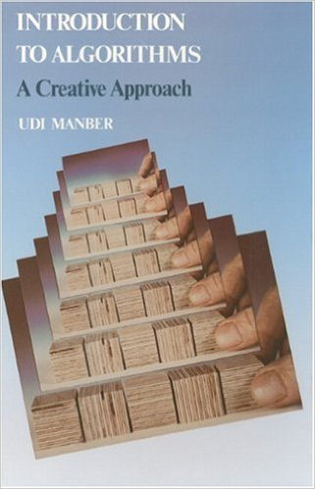
Reference
Udi Manber, <<Introduction to Algorithms – A Creative Approach>>

