Slide 1
The Conflict of Two Cultures in Statistical Modeling
Yuran Liang, Daiwei Zhang, Yongwen Zhuang, Yuqi Zhai

Slide 2
Introduction
Data Modeling Culture
Algorithmic Modeling Culture
Model
Y
Black Box
X
Linear regression
Logistic regression
Cox model
Y
X
Decision trees
Neural nets
Validation
Goodness-of-fit tests Residual examination
Predictive accuracy
Estimated culture population
98%
2%

Slide 3
Data Models: Problems
Model fitting
Goodness-of-fit
Rejects non-linearity only when extreme
Not applicable when variables deleted or non-linear terms added
Residual analysis
Unreliable in more than 4-5 dimensions
Too many ways to analyze residuals

Slide 4
Data Models: Problems
Multiplicity
Multiple models can fit the same data
Predictive Accuracy
“Noisy” variables are unmeasured
Overfitting can be resolved by cross-validation
Complex systems
Data are not multivariate normal
Simple parametric models are not enough

Slide 5
Algorithmic Modeling: Introduction
Philosophy
“Nature produces data in a black box whose insides are complex, mysterious, and at least, partly unknowable.”
Assumption
Data is drawn iid from a multivariate distribution
Goal
Find an algorithm f(x) that predicts y
x: predictor data
y: response data
Includes but is not limited to linear models
Notes:
Daiwei

Slide 6
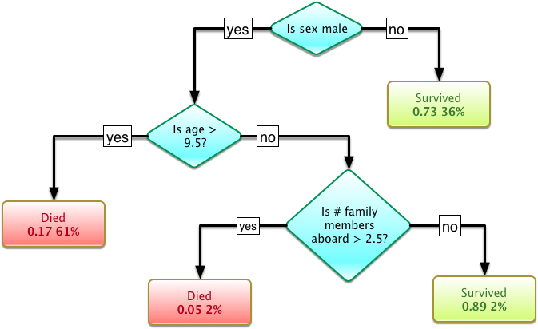
Algorithm Example: Decision Tree
Survival of passengers on the Titanic (Source: Wikipedia)
Notes:
Daiwei

Slide 7
Algorithm Example: Decision Tree
Randomly select a sequence of predictors as nodes
Determine the decision at the end of each path by using the training data
Find the tree’s prediction error rate when applied to the testing data
Repeat Step 1-3 for many times and select the tree with the lowest prediction error rate
Notes:
Daiwei

Slide 8
Data Modeling
Algorithmic Modeling
Pros
Simple to interpret
Cons
Strong assumptions about models
Model assumptions are not falsifiable
Ineffective for handling high-dim data
Many models can fit the same data equally well
Pros
Accurate in making predictions
More relaxed assumptions about models
Takes advantage of high-dim data
Cons
Algorithms are difficult to interpret
Many models can fit the same data equally well

Slide 9
Breiman’s Argument for Algorithmic Modeling
“Simplicity vs Accuracy” is an incorrect way to understand the goal of statistical analysis.
The purpose of a model is to retrieve useful information about the relation between the response and the predictor.
Interpretability is only one way of getting information
A model does not have to be simple to be reliable
There is no reason to restrict our options to a certain subset of models

Slide 10
Comment & Rejoinder: Cox
Starting point: Data vs Issue
It is the question/hypothesis that is unknown
Hard to understand data without probabilistic modeling
Objective: Prediction vs Understanding
Stability of the predictor comes from clarifying mechanisms
Prediction for different conditions:
Cannot rely solely on data set available
Other objectives need emphasis on understanding
Notes:
Yongwen Zhuang

Slide 11
Comment & Rejoinder: Cox
Starting point: Data vs Issue
It is the question/hypothesis that is unknown
Hard to understand data without probabilistic modeling
Objective: Prediction vs Understanding
Stability of the predictor comes from clarifying mechanisms
Prediction for different conditions:
Cannot rely solely on data set available
Other objectives need emphasis on understanding
Yes, with insufficient data, data models can be useful
Many successful algorithmic applications extract useful information from data
Notes:
Yongwen Zhuang

Slide 12
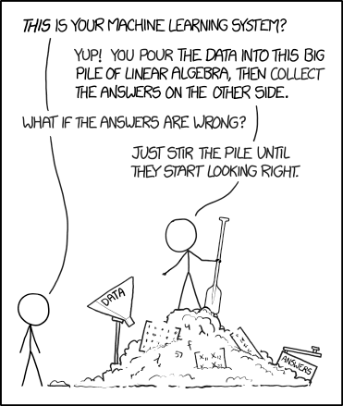
Comment & Rejoinder: Cox
Ideal method for statistical analysis
Descriptively appealing
Transparent
Firm model base
NOT a mechanical process
picture source: xkcd.com
Notes:
Yongwen Zhuang

Slide 13
Comment & Rejoinder: Cox
Ideal method for statistical analysis
Descriptively appealing
Transparent
Firm model base
NOT a mechanical process
Cannot rely on data models alone, due to vast extensions & changes in problems
Notes:
Yongwen Zhuang

Slide 14
Comment & Rejoinder: Cox
Form the right question
Subject-matter → a form for interpretation
“Provide the many people working in applications outside of academia with useful, reliable, and accurate analysis tools ...”
Notes:
Yongwen Zhuang

Slide 15
Comment & Rejoinder: Efron
Changes in new era
More noise in data
Less distinct goals
New & complex methods w/ little supporting theory
Role of Prediction
Prediction is not sufficient in many settings
Can lead to potential inferential innovations
“The whole point of science is to open up black boxes, understand their insides, and build better boxes for the purpose of mankind”
Notes:
Yongwen Zhuang

Slide 16
Comment & Rejoinder: Efron
Changes in new era
More noise in data
Less distinct goals
New & complex methods w/ little supporting theory
Role of Prediction
Prediction is not sufficient in many settings
Can lead to potential inferential innovations
“The whole point of science is to open up black boxes, understand their insides, and build better boxes for the purpose of mankind”
Need for answering questions with complex and accurate models
Can be useful in model assessment
Be pragmatic
Notes:
Yongwen Zhuang

Slide 17
Comment & Rejoinder: Hoadley
Breiman’s conclusions are consistent with practice of statistics in business
Credit scoring
Input variables x: monthly bills and payments over the last 12 months (24-dimensional)
Output variable y: indicator of no severe delinquency over the next 6 months (binary)
Goal: estimate f(x)=log( Pr{ y=1|x } / Pr{ y=0|x } )
Data modeling culture Algorithmic modeling culture
Simple logistic regression Fair, Isaac (scorecard)

Slide 18
Comment & Rejoinder: Hoadley
Performance on the test sample
Breiman emphasizes it; however, it can be overdone
A random sample of current population
High performance High performance on future samples
Things do change → Protect against change:
Monitor the performance of models over time
Sufficient degradation of performance → new model
Example: Fair, Isaac -- redevelopment cycle is about 18-24 months -- make the models more robust over time
Rejoinder by Breiman
Agree -- models must be modified to stay accurate
NOT necessary to alter the way of model construction
Notes:
Yongwen Zhuang

Slide 19
Comment & Rejoinder: Hoadley
It is possible to have both accuracy and interpretability
Segmented palatable scorecards -- interpretable by the customer and very accurate
Rejoinder by Breiman
In either stock prediction or credit scoring, the priority is accuracy
Interpretability is a secondary goal that can be finessed
Notes:
Yongwen Zhuang

Slide 20
Comment & Rejoinder: Hoadley
Challenges for the algorithmic modeling approach
Tuning dilemma
How to set the tuning parameters → optimize the results
Measuring importance -- Is it really possible?
A variable and its relationships will change
“Ping-Pong theorem”
Notes:
Yongwen Zhuang

Slide 21
Comment & Rejoinder: Hoadley
Do algorithmic modeling with data modeling tools
Ignore most textbook advice
Embrace the blessing of dimensionality
Use constraints in the fitting optimizations
Use regularization
Validate the results
Notes:
Yongwen Zhuang

Slide 22
Comment & Rejoinder: Parzen
Open to the issue raised in Leo Breiman’s paper
Statistician, AVOID doing harm
Two goals in analyzing the data
Management (prediction) seeks profit -- practical answers → decision making in the short run
Science (information) seeks truth -- fundamental knowledge about nature → understanding and control in the long run
Methods of algorithmic modeling are important contributions to the tool kit of Statisticians
Better predictive accuracy, better information about the underlying mechanism, perfect separation and discrimination between two classes...

Slide 23
Comment & Rejoinder: Parzen
Hypotheses to test to avoid blunders of statistical modeling (generic deviations from standard assumptions)
Bivariate dependence (correlation)
Between independent (input) variables
Two-sample conditional clustering
Arises in the distributions of independent (input) variables to discriminate between two classes
(conditional) P(class 1|X) = P(class 1) (pooled)

Slide 24
Comment & Rejoinder: Parzen
NOT two, BUT many modeling cultures
Robust methods, Bayesian methods...
Eclectic philosophy of statistical modeling
Statistical methods mining seeks to provide a framework to synthesize and apply the past methodological progress in computationally intensive methods for statistical modeling
“Data mining” is a special case of “data modeling”
Statistical data modeling done in a systematic way -- SIEVE/PPDAC
Rejoinder by Breiman
Not an issue he wants to fiercely contest
Pretty clear cut -- are you modeling the inside of the box or not?

Slide 25
Comment & Rejoinder: Parzen
Quantile culture
Quantile ideas for HIGH dimensional data analysis

Slide 26
Questions & Discussion

Slide 27
Questions for discussion
Which type of models is more appealing to you, data models or algorithmic models?
If you can only choose one, are you more interested in 1) understanding the mechanism behind natural processes, OR 2) being able to predict and manipulate natural processes?
If a skeptic reads your report for the first project in Biostat 699 and asks you “How do you know the model you use is true”, how would you respond?
What are the possible future paths for both cultures?
Notes:
Yongwen Zhuang

Slide 28

Algorithm Example: Random Forest
Source: TIBCO
Notes:
Daiwei

Slide 29
Algorithm Example: Random Forest
Randomly select a subset of the training data
Find the best decision tree for this training subset
Repeat Step 1-2 for many times and obtain many trees
Everytime a new input comes, path it down to every tree and combine the results by majority vote
Notes:
Daiwei

Slide 30
Thoughts (maybe move to discussion?)
Notes:
Yongwen Zhuang

Slide 31
Questions for discussion
Different purposes (e.g. Netflix recommendation vs. medical study) may be the underlying reason for adopting different culture
What does statistics mean (do)?
“Mainstream serious statistics” ?- Cox
Build methodology foundation?
Applied analytics?
Embrace computation & data mining?
Notes:
Yongwen Zhuang

