Slide 1

Who would be a good loanee?
Zheyun Feng
7/17/2015

Slide 2

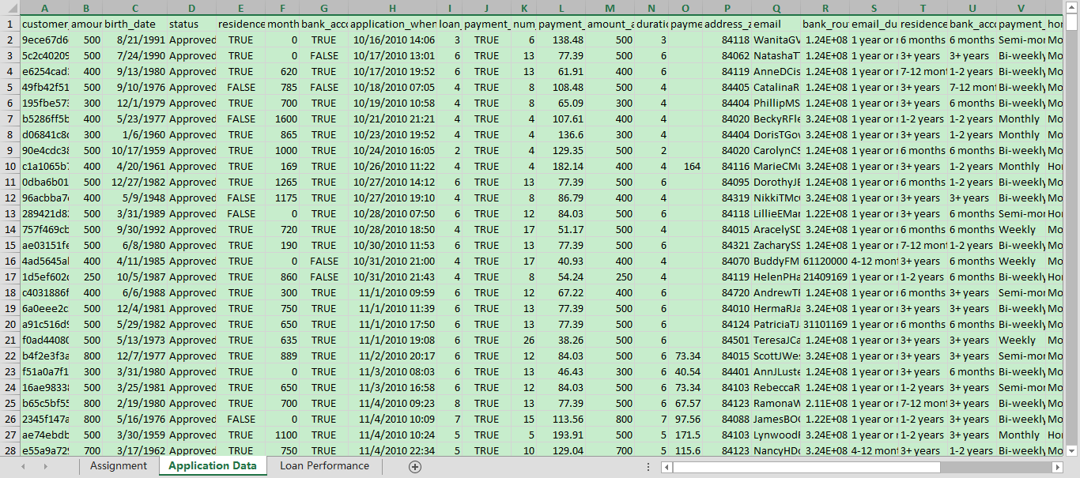

Introduction
Objective
Given the application data of a customer, determine if he/she should be given the loan or not
What the data
looks like
Tools
Python
Scikit-learn

Slide 3

TABLE OF CONTENTS
Exploring and understanding the input data
Types of data
Matching features and labels
Presenting the data to learning algorithms
Problematic (missing or ambiguous) data
Represent data feature as a matrix
Choosing models and learning algorithms
Algorithms
Evaluating the performance
Conclusion

Slide 4
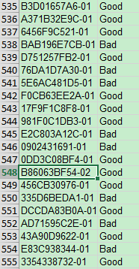
Understanding the labels
Totally 1285 records
1269 with -01
16 with -02
Loan ID repeats
Duplication or Meaningful?
1269
with 01
16
with 02
Most data: labels are the same
3 data: labels conflicts
Processed labels:
2 Good: 2
1 Good: 1
1 Bad: -1
No label/Conflicting label: 0

Slide 5
Understanding the data features
Nonsense feature
Status (all approved)
Payment_ach ( except 1)
Nominal
Loan id – matching label
P: address_zip
Q: email
R: bank routing
Binary/Multiple choices
Rent or own
How use money
Contact way
Payment frequency
Ordinal
Email/back/address duration
Numeric
FICO score
Money amount, eg. payment amount, income

Slide 6
Understanding the data features
Loan ID – Matching the labels
No duplicates
16 no label (0) : label missing(13)/label conflicting (3)
281 good (1:268, 2:13)
350 bad (-1)
Email/Zipcode/Bank Routing
Email: No duplicates -> no sense; with duplicates -> copy labels
Duplicates of domain
yahoo 0.592307692308 (N/(N+P))
aol 0.5546875
bing 0.561538461538
hotmail 0.5234375
gmail 0.539130434783
Convert binary to numeric: prior indicating negative ratio

Slide 7
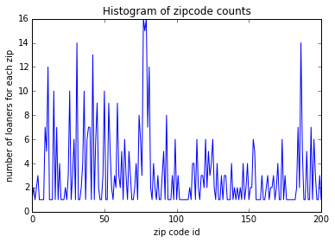
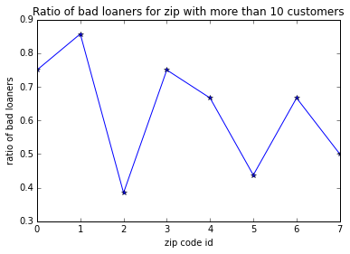
Understanding the data features
Zipcode
Many repetition
Convert binary to numeric value: prior indicating negative ratio
Repetition counts >10 => negative ratio; else => 0.55

Slide 8
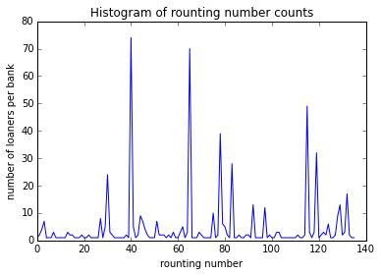
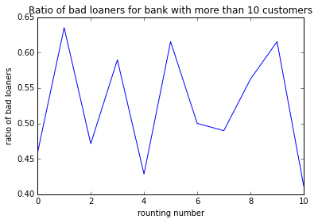
Understanding the data features
Bank Routing
Many repetition
Convert binary to numeric value: prior indicating negative ratio
Repetition counts >10 => negative ratio; else => 0.55

Slide 9
Presenting data to the learning algorithms
Multiple choice data ( eg. Contacts, how use money ):
encode to a sequence of binary value
Ordinal:
assign as 1, 2, 3, …
Missing values ( eg. Payment approved )
regression. Train a regression model on the non-missing data and predict the values for the missing samples
add a binary feature indicating if value is missing or not
Missing values ( eg. Other contacts)
ignore the missing values.
consider the non-missing values together with “contacts”
Concatenate all features together to form a matrix

Slide 10
Data Statistics
Data size: 631 + 16 samples without label
Feature dimension: 34
Positive samples: 281, negative samples: 350
After normalization: each feature item is in [0,1]
Training set: 80%, testing set: 20%

Slide 11
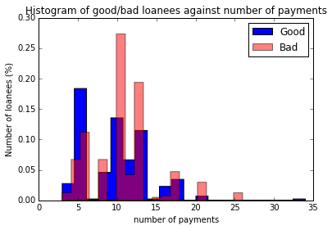
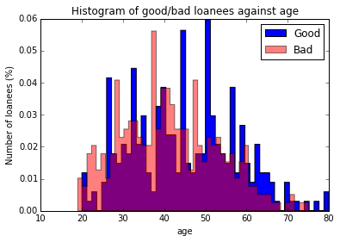
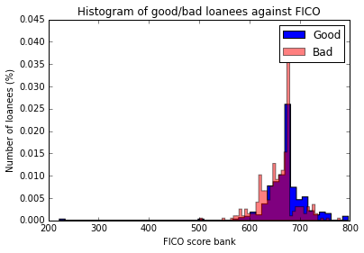
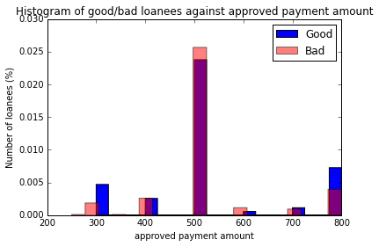
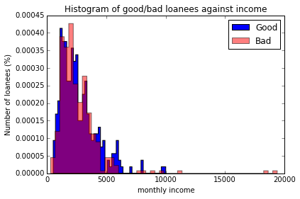
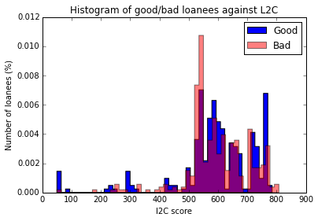
Impacts of certain features

Slide 12
Learning Models
SVM with poly kernel
Logistic regression
Linear discriminant analysis
Quadratic discriminant analysis
Adaboost
Bagging
Random Forest
Extra Tressa
K-nearest neighbors

Slide 13
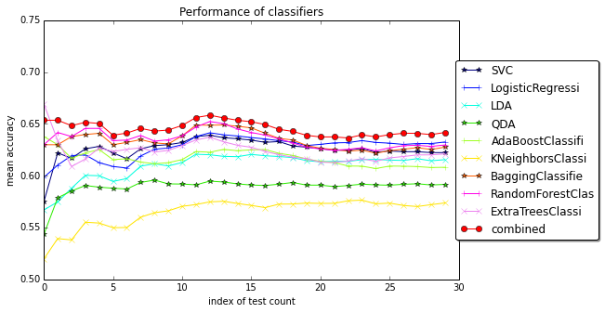
Learning Models

Slide 14
Conclusion and future direction
Data matters
Choose data with better quality
Explore more features: household income, occupation, payment records
Pre-processing of missing/problematic data is important
Data normalization is important
Ensemble classifier outperforms single classifiers
Majority voting/ weighted combination / boosting
Overfitting risk
Randomness
Parameter tuning
If data is large enough
Neuronetwork /deep learning
Kernel methods

Slide 15


