Slide 1

Commercial Detection in Videos of TV Show
Zheyun Feng
8/28/2014

Slide 2

TABLE OF CONTENTS
Re-organize Programming Framework
Frame Feature Improvement
New Image Feature
Re-packaging Audio Packet
New Audio Feature
Image-Audio Alignment
Transit Feature Improvement
Block Boundary Detection Improvement
Decision Tree
Simple Regression
Block Classification
Decision Tree
Naïve Bayes
Sequential Correction

Slide 3
Comparison The Work of Two Years
2013
2014
Create a bottom-to-top commercial detection framework
Basic image/audio feature extraction
Image-audio packet alignment
Transit feature extraction from image feature
Block feature extraction
Decision tree to classify blocks
Inherit the bottom-to-top framework
Reduce the connection between levels
New image/audio Feature
Re-packaging audio packet
Align image/audio on frame level
Transit feature extraction based on frame(image, audio)/shot features
New block feature extraction
Decision tree to get training data
Naïve Bayes to classify
Correction based on sequential relation

Slide 4
Some Definitions
Frame: Image frame + audio frame.
Re-package audio packet and force each to cover the same time as its correspondent image frame.

Slide 5
Some Definitions
Frame: Image frame + audio frame.
Re-package audio packet and force each to cover the same time as its correspondent image frame.
Shot: Frames showing the same scene, whose content are very similar.

Slide 6
Some Definitions
Frame: Image frame + audio frame.
Re-package audio packet and force each to cover the same time as its correspondent image frame.
Shot: Frames showing the same scene, whose content are very similar.
Transit: The bridge frames between different scene or programs
Between scene => shot boundary
Between program => block boundary

Slide 7
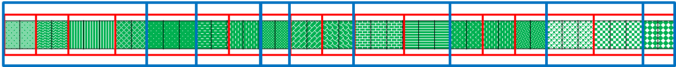
Some Definitions
Frame: Image frame + audio frame.
Re-package audio packet and force each to cover the same time as its correspondent image frame.
Shot: Frames showing the same scene, whose content are very similar.
Transit: The bridge frames between different scene or programs
Between scene => shot boundary
Between program => block boundary
Blocks: Video segments from the same program.

Slide 8
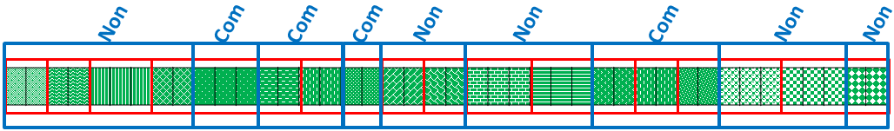
Some Definitions
Frame: Image frame + audio frame.
Re-package audio packet and force each to cover the same time as its correspondent image frame.
Shot: Frames showing the same scene, whose content are very similar.
Transit: The bridge frames between different scene or programs
Between scene => shot boundary
Between program => block boundary
Blocks: Video segments from the same program.
Commercial Detection: Classify blocks into commercial or non-commercial.

Slide 9
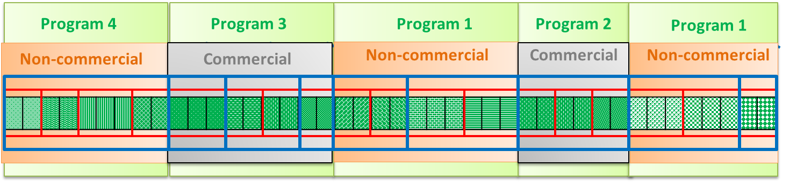
Some Definitions
Frame: Image frame + audio frame.
Re-package audio packet and force each to cover the same time as its correspondent image frame.
Shot: Frames showing the same scene, whose content are very similar.
Transit: The bridge frames between different scene or programs
Between scene => shot boundary
Between program => block boundary
Blocks: Video segments from the same program.
Commercial Detection: Classify blocks into commercial or non-commercial.

Slide 10
Hierarchical Structure
Image
Audio
Frame
Shot
Block

Slide 11

Hierarchical Structure
Image
Audio
Frame
Shot
Block

Slide 12
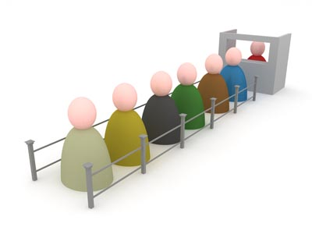

Hierarchical Structure
Image
Audio
Frame
Shot
Block

Slide 13
Hierarchical Structure
Commercial Detection
Clock Detection
Other functions … …
Block

Slide 14
Frame Feature Improvement
Re-organize Programming Framework
Frame Feature Improvement
New Image Feature
Re-packaging Audio Packet
New Audio Feature
Image-Audio Alignment
Transit Feature Improvement
Block Boundary Detection Improvement
Decision Tree
Simple Regression
Block Classification
Decision Tree
Naïve Bayes
Sequential Correction

Slide 15
Frame Feature Improvement
INDEX
INDEX
Audio
Feature
Image
Feature
Package
Audio
Alignment
Basic feature:
Hist, edge, entropy
Force each audio packet to have the same duration as a image frame
Basic Feature:
Volume, zcr, hzcrr
Based on pts
Logo Detection, Tracking
MFCC
Text Detection,
Tracking

Slide 16
Logo Detection
Frame with Logo
Logo
Original Frame

Slide 17

Logo Detection
Frame with Logo
Logo
Original Frame
Logo
Logo
Zero
Get the minimum value for each pixel over long time ( 600 frames)
Transparent Logo

Slide 18

Text Detection
Original Image Frame

Slide 19

Text Detection
Horizontal Contrast

Slide 20

Text Detection
Fill Horizontal Holes

Slide 21
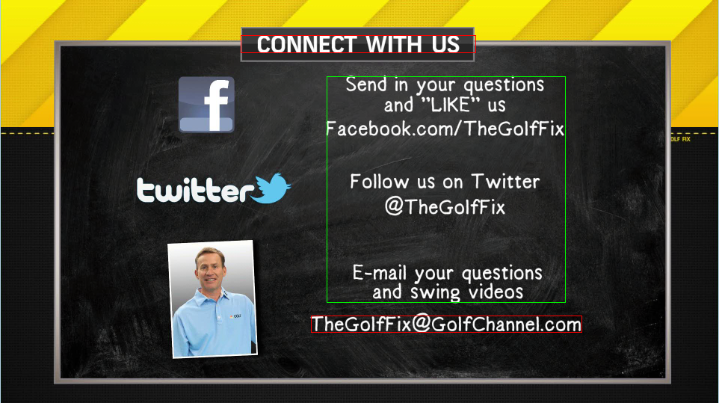
Text Detection
Potential Text Regions

Slide 22

Text Detection
Verify with Connected Component

Slide 23
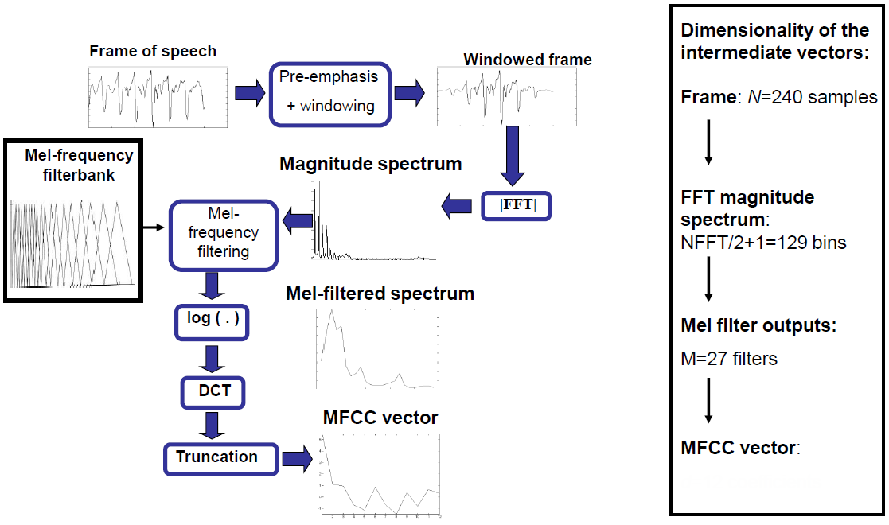

Mel-frequency cepstral coefficients (MFCCs)
4-25th

Slide 24
TABLE OF CONTENTS
Re-organize Programming Framework
Frame Feature Improvement
New Image Feature
Re-packaging Audio Packet
New Audio Feature
Image-Audio Alignment
Transit Feature Improvement
Block Boundary Detection Improvement
Decision Tree
Simple Regression
Block Classification
Decision Tree
Naïve Bayes
Sequential Correction

Slide 25
Transit Feature Computation
Why Compute
Transit ??

Slide 26
Transit Feature Computation
Frame Feature
Shot Feature
Block Feature
Why Compute
Transit ??
soft
Shot Boundary
hard
Block Boundary
Transit

Slide 27
Transit Feature Computation
How ??
Frame
Feature
Shot Feature
Transit Feature

Slide 28
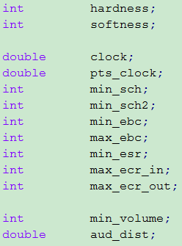
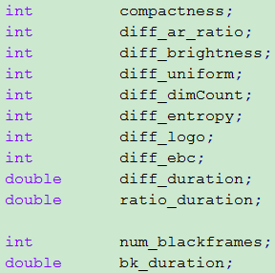
Transit Feature Computation
How ??
Frame
Feature
Shot Feature
Transit Feature

Slide 29
Transit Feature Computation
Transit feature
Frame feature
Block feature
Shot feature
1
3
2
5
4
6

Slide 30
TABLE OF CONTENTS
Re-organize Programming Framework
Frame Feature Improvement
New Image Feature
Re-packaging Audio Packet
New Audio Feature
Image-Audio Alignment
Transit Feature Improvement
Block Boundary Detection Improvement
Decision Tree
Simple Regression
Block Classification
Decision Tree
Naïve Bayes
Sequential Correction

Slide 31

Transit Feature Computation
Softness => shot boundary detection
Linear regression
Hardness => block boundary detection
Decision tree with hard constraints: volume, edge/color change, etc.
Logo tracking to exclude boundary
Black frames
Aspect ratio change
Audio distance
Linear regression
Further improvement

Slide 32

TABLE OF CONTENTS
Re-organize Programming Framework
Frame Feature Improvement
New Image Feature
Re-packaging Audio Packet
New Audio Feature
Image-Audio Alignment
Transit Feature Improvement
Block Boundary Detection Improvement
Decision Tree
Simple Regression
Block Classification
Decision Tree
Naïve Bayes
Sequential Correction

Slide 33
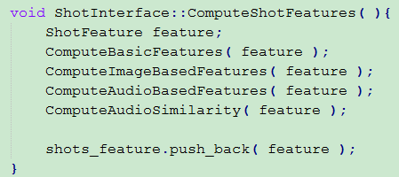
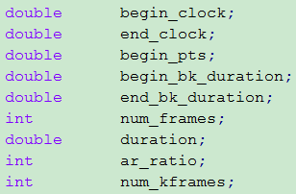
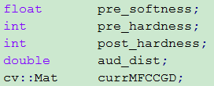

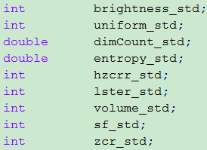
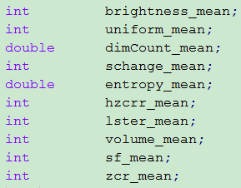
Shot Feature Computation
xx

Slide 34
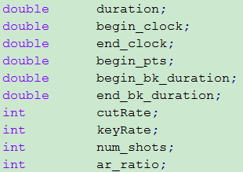
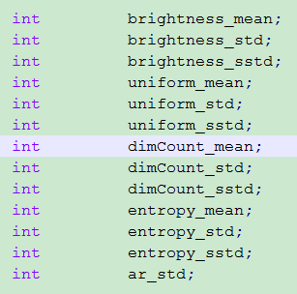
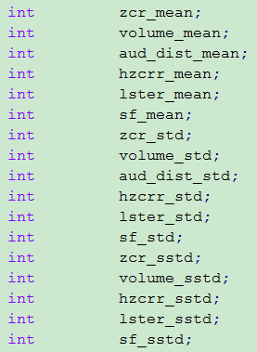
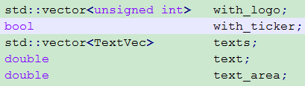
Block Feature Computation
xx

Slide 35
Block Feature Classification
Long blocks => Non-commercial block
Train long blocks, Classify sub-long blocks
Exceptions: credit roll
Decision tree (hard constraints) commercials
Naïve Bayes
Sequential correction

Slide 36
Block Feature Classification – Decision Tree
Long blocks
Larger than max_com_size
Non-commercial
Training
Data
Param: max_com_size
Set by user
Pre-default
This project: 301 second

Slide 37
Block Feature Classification – Decision Tree
Large aspect ratio, small brightness
Appropriate duration
Large cutRate
Large text region, small brightness
Small brightness
Large brightness mean/variance
Large brightness, small brightness
Large text region/number
Large text params
Large volume, small zcr
Appropriate cutRate
Different aspect ratio, large ar_std
Leading black frames
Testing frames
No-content frames
Credit roll
Commercial

Slide 38
Block Feature Classification – Naïve Bayes Methods
Training data
Sub-long block
Sub-long block
Sub-long block
Sub-long block
Other block
Commercial blocks

Slide 39
Block Feature Classification – Naïve Bayes Methods
Training data
Follows
INDEX
Multi-variant
Gaussian
distribution
Sub-long block
Large Probability
Sub-long block
Sub-long block
Medium Probability
Small Probability
Sub-long block
Other block
Commercial blocks

Slide 40
Block Feature Classification – Naïve Bayes Methods
Training data
Follows
INDEX
Original training data
Multi-variant
Gaussian
distribution
Sub-long block
Large Probability
Positive Sub-long block
Sub-long block
Positive Sub-long block
Sub-long block
Medium Probability
Positive Sub-long block
Small Probability
Sub-long block
Waiting for further classification
Other block
Other blocks
Commercial blocks
Commercial blocks

Slide 41
Block Feature Classification – Naïve Bayes Methods
Training data
Follows
INDEX
Original training data
Multi-variant
Gaussian
distribution
Follows
INDEX
Multi-variant
Gaussian
Distribution
Sub-long block
Large Probability
Positive Sub-long block
Sub-long block
Positive Sub-long block
Large Probability
Sub-long block
Medium Probability
Positive Sub-long block
Medium Probability
Small Probability
Sub-long block
Waiting for further classification
Small Probability
Other block
Other blocks
Commercial blocks
Commercial blocks

Slide 42
Block Feature Classification – Naïve Bayes Methods
Training data
Follows
INDEX
Original training data
Non-commercial
Multi-variant
Gaussian
distribution
Follows
INDEX
Multi-variant
Gaussian
Distribution
Sub-long block
Large Probability
Positive Sub-long block
Non-commercial
Sub-long block
Positive Sub-long block
Non-commercial
Large Probability
Sub-long block
Medium Probability
Positive Sub-long block
Non-commercial
Medium Probability
Small Probability
Sub-long block
Waiting for further classification
No Decision
Small Probability
Other block
Other blocks
Commercial
Commercial blocks
Commercial blocks
Commercial

Slide 43
Block Feature Classification – Sequential Correction
Leading black
Long block
Very shot block
Shot block
Commercial
Non-commercial
Credit roll
L
C
N
C
N
C
N
C
C
N
C
R
Sequential Correction
L
C
N
C
C
N
C
C
C
C
C
N
N
R

Slide 44
Data Statistics
102 Videos
2966 Blocks
620 non-commercial blocks
2082 commercial blocks
22 credit roll blocks
SD | 58
HD | 44
abc | 32
cbs | 33
nbc | 18
telemundo | 6
usanetwork | 5
fox | 3
PersonOfInterest | 9
GeneralHospital | 4
NightShift | 4
2BrokeGirls | 4
Mistresses | 4
UnderTheDome | 4

Slide 45
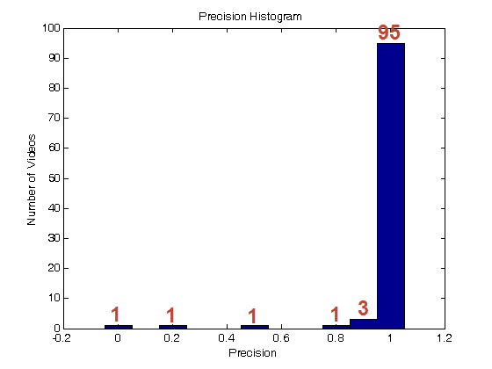
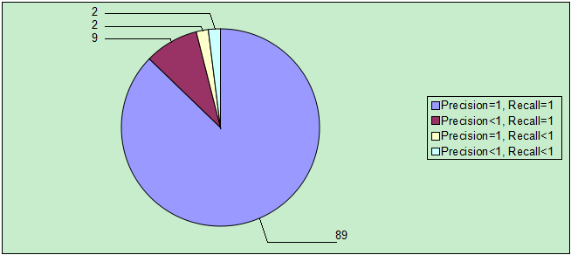
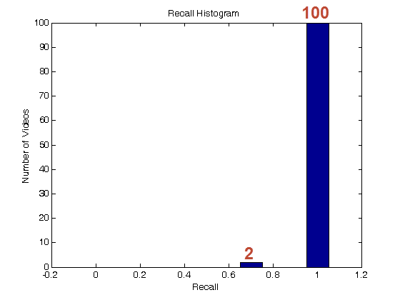
Commercial Detection Performance of Our Methods
Total blocks
Precision: 0.986
Recall: 0.984
Average over all videos
Average Precision: 0.973
Average Recall: 0.993
Videos without commercial

Slide 46
Commercial Detection Performance of Our Methods
HD
SD
Total blocks
Precision: 0.991
Recall: 0.979
Average over all videos
Average Precision: 0.969
Average Recall: 0.992
Total blocks
Precision: 0.983
Recall: 0.987
Average over all videos
Average Precision: 0.976
Average Recall: 0.994

Slide 47
Commercial Detection Performance of Our Methods
Channel | Num of Videos | Total precision | Total recall | Average precision | Average recall
abc | 32 | 0.991 | 0.974 | 0.989 | 0.980
cbs | 33 | 0.931 | 1 | 0.932 | 1
nbc | 18 | 0.989 | 0.997 | 0.988 | 0.999
telemundo | 6 | 1 | 1 | 1 | 1
usanetwork | 5 | 1 | 1 | 1 | 1
fox | 3 | 1 | 0.989 | 1 | 0.988

Slide 48
Commercial Detection Performance of Our Methods
Name of Show | Num of Videos | Total precision | Total recall | Average precision | Average recall
Person Of Interest | 9 | 1 | 1 | 1 | 1
General Hospital | 4 | 1 | 1 | 1 | 1
Night Shift | 4 | 0.987 | 1 | 0.956 | 1
2 Broke Girls | 4 | 1 | 1 | 1 | 1
Mistresses | 4 | 0.975 | 1 | 0.976 | 1
Under The Dome | 4 | 1 | 1 | 1 | 1

Slide 49
Commercial Detection Performance of Our Methods
Methods | Total precision | Total recall | Average precision | Average recall
Ours | 0.986 | 0.984 | 0.974 | 0.993
Time (135) | 0.921 | 0.973 | 0.773 | 0.987
Time (95) | 0.955 | 0.923 | 0.814 | 0.958
Decision Tree (Xiaodong) | 0.939 | 0.957 | 0.930 | 0.964
SVM | 0.974 | 0.967 | 0.942 | 0.952
Normal Naïve Bayes | 0.935 | 0.992 | 0.875 | 0.978

Slide 50
Future Direction
Logo ( Transparent/Textual )
Logo detection/tracking/recognition
Block Boundary Detection
Add training data
Non-linear algorithm
Better audio feature, e.g. melody
Visual content analysis
Block Classification
Better distance metric
Non-linear algorithm
Correlation between sequential blocks
HMM
Objective function penalize number of switches

Slide 51


