Slide 1

Department of Computer Science Gujarat University 5 Year Integrated M.Sc.(Computer Science) Semester – VI
E-COMMERCE APPLICATION
PRESENTED BY:
Jhanvi Vekariya (60024)
Fenil Kachhadiya (60026)
Tanisha Rathod (60071) UNDER THE GUIDANCE OF :
Dr. Jigna Satani

Slide 2

Table of Content
• Project Profile
• System Analysis
– Reference websites
– List of users
– Requirement specifications
– Tools and Technologies
• System Architecture
– Module hierarchy
– Work division
• System Design
– Use case diagram
– System Flow Diagram
– Activity diagram
– ER diagram
– Class diagram
• Data Dictionary
Screenshots

Slide 3

PROJECT PROFILE
TITLE | DESCRIPTION
1.Name of the project | E-commerce Application
2.Objective | Aim of our application is to offer users seamless shopping experience, enable customization, give detailed product information and secure transaction
3.Tools,Technologies and Framework | HTML,CSS,PHP,MYSQL,JAVA,XML, ANDROID.
4.Duration | 6 Months
5.Minimum software and hardware requirements | Android studio , XAMPP , Visual Studio
6.Team size | 3
7.Team members | Fenil Kachhadiya (14) Tanisha Rathod (95) Jhanvi Vekariya (116)

Slide 4
SYSTEM ANALYSIS
REFERENCE WEBSITES
www.giva.com
www.tanishq.com
www.blueston.com

Slide 5
LIST OF USERS
ADMIN
CUSTOMER
VISITOR

Slide 6

ADMIN
This section encompasses key operational features of the application, including inventory management, order processing, and user administration. These functionalities are structured across various modules to support smooth workflows and efficient system management.

Slide 7

CUSTOMER
Features available on the customer side include log-in, searching and viewing products, managing a cart, purchasing items, and handling order confirmations or cancellations.

Slide 8

VISITOR The visitor side includes features such as viewing categories, products, search.

Slide 9
REQUIREMENT SPECIFICATIONS
User login
Product Catalog
Product Details
Customization Feature
Shopping Cart
Search
Payment Gateway
Order Tracking
User Reviews
Notifications and Alerts

Slide 10
1)User Login: Allow users to log in using username, email.
2)Product Catalog: Display a wide range of jewelry items categorized (e.g.,necklaces, earrings, phone charms).
3)Product Details: Display detailed descriptions, images information for each item.
4)Shopping Cart: Enable users to add items to a cart for purchase.
5)Search: Implement a search bar for finding specific product

Slide 11
6)Payment Gateway : Support multiple payment options (RazorPay, UPI, Card, etc.).
7)User Reviews: Allow users to review products.
8)Order Tracking: Users can view their order history and track the status of current orders. (Future Work).
9)Customization Feature: Allow users to customize jewelry (e.g., choose materials, beads, charms, etc).(Future Work)
10)Notifications and Alerts: Send push notifications for order updates, discounts, new arrivals, etc(Future Work).

Slide 12
TOOLS AND TECHNOLOGIES
FRONTEND | BACKEND
HTML: Structures the content of a web page displayed inside an Android app. | PHP: Handles backend logic like Processing requests from Android apps.
CSS: Styles the HTML content (colors, layout, fonts) for a better user interface. | MYSQL: Stores app data such as user profiles, product info, etc.,
JAVASCRIPT: Adds dynamic behaviors such as form validation, animations. | JAVA: Builds the core app logic, UI behavior, services, activities, and handles system interactions.
XML: Used to define: UI layouts, App configuration, Resource values | ANDROID

Slide 13
SYSTEM ARCHITECTURE MODULE HIERARCHY
User Management Module
Product Management Module
Order Management Module
Reviews Management Module
Category Management

Slide 14
MODULE HIERARCHY
User Management Module
Responsible for user authentication, profile management, etc.
B) Product Management Module
Handles the management of jewelry products, including adding new products, updating existing ones, managing inventory, etc.
C) Order Management Module
Deals with processing orders, managing the shopping cart, calculating prices, handling payments, etc.

Slide 15
D) Review Management Module
A review management module for an online jewellery application is essential for facilitating customer feedback, and improving the overall user experience.
E) Category Management
Enables administrators to create and manage product categories (e.g., earings, necklaces, bracelets) to organize products for easy navigation.

Slide 16
WORK DIVISION
WORK DIVISION | TEAM MEMBERS
JAVA , XML ,ANDROID, MYSQL | FENIL KACHHADIYA TANISHA RATHOD
HTML , CSS , PHP , ANDROID | FENIL KACHHADIYA JHANVI VEKARIYA

Slide 17
Use Case Diagram
SYSTEM DESIGN

Slide 18
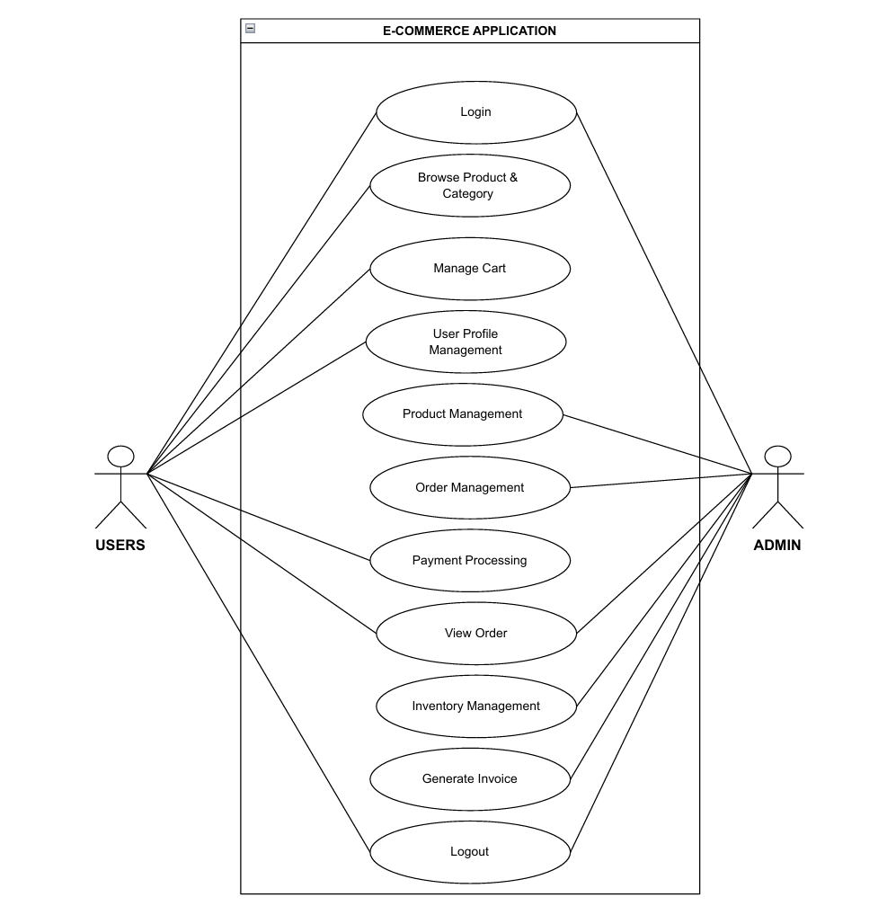
Figure: 1.1

Slide 19
SYSTEM DESIGN
System Flow Diagram

Slide 20
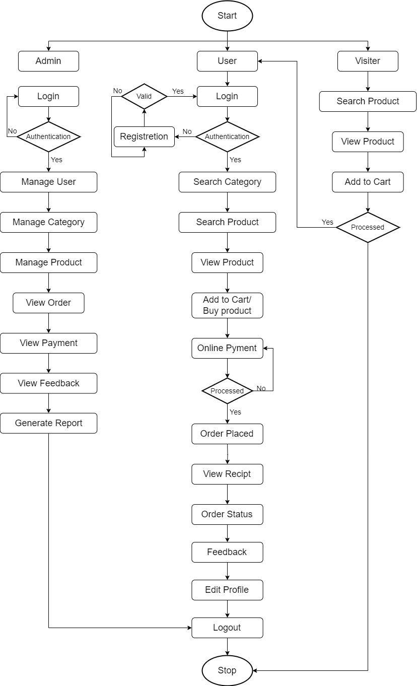
Figure: 2.1

Slide 21
Activity Diagram

Slide 22
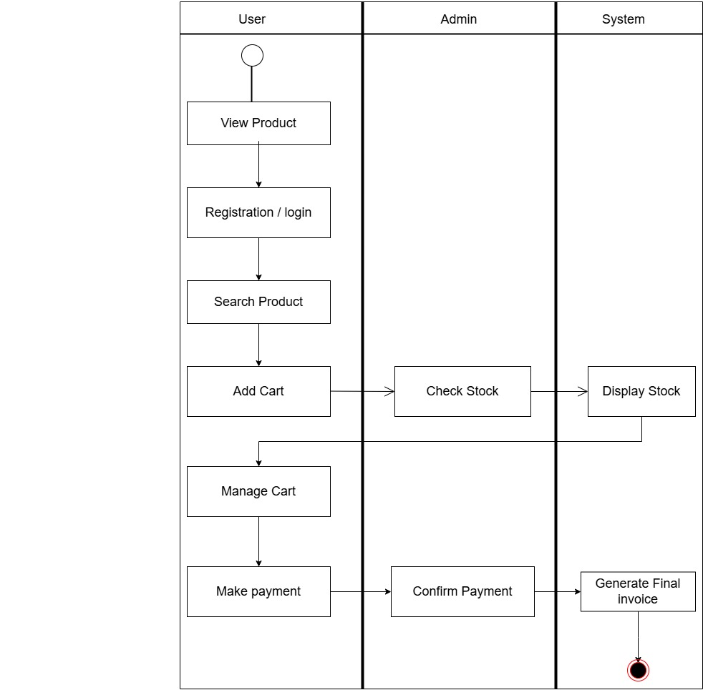
Figure: 3.1

Slide 23
SYSTEM DESIGN
ER DIAGRAM

Slide 24
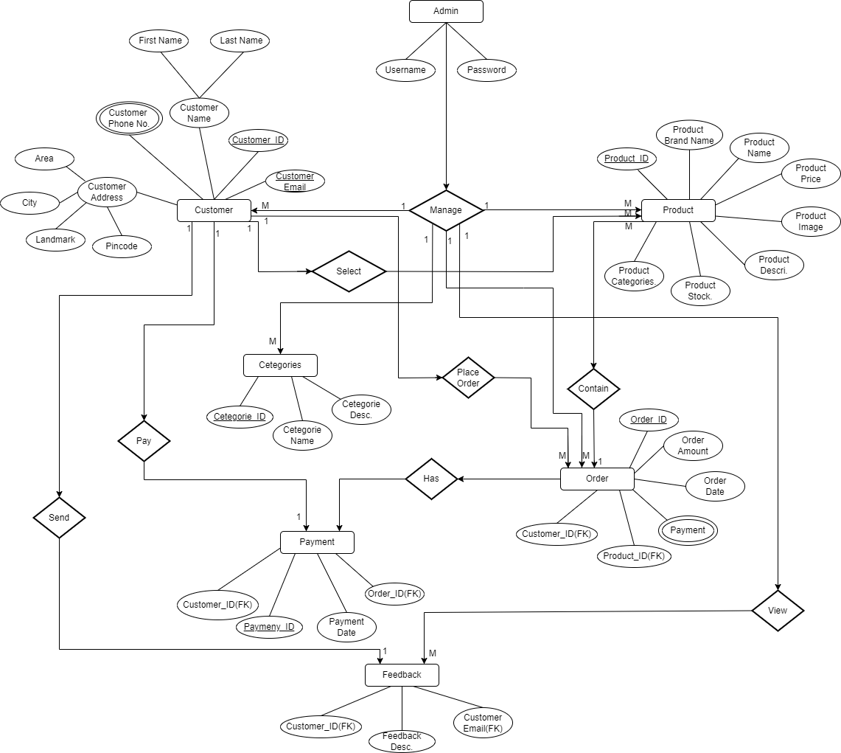
Figure: 4.1

Slide 25
SYSTEM DESIGN
CLASS DIAGRAM

Slide 26
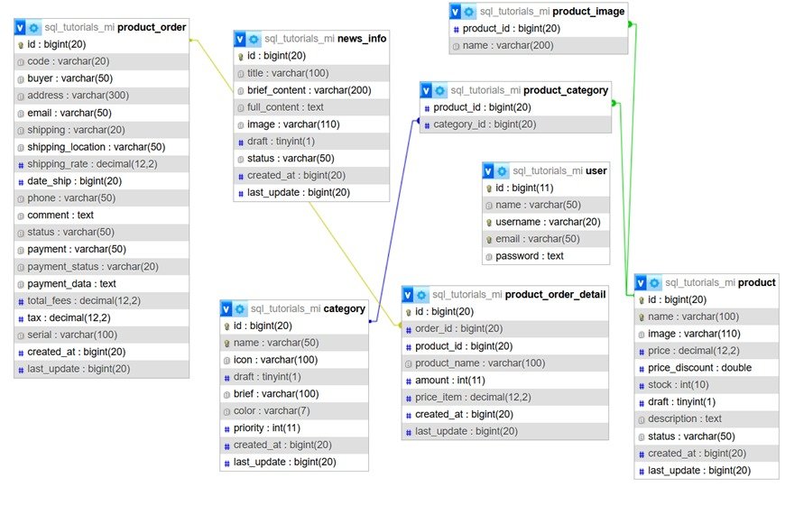
Figure: 5.1

Slide 27
DATA DICTIONARY DIAGRAM
SYSTEM DESIGN

Slide 28
1. Table Name: product_order
Column Name | Data Type | Size | Description
Id | bigint | 20 | Primary key (Order ID)
Code | Varchar | 20 | Unique order code
buyer | Varchar | 50 | Name of the buyer
address | Varchar | 300 | Delivery address
email | varchar | 50 | Buyer email address
shipping | varchar | 20 | Shipping method
shipping_location | varchar | 50 | Location of shipping
shipping_rate | decimal | 12,2 | Cost of shipping
date_ship | bigint | 20 | Shipping date (timestamp)
phone | varchar | 50 | Contact number
comment | text | - | Buyer comment
status | varchar | 50 | Status of the order
payment | varchar | 50 | Payment method
payment_status | varchar | 20 | Payment status
payment_data | text | - | Payment information
total_fees | decimal | 12,2 | Total order amount
tax | decimal | 12,2 | Tax amount
serial | varchar | 100 | Serial number of order
created_at | bigint | 20 | Creation timestamp
last_update | bigint | 20 | Last update timestamp

Slide 29
2. Table Name: product
Column Name | Data Type | Size | Description
id | bigint | 20 | Primary key (Product ID)
name | varchar | 100 | Name of the product
image | varchar | 110 | Product image URL
price | decimal | 12,2 | Regular price
price_discount | double | - | Discounted price
stock | int | 10 | Quantity in stock
draft | tinyint | 1 | Draft status (0 or 1)
description | text | - | Product description
status | varchar | 50 | Product status
created_at | bigint | 20 | Creation timestamp
last_update | bigint | 20 | Last update timestamp

Slide 30
3. Table Name: product_order_detail
Column Name | Data Type | Size | Description
id | bigint | 20 | Primary key
order_id | bigint | 20 | Foreign key referencing order
product_id | bigint | 20 | Foreign key referencing product
product_name | varchar | 100 | Name of the product
amount | int | 11 | Quantity ordered
price_item | decimal | 12,2 | Price per item
created_at | bigint | 20 | Creation timestamp
last_update | bigint | 20 | Last update timestamp

Slide 31
4. Table Name: category
Column Name | Data Type | Size | Description
id | bigint | 20 | Primary key
name | varchar | 50 | Category name
icon | varchar | 100 | Icon image
draft | tinyint | 1 | Draft status
brief | varchar | 100 | Short description
color | varchar | 7 | Color code
priority | int | 11 | Display priority
created_at | bigint | 20 | Creation timestamp
last_update | bigint | 20 | Last update timestamp

Slide 32
5. Table Name: user
Column Name | Data Type | Size | Description
id | bigint | 11 | Primary key
name | varchar | 50 | Full name
username | varchar | 20 | Unique username
email | varchar | 50 | User email
password | text | - | Encrypted password

Slide 33
6. Table Name: product_image
Column Name | Data Type | Size | Description
product_id | bigint | 20 | Foreign key referencing product
name | varchar | 200 | Image file name

Slide 34
7. Table Name: product_category
Column Name | Data Type | Size | Description
product_id | bigint | 20 | Foreign key referencing product
category_id | bigint | 20 | Foreign key referencing category

Slide 35
8. Table Name: news_info
Column Name | Data Type | Size | Description
id | bigint | 20 | Primary key
title | varchar | 100 | News title
brief_content | varchar | 200 | Short content
full_content | text | - | Full content
image | varchar | 100 | Image URL
draft | tinyint | 1 | Draft status
status | varchar | 50 | Publication status
created_at | bigint | 20 | Creation timestamp
last_update | bigint | 20 | Last update timestamp

Slide 36
SCREENSHOTS
ADMIN PANEL

Slide 37
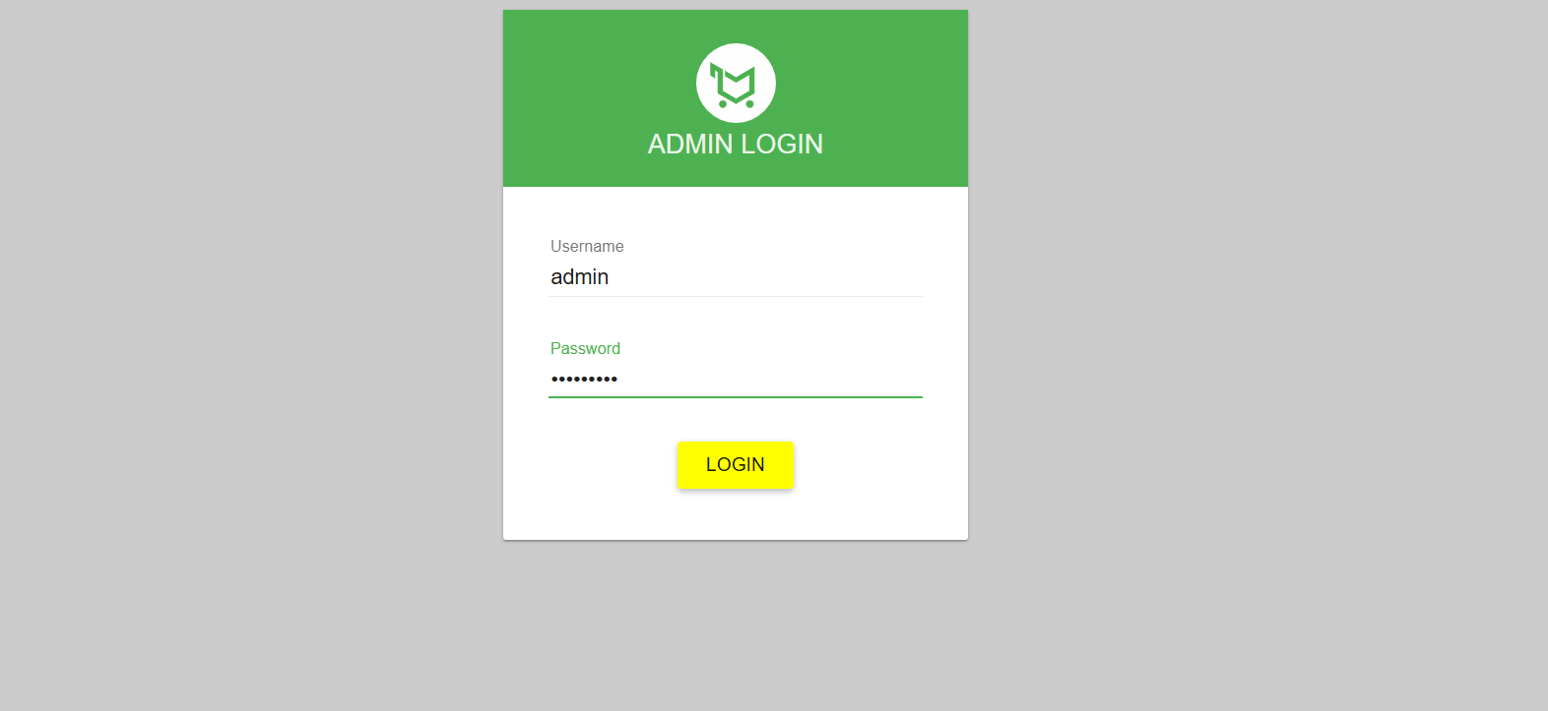
Figure 5.1 Admin login page

Slide 38
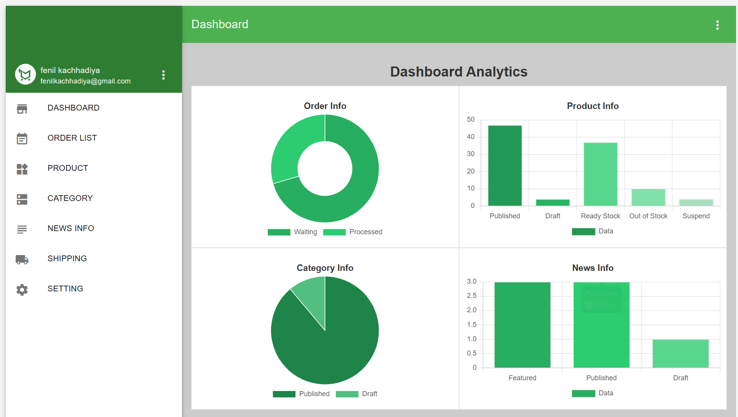
Figure 5.2 Admin dashboard

Slide 39
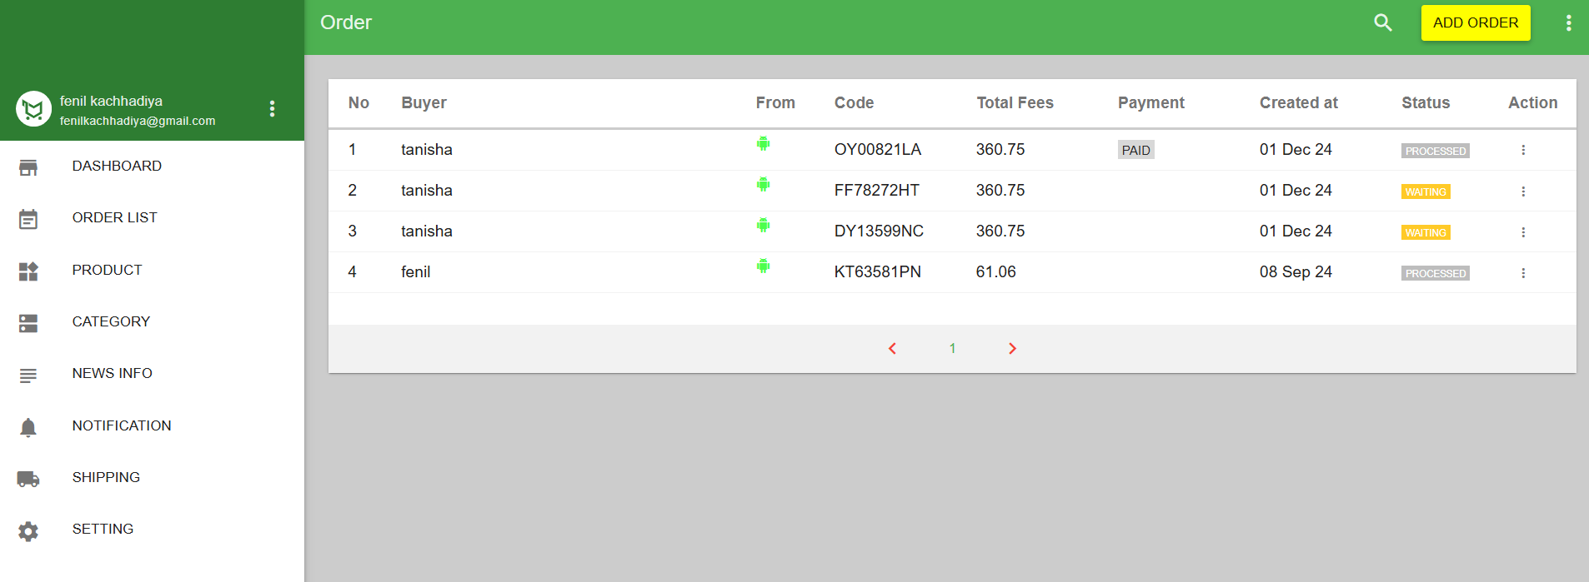
Figure 5.3 User order list

Slide 40
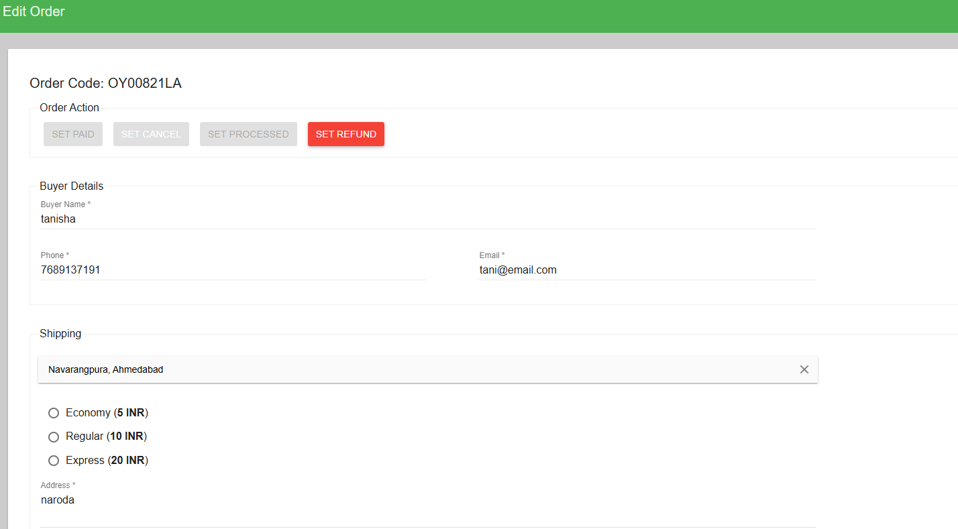
Figure 5.4 User order update

Slide 41
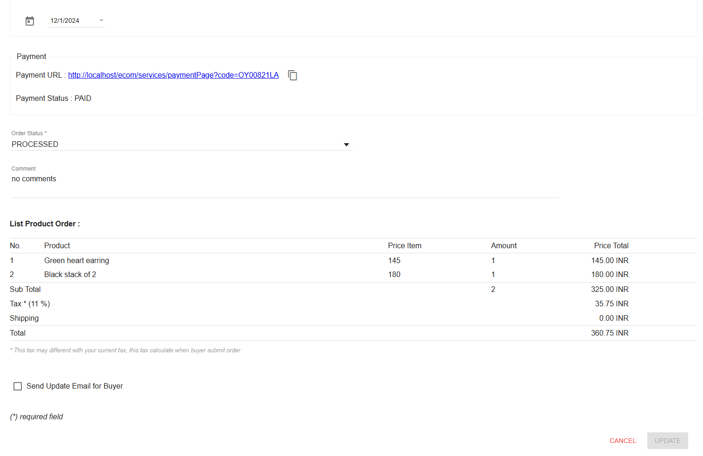
Figure 5.5 User order update

Slide 42
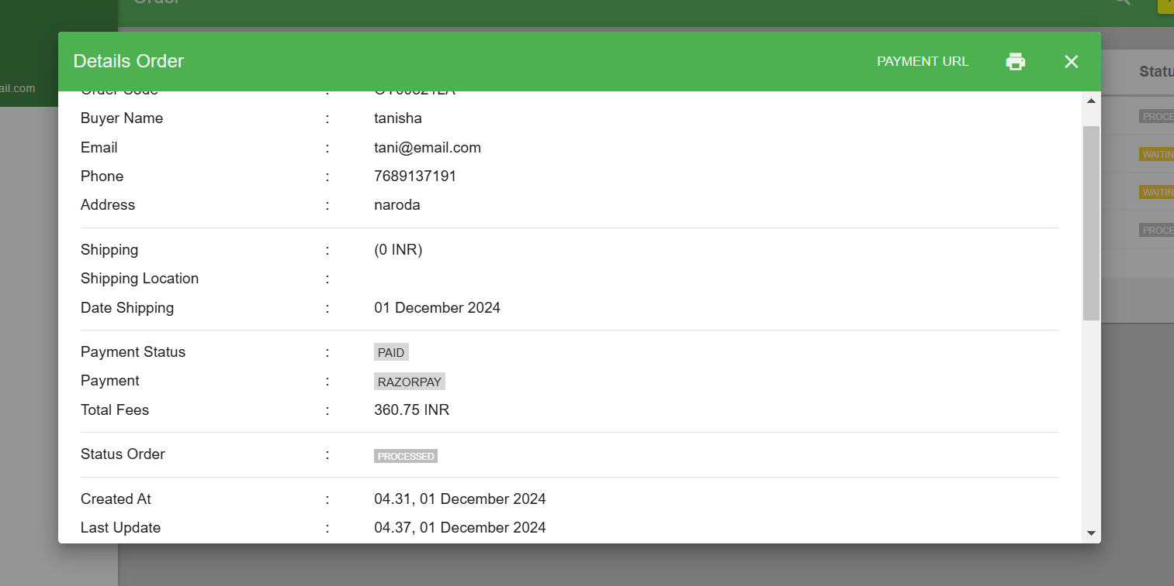
Figure 5.6 User order invoice

Slide 43
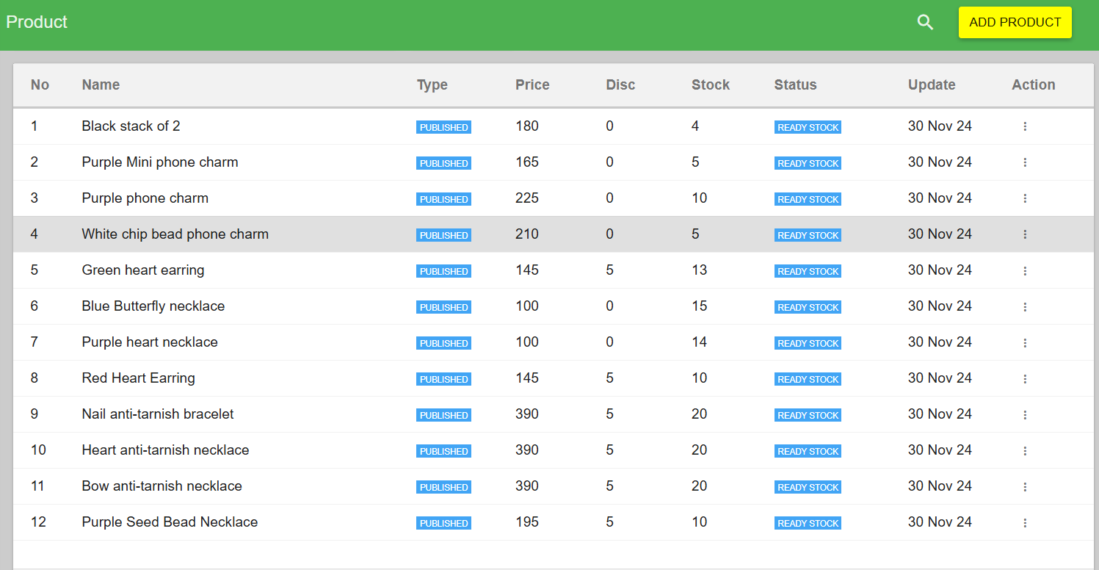
Figure 5.7 Product details

Slide 44
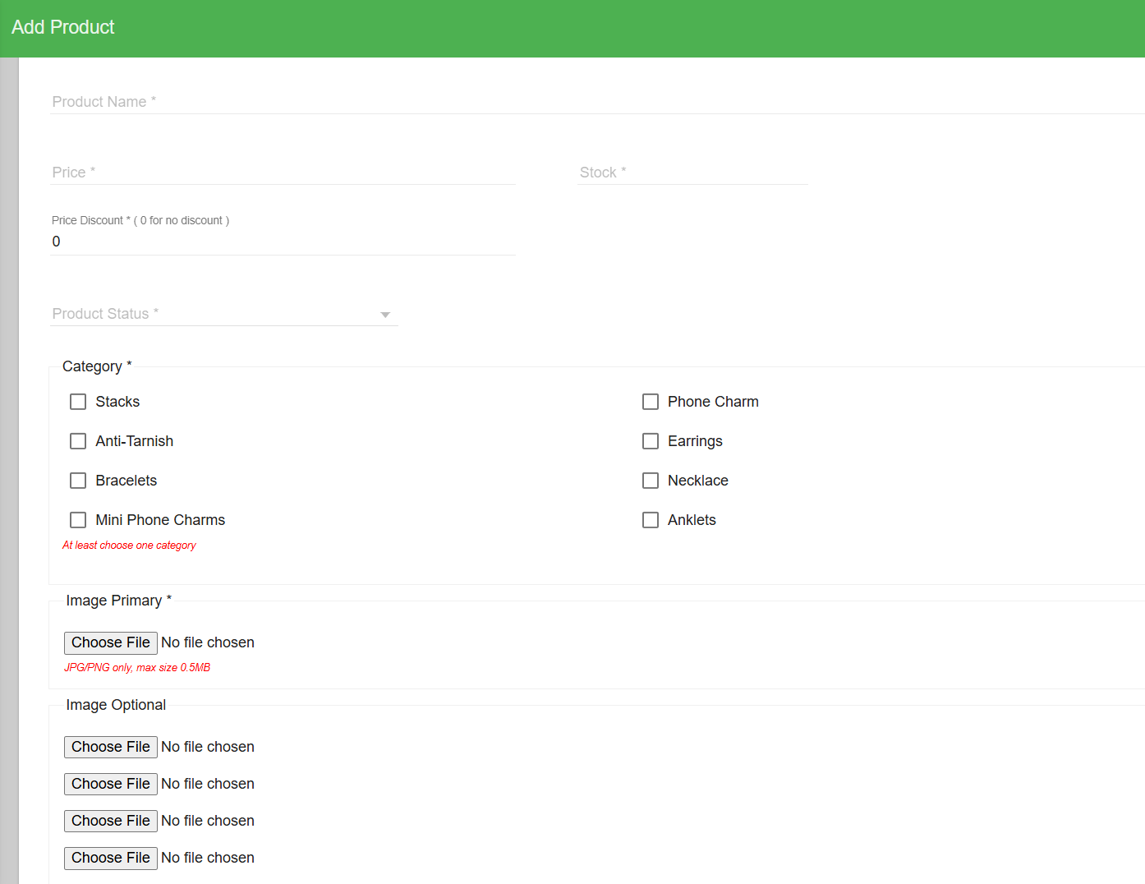
Figure 5.8 Add product

Slide 45
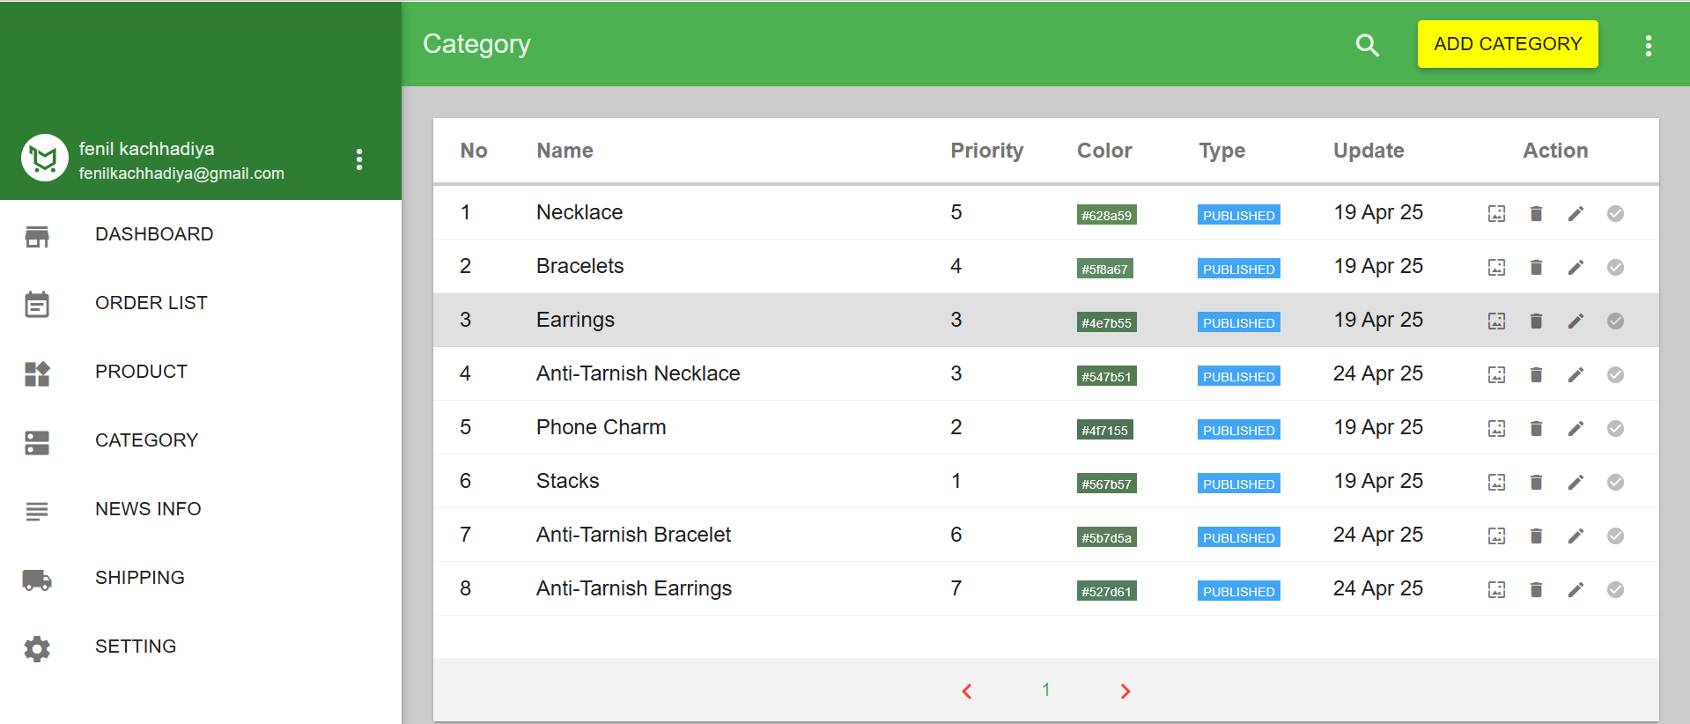
Figure 5.9 Category details

Slide 46
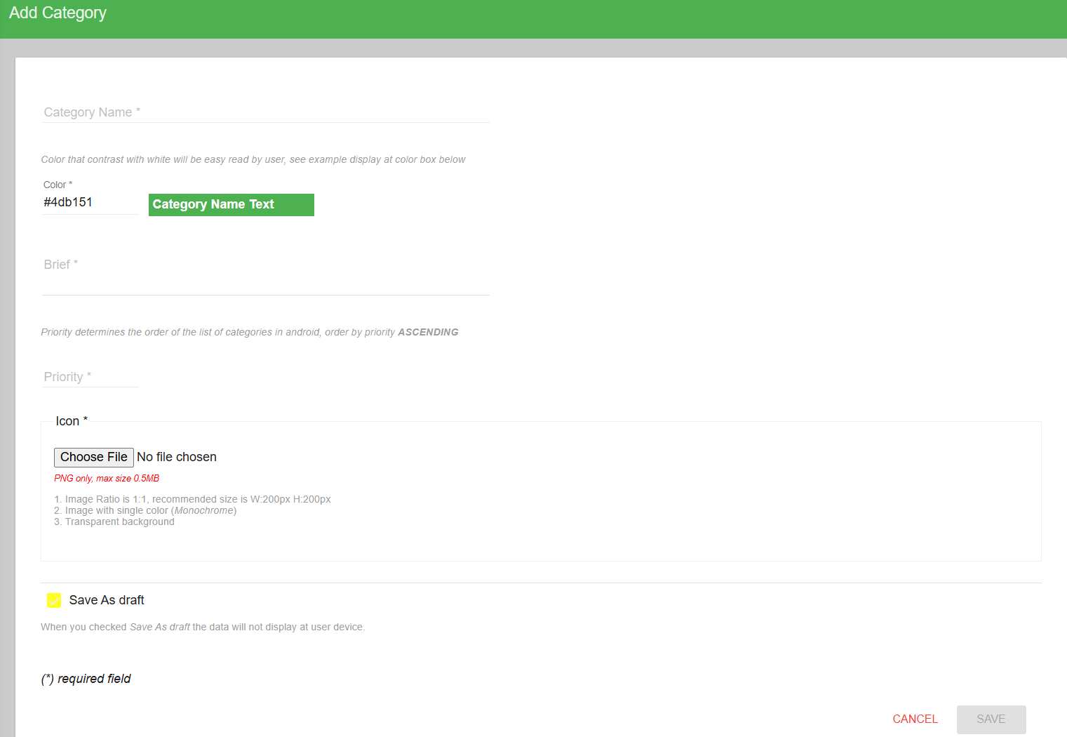
Figure 5.10 Add Category

Slide 47
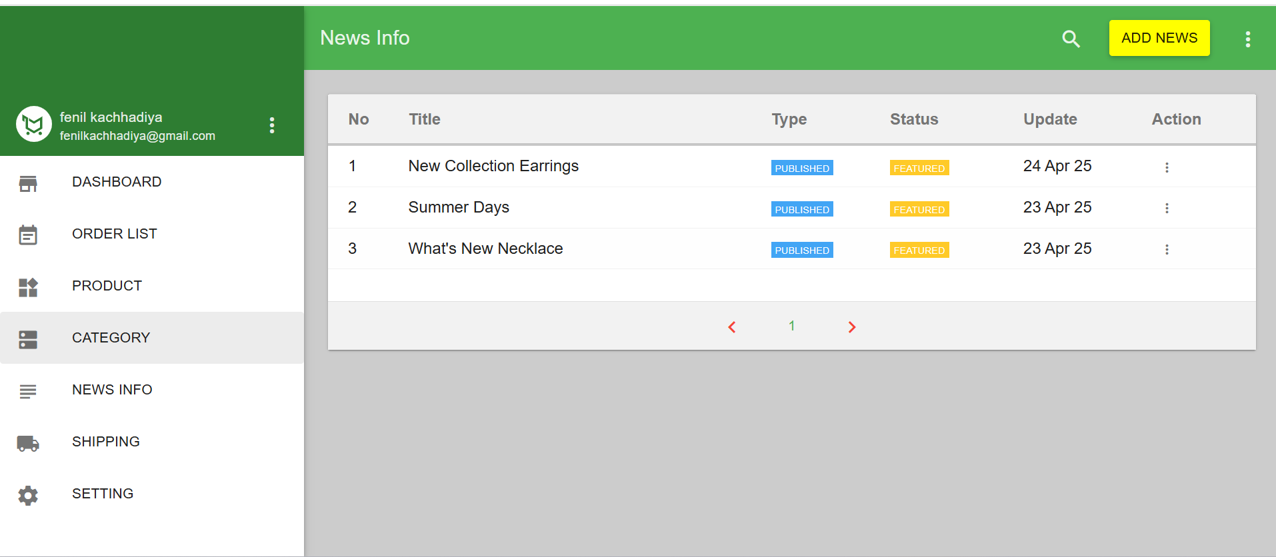
Figure 5.11 News information detail

Slide 48
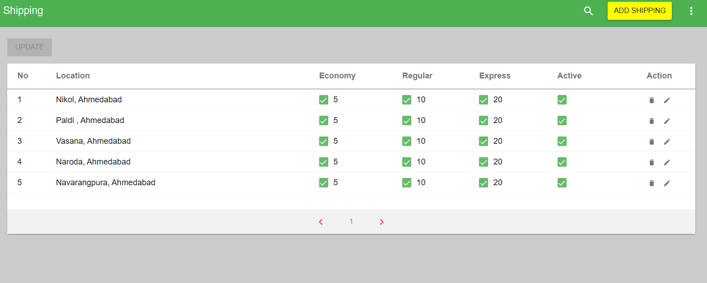
Figure 5.12 Shipping Location details

Slide 49
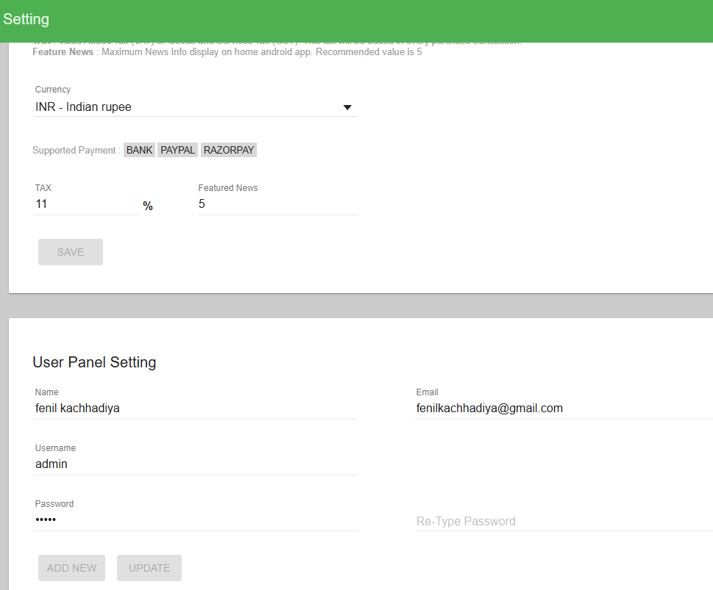
Figure 5.13 Admin setting

Slide 50
SCREENSHOTS
ANDROID APPLICATION

Slide 51
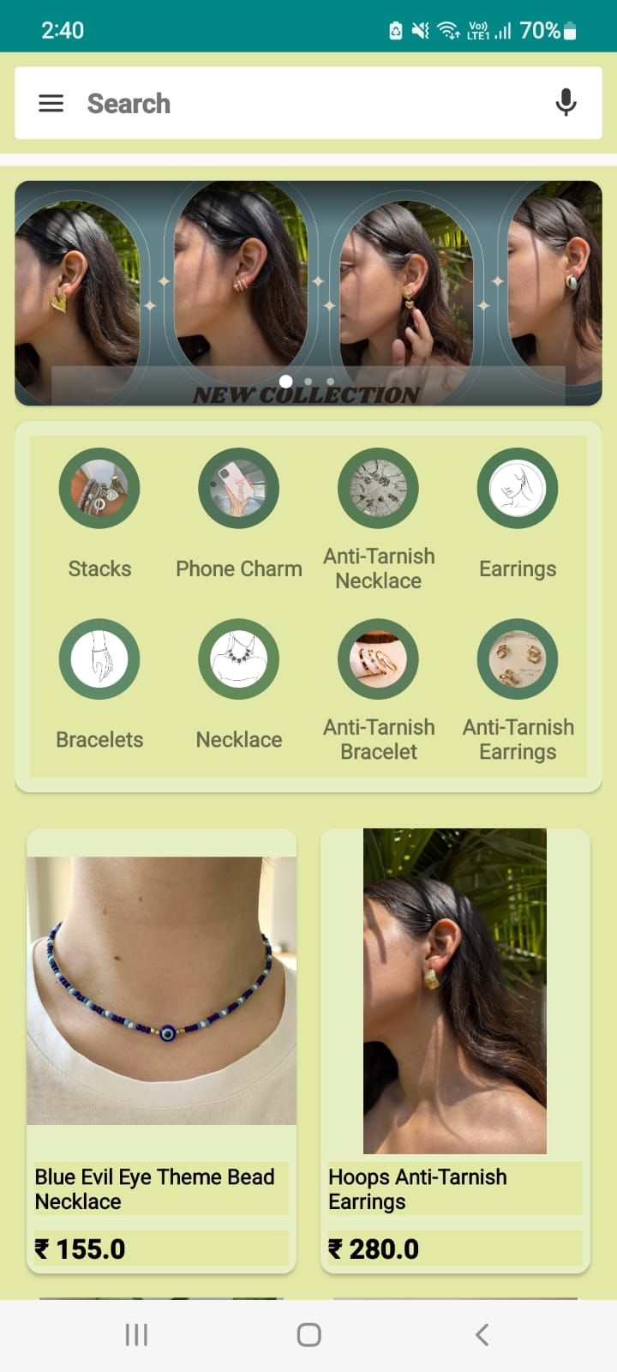
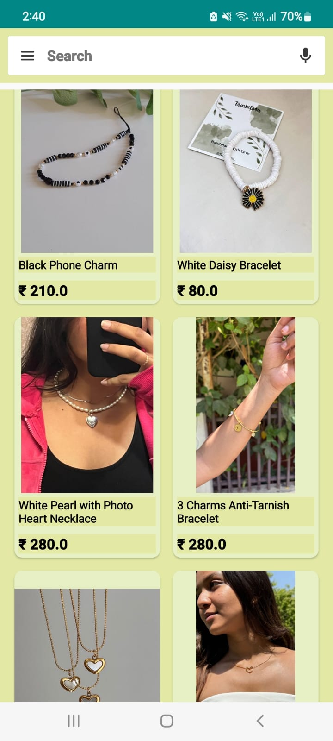
Figure 5.14 Android Application Views

Slide 52
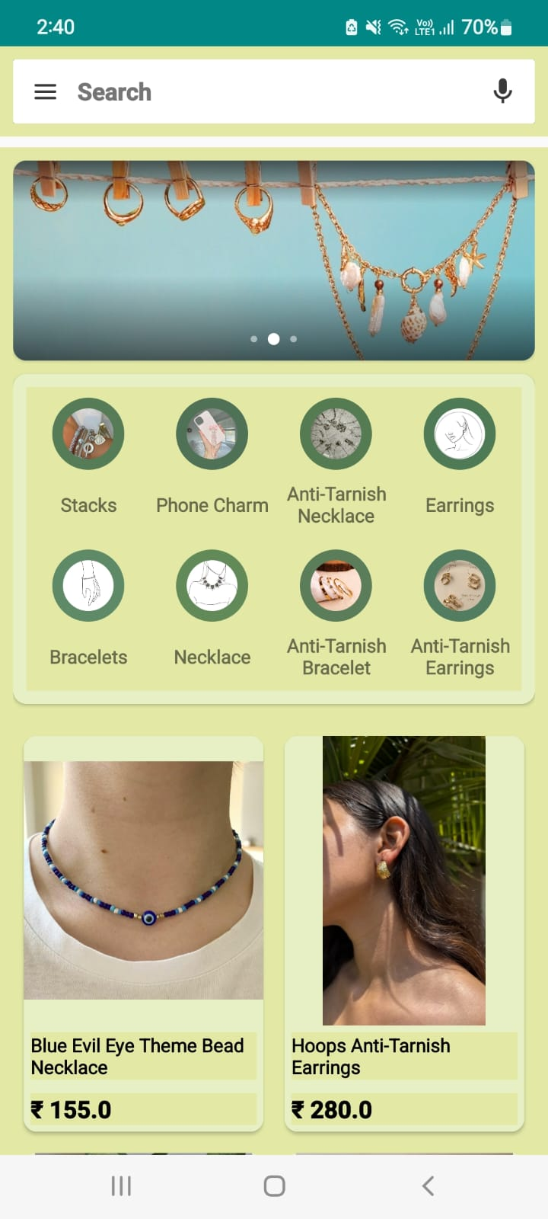
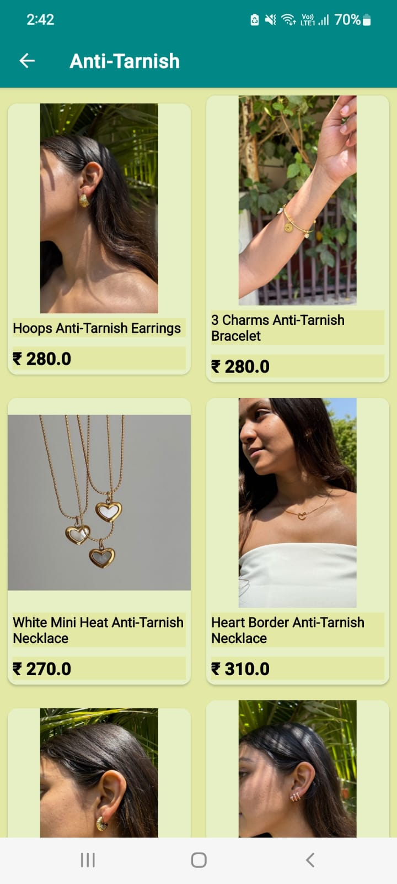
Figure 5.14 Searchbar

Slide 53
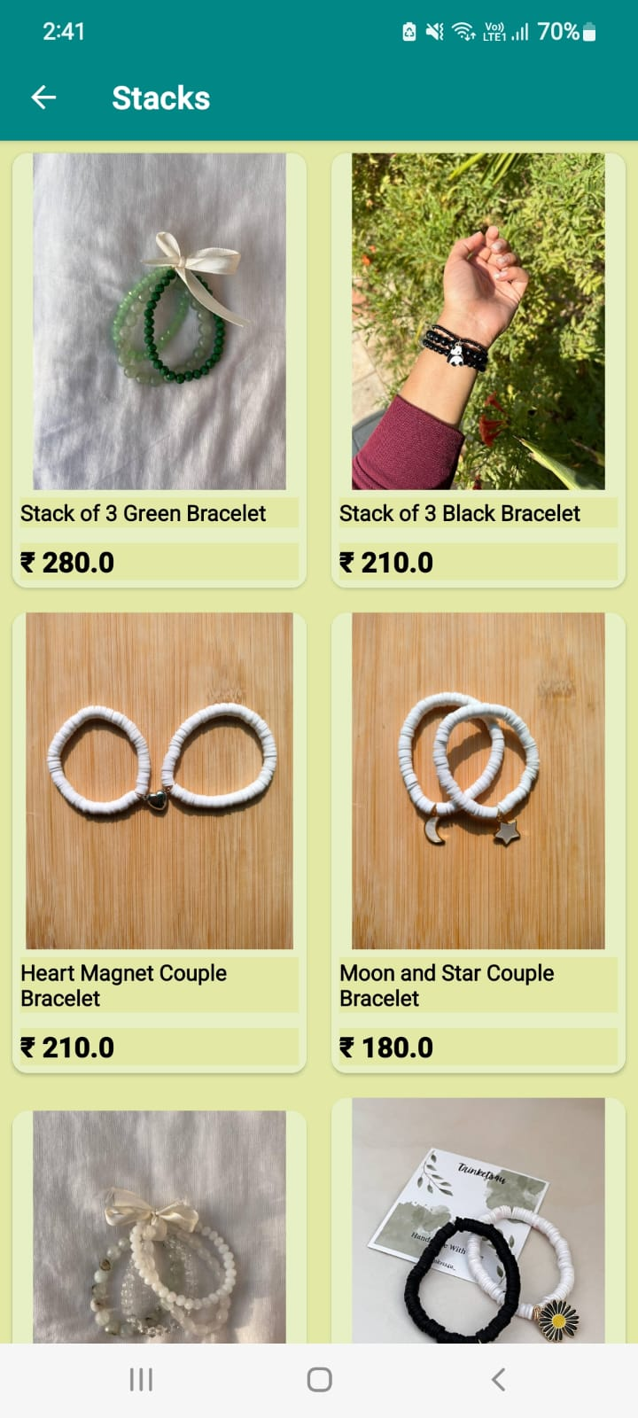
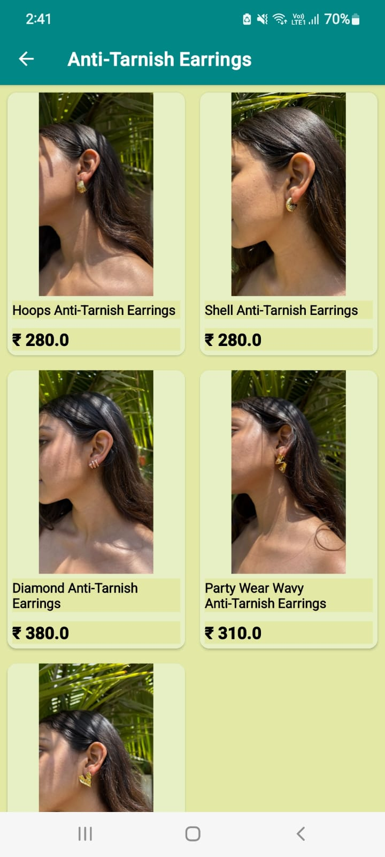
Figure 5.15 Categorized Items

Slide 54
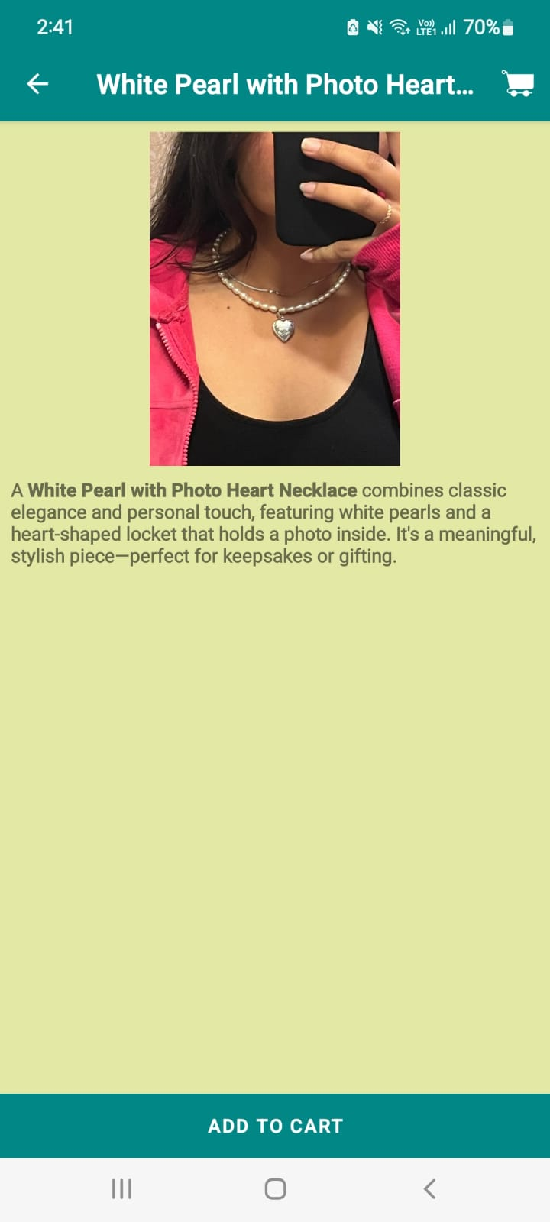
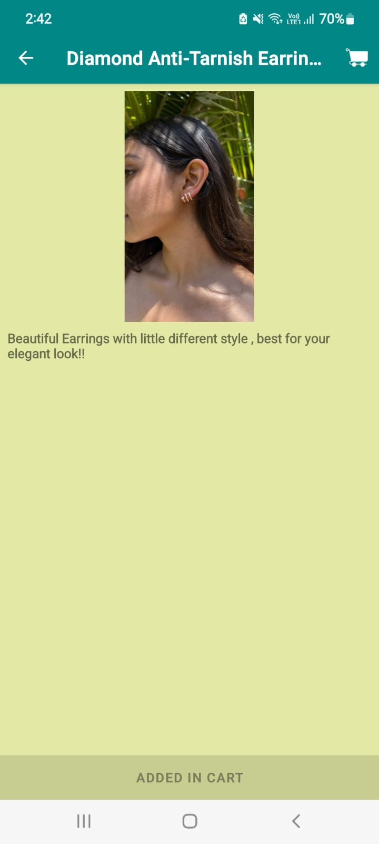
Figure 5.16 Product details

Slide 55
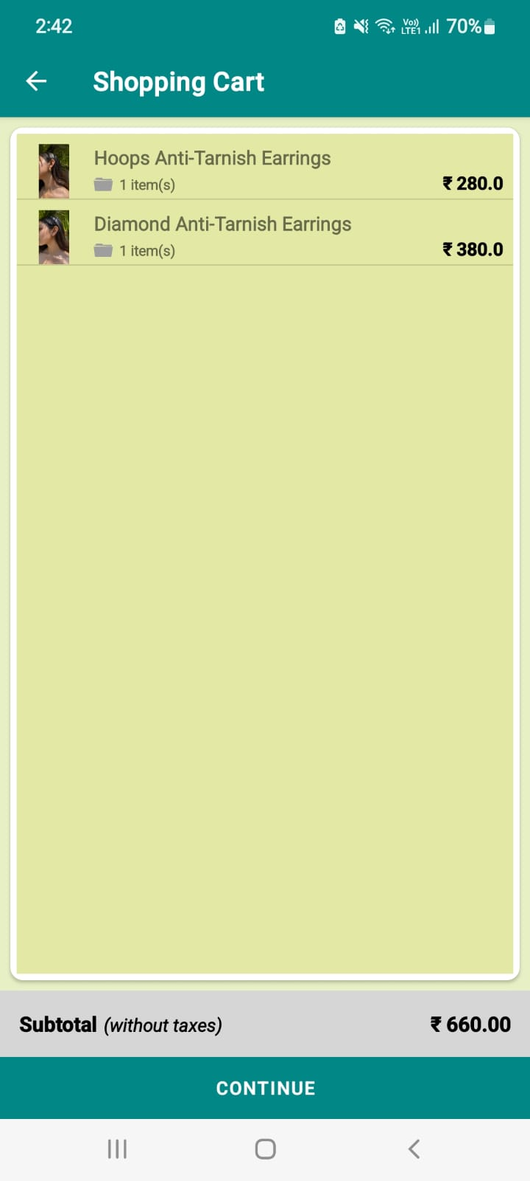
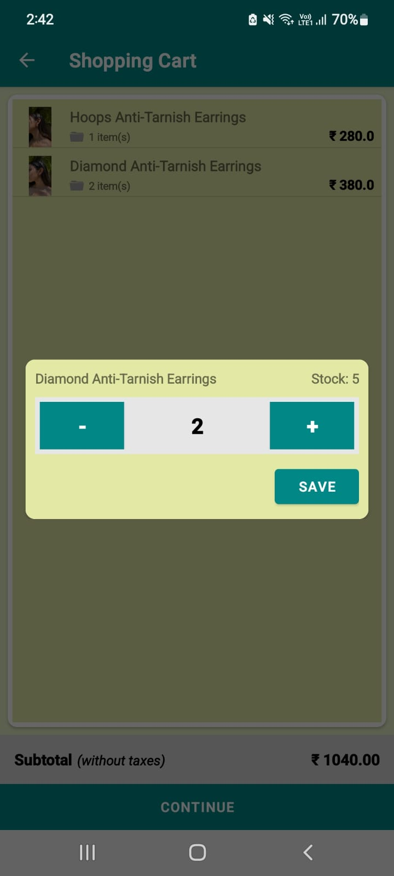
Figure 5.17 Shopping cart

Slide 56
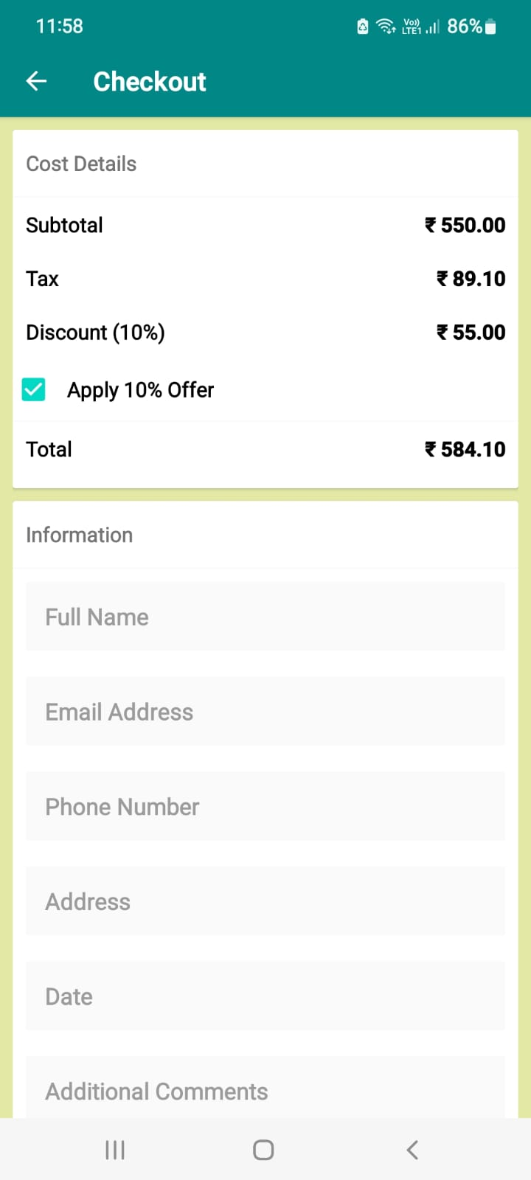
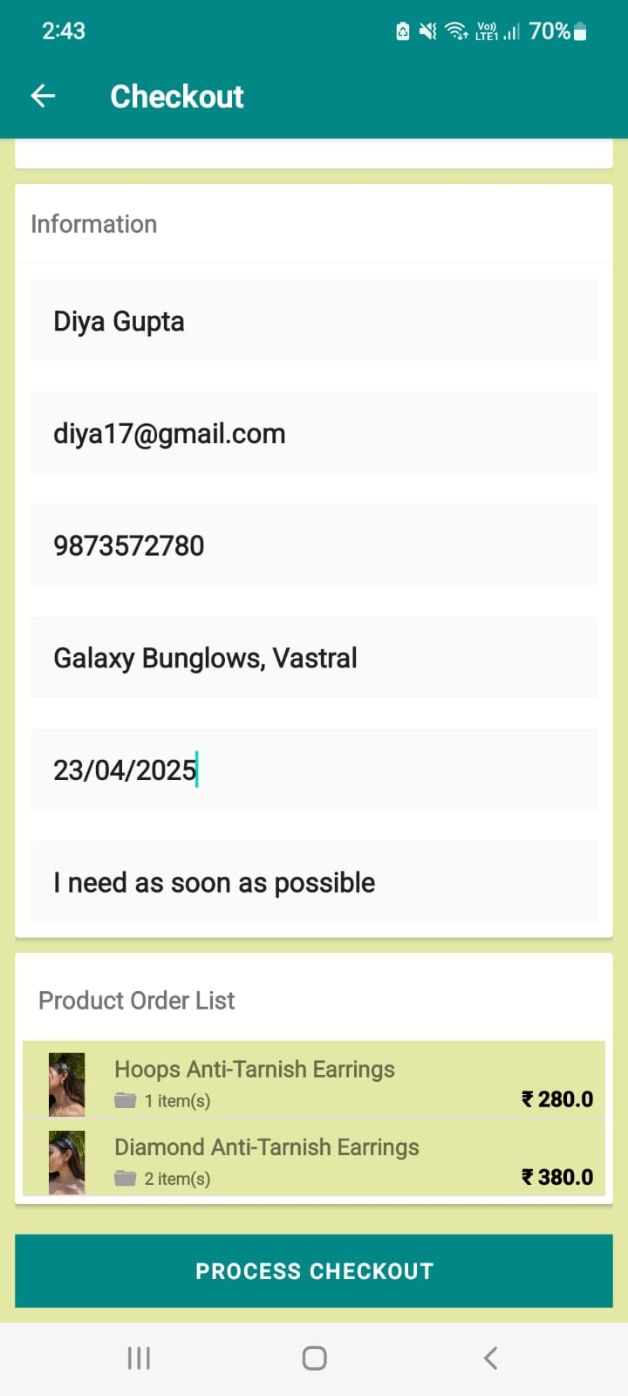
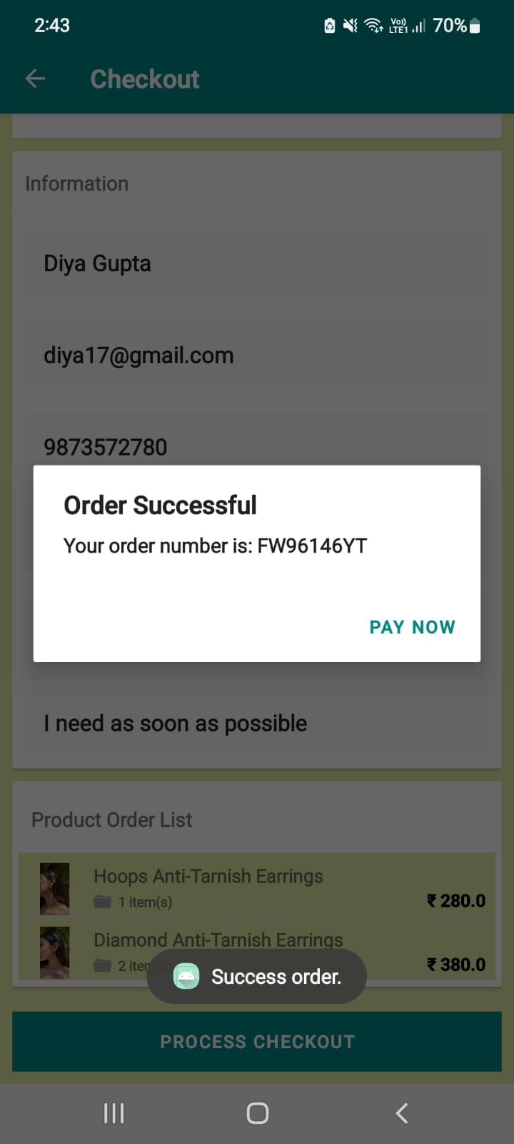
Figure 5.18 Checkout order and view order number

Slide 57
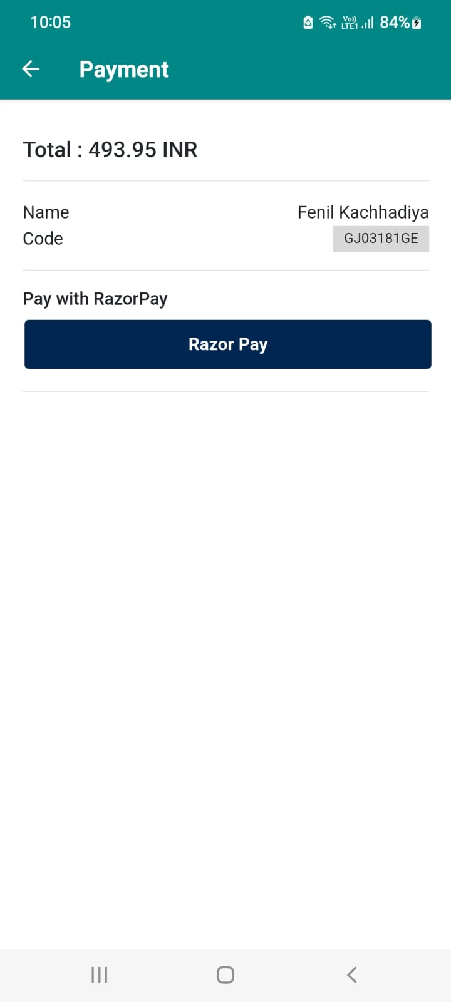
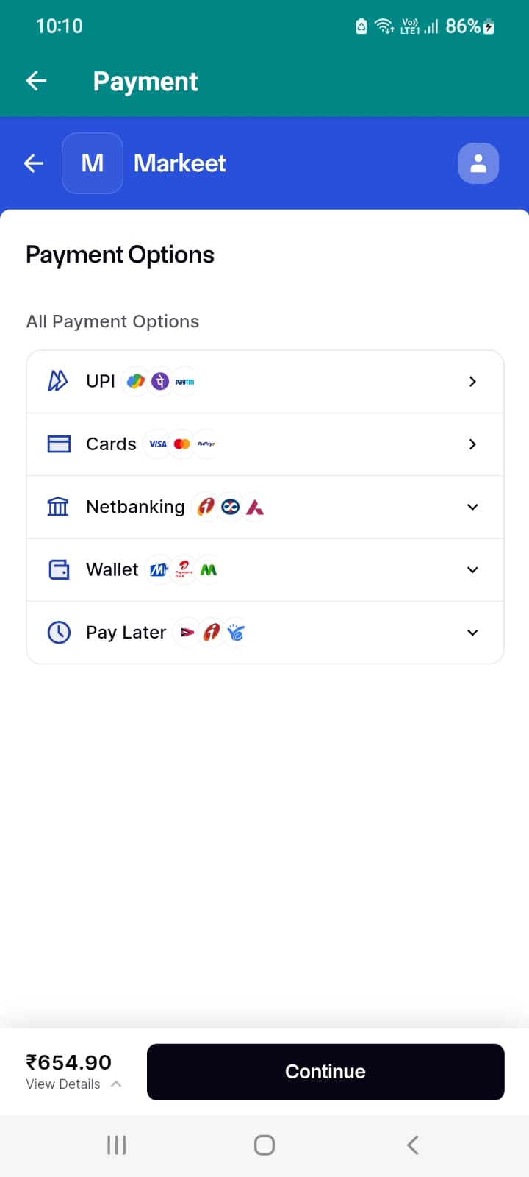
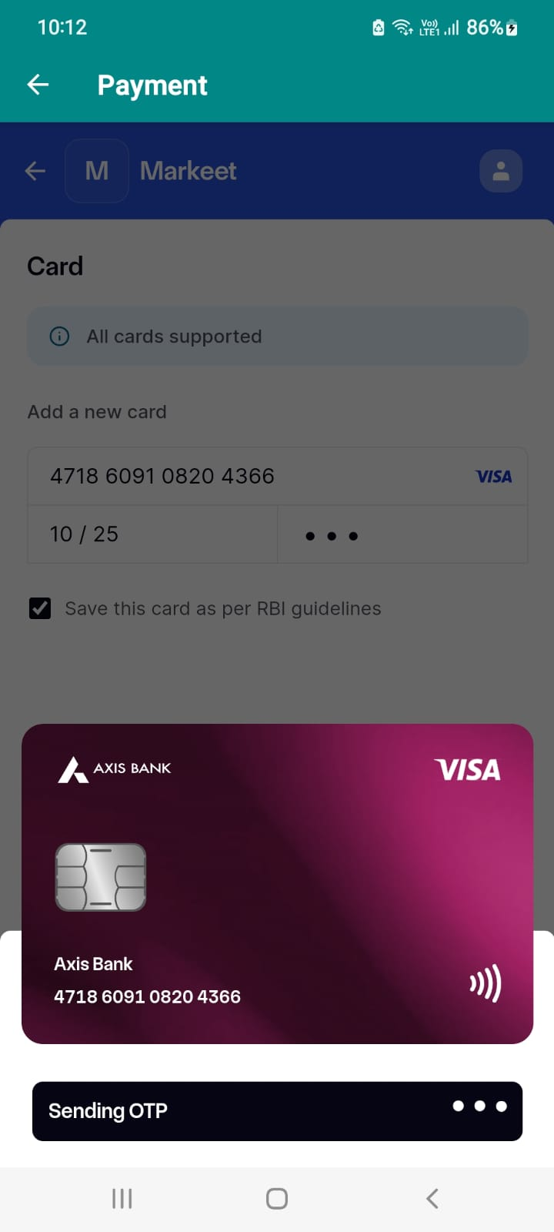
Figure 5.19 Payment method

Slide 58
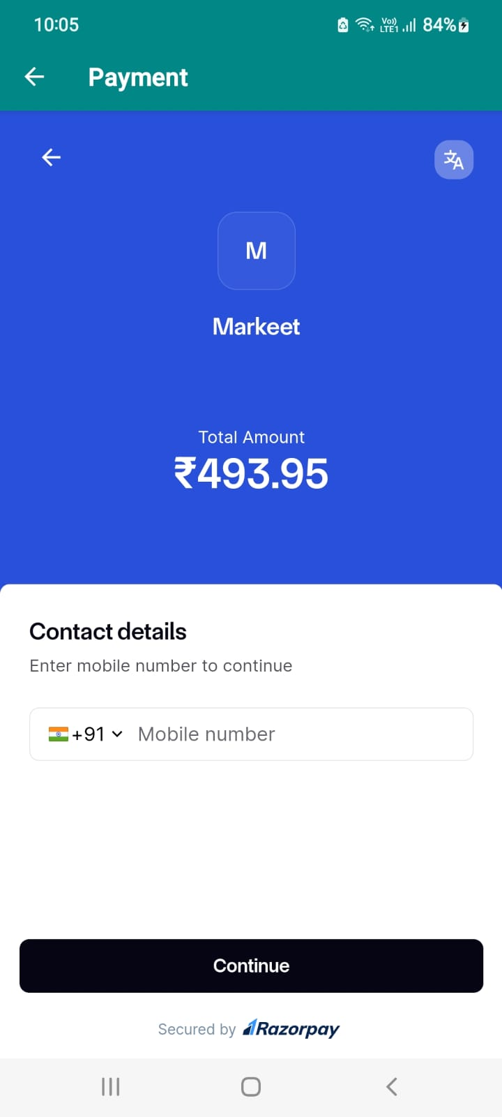
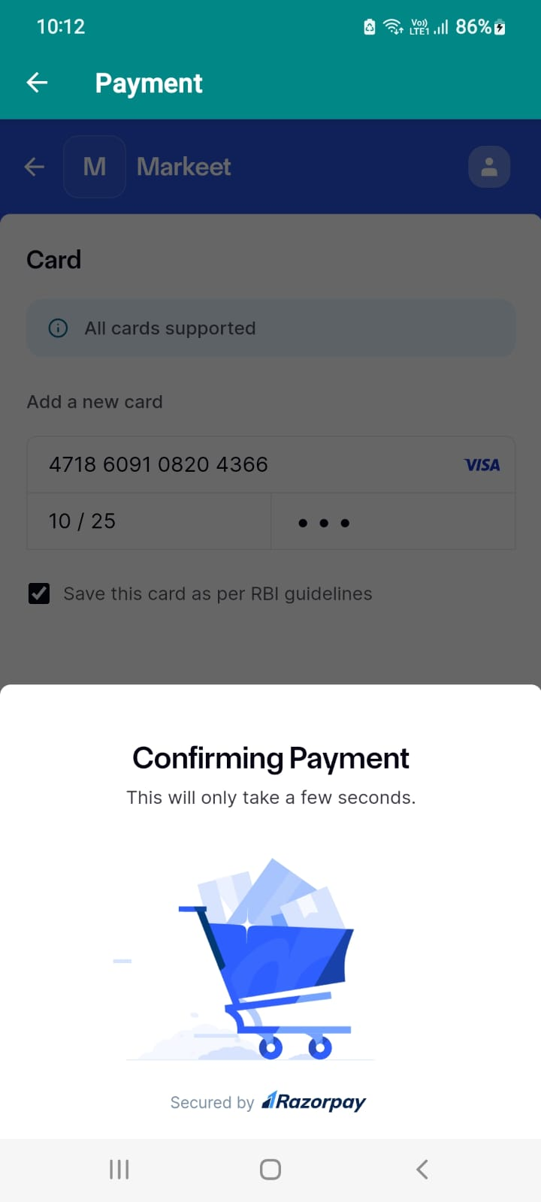
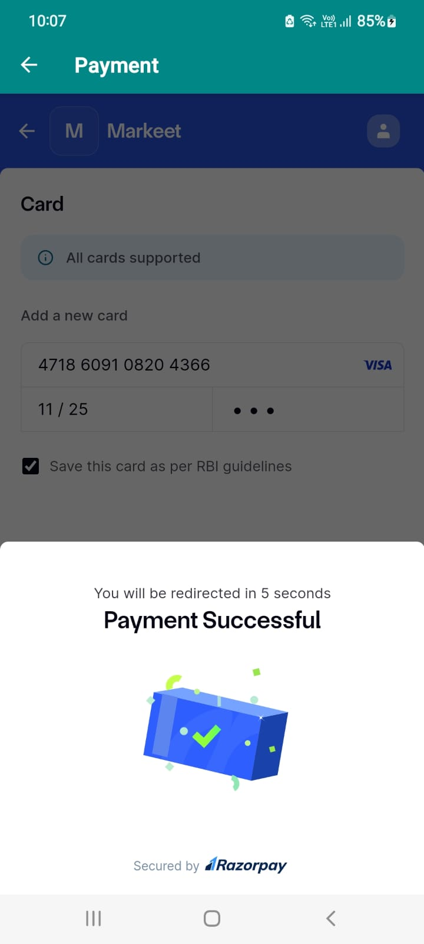
Figure 5.20 Payment Confirming Process

Slide 59
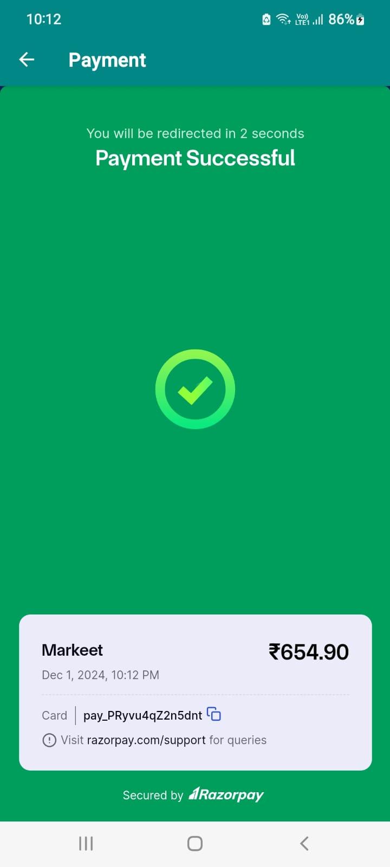
Figure 5.21 Payment Successful invoice and show payment id

Slide 60
Thank you

