Slide 1

Gym & Nutrition
-: Presented By :-
Mukunda D - 1AY18MCA09
Fenil Patel - 1AY18MCA18

Slide 2
Introduction
Our Gym management provides lots of functions such keeping records of all the things about customer’s fees, plan, and physical fitness which help to provide good quality of services to customer from Gym.
Gym Management System is an online service that can be setup for your gym to help detail about classes, memberships detail, receive payments , online classes, customer management, and online store so you can purchase products (nutrition and supplements) to your customers.
And also we provide extra activity like cycling, swimming, yoga and etc.

Slide 3
Module
Admin :
ADMIN
Admin is the role with the highest level of access in website. Admin can add content on all pages and access all items in the Admin. This means that Admin can control site. They can add, update and delete content.
User :
You User have note major role in site. User can get the detail about class, schedule , nutrition product, trainer detail and membership plan and user can comment and contact without login.
Fitness & Nutrition
USER

Slide 4

Pages
User :
Admin :
Home
Dashboard
More
component
Schedule
Forms
Trainers
Tables
About us
Contact us

Slide 5
Design
Text Here
Get a modern PowerPoint Presentation that is beautifully designed.
04
Text Here
Fitness
&
Nutrition
03
Get a modern PowerPoint Presentation that is beautifully designed.
USER
ADMIN
Text Here
Get a modern PowerPoint Presentation that is beautifully designed.
02
Text Here
01
Get a modern PowerPoint Presentation that is beautifully designed.

Slide 6
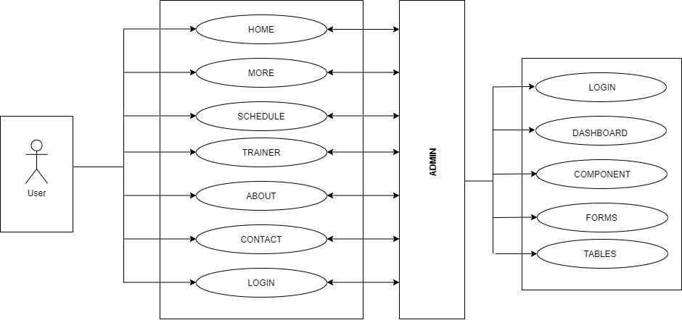
Flow Diagram
Text Here
Get a modern PowerPoint Presentation that is beautifully designed.
04
Text Here
03
Get a modern PowerPoint Presentation that is beautifully designed.
Text Here
Get a modern PowerPoint Presentation that is beautifully designed.
02
Text Here
01
Get a modern PowerPoint Presentation that is beautifully designed.

Slide 7
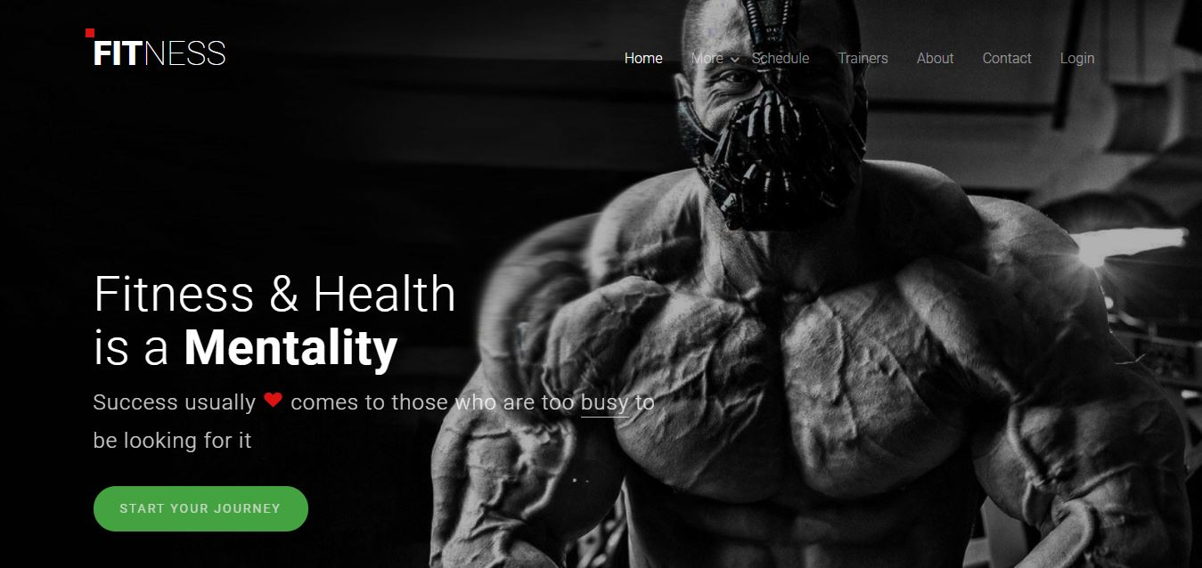
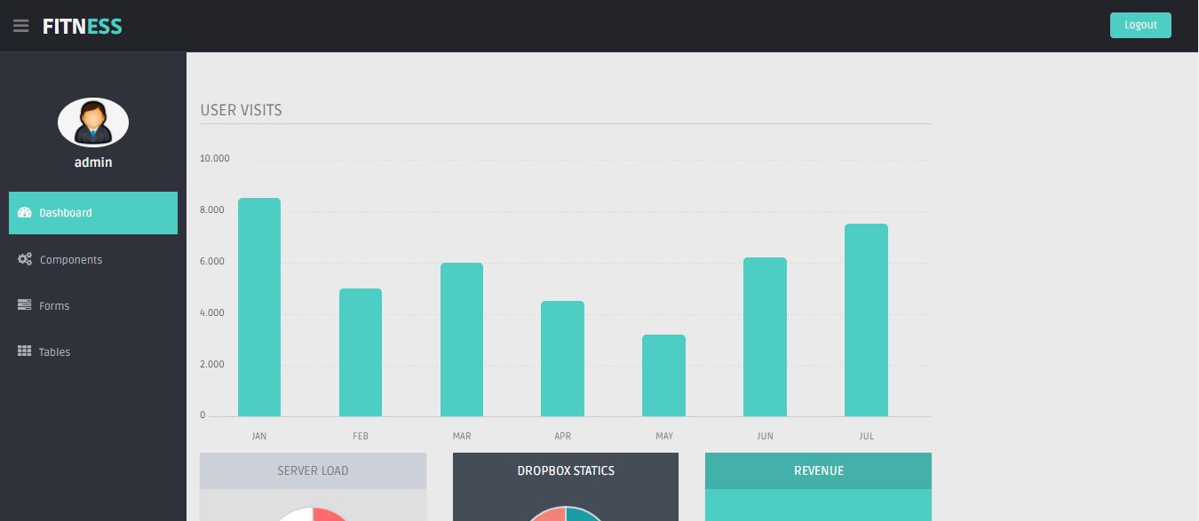
Screenshots
User :
You can simply seen the detail about the gym classes and schedule.
Admin :
Here admin can saws the detail about visitors .

Slide 8
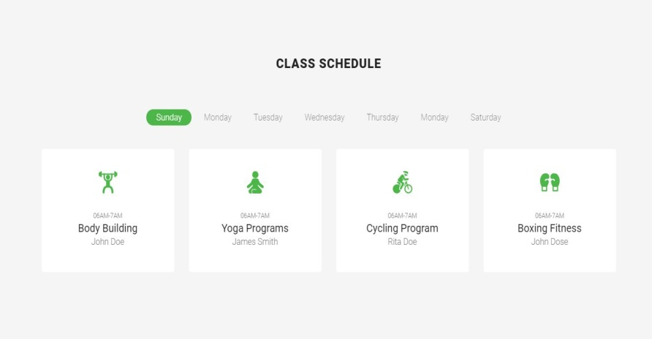

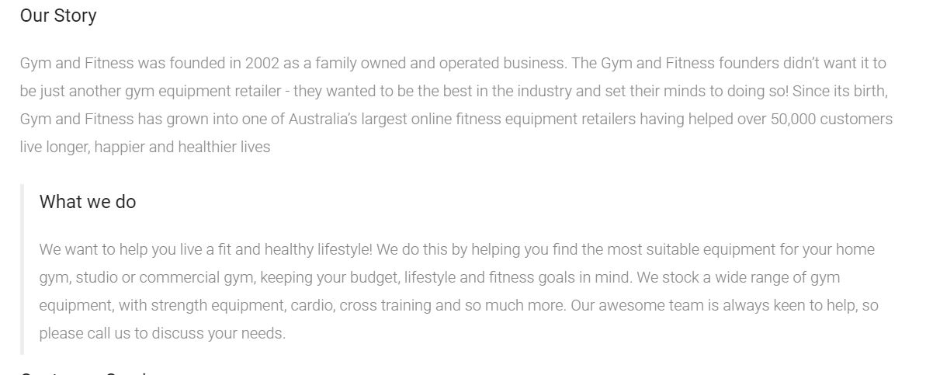
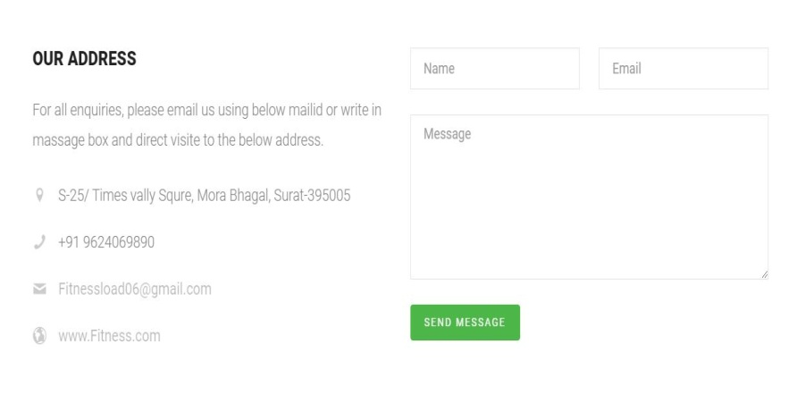
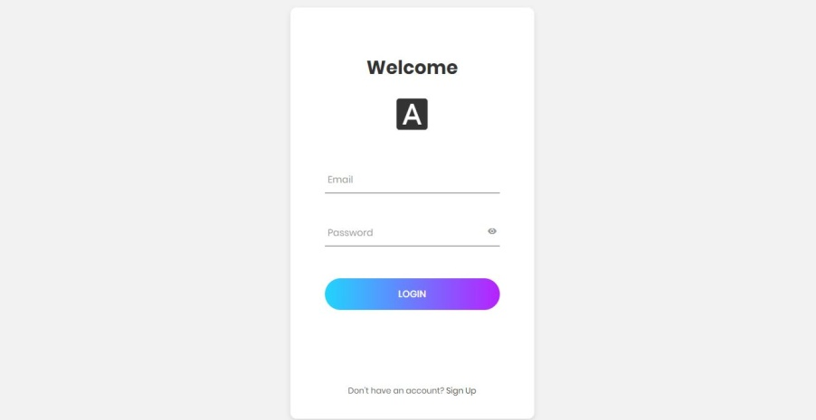
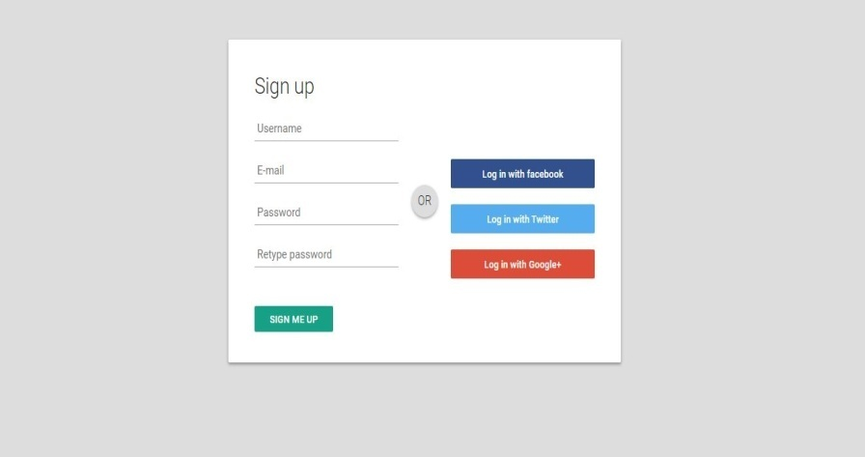
Screenshots
03
About
Schedule
Trainers
Contact
login
Signup

Slide 9
Conclusion
Contents
Example Text : Get a modern PowerPoint Presentation that is beautifully designed. I hope and I believe that this Template will your Time, Money and Reputation. Easy to change colors, photos and Text.
Contents
Example Text : Get a modern PowerPoint Presentation that is beautifully designed. I hope and I believe that this Template will your Time, Money and Reputation. Easy to change colors, photos and Text.
Contents
Example Text : Get a modern PowerPoint Presentation that is beautifully designed. I hope and I believe that this Template will your Time, Money and Reputation. Easy to change colors, photos and Text.
Contents
Example Text : Get a modern PowerPoint Presentation that is beautifully designed. I hope and I believe that this Template will your Time, Money and Reputation. Easy to change colors, photos and Text.

Slide 10

Future Enhancement
01
Contents
Get a modern PowerPoint Presentation that is beautifully designed. I hope and I believe that this Template will your Time.
02
Contents
Get a modern PowerPoint Presentation that is beautifully designed. I hope and I believe that this Template will your Time.
03
Contents
Get a modern PowerPoint Presentation that is beautifully designed. I hope and I believe that this Template will your Time.
04
Contents
Get a modern PowerPoint Presentation that is beautifully designed. I hope and I believe that this Template will your Time.

Slide 11
Thank You

Slide 12
Fully Editable Shapes

Slide 13
Fully Editable Shapes
10

Slide 14


PNG IMAGES
Place Your Picture Here
Insert Your Image

Slide 15
Fully Editable Icon Sets: A

Slide 16
Fully Editable Icon Sets: B

Slide 17
Fully Editable Icon Sets: C

