Slide 1

Project Title: Student_Performance Analysis
Group No: 602_90
Guided By:- Prof. Jaimini Patel
:: Presented By ::
Bhingradiya Fenil Nitinbhai
Avaiya Nand Rajeshbhai

Slide 2
Personal Profile:
Exam No: | 6757
Name: | BHINGRADIYA FENIL NITINBHAI [Group Leader]
Roll No: | 403
Division: | C
Year: | TYBCA
Exam No: | 6730
Name: | AVAIYA NAND RAJESHBHAI [Group Member]
Roll No: | 402
Division: | C
Year: | TYBCA

Slide 3
Student_Performance Analysis Overview
Exploratory Data Analysis (EDA) is the process of examining and summarizing a dataset to understand its main characteristics before applying statistical or machine learning models. It helps in identifying patterns, detecting missing values, finding outliers, and understanding relationships between variables.
In this project, Python is used for performing EDA because it provides powerful libraries such as Pandas,NumPy, Matplotlib, and Seaborn for data manipulation and visualization. These libraries help in cleaning the data, calculating statistical summaries, and creating graphical representations of the dataset.
The dataset contains 1000 records (rows) and 12 variables (columns) representing students' demographic information, subject marks, and performance indicators. The dataset is mainly used for Exploratory Data Analysis (EDA), regression analysis, and classification tasks.

Slide 4
1. Data Collection:
Data Collection is the process of gathering data from different sources to use it for analysis and machine learning.
Sources of Data:
Data can be collected from:
• CSV files
• Databases
• APIs
• Web scraping
• Online datasets (Kaggle, UCI Repository, etc.)
File Name: student_performance.csv

Slide 5
2. Data Understanding:
Data Understanding is the step where we study and explore the dataset to know what information it contains. It helps us understand the structure, features, and quality of the data before performing analysis.
1. Purpose of Data Understanding
2. Dataset Structure
3. Types of Data
3.1: Numerical Data
3.2: Categorical Data
4. Checking the Dataset in Python

Slide 6
3. Exploratory Data Analysis (EDA):
Exploratory Data Analysis (EDA) is the process of analyzing and visualizing the dataset to discover patterns, relationships, and important information.
1. Univariate Analysis:
Univariate Analysis is the analysis of one variable at a time in a dataset.
2. Bivariate Analysis:
Bivariate Analysis is the analysis of two variables at the same time to understand the relationship between them.
3. Multivariate Analysis:
Multivariate Analysis is a statistical technique used to analyze more than two variables at the same time to understand relationships, patterns, or effects between them.

Slide 7
4. Handling Missing Data & Outliers:
4.1 Handling Missing Data:
Handling Missing Data means the process of detecting and managing missing values (NaN or empty values) in a dataset so that the data can be analyzed correctly.
4.2 Outliers Detection:
Outlier Detection is the process of identifying data points that are very different from the rest of the data in a dataset.
4.2 Outliers detection using Boxplot:
A box plot is a graphical method used to identify outliers in a dataset using quartiles and the interquartile range (IQR).

Slide 8
5. Spread of Data
5.1 Ckeck Data Distribution:
Spread of data refers to how much the values in a dataset vary or are distributed from the center (mean or median).
5.2 Calculations:
Mean: The mean of the percentage column shows the average performance of students based on their percentage scores in the dataset.
Median: The median of the percentage column represents the middle percentage score of students in the dataset when all percentages are arranged in order.
Std: The standard deviation of the percentage column shows how much the students' percentage scores deviate from the average percentage in the dataset.
Skewness: The skewness of the percentage column indicates how the percentage values are distributed around the mean, showing whether the data is skewed to the left or right.
Kurtosis: The kurtosis of the percentage column indicates how peaked or flat the distribution of percentage values is in the dataset.

Slide 9
6. Automating EDA using Python
Automating Exploratory Data Analysis (EDA) using Python refers to the process of automatically analyzing and summarizing a dataset using Python libraries and tools instead of performing each step manually. It helps data analysts quickly understand the structure, patterns, relationships, distributions, and potential issues in the data.
6.1: Reusable Python Function:
A reusable Python function is a function that can be used multiple times in a program without rewriting the same code again. It is created using the def keyword and helps make the code simpler, organized, and efficient.

Slide 10
7. Regression Analysis
Regression analysis is a statistical method used to study the relationship between a dependent variable and one or more independent variables. It helps to predict the value of the dependent variable based on the independent variables.
6.1 Linear Regression:
Linear Regression is a machine learning technique used to predict the value of a dependent variable based on the relationship with an independent variable using a straight-line equation.
6.2 Analyze Covariance & Correlation:
Covariance: It calculates the covariance between the math scores and percentage, which measures how the two variables change together in the dataset.
Correlation: It calculates the correlation between math scores and percentage, which measures the strength and direction of the relationship between the two variables.

Slide 11
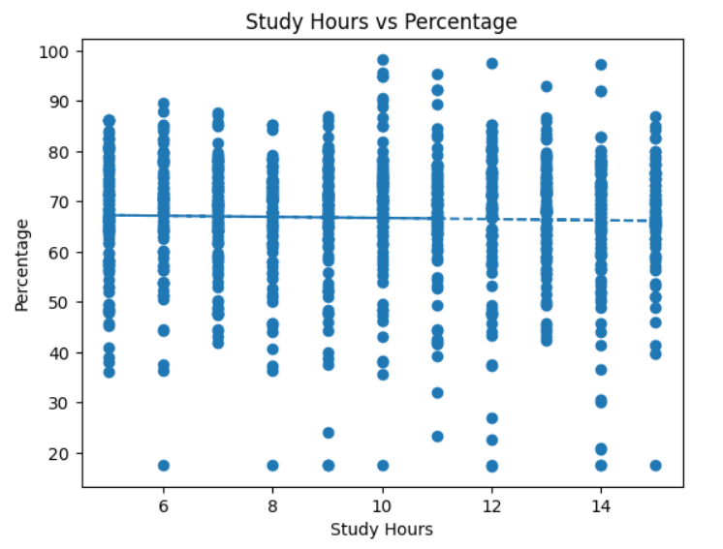
8. Supervised Learning – Regression Model
Supervised Learning – Regression Analysis is a machine learning technique where a model learns from labeled data to predict continuous numerical values. The algorithm is trained using input features (independent variables) and known outputs (dependent variables) to learn the relationship between them.

Slide 12
9. Overfitting and Underfitting Analysis
In machine learning models (like the regression model in your code), we evaluate whether the model learns the data properly or not. Two common problems are Overfitting and Underfitting.
Overfitting: Overfitting is when a model fits the training data too closely and fails to generalize to new data.
Underfitting: Underfitting is when a model cannot learn the patterns in the data because it is too simple.

Slide 13
10. Classification Task
A classification task is a type of supervised machine learning problem where the model predicts categorical or class labels instead of numerical values.
Classification is a supervised machine learning task used to predict categorical outcomes or class labels based on input data. In classification, the model is trained using labeled data so it can learn patterns and assign new data to the correct category. The output of a classification model is a discrete value, such as pass or fail, yes or no, or different classes of categories. In data analysis and machine learning projects, classification helps in grouping data into predefined classes and making predictions based on learned patterns from the dataset.

Slide 14
11. Model Evaluation
Model Evaluation is the process of measuring how well a trained machine learning model performs on unseen test data using evaluation metrics.
Model evaluation is the process of assessing the performance and accuracy of a machine learning model after it has been trained. It helps determine how well the model predicts or fits the data. In data analysis and machine learning projects, model evaluation is done using different performance metrics such as Mean Squared Error (MSE), Mean Absolute Error (MAE), and R² Score. These metrics help measure the difference between the actual values and the predicted values. Proper model evaluation ensures that the model is reliable and can make accurate predictions on new or unseen data.

Slide 15
12. Data Visualization
Data visualization is the process of representing data in graphical or visual forms such as charts, graphs, and plots to make the information easier to understand and interpret. It helps in identifying patterns, trends, and relationships within the dataset. In data analysis and EDA, data visualization is an important step because it allows analysts to quickly explore the data and gain insights. Common visualization techniques include bar charts, histograms, scatter plots, and box plots, which help in better understanding the structure and distribution of the data.
Histogram [Univariate Analysis]:
Scatter Plot [Bivariate Analysis]:
Heatmap [Multivariate Analysis]:
Negative Skewed Distribution [Skewness]:

Slide 16
Project Conclusion
This project analyzed students’ academic data using Exploratory Data Analysis (EDA) in Python. Various techniques such as univariate, bivariate, and multivariate analysis were used to understand the patterns and relationships in the dataset.
The histogram analysis showed the distribution of total marks and percentages, helping to understand how students’ scores are spread. The scatter plot revealed the relationship between study hours and total marks, indicating that students who study more tend to achieve higher marks. The heatmap correlation analysis showed a positive relationship between subjects like math, science, and english with total marks and percentage, meaning performance in these subjects contributes significantly to overall results.

Slide 17
Thank You

