Slide 1
CSS
Cascading Style Sheet

Slide 2
Power of CSS
CSS Zen Garden
The Beauty of CSS Design
The HTML remains the same, the only thing that has changed is the external CSS file.
More than 200 designs available

Slide 3
Tools
Visual Studio Code
Extensions
Live Server
Prettier - Code formatter
Indent-rainbow

Slide 4
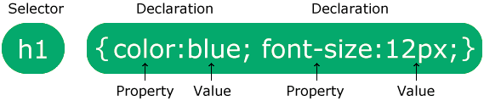
Syntax
Selector: What are you selecting? In which element do you want to apply CSS?
Property: What are you trying to change?
Value: Properties have specific values that are applicable

Slide 5
Connection with HTML
CSS can be added to HTML documents in 3 ways:
Inline - by using the style attribute inside HTML elements
Internal - by using a <style> element in the <head> section
External - by using a <link> element to link to an external CSS file
Inline CSS has higher priority than External and Internal CSS
Internal CSS has higher priority than External CSS

Slide 6
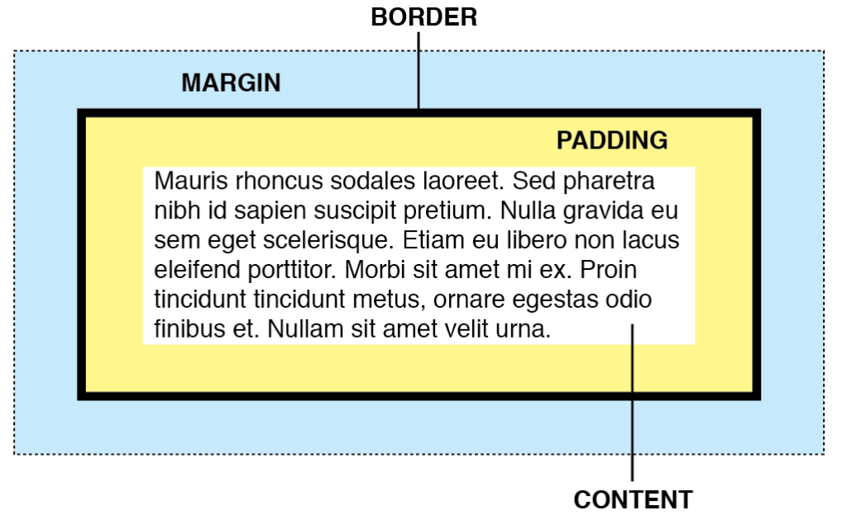
Box Model
Four Components:
Content
Padding
Border
Margin

Slide 7
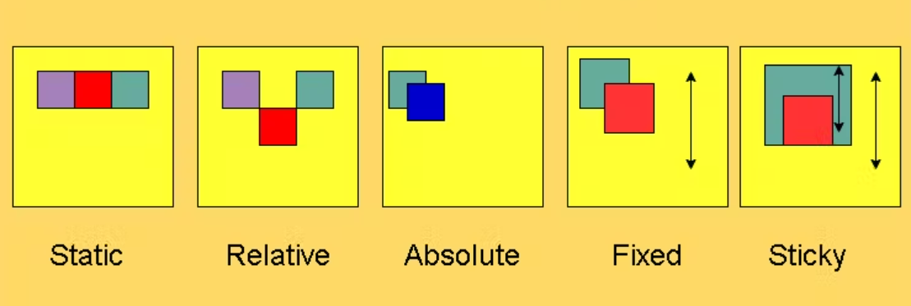
Position Property

Slide 8
Display Property
display: inline
Displays an element as an inline element (like <span>). Any height and width properties will have no effect
display: block
Displays an element as a block element (like <p>). It starts on a new line, and takes up the whole width
display: inline-block
Displays an element as an inline-level block container. The element itself is formatted as an inline element, but you can apply height and width values
display: none
The element is completely removed

