Slide 1

CSS
Cascading Style Sheet

Slide 2
Power of CSS
CSS Zen Garden
The Beauty of CSS Design
The HTML remains the same, the only thing that has changed is the external CSS file.
More than 200 designs available

Slide 3

Tools
Visual Studio Code
Extensions
Live Server
Prettier - Code formatter
Indent-rainbow

Slide 4
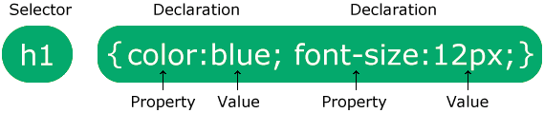
Syntax
Selector: What are you selecting? In which element do you want to apply CSS?
Property: What are you trying to change?
Value: Properties have specific values that are applicable

Slide 5
Connection with HTML
CSS can be added to HTML documents in 3 ways:
Inline - by using the style attribute inside HTML elements
Internal - by using a <style> element in the <head> section
External - by using a <link> element to link to an external CSS file
Inline CSS has higher priority than External and Internal CSS
Internal CSS has higher priority than External CSS

Slide 6
CSS Basic Selectors
Element Selector
Syntax: tagname { … }
Id Selector
Syntax: #id { ... }
Class Selector
Syntax: .classname { … }
Universal Selector
Syntax: * { … }

Slide 7
CSS Colors
Ways to declare color property
color: color name
color: rgb(256,256,256)
color: #RRGGBB or #RGB
For black
#000 or rgb(0, 0, 0)
For white
#fff or rgb(256, 256, 256)
There is no difference between #RRGGBB and #RGB.
#RGB is a shorthand property of #RRGGBB.

Slide 8
CSS Width & Height
width: 30%;
width: auto;
width: 50px;
height: 30%;
height: auto;
height: 50px;
% (Percentage)
Defines the height/width in percent of the containing block
auto
This is default. The browser calculates the height and width
length
Defines the height/width in px

Slide 9
CSS Fonts
Property-1: font-family
A font family name and a generic family name
font-family: "Roboto", sans-serif;
A generic family name only
font-family: sans-serif;
Google Fonts
Property-2: font-style
normal
italic
oblique

Slide 10
CSS Fonts
Property-3: font-weight
normal
bold
lighter
bolder
100 to 900 (number)
Property-4: font-size
Property-5: line-height
set the distance between lines of text
normal
number
length (px)
% (Percentage)

Slide 11
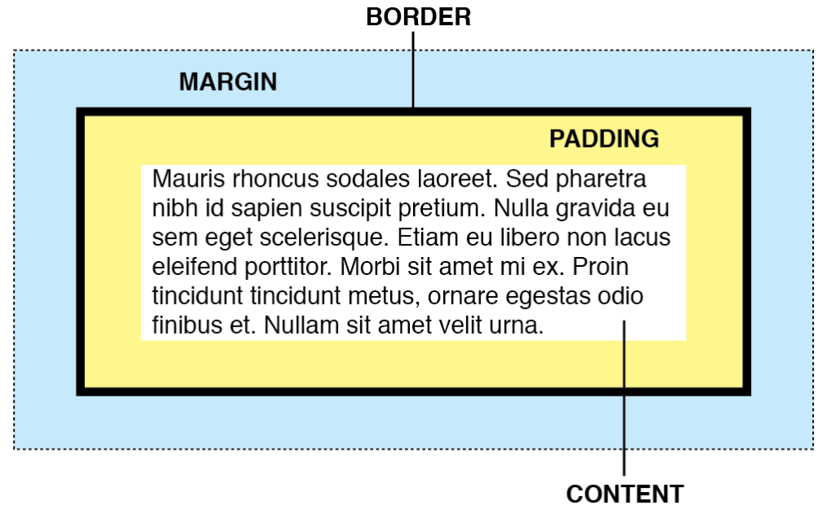
Box Model
Four Components:
Content
Padding
Border
Margin

Slide 12
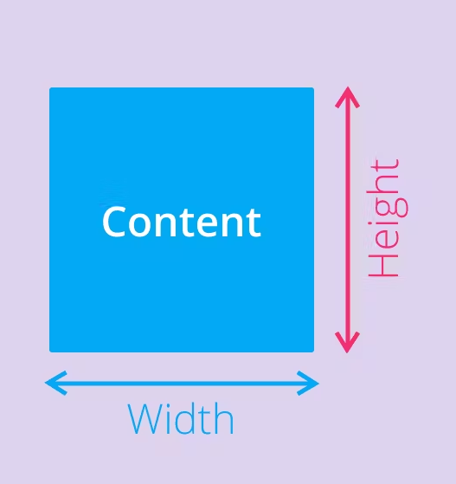
https://www.youtube.com/watch?v=MzTOXgrwVwg

Slide 13
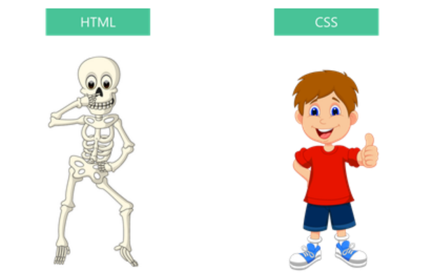
Why should I learn CSS?
Think of HTML (HyperText Markup Language) as the skeleton of the web. It is used for displaying the web.
On the other hand, CSS is like our clothes. We put on fashionable clothes to look better. Similarly, the web is quite stylish as well. It uses CSS for styling purpose.

Slide 14
Height/Width
auto - This is default. The browser will calculate and select a height/width for the specified element.
length - Defines the height/width in px.
% - Defines the height/width in percent of the containing block
initial - Sets the height/width to its default value
inherit - The height/width will be inherited from its parent value

Slide 15
Background Property
background-color:
background-position: x y;
background-position-x:
background-position-y:
background-image: url(‘demo.jpg’);
background-size:
auto
cover
contain
length
percentage
background-repeat:
repeat
repeat-x
repeat-y
no-repeat

Slide 16
Opacity
The CSS opacity property is used to specify the transparency of an element.
The opacity property can take a value from 0.0 - 1.0.
The lower the value, the more transparent
Default value of opacity is 1

Slide 17
Display Property
display: inline
Displays an element as an inline element (like <span>). Any height and width properties will have no effect
display: block
Displays an element as a block element (like <p>). It starts on a new line, and takes up the whole width
display: inline-block
Displays an element as an inline-level block container. The element itself is formatted as an inline element, but you can apply height and width values
display: none
The element is completely removed

Slide 18
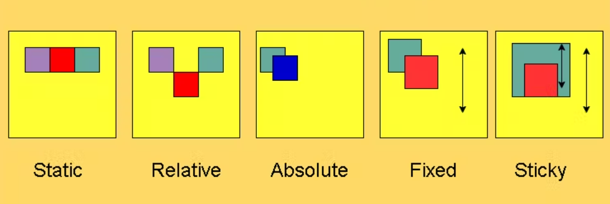
Position Property

Slide 19
Benefits
Better User Experience
Quicker Development Time
Easy Formatting Changes
Limitation
CSS can have compatibility issues

Slide 20
Questions
A stylesheet is a collection of CSS rules
True or False
What are the different types of Selectors in CSS?
A CSS rule can be applied to only one selector at a time.
True or False
How many ways to include CSS in the webpage?
Which CSS properties are a part of Box model?

