Slide 1
JS and ES6

Slide 2
This
This when declared or defined.
This depend on: How-When-Where not declared or defined.
Example:
Conclusion: until an object invokes the function where this is defined.

Slide 3
Apply – Call – Bind
Apply – Call – Bind specify what object which function execution on.
Example:
Apply vs Call vs Bind.

Slide 4
Closure
A Counter Dilemma
Closure can solve this
Use closure to provide object private properties.

Slide 5
Callback
Function as a parameter.
Should we use callback?
What should notice about callback?

Slide 6
Promise
What Promise
Promise chain - Promise.all - Promise.race
Promise chain vs Promise.all

Slide 7
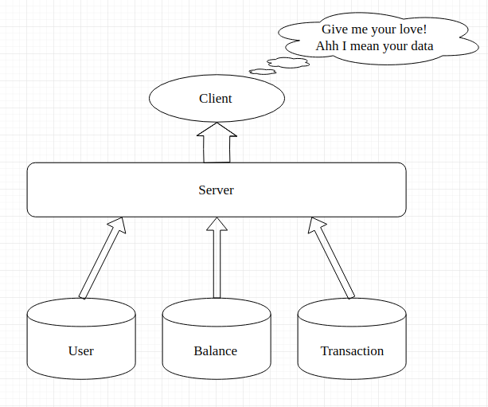
Promise

Slide 8
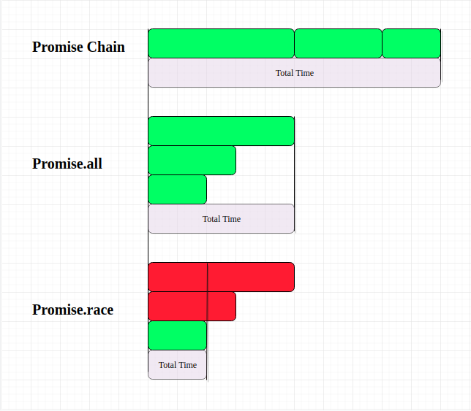
Promise

Slide 9
Async-Await
Extensions of promises
Async/await vs callback
About await keyword

Slide 10
Question
I don't understand Promise in ES6 very much
What is diffence between using bind() and arrow function?
Server .emit – Client .on không được.

Slide 11

Any Question

Slide 12

Thank you guys!

