Slide 1
Augur: Mining Human Behaviors from Fiction to Power Interactive Systems
2019.09.03
임도연

Slide 2
Contents
Context Vector Space
Task Overview
Data Mining for (object/activity/affordance) detection
Vector Space Model for Retrieval
API & Application
Evaluation

Slide 3
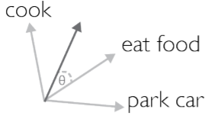
Context Vector Space
Represent context as vector in vector space
Wake up <> Want Breakfast
←---→ upload picture

Slide 4
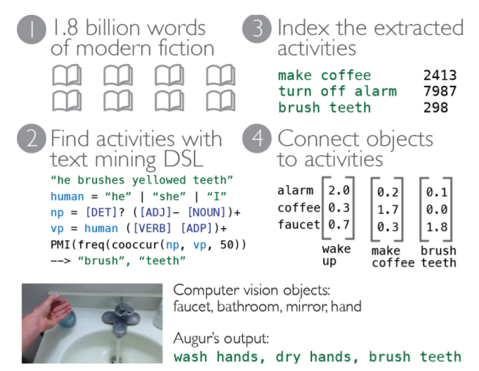
Task Overview
AUGUR
Activity detection
maps a set of objects onto an activity
Object affordance
return a list of actions that can be taken on or by an object
Activity prediction
→ predict which activities may occur next

Slide 5
Model
AUGUR: a knowledge base that uses fiction to connect human activities to objects and their behaviors
Human Activities
Object Affordances
Connections between activities

Slide 6
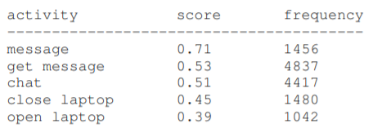
Model: Components
Human Activities
verb phrases that have human subjects
e.g. he opens the fridge, we turn off the lights.
Facebook

Slide 7
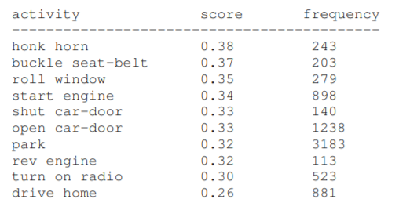
Model: Components
Object Affordances
actions that are strongly associated with specific objects
Car

Slide 8
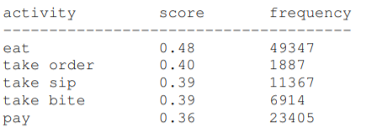
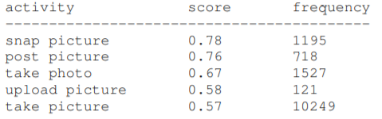
Model: Components
Connections between activities
information about the connections between human activities
orders coffee
take selfie

Slide 9


Data Mining for (object/activity/affordance) detection
Mining activity patterns from text
Activity-Object statistics
Object-affordance statistics

Slide 10

Data Mining for (object/activity/affordance) detection
Mining activity patterns from text
Activity-Activity statistics

Slide 11
Vector Space Model for Retrieval
Object-Activity: each vector is a human activity and its dimensions are smoothed MI between it and every object.
Object-Affordance: each vector is an affordance and its dimensions are smoothed MI between it and every object.
Activity-Prediction: each vector is a activity and its dimensions are smoothed MI between it and every other activity.

Slide 12
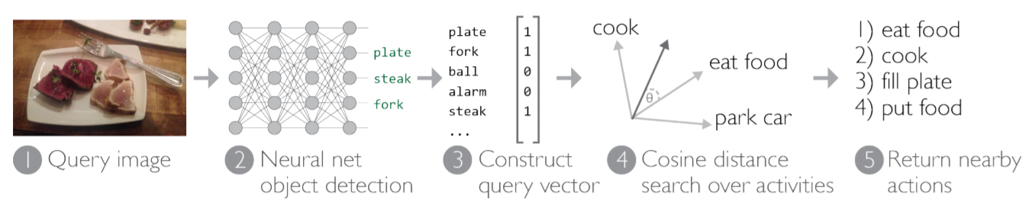
Vector Space Model for Retrieval

Slide 13
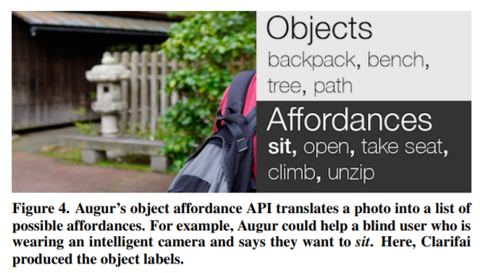
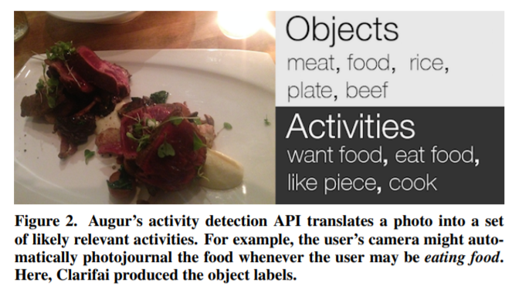
API & Application

Slide 14


API & Application
Identifying Activities
What are you currently doing?
Expanding Activites with Object Affordances
How can you interact with your environment?

Slide 15
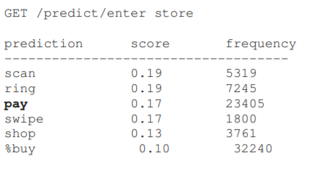
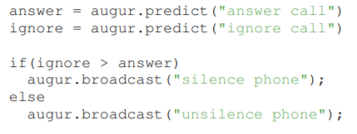

API & Application
Predicting Future Activities
What will you do next?

Slide 16
Evaluation
Bias of Fiction
compare Augur’s activity predictions to human activity predictions
understand what forms of bias fiction may have introduced
e.g) kissing in the rain, drawing swords

Slide 17
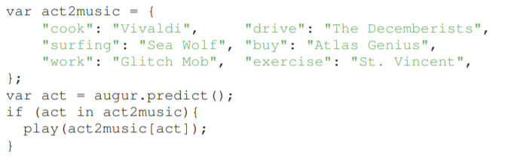
Evaluation
Field test of A Soundtrack for Life
common activities over a two-hour window of daily life
Using <A Soundtrack for Life> application

Slide 18
Evaluation
A stress test over #dailylife
stress test Augur over a wider range of activities
evaluate its activity predictions on a dataset of 50 images sampled from the Instagram hashtag #dailylife.

Slide 19
Conclusion
From fictions, it is possible to build a model which predicts human activities and object affordances.
This technology can be used as pro-active suggestions

