Slide 1
CANE: Context-Aware Network Embedding for Relation Modeling
Cunchao Tu , Han Liu, Zhiyuan Liu, Maosong Sun
ACL 2017
Doyeon Lim
2018.05.01

Slide 2
Contents
Application & Domains of Embedding
Limitation of existing Network Embedding
Related Work
CANE approach
Problem Definition
Model Description
Result
Conclusion

Slide 3
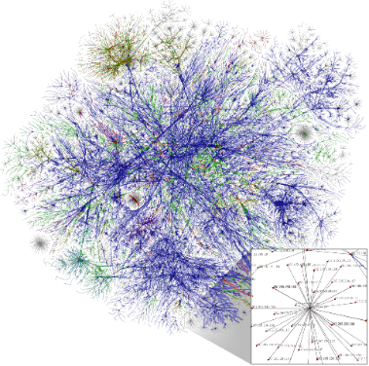
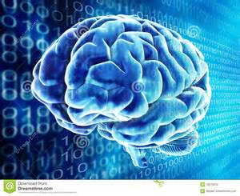
Application of Embedding
+
Deep Learning
Sparse, high-dimension
Dense, low-dimension
Node classification
Social network: predicting interests of users
Protein-protein interaction network: predicting functional labels of proteins
Link prediction
Genomics: novel interactions between genes
Social network: identify real-world friends
Notes:
If sparse and high-dimension information converted to dense and low-dimension form, we can use that information more easily and efficiently.
Also computational cost will be much cheaper

Slide 4
Domains of Embedding
Natural Language / Text
degree
document
text
doc_1
null
Text representation, e.g., word and document representation, …
information
doc_2
null
Deep learning has been attracting increasing
attention …
node
network
word
network
doc_3
text
null
A future direction of deep learning is to integrate
unlabeled data …
edge
word
doc_4
…
embedding
classification
…
…
label
The Skip-gram model is quite effective and efficient …
classification
…
label
Information networks encode the relationships
between the data objects …
Word co-occurrence network
Word-document network
label
document
Unsupervised text (e.g., words and documents) embedding
Free text
text
information
label_1
network
label_2
word
label_3
…
…
classification
…
Word-label network
Predictive text (e.g., words and documents) embedding

Slide 5
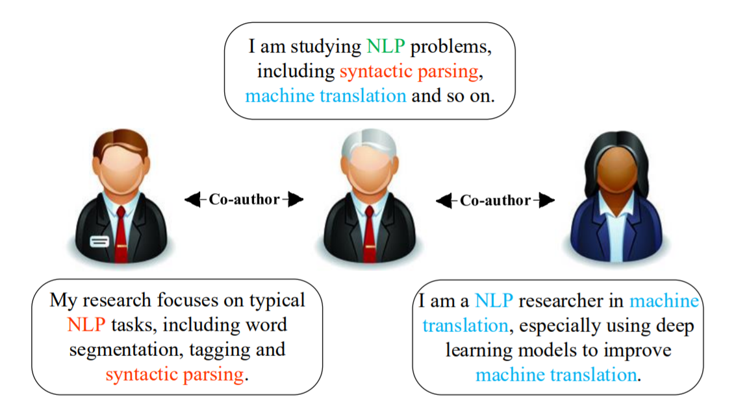
Limitation of existing Network Embedding
learn a fixed context-free embedding for each vertex and neglect the diverse roles when interacting with other vertices.
only encode the structural information into vertex embeddings
Notes:
Red – left user
Blue – right user
Green – both
Existing – only arrange one single embedding vector to each vertex

Slide 6
Previous Work
DeepWalk (Perozzi et al. 2014)
random walks over networks
Use SkipGram (Mikolov et al., 2013a), to learn network embeddings
LINE (Tang et al., 2015)
d/2 dimensions by BFS-style simulations, learns the next d/2 dimensions by sampling nodes strictly at a 2-hop distance from the source nodes
Node2vec (Grover and Leskovec, 2016)
modifies the random walk strategy in DeepWalk into biased random walks
Notes:
Classical: first construct the affinity graph using the feature vectors of the data points, e.g., the K-nearest neighbor graph of data, and then embed the affinity graph Take long time to compute

Slide 7
Previous Work
text-associated DeepWalk (TADW)
Improve matrix factorization based deepwask
max-margin DeepWalk (MMDW)
Learn discriminative network representations by utilizing labeling information of vertices
Group-enhanced network embedding (GENE)
context-enhanced network embedding (CENE)
Notes:
Even though they considered text imforamtion, they didn’t consider the interaction between nodes

Slide 8
CANE Overall
context-aware embeddings are critical for network analysis
complicated interactions between vertices such as link prediction
performance of this framework is verified by link prediction, vertex classification and case studies

Slide 9
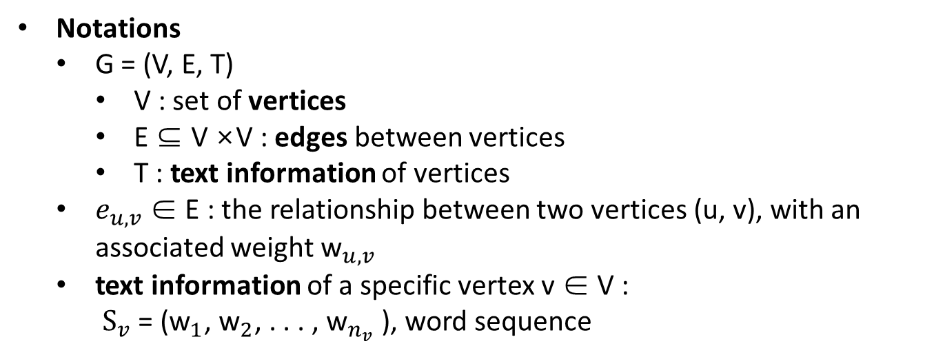
CANE approach
Problem Formulation
Notations
G = (V, E, T)
V : set of vertices
E ⊆ V ×V : edges between vertices
T : text information of vertices
$e_{u,v}$ ∈ E : the relationship between two vertices (u, v), with an associated weight ${\text{w}}_{u,v}$
text information of a specific vertex v ∈ V : ${\text{S}}_{v}$ = (${\text{w}}_{1}$, ${\text{w}}_{2}$, . . . , ${\text{w}}_{n_{v}}$ ), word sequence

Slide 10
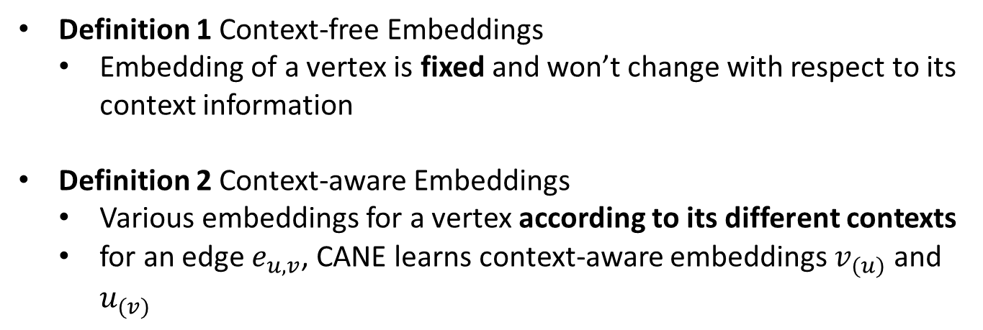
CANE approach
Problem Definition
Definition 1 Context-free Embeddings
Embedding of a vertex is fixed and won’t change with respect to its context information
Definition 2 Context-aware Embeddings
Various embeddings for a vertex according to its different contexts
for an edge $e_{u,v}$, CANE learns context-aware embeddings $v_{(u)}$ and $u_{(v)}$

Slide 11
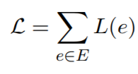

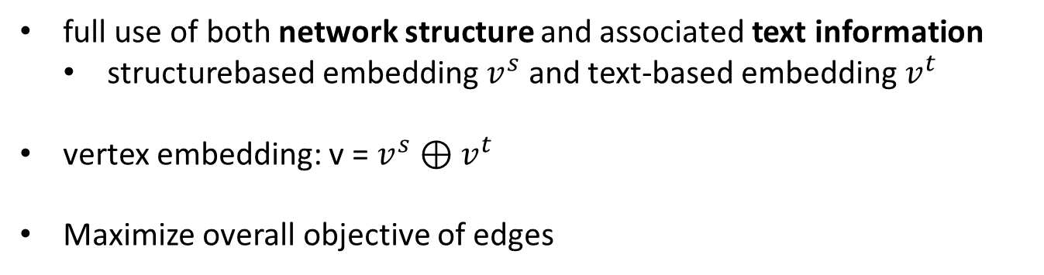
CANE approach
Overall Framework
full use of both network structure and associated text information
structurebased embedding $v^{s}$ and text-based embedding $v^{t}$
vertex embedding: v = $v^{s}$ ⊕ $v^{t}$
Maximize overall objective of edges
structure-based objective
text-based objective

Slide 12

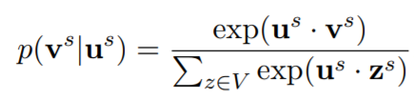
CANE approach
Structure-based Objective
conditional probability of v generated by u

Slide 13

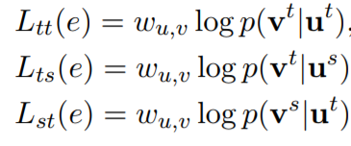
CANE approach
Text-based Objective
Notes:
알파 베타 감마 grid search
Meaning?

Slide 14
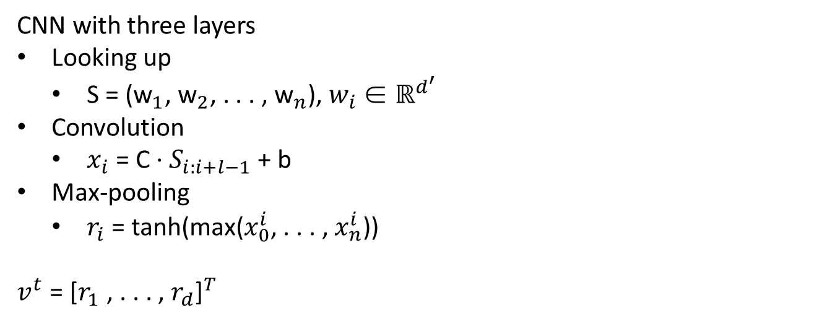
CANE approach
Context-Free Text Embedding
CNN with three layers
Looking up
S = (${\text{w}}_{1}$, ${\text{w}}_{2}$, . . . , ${\text{w}}_{n}$), $w_{i}$ ∈ $ℝ^{d^{′}}$
Convolution
$x_{i}$ = C · $S_{i:i+l−1}$+ b
Max-pooling
$r_{i}$ = tanh(max($x_{0}^{i}$, . . . , $x_{n}^{i}$))
$v^{t}$= ${\text{[}r_{1} \text{, . . . , }r_{d}\text{]}}^{T}$
Notes:
D개의 filter 맞나?

Slide 15
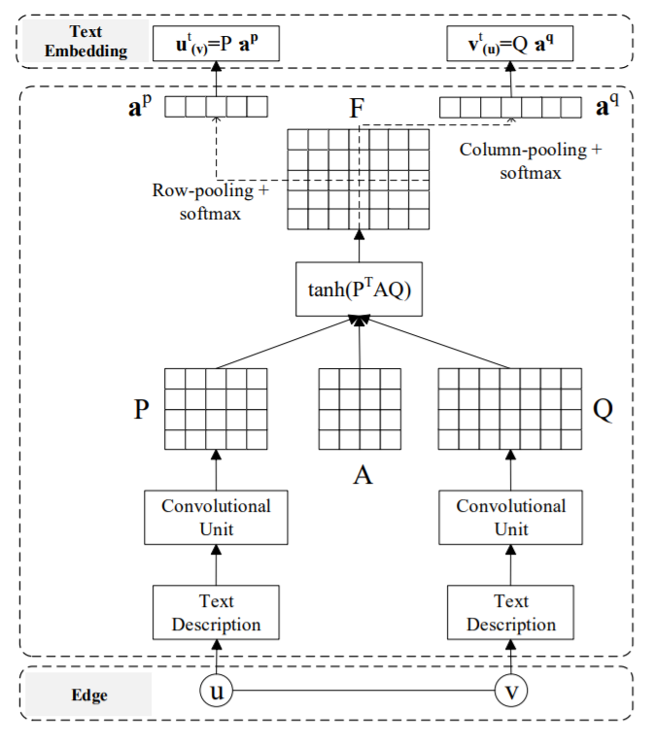
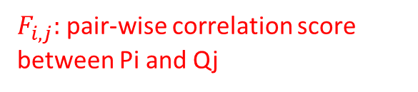
CANE approach
Context-Aware Text Embedding
specific vertex plays different roles when interacting with others vertices
Length of text information of u
Correlation matrix
$F_{i,j}:$pair-wise correlation score between Pi and Qj
mutual attention matrix

Slide 16
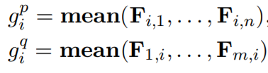
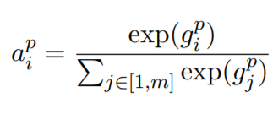
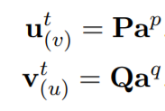
CANE approach
Context-Aware Text Embedding
Correlation matrix
Notes:
Mean pooling perform better

Slide 17


CANE approach
context-aware embedding

Slide 18
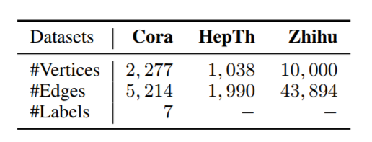
Experiments - Dataset
Cora
Cora is a typical paper citation network (2, 277 machine learning papers, 7 categories)
HepTh2 (High Energy Physics Theory)
Citation network from arXiv (1, 038 papers)
Zhihu4
largest online Q&A website in China (randomly crawl 10, 000 active users)
Notes:
abstract information
They have friendship between users, concerned topics

Slide 19
Result – Compared Algorithms
Structure-only
MMB conventional graphical model of relational data.
DeepWalk performs random walks over networks and employ Skip-Gram model
LINE vertex embeddings in large-scale networks using first-order and second-order proximities
Node2vec biased random walk algorithm based on DeepWalk to explore neighborhood architecture more efficiently
Notes:
Doesn’t use classical algorithms → cannot handle this scale
Graph factorization
Graph factorization Weight로 node간 linking 을 표현한 affinity graph를 matrix factorization해서 low dimensional vector를 만들 수 있음

Slide 20
Result – Compared Algorithms
Structure and Text
Naive Combination simply concatenate the best-performed structure-based embeddings with CNN based embeddings to represent the vertices
TADW matrix factorization to incorporate text features of vertices into network embeddings
CENE both structure and textural information by regarding text content as a special kind of vertices, and optimizes the probabilities of heterogeneous links
Notes:
Doesn’t use classical algorithms → cannot handle this scale
Graph factorization

Slide 21
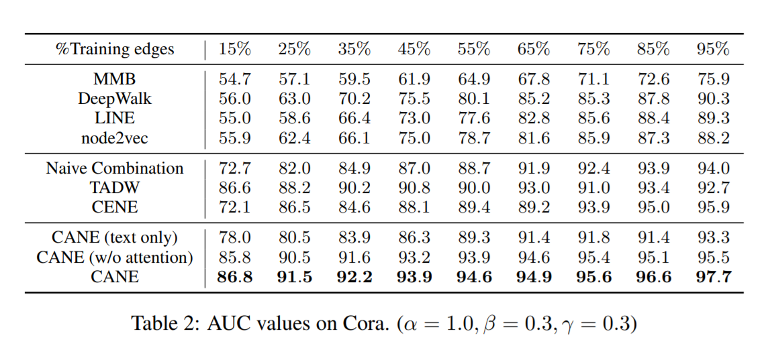
Result-Link prediction
Notes:
Vertex classificatio으로 L2 Regularized logistic regression 사용
200dimension으로 통일

Slide 22
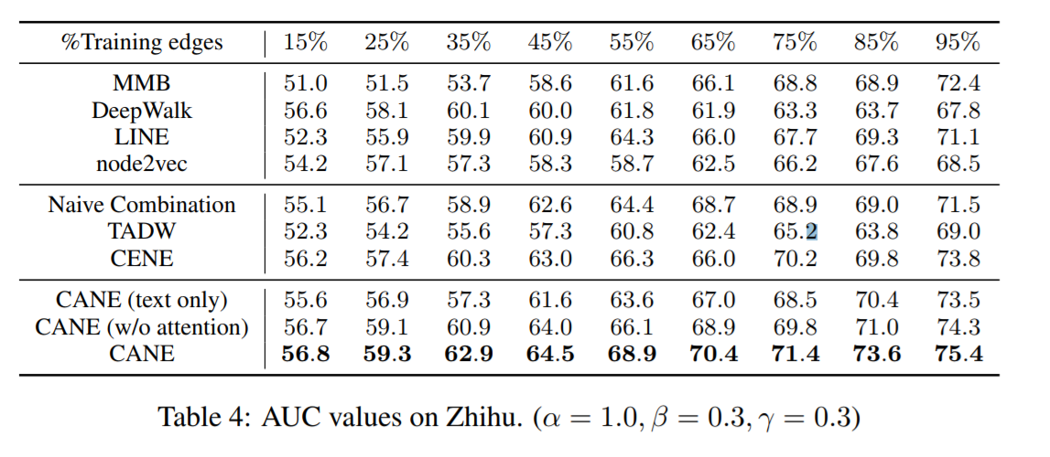
Result-Link prediction

Slide 23
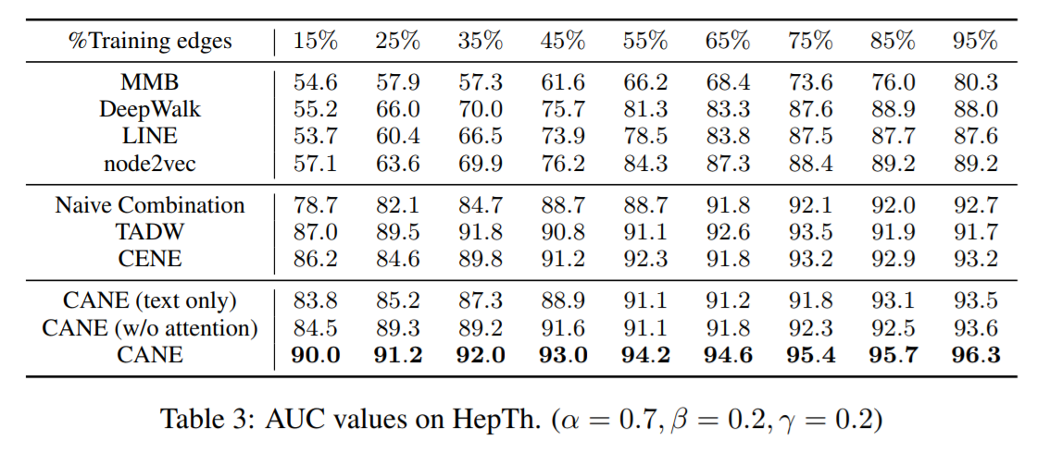
Result-Link prediction
Notes:
CENE은 small ratio에 working 잘 안함 → parameter가 훨씬 많아서
TADW는 deepwalk기반이라 sparse matrix에 강함 하지만 large training data에서는 simplicity때문에 좋은 성능을 내지 못함
all the above observations demonstrate that CANE can learn high-quality context-aware embeddings, which are conducive to estimating the relationship between vertices precisely

Slide 24
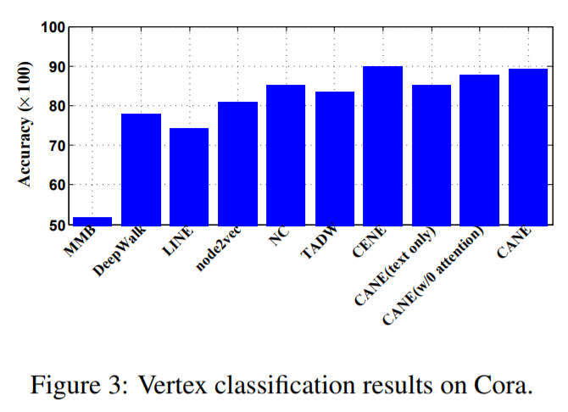
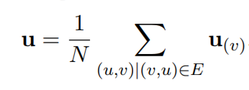
Result - Vertex Classification
Notes:
learnt context-aware embeddings can transform into high-quality context-free embeddings through simple average operation

Slide 25
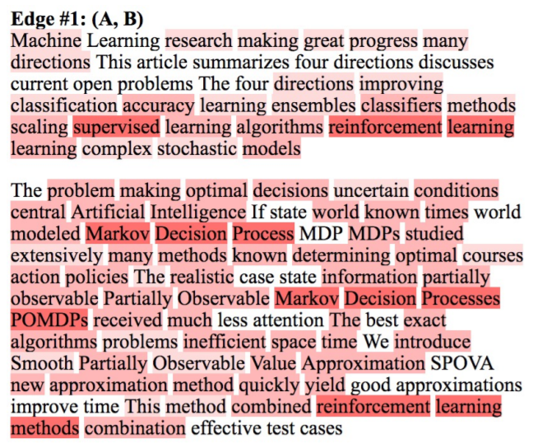
Result – Case study
Notes:
all these key elements in A can find corresponding words in B and C. It’s intuitive that these key elements give an exact explanation of the citation relations

Slide 26
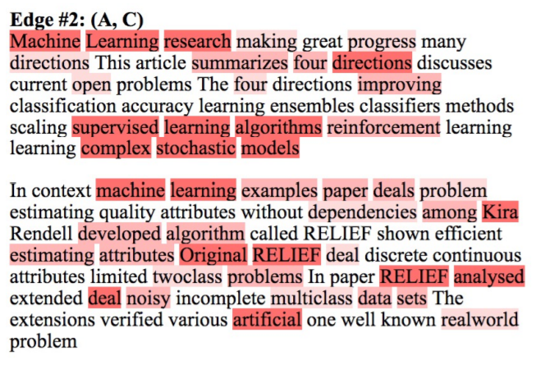
Result – Case study
Notes:
all these key elements in A can find corresponding words in B and C. It’s intuitive that these key elements give an exact explanation of the citation relations

Slide 27
Conclusion
learn various context-aware embeddings for a vertex according to the neighbors it interacts with
proposed mutual attention mechanism
Future work
implement CANE on a wider variety of information networks with multi-modal data
CANE encodes latent relations between vertices → how to incorporate and predict these explicit relations
Notes:
친구, 가족 등등

