Slide 1
LINE: Large-scale Information Network Embedding
Jian Tang*, Meng Qu, Mingzhe Wang, Qiaozhu Mei, Ming Zhang
*Microsoft Research Asia
*Some slides are from author’s original slide

Slide 2
Contents
Introduction
What is Large-scale information Network
Why Network embedding useful
Kinds of information network
Relate Works
Problem Definition
Information network, first-order and second-order proximity
LINE Model description
Model for each proximity
Optimization Technique
Experiment and Result
Discussion

Slide 3
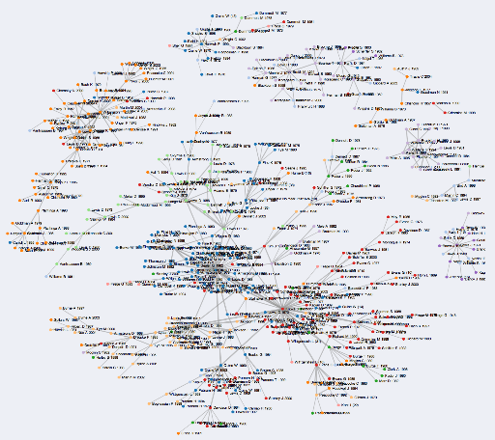
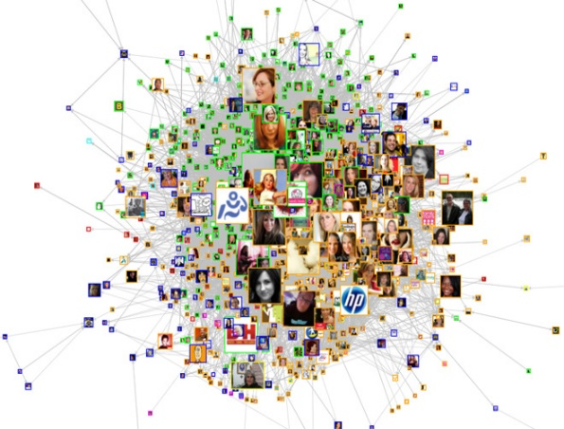
Large-scale information network
Real-world networks are very large
Facebook social network: ~ 1 billion
WWW: ~50 billion webpages
Information can be converted to Network
Even text can be seen as network
Very challenging in analyzing large-scale networks
Sparse and High-dimension
degree
document
node
network
word
text
edge
embedding
classification

Slide 4
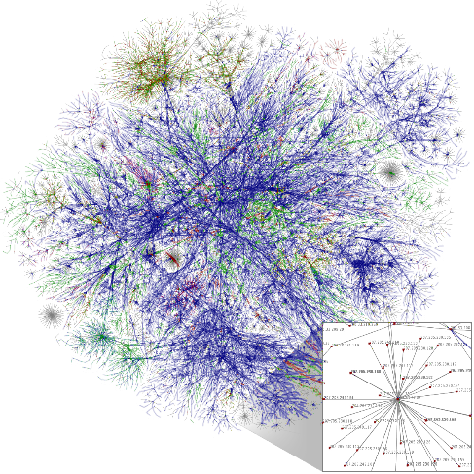
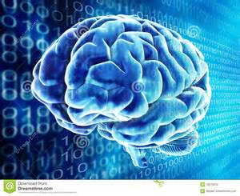
Why Network Embedding is useful?
+
Deep Learning
Sparse, high-dimension
Dense, low-dimension
If sparse and high-dimension information converted to dense and low-dimension form, we can use that information more easily and efficiently.
Also computational cost will be much cheaper

Slide 5
Kinds of information network - Text
degree
document
text
doc_1
null
Text representation, e.g., word and document representation, …
information
doc_2
Deep learning has been attracting increasing
attention …
node
network
word
null
text
network
doc_3
null
A future direction of deep learning is to integrate
unlabeled data …
edge
word
doc_4
classification
…
…
…
embedding
classification
…
label
The Skip-gram model is quite effective and efficient …
label
Information networks encode the relationships
between the data objects …
Word co-occurrence network
Word-document network
label
document
text
Free text
information
label_1
network
label_2
word
label_3
…
…
…
classification
Word-label network

Slide 6




Kinds of information network – Academic Network
Author, paper, venue embedding
Recommend related authors, papers, venues
Author, paper, venue classification
Author
Paper
Venue

Slide 7


Kinds of information network – Social Network
User embedding
Friend recommendation
User classification

Slide 8
Relate works
Classical graph embedding algorithms
MDS, IsoMap, LLE, Laplacian Eigenmap etc
Hard to scale up
Graph factorization (Ahmed et al. 2013)
Not specifically designed for network embedding
Usually for undirected graphs
DeepWalk (Perozzi et al. 2014)
Lack a clear objective function
Only designed for networks with binary edges

Slide 9
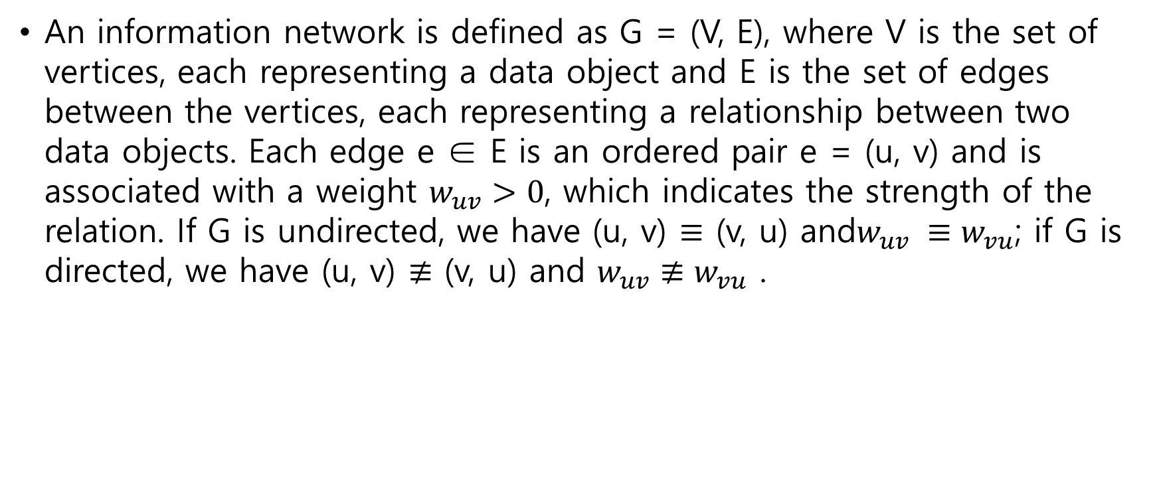
Problem Definition – Information Network
An information network is defined as G = (V, E), where V is the set of vertices, each representing a data object and E is the set of edges between the vertices, each representing a relationship between two data objects. Each edge e ∈ E is an ordered pair e = (u, v) and is associated with a weight $w_{uv}>0$, which indicates the strength of the relation. If G is undirected, we have (u, v) $≡$ (v, u) and$w_{uv} ≡w_{vu}$; if G is directed, we have (u, v) $≢$ (v, u) and $w_{uv}≢w_{vu}$ .

Slide 10
Problem Definition – First-order Proximity
The local pairwise proximity between the vertices
Determined by the observed links
However, many links between the vertices are missing
Not sufficient for preserving the entire network structure
1
8
2
5
7
9
3
6
10
4
Vertex 6 and 7 have a large
first-order proximity

Slide 11




Problem Definition Second-order Proximity
The proximity between the neighborhood structures of the vertices
Mathematically, the second-order proximity between each pair of vertices (u,v) is determined by:
1
8
2
5
7
9
3
6
10
4
$${\hat{p}}_{u}=(w_{u1},w_{u2}, …, w_{u\left|V\right|})$$
Vertex 5 and 6 have a large
second-order proximity
$${\hat{p}}_{v}=(w_{v1},w_{v2}, …, w_{v\left|V\right|})$$
$${\hat{p}}_{5}=(1,1, 1,1,0,0,0,0,0,0)$$
$${\hat{p}}_{6}=(1,1, 1,1,0,0,5,0,0,0)$$

Slide 12

Problem Definition – Network Embedding
Given a large network G = (V, E), the problem of Large-scale Information Network Embedding aims to represent each vertex v ∈ V into a low-dimensional space $R^{d}$ , i.e., learning a function$f_{G}:V→R^{d}$, where $d≪|V|$ In the space $R^{d}$, both the first-order proximity and the second-order proximity between the vertices are preserved.

Slide 13
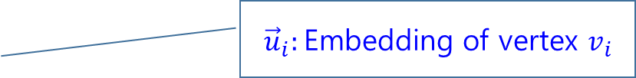

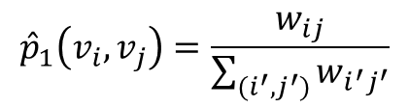

Model Description, First-order Proximity
It only works on undirected graph
Given an undirected edge $\left(v_{i},v_{j}\right)$, the joint probability of ${ v}_{i},v_{j}$
Objective : $O_{1}=d({\hat{p}}_{1}\left(⋅,⋅\right), p_{1}\left(⋅,⋅\right))∝−\sum_{\left(i,j\right)∈E}{w_{ij}\log{p_{1}(v_{i}, v_{j})}}$
$$p_{1}\left(v_{i},v_{j}\right)=\frac{1}{1+exp⁡(−{\vec{u}}_{i}^{T}⋅{\vec{u}}_{j})}$$
${\vec{u}}_{i}:$Embedding of vertex $v_{i}$
$${\hat{p}}_{1}\left(v_{i}, v_{j}\right)=\frac{w_{ij}}{\sum_{(i^{′},j^{′})}{w_{i^{′}j^{′}}}}$$
KL-divergence

Slide 14
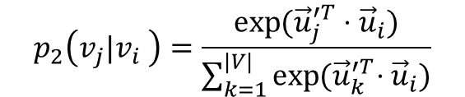
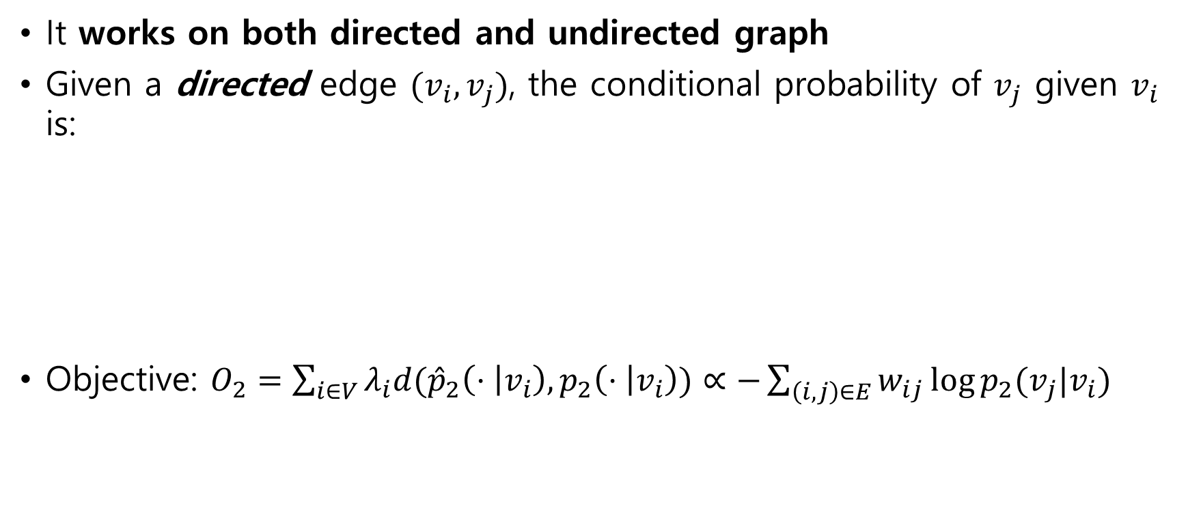
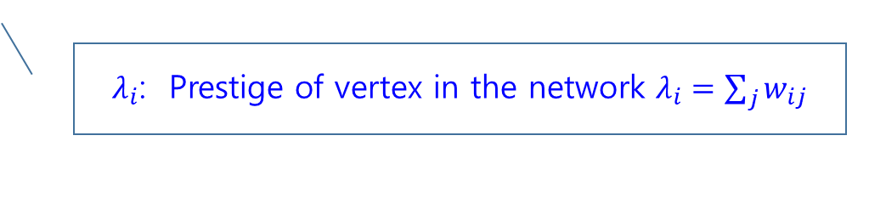
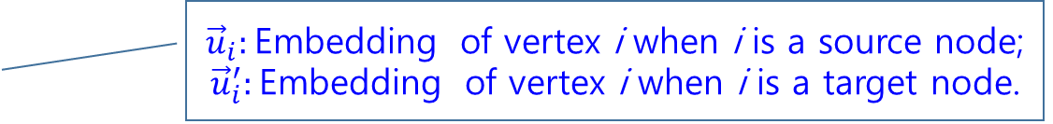

Model Description, Second-order Proximity
It works on both directed and undirected graph
Given a directed edge $(v_{i},v_{j})$, the conditional probability of $v_{j}$ given $v_{i}$ is:
Objective: $O_{2}=\sum_{i∈V}{λ_{i}d({{\hat{p}}_{2}\left(⋅ | v_{i}\right), p}_{2}\left(⋅ | v_{i}\right))}∝−\sum_{\left(i,j\right)∈E}{w_{ij}\log{p_{2}(v_{j}|v_{i})}}$
$$p_{2}\left(v_{j}|v_{i} \right)=\frac{\exp{({\vec{u}}_{j}^{′T}⋅{\vec{u}}_{i})}}{\sum_{k=1}^{|V|}{\exp{{(\vec{u}}_{k}^{′T}⋅{\vec{u}}_{i})}}}$$
${\vec{u}}_{i}:$Embedding of vertex i when i is a source node;
${\vec{u}}_{i}^{′}:$Embedding of vertex i when i is a target node.
$${\hat{p}}_{2}\left(v_{j}|v_{i} \right)=\frac{w_{ij}}{\sum_{k∈V}{w_{ik}}}$$
$λ_{i}$: Prestige of vertex in the network $λ_{i}=\sum_{j}{w_{ij}}$

Slide 15

Model Description – Both proximity
It’s a just two-step model
This model just concatenate the embeddings individually learned by the two proximity
A more principled way to combine the two proximity is to jointly train the objective function $O_{1}$ and $O_{2}$, they leave this for future works

Slide 16

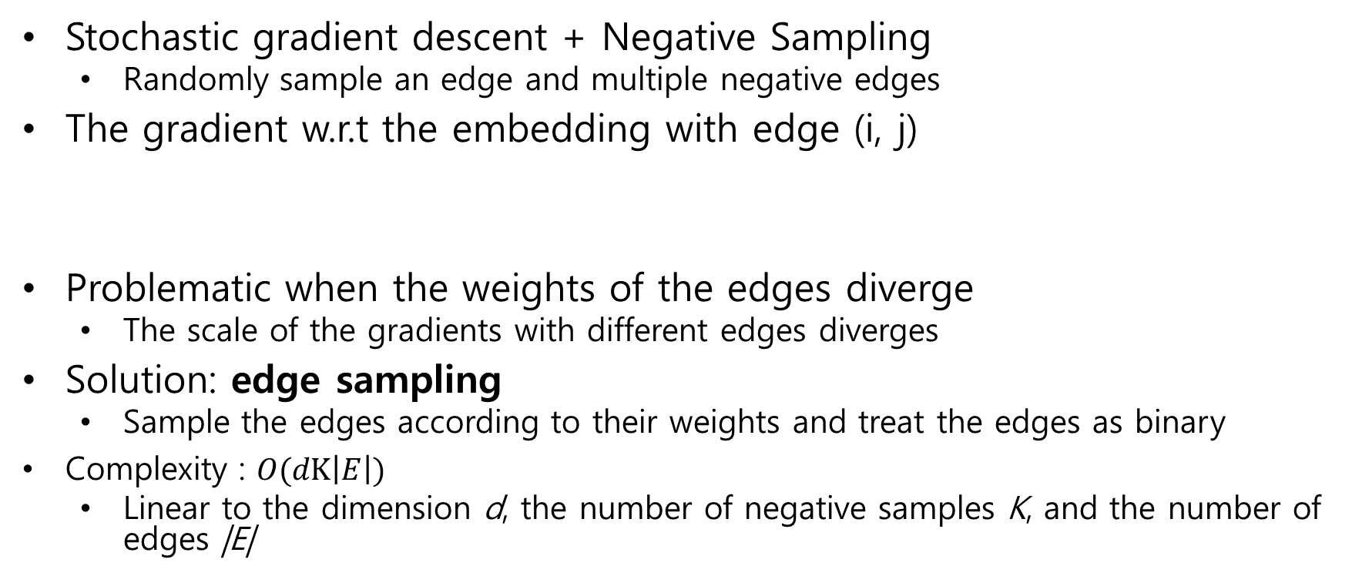
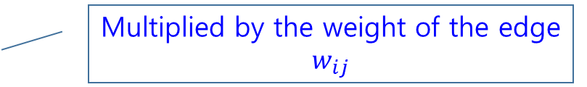
Model Optimization
Stochastic gradient descent + Negative Sampling
Randomly sample an edge and multiple negative edges
The gradient w.r.t the embedding with edge (i, j)
Problematic when the weights of the edges diverge
The scale of the gradients with different edges diverges
Solution: edge sampling
Sample the edges according to their weights and treat the edges as binary
Complexity : $O(dK\left|E\right|)$
Linear to the dimension d, the number of negative samples K, and the number of edges |E|
$$\frac{∂O_{2}}{∂{\vec{u}}_{i}}=w_{ij}⋅\frac{∂\log{p_{2}(v_{j}|v_{i})}}{∂{\vec{u}}_{i}}$$
Multiplied by the weight of the edge $w_{ij}$

Slide 17
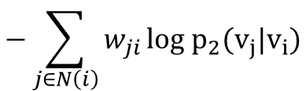
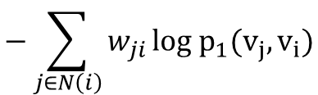
Model Discussion
Embedding Vertices of small degrees
Embedding New Vertices
Sparse information in the neighborhood
Solution: expand the neighbors by adding higher-order neighbors
e.g., neighbors of neighbors
breadth-first search
only consider the second-order neighbors
Fix existing embeddings, and optimize w.r.t the new ones
Objective
$$−\sum_{j∈N\left(i\right)}{w_{ji}}{log p}_{1}(v_{j},v_{i})$$
or
$$−\sum_{j∈N\left(i\right)}{w_{ji}}{log p}_{2}(v_{j}|v_{i})$$

Slide 18
Data-sets
(1) Language network.
It constructed a word co-occurrence network from the entire set of English Wikipedia pages. Words within every 5-word sliding window are considered to be co-occurring with each other. Words with frequency smaller than 5 are filtered out.
(2) Social networks.
It uses two social networks: Flickr and Youtube . The Flickr network is denser than the Youtube network (the same network as used in DeepWalk).
(3) Citation Networks.
Two types of citation networks are used: an author citation network and a paper citation network. We use the DBLP data set to construct the citation networks between authors and between papers. The author citation network records the number of papers written by one author and cited by another author.
They represent a variety of information networks: directed and undirected, binary and weighted. Each network contains at least half a million nodes and millions of edges, with the largest network containing around two million nodes and a billion edges.

Slide 19
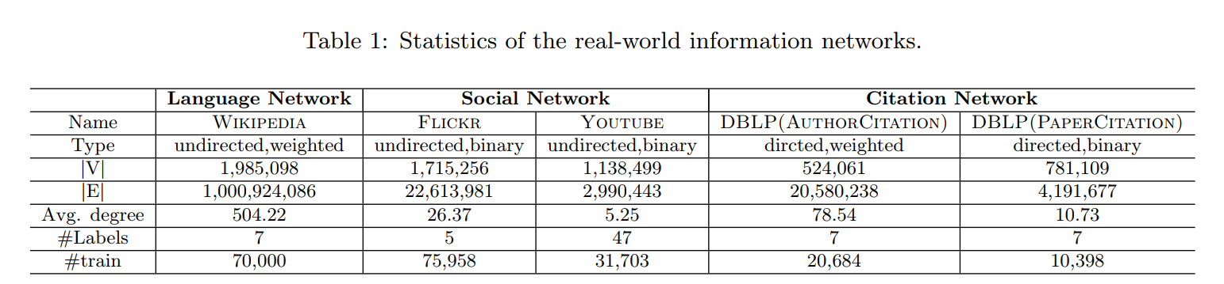
Data-sets

Slide 20
Baseline models
Graph factorization (GF)
Matrix Factorization graph version
DeepWalk
DeepWalk is an approach recently proposed for social network embedding, which is only applicable for networks with binary edges.
LINE-SGD(1st,2nd)
LINE model without edge-sampling, directly using stochastic gradient descent
LINE(1st,2nd)
LINE model with edge-sampling
LINE (unified)
LINE model with concatenated 1st proximity and 2nd proximity model

Slide 21
Parameter Setting
The mini-batch size of the stochastic gradient descent is set as 1 for all the methods
For fair comparisons, the dimensionality of the embeddings of the language network is set to 200, as used in word embedding
For other networks, the dimension is set as 128 by default
the number of negative samples K = 5 for LINE and LINE-SGD; the total number of samples T = 10 billion for LINE(1st) and LINE(2nd), T = 20 billion for GF; window size win = 10, walk length t = 40, walks per vertex γ = 40 for DeepWalk.

Slide 22
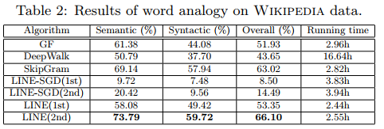
Result – Language Network
Word Analogy
Given a word pair (a, b) and a word c, the task aims to find a word d, such that the relation between c and d is similar to the relation between a and b, or denoted as: a : b → c :?
Effectiveness : LINE(2nd) > Skip-gram >LINE(1st)>GF>DeepWalk
Efficiency : LINE(1st)>LINE(2nd)> Skip-gram>GF>DeepWalk
Notes:
For instance, given a word pair (“China”,“Beijing”) and a word “France,” the right answer should be “Paris” because “Beijing” is the capital of “China” just as “Paris” is the capital of “France.”

Slide 23
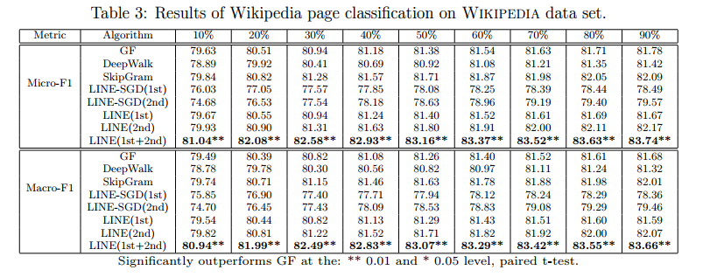
Result – Language Network
Effectiveness : LINE(Unified) > Skip-gram > GF>DeepWalk

Slide 24
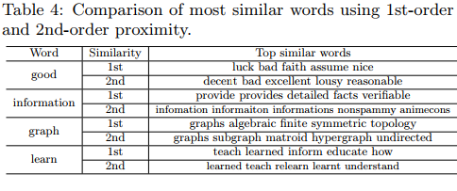
Result – Language Network
Difference Between 1st and 2nd order proximity can be seen through result of similar words

Slide 25
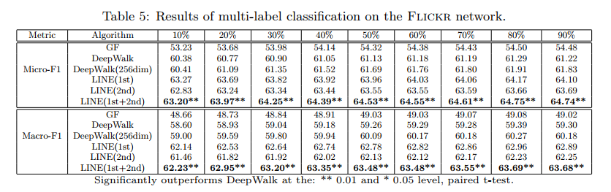
Result – Social network
Paper choose the most popular 5 communities as the categories of the vertices for multi-label classification.

Slide 26
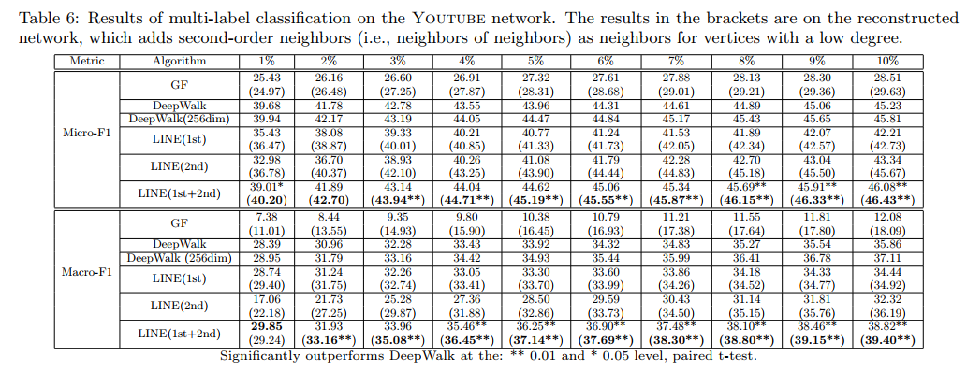
Result – Social network
Youtube network, which is extremely sparse and the average degree is as low as 5
Paper expand the neighborhood of the vertices whose degree are less than 1,000 by adding the neighbors of neighbors until the size of the extended neighborhood reaches 1,000 nodes

Slide 27
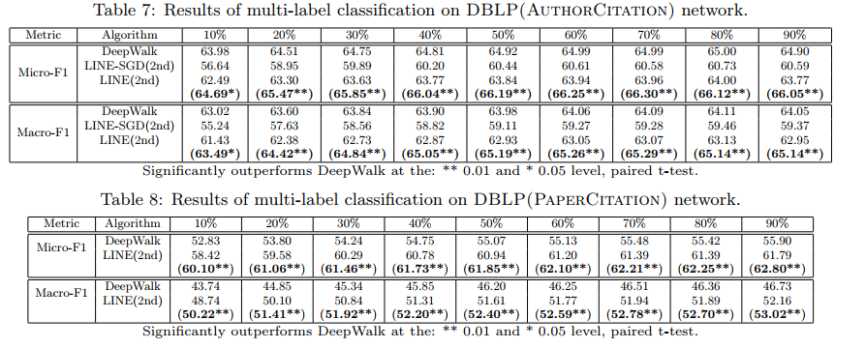
Result – Citation Networks
Reconstructed network through recursively adding neighbors of neighbors for vertices with small degrees (smaller than 500/200)

Slide 28
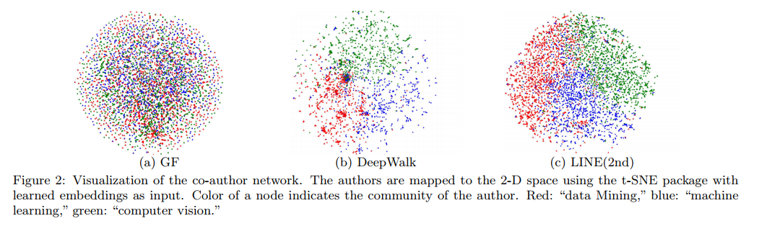
Result – Citation Networks
Some conferences from three different research fields: WWW, KDD from “data mining,” NIPS, ICML from “machine learning,” and CVPR, ICCV from “computer vision.”

Slide 29
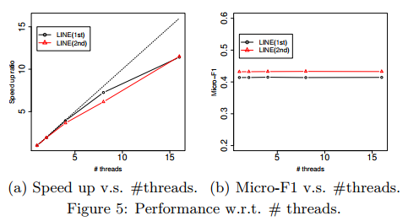
Result - Scalability
For adding threads to the model, Speed - # of thread relation shows meaningful linear relationship

Slide 30
Discussion – Contribution Point
This paper has a carefully designed objective function that preserves both the first-order and second-order proximities.
This paper propose an edge-sampling algorithm for optimizing the objective. The algorithm tackles the limitation of the classical stochastic gradient decent and improves the effectiveness and efficiency of the inference.
This paper conduct extensive experiments on real-world information networks. Experimental results prove the effectiveness and efficiency of the proposed LINE model.

