Slide 1
node2vec: Scalable Feature Learning for Networks
Aditya Grover and Jure Leskovec
KDD 2016
Doyeon Lim
2018.02.19
Notes:
Hello, today I will introduce node2vec: scalable feature learning for network paper. Last time I present Line paper which was also deal with the network embedding. This is following research after the LINE model.

Slide 2
Contents
Application of Graph representation
Previous Work
node2vec
Node2vec introduction
Model approach – Feature Learning Framework
Result
Conclusion

Slide 3
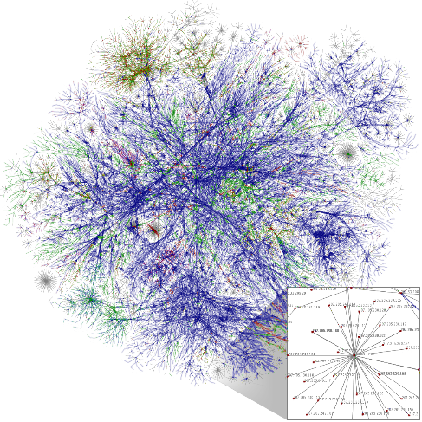
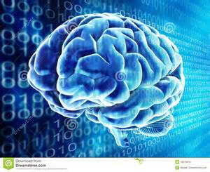
Application of Graph representation
+
Deep Learning
Sparse, high-dimension
Dense, low-dimension
Node classification
Social network: predicting interests of users
Protein-protein interaction network: predicting functional labels of proteins
Link prediction
Genomics: novel interactions between genes
Social network: identify real-world friends
Notes:
To remind about graph or network representation, this is an application of graph representation
Converting sparse and high-dimension information to dense and low-dimension form, we can use that information more easily and efficiently.
Also computational cost will be much cheaper

Slide 4
Application of Graph representation
Natural Language / Text
degree
document
text
doc_1
null
Text representation, e.g., word and document representation, …
information
doc_2
Deep learning has been attracting increasing
attention …
node
network
word
null
text
network
doc_3
null
A future direction of deep learning is to integrate
unlabeled data …
edge
word
doc_4
classification
…
…
…
embedding
classification
…
label
The Skip-gram model is quite effective and efficient …
label
Information networks encode the relationships
between the data objects …
Word co-occurrence network
Word-document network
label
document
Unsupervised text (e.g., words and documents) embedding
text
Free text
information
label_1
network
label_2
word
label_3
…
…
…
classification
Word-label network
Predictive text (e.g., words and documents) embedding

Slide 5
Previous works
Supervised machine learning algorithms requires a set of informative, discriminating, and independent features → feature vector representation for nodes and edges
hand-engineering domain-specific features - tedious effort, usually designed for specific task (can’t generalize)
Learn feature representations by solving an optimization problem - trade-off in balancing computational efficiency and predictive accuracy - fails to define and optimize a reasonable objective for scalable unsupervised feature learning.
Objective that seeks to preserve local neighborhoods - rely on a rigid notion of a network neighborhood → insensitive to connectivity patterns unique to networks.
Notes:
For example, PCA, MDS (Multi-Dimensional Scaling) which maximize the variance of the data representation was suggested but it is expensive for large real-world network. Also latent representations give poor performance on various prediction tasks
Deepwalk

Slide 6
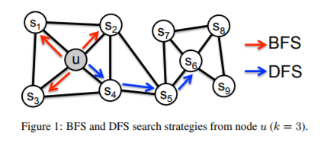
node2vec introduction
Efficient neighborhood preserving scalable algorithm for feature learning in networks.
Generalize prior work and can model the full spectrum of equivalences observed in network
Extend node2vec from nodes to pairs of nodes (edge) prediction task
Homophily: same network community
Structural equivalence: share similar roles
Notes:
Compared to previous rigid search procedures, they generalize prior work by tuning the parameters
By choosing an appropriate notion of a neighborhood, node2vec can learn representations that organize nodes based on their network roles and/or communities they belong to.
Intuitively, in same network, neighborhood which searched by DFS will share same nodes, and BFS contains the connectivity information of each nodes to show the structural equivalence

Slide 7
node2vec introduction
Evaluation - Multi-label classification task: Every node is assigned one or more class labels - Link prediction task: predict the existence of an edge given a pair of nodes
Data - social network, information network, networks from systems biology

Slide 8
node2vec approach
Inspired by Skip-gram
Skip-gram objective is based on the distributional hypothesis which states that words in similar contexts tend to have similar meanings.
Representing a network as a document
Sample the sequences of nodes from the network with sampling strategy
Notes:
Nodes in similar structure tend to have similar meaning, is the point

Slide 9

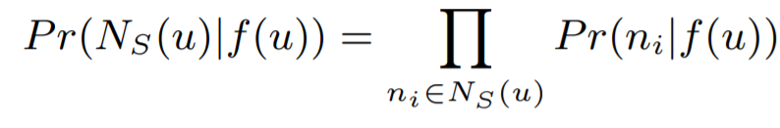
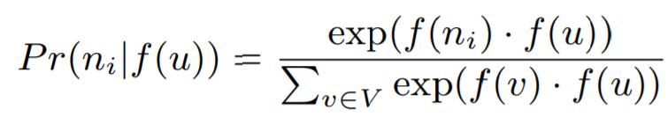
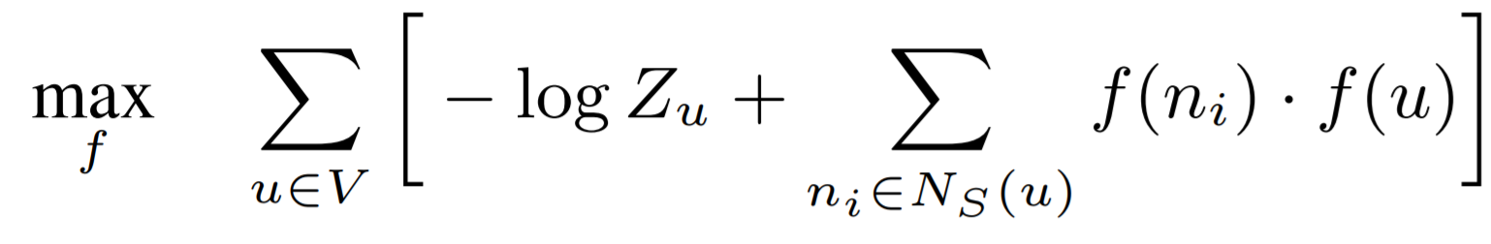
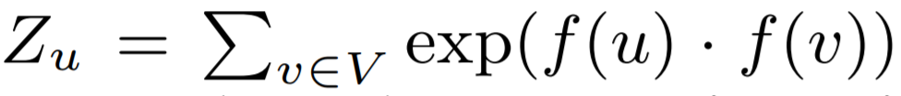
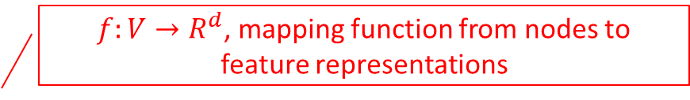
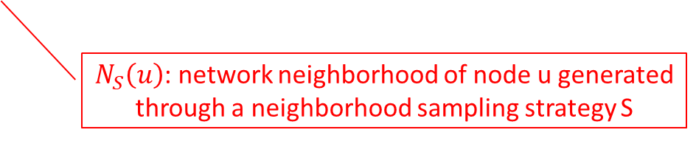
node2vec approach
Feature Learning Framework
$f:V→R^{d}$, mapping function from nodes to feature representations
Objective function
$N_{S}\left(u\right)$: network neighborhood of node u generated through a neighborhood sampling strategy S
Conditional independence
Symmetry in feature space
Objective function
(Simplified)
Notes:
Maximize the log-probability of observing a network neighborhood Ns(u) for a node u conditioned on its feature representation
A source node and neighborhood node have a symmetric effect over each other in feature space.
Compute Zu for large networks is expensive to compute, so they approximate it using negative sampling

Slide 10



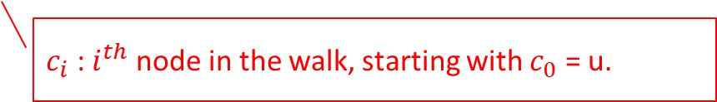
node2vec approach
Feature Learning Framework
Sampling stretegy
Classical search strategies: BFS – microscopic view, contribute to structural equivalence DFS – macro view, inferring communities based on homophily
node2vec
$π_{vx}$: Unnormalized transition probability b/w v and x
Z: Normalizing constant
$c_{i}$ : $i^{th}$ node in the walk, starting with $c_{0}$ = u.
Search bias $α$
Notes:
In word embedding, context is defined as a words in same window. However, graph is not linear structure, we have to define the sampling strategy for neighborhood
How nodes will search around.

Slide 11
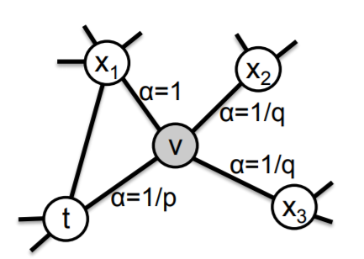
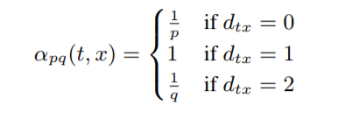
node2vec approach
Feature Learning Framework
1
2
Sampling stretegy
node2vec
2
0
Shortest distance between nodes t and x
Parameter p, q control how fast the walk explores and leaves the neighborhood of starting node u
Notes:
Change the probability of exploration to node regarding to the distance between t and x

Slide 12
node2vec approach
Feature Learning Framework
Sampling stretegy
node2vec
Return parameter, p
controls the likelihood of immediately revisiting > max(q, 1) : moderate exploration and avoids 2-hop redundancy < min(q, 1) : keep the walk “local” close to the starting node u
In-out parameter, q
differentiate between “inward” and “outward” nodes q > 1: random walk is biased towards nodes close to node t → approximate BFS q < 1: reflective of DFS

Slide 13
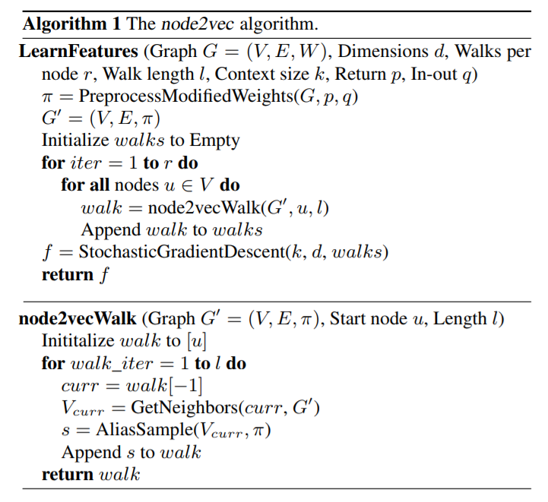
node2vec approach
Feature Learning Framework
algorithm

Slide 14

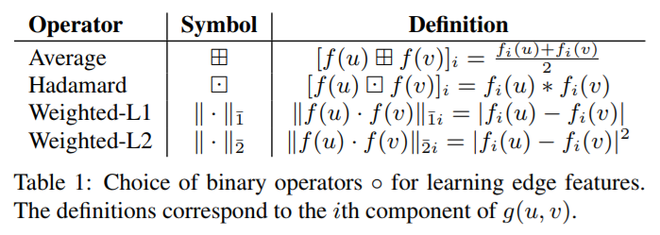
node2vec approach
Feature Learning Framework
Learning edge features

Slide 15
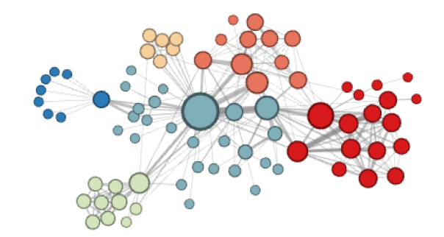
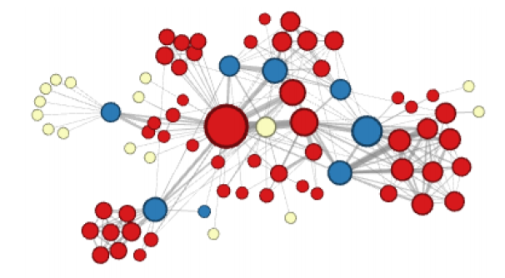
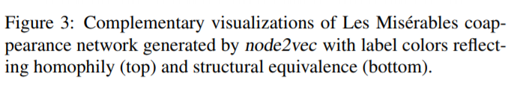
Experiments – Case study (Les miserables)
Coappearance
Character
Characters which frequently interact with each other
p: 1, q: 0.5
p: 1, q: 2
Characters that act as bridges between different sub-plots of the novel
Notes:
Node – character
Edge – coappearing between characters

Slide 16
Result – Compared Algorithms
Spectral clustering matrix factorization approach in which we take the top d eigenvectors of the normalized Laplacian matrix of graph G
DeepWalk For each vertex, truncated random walks starting from the vertex are used to obtain the contextual information. special case of node2vec with p = 1 and q = 1.
LINE d/2 dimensions by BFS-style simulations, learns the next d/2 dimensions by sampling nodes strictly at a 2-hop distance from the source nodes

Slide 17
Result – Dataset (Multi-label classification)
• BlogCatalog
Network of social relationships of the bloggers listed on the BlogCatalog website. The labels represent blogger interests (10,312 nodes, 333,983 edges, and 39 different labels)
• Protein-Protein Interactions (PPI)
PPI network for Homo Sapiens. labels from the hallmark gene sets and represent biological states. (3,890 nodes, 76,584 edges, and 50 different labels)
• Wikipedia
Cooccurrence network of words in Wikipedia dump. The labels represent the Part-of-Speech (POS) tags. (4,777 nodes, 184,812 edges, and 40 different labels)
Notes:
Wiki – 2 length window

Slide 18
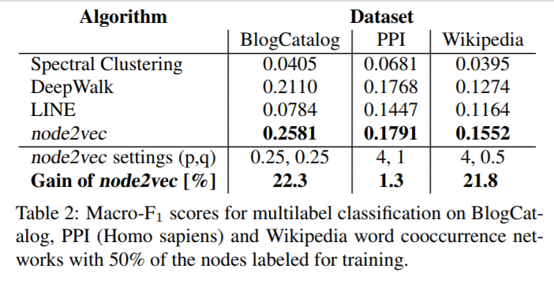
Result - Multi-label classification
- One-vs-rest logistic regression classifier with L2 regularization
- Split equally over 10 random instances
Notes:
Deepwalk is special case of node2vec. So node2vec always shows better performance
Best hyperparameters were learned using 10-fold corss-validation on 10% labeled data with a grid search over p,q
LINE shows worse performance because it only consider 2-hop nodes

Slide 19
Result – Dataset (Link prediction)
• Facebook
Nodes represent users, and edges represent a friendship relation between any two users. (4,039 nodes and 88,234 edges)
• Protein-Protein Interactions (PPI)
In the PPI network for Homo Sapiens, nodes represent proteins, and an edge indicates a biological interaction between a pair of proteins. (19,706 nodes and 390,633 edges)
• arXiv ASTRO-PH
Papers submitted to the e-print arXiv. Nodes represent scientists, and an edge is present between two scientists if they have collaborated in a paper. (18,722 nodes and 198,110 edges)
Notes:
Remove edges and predict the link

Slide 20
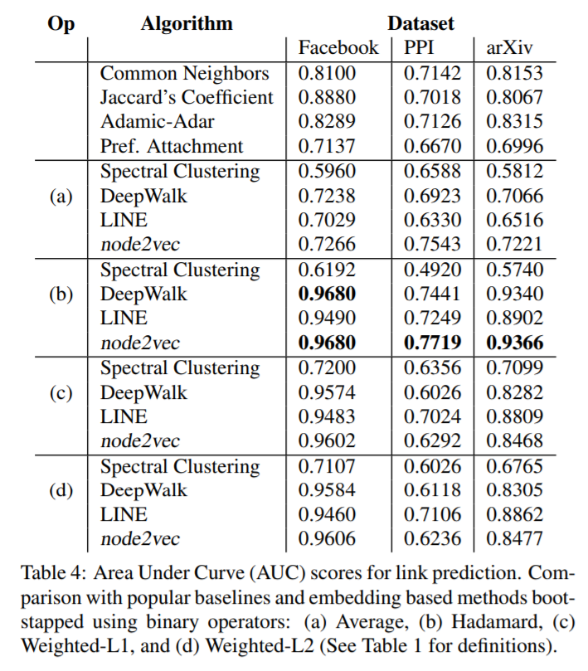
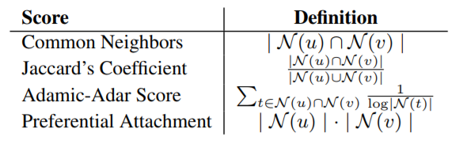
Result – Link prediction
Notes:
Since none of feature learning algorithms have been previously used for link prediction, use heuristic scores

Slide 21
Conclusion
Explanation on classic search strategies on the basis of exploration-exploitation trade-off
Flexible and controllable exploring network compared to previous works
Show how to extend node embeddings to link prediction
Notes:
Deepwalk: no control over the explored neighborhood
LINE: only consider 1-hop, 2-hop neighbors.

