Slide 1
Learning Entity and Relation Embeddings for Knowledge Graph Completion
Lin, Yankai, et al.
AAAI. 2015.
Doyeon Lim
2018.02.25

Slide 2
Contents
Application of knowledge graph embedding
transE, transH
transR
Result
Conclusion

Slide 3
Application of Knowledge Graph Embedding
Knowledge graph completion aims to perform link prediction between entities.
Knowledge Graph encode a structred information within entity and relation
Application - Question Answering - Relation Extraction
Why Knowledge graph prediction is harder than network link prediction? - Nodes have their own type and attribute - Relation has different type → not only consider the linking but also the type of the relation

Slide 4
Knowledge graph completion
Doyeon studies in KAIST ➔ (Doyeon, School, KAIST)
KAIST
t
School
Doyeon
h

Slide 5


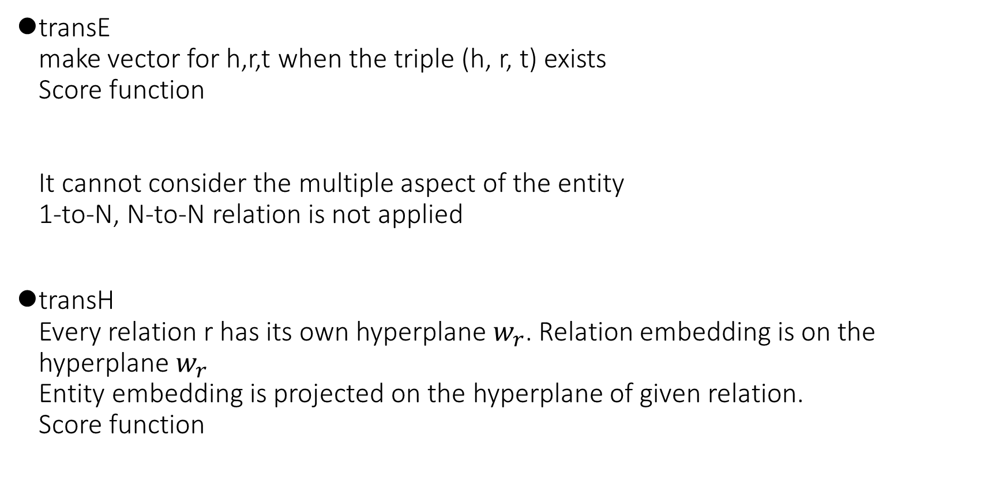
Previous works
transE make vector for h,r,t when the triple (h, r, t) exists Score function It cannot consider the multiple aspect of the entity 1-to-N, N-to-N relation is not applied
transH Every relation r has its own hyperplane $w_{r}$. Relation embedding is on the hyperplane $w_{r}$ Entity embedding is projected on the hyperplane of given relation. Score function

Slide 6

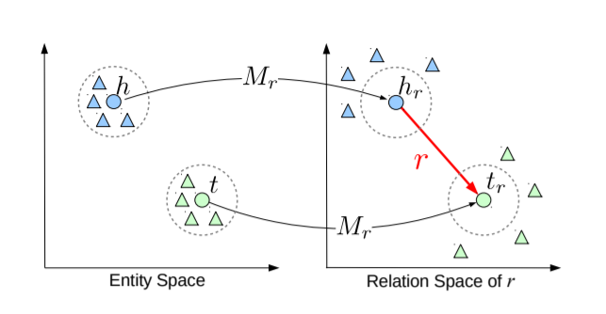


transR approach
Entity and relation has totally different characteristic → proposed a new method which models entities and relations in distinct semantic spaces (dimension for entity and relation can be different) Score function
$M_{r}$: projection matrix for Relation r

Slide 7
transR approach
Entity Daejeon, Seoul may be closer in an aspect, location-contain, than Daejeon and Doyeon
Entity Daejeon, Doyeon may be closer in an aspect, location-living in, than Daejeon and Seoul

Slide 8
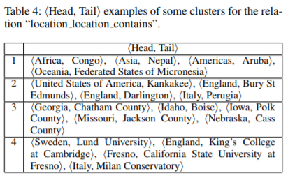

transR approach
For the same relation, 'location_location_contains’, head, tail relation can be different
e.g) country-city/ country-university/continent-country
Suggest CtransR (cluster-based TransR)
CtransR clusters the same relation in several clusters according to the transE results head-tail pairs are grouped using K-means clustering
Score function

Slide 9

transR approach
Loss function (margin-based score function):
S: correct triples, S': incorrect triples
To avoid overfitting, initialize entity embedding to transE result, and relation projection matrix to identity matrix

Slide 10
Result
Data: - WordNet: synset consisting of several words, corresponding to distinct word sense relation: hypernym, hyponym, meronym, holonym - Freebase: general facts of the world
Evaluation: 1. Link prediction: arbitrarly empty the entity in triple to predict the blank 2. triple classification: give random triple with arbitrary combination of entity and relation → Do binary classification

Slide 11
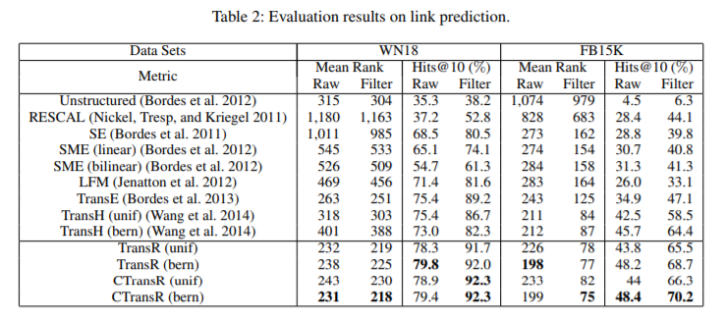
Result – Link prediction
(1) Mean Rank: mean rank of correct entities
(2) Hits@10: proportion of correct entities in top-10 ranked entities

Slide 12
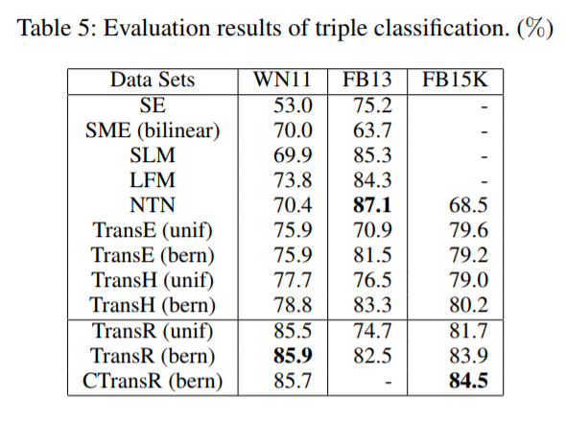
Result – triple classification
NTN can learn complicated correlations using tensor transformation from the dense graph of FB13
Notes:
results may correlate with the characteristics of data sets: There are 1, 345 relation types in FB15K and only 13 relations types in FB13.
knowledge graph in FB13 is much denser than FB15K and even WN11
simpler models are able to better handle the sparse graph of FB15K with good generalization

Slide 13
Conclusion & Further work
TransR embeds entities and relations in distinct entity space and relation space
CTransR, which aims to model internal complicated correlations within each relation type
Relation correlate with each other e.g) (goldfish, kind_of, fish) (fish, kind_of, animal) then (goldfish, kind_of, animal). Kind_of --> transitive relation type
CTransR is an initial exploration for modeling internal correlations within each relation type. → investigate more sophisticated models for this purpose.

