Slide 1
Korol conductivity model
Guillaume von Gastrow
4/11/2020

Slide 2
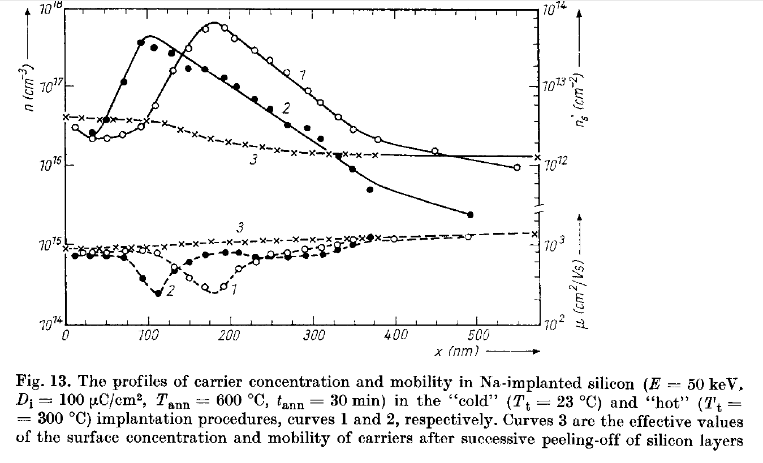

Sodium implantation experiments
Korol et al, Sodium implantation in Silicon, 1988
$$σ=qμn$$
[Na]=n (complete ionization)

Slide 3
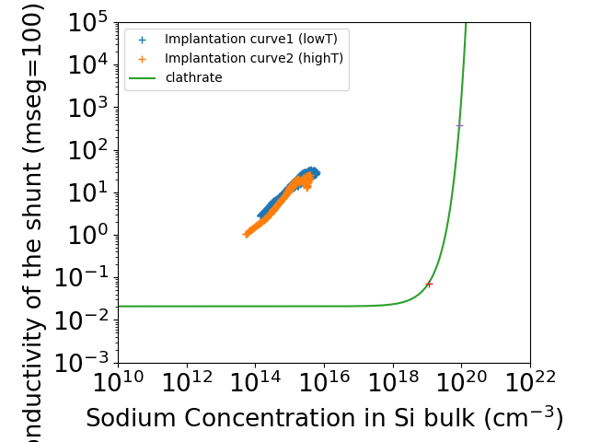
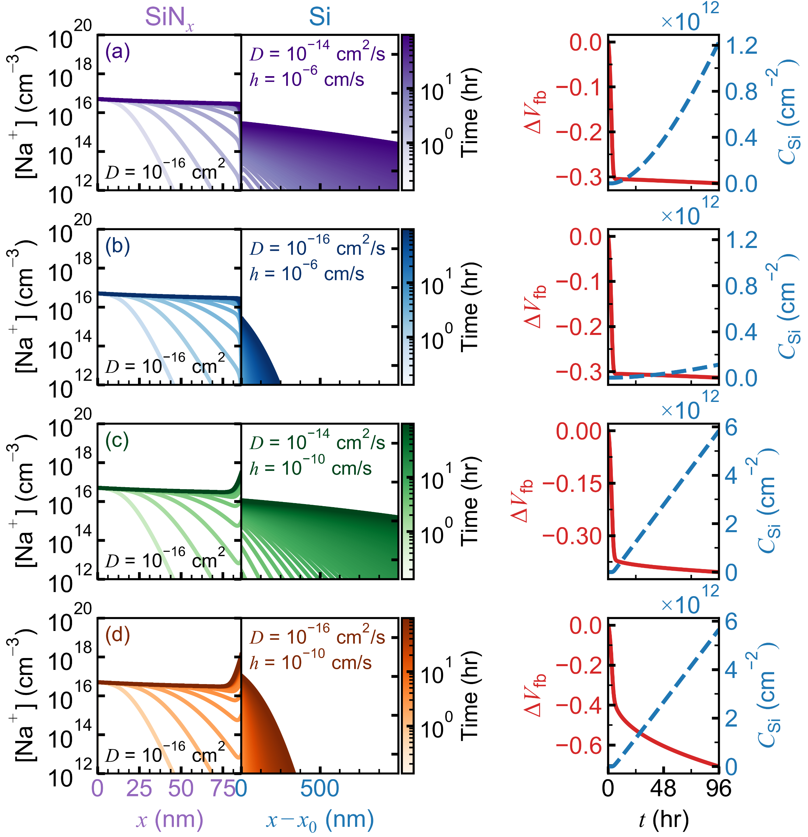
New conductivity model
Na₈Si₄₆
Na₃Si₁₃₆
Na concentration according to simulations
Experimental range of the clathrate model
The clathrate model predicts very low conductivity even at high Na concentrations in the shunt (which we won’t reach according to the migration model
We propose a new doncuctivity model based on implantated Na in Si

Slide 4
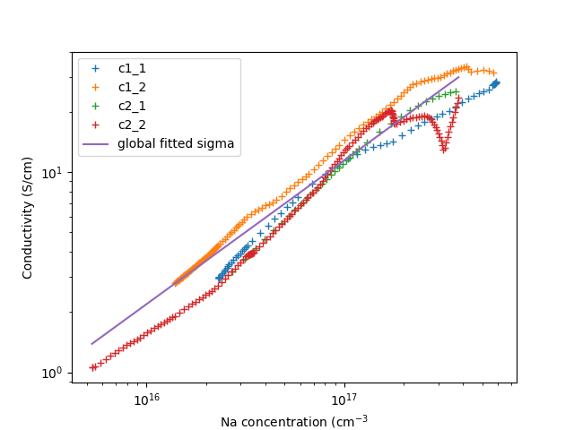
Conductivity model fit
Conductivity model (“global fitted sigma) obtained by fitting data in Korol’s paper, fig. 13
Fitting in “Extract_NaImp.py” in /home/linux/ieng6/na299x/na299x/DB/Guillaume/cell_AlBSF/Al_BSF
sigma=10**Intercept*CNa**slope
Intercept= -11.144769029961262
Slope= 0.717839509854622

