Slide 1
Sentaurus for PID device simulations
2/19/2020
Guillaume von Gastrow

Slide 2
Outline
I. Overview of the simulation environment
II. Running the simulations
III. Output data visualization

Slide 3
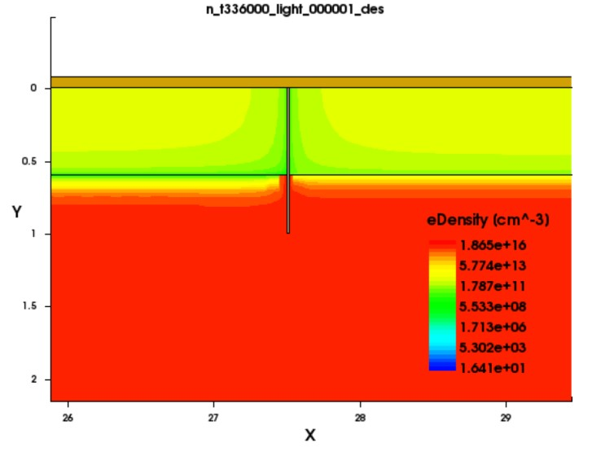
I. Overview of the simulation environment
Simulation process
At each time t, the Na migration profile is converted to a conductivity profile
A geometry is created in Sentaurus Structure editor
Poisson equation and transport equation are solved in Sentaurus Device at this time point and efficiency is extracted
The same procedure is repeated for Na migration profiles at all time points, leading to an efficiency curve as a function of time

Slide 4
I. Overview of the simulation environment
PIDmodel.py
runSent.py
DatAnalysis.py
Module 1: Physical models
Module 2: OS interfacing
Module 3: Output data analysis
analyzedata
runPIDsim
run_svisual
Extracts IV data from each .plt output file
Main function running PID simulations
Runs Sentaurus visual (visualization)
batchanalysis
condmodel
Analyzes and plots all time points
run_sde
findeff
Returns the conductivity profile
Calculates efficiency from IV curves
changefiles
Runs Sentaurus Device Editor (geometry)
createlog
Logs parameters to a .txt file
Implements physical parameters in .cmd templates
run_sdevice
replace_line
SRVparam
Modifies a line in a Sentaurus template file
Runs Sentaurus Device (physics)
NaNlist
Implements SRV parameterization
makePIDvideo

Slide 5
I. Overview of the simulation environment
Other useful functions
Extract_NaImp.py
Extracts data from Korol et al, Sodium implantation in silicon. Returns the coefficients for the shunt model (hard-coded in function condmodel).
Plot_model_params.py
Plots various useful parameters such as the sodium migration profiles or a comparison of the sodium conductivity models.
Path to all functions “/home/linux/ieng6/na299x/na299x/DB/Guillaume/cell_AlBSF/Al_BSF”

Slide 6
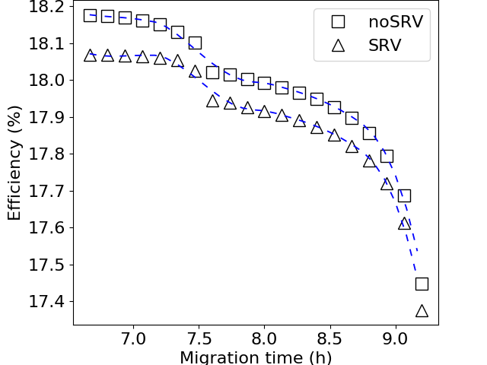
II. Running Sentaurus simulations
1. Connect to the server (see Sentaurus primer for instructions)
2. Change directory to the code location “/home/linux/ieng6/na299x/na299x/DB/Guillaume/cell_AlBSF/Al_BSF” It contains the template files (sde_dvs.cmd, sdevice_light_des.cmd, sdevice.par) the Na migration profiles (*.h5) and the optical generation profile (*.plx).
3. Load Python with the h5py package installed, and start Python
module load python-3.7
Python
4. Import the main module
Import PIDmodel
5. Run batch simulations
Example: PIDmodel.runPIDsim(batchdir="./testdir", mseg=200, use_SRV=True, startstep=0, endstep=700)
Simulation data will be saved in the directory “testdir”. Startstep and endstep correspond to the time points.
6. Analyze simulation data and plot solar cell efficiency as a function of time
PIDmodel.DatAnalysis.batchanalysis(‘./testdir’,startstep=0,endstep=700)
Note that startstep and endstep can both be set to 0, in which case the script will search for all time points.
Efficiency simulation results after analysis

Slide 7
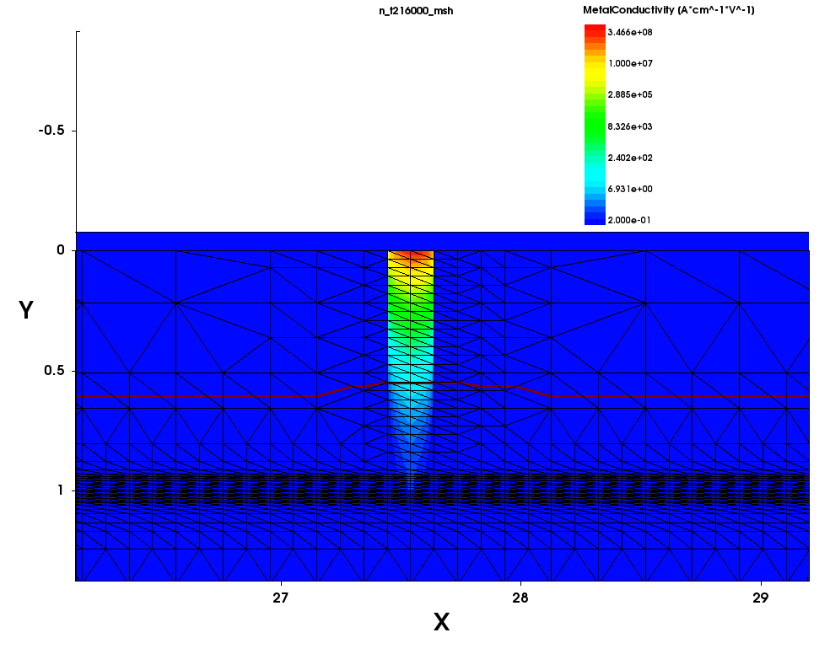
III. Output data visualization
All output files will be saved in the directory defined when calling the runPIDsim function, for instance ‘./testdir’.
The ‘*.tdr’ files have an HDF format and can be used to plot spatial simulation results. This can be done simply using Sentaurus Visual.
(um)
Example for a simulation point at t=900 s Output from Sentaurus Device (physics) at a voltage of 0 V: PIDmodel.runSent.run_svisual(‘n_t900_light_000000_des.tdr’)
Note: The number of voltages that can be accessed is defined in the sdevice_light_des.cmd template file by the command plot { range=(0, 1) intervals=2 }, called during ramping from 0 V to 0.8 V of the terminal voltage. In this case, two intervals are defined so three ‘*.tdr’ files are created from the intial voltage to the final voltage (0 V, 0.4 V and 0.8 V).
Output from Sentaurus Structure Editor (geometry):
PIDmodel.runSent.run_svisual(‘n_t900_msh.tdr’)
(um)
Simulated cell cross section and shunt from a geometry output file
Simulated near-shunt electron density after 93 h of sodium migration. Plot obtained from a physics output file.

Slide 8
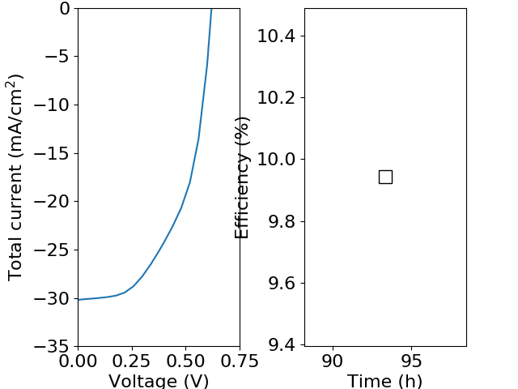
Effect of shunt conductivity on shunting?
Segregation coefficients of 1e-4, 1e-2, 10, 500 (conductivity at the junction from 0.1 S/cm to 1000 S/cm) cause no difference in efficiency. In principle they should.
The shunt is depicted by a metallic region in the cross-section below, but it does not contribute to conductivity (replaced by the external conductivity profile).
Simulated near-shunt electron density after 93 h of sodium migration, corresponding to the efficiencies on the left.

Slide 9
Next steps
Output data visualization
Find how to plot the 2D cell cross-section externally (raw data is saved in the .tdr file opened with svisual, which is actually an HDF file)
Solve problem of vectorial values representation in svisual, such as electron/hole currents. Compare with simple PN junction example where it works.
Simulations
Find why different conductivities do not seem to affect shunting severity

