Slide 1
In this session, you will learn to:
  Overview of Queue
  Applications of Queues
  Insertion and deletion in a Linear queue
  Implementation of Circular Queue
  Dequeue
  Priority Queue
Objectives

Slide 2
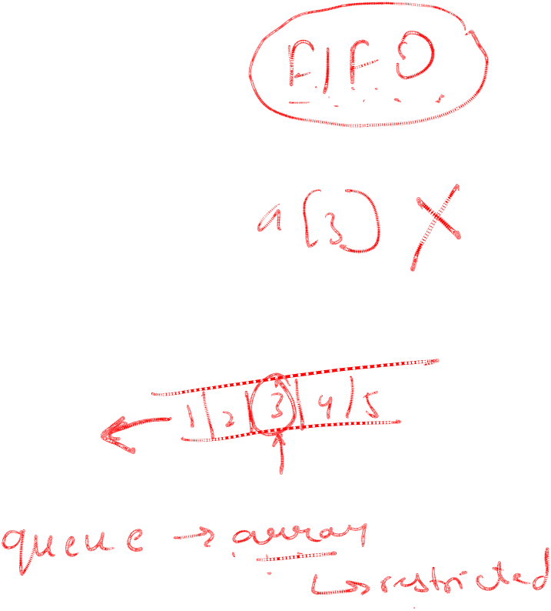
Consider a situation where you have to create an application with the following set of requirements:
  Application should serve the requests of multiple users.
  At a time, only one request can be processed.
  The request, which came first should be given priority.
However, the rate at which the requests are received is much faster than the rate at which they are processed.
  Therefore, you need to store the request somewhere until they are processed.
How can you solve this problem?
  You can solve this problem by storing the requests in such a manner so that they are retrieved in the order of their arrival.
  A data structure called queue stores and retrieves data in the order of its arrival.
  A queue is also called a FIFO list.
Defining Queues

Slide 3
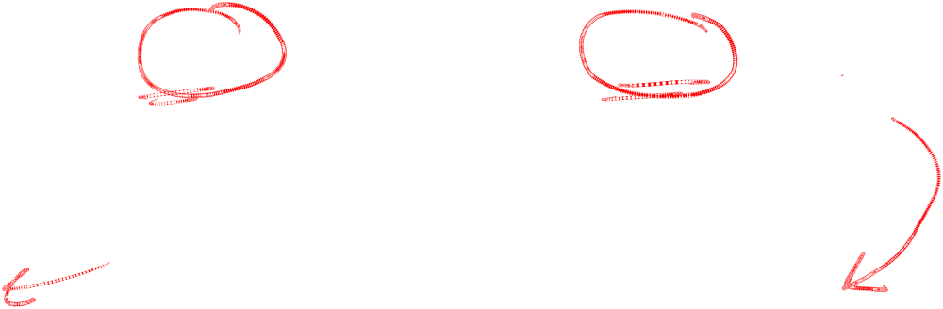
Defining Queues (Contd.)
Elements are inserted at the rear end and deleted from the front end.
Queue is a list of elements in which an element is inserted at one end and deleted from the other end of the queue.
FRONT
REAR
B
A
E
C
D

Slide 4
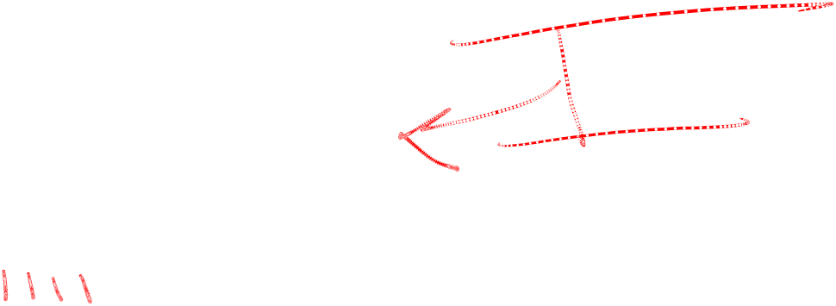
Just a minute
A queue is also known as a __________ list.
Answer:
  FIFO
Notes:
In this slide you need to show the calculation to determine the sum of an arithmetic progression for bubble sort algorithm. Refer to student guide.

Slide 5
Various operations implemented on a queue are:
  Insert
  Delete
Identifying Various Operations on Queues
FRONT
REAR
B
A
E
C
D

Slide 6
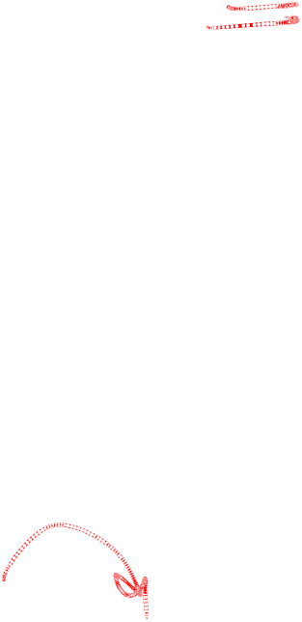
Insert: It refers to the addition of an item in the queue.
  Suppose you want to add an item F in the following queue.
  Since the items are inserted at the rear end, therefore, F is inserted after D.
  Now F becomes the rear end.
F
FRONT
REAR
REAR
B
A
E
C
D
F

Slide 7

Delete: It refers to the deletion of an item from the queue.
  Since the items are deleted from the front end, therefore, item B is removed from the queue.
  Now A becomes the front end of the queue.
FRONT
FRONT
REAR
B
A
E
C
D
F

Slide 8
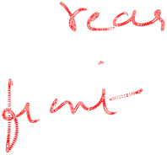
Queues are the data structures in which data can be added at one end called ______ and deleted from the other end called _________.
Answer:
  rear, front
Notes:
In this slide you need to show the calculation to determine the sum of an arithmetic progression for bubble sort algorithm. Refer to student guide.

Slide 9
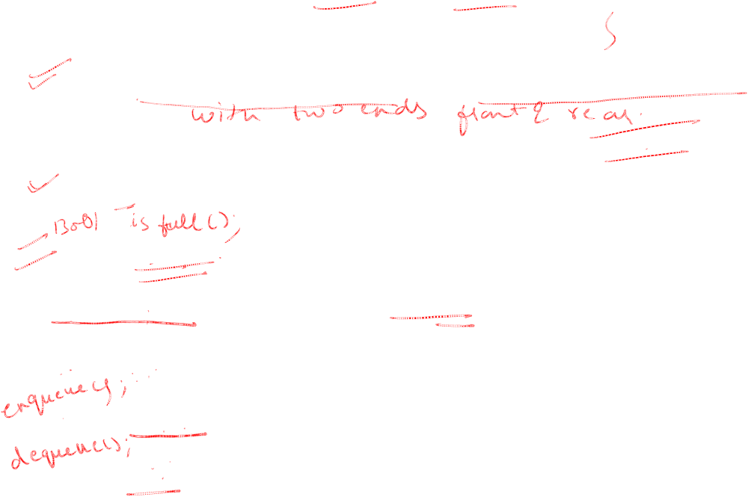
ADT QUEUE
Class queue
{//a finite ordered list with zero or more elements.
Public:
Queue();//create queue with some initial capacity.
Bool isempty();//to check queue is empty or not.
int front();//return element at front.
int rear();//return element at rear.
void push();//insert item at rear f the queue.
void pop();//delete front element of the queue.
}

Slide 10
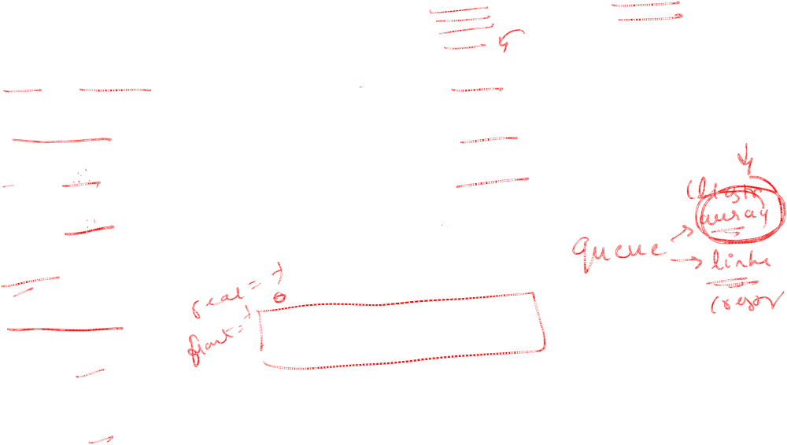
Realization of queues using array
class queue1
{ int a[10];
int rear;
int front;
Public:
queue1()
{rear=-1;
front=-1;
}
void insert(int);
Void delete();
Void display();
}q;

Slide 11
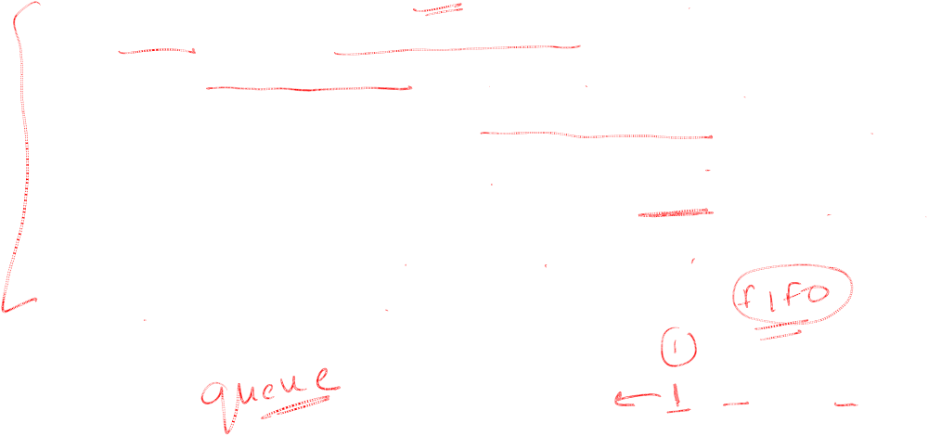
Problem Statement:
  Consider a scenario of a bank. When the customer visits the counter, a request entry is made and the customer is given a request number. After receiving request numbers, a customer has to wait for some time. The customer requests needs to be queued into the system and processed on the basis of their arrival. You need to implement an appropriate data storage mechanism to store these requests in the system.

Slide 12
Implementing a Queue Using an Array (Contd.)
How can you solve this problem?
  You can solve this problem by implementing a queue.
Let us implement a queue using an array that stores these request numbers in the order of their arrival.
To keep track of the rear and front positions, you need to declare two integer variables, REAR and FRONT.
If the queue is empty, REAR and FRONT are set to –1.
To insert a request number, you need to perform the following steps:
  Increment the value of REAR by 1.
  Insert the element at index position REAR in the array.
FRONT = –1
REAR = –1
0
1
2
3
4

Slide 13
Implementing a Queue Using an Array (Contd.)
Let us now insert request numbers in the following queue.
1. IF(FRONT==-1 )
1.1 FRONT = 0
2. REAR = REAR+1
3. QUEUE[REAR] = ITEM
FRONT = –1
10
REAR = –1
0
1
2
3
4

Slide 14
Implementing a Queue Using an Array (Contd.)
Request number generated
3
1. IF(FRONT==-1 )
1.1 FRONT = 0
2. REAR = REAR+1
3. QUEUE[REAR] = ITEM
FRONT = –1
10
REAR = –1
0
1
2
3
4

Slide 15
Implementing a Queue Using an Array (Contd.)
Request number generated
3
1. IF(FRONT==-1 )
1.1 FRONT = 0
2. REAR = REAR+1
3. QUEUE[REAR] = ITEM
FRONT = 0
FRONT = –1
10
REAR = –1
0
1
2
3
4

Slide 16
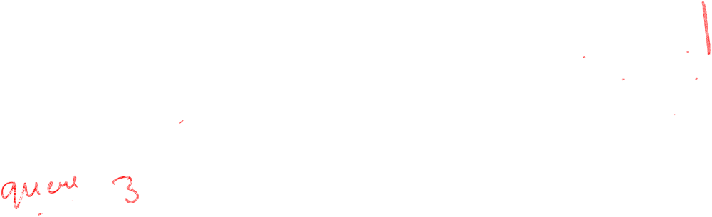
Implementing a Queue Using an Array (Contd.)
Request number generated
3
1. IF(FRONT==-1 )
1.1 FRONT = 0
2. REAR = REAR+1
3. QUEUE[REAR] = ITEM
FRONT = 0
REAR = 0
10
REAR = –1
0
1
2
3
4

Slide 17
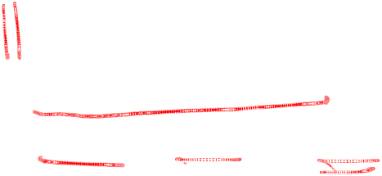
Implementing a Queue Using an Array (Contd.)
Request number generated
3
1. IF(FRONT==-1 )
1.1 FRONT = 0
2. REAR = REAR+1
3. QUEUE[REAR] = ITEM
FRONT = 0
REAR = 0
3
10
0
1
2
3
4
Insertion complete

Slide 18
Implementing a Queue Using an Array (Contd.)
Request number generated
5
1. IF(FRONT==-1 )
1.1 FRONT = 0
2. REAR = REAR+1
3. QUEUE[REAR] = ITEM
FRONT = 0
REAR = 0
3
10
0
1
2
3
4

Slide 19
Implementing a Queue Using an Array (Contd.)
Request number generated
5
1. IF(FRONT==-1 )
1.1 FRONT = 0
2. REAR = REAR+1
3. QUEUE[REAR] = ITEM
FRONT = 0
REAR = 0
REAR = 1
3
10
0
1
2
3
4

Slide 20
Implementing a Queue Using an Array (Contd.)
Request number generated
5
1. IF(FRONT==-1 )
1.1 FRONT = 0
2. REAR = REAR+1
3. QUEUE[REAR] = ITEM
FRONT = 0
REAR = 1
3
5
10
0
1
2
3
4
Insertion complete

Slide 21
Implementing a Queue Using an Array (Contd.)
Request number generated
7
1. IF(FRONT==-1 )
1.1 FRONT = 0
2. REAR = REAR+1
3. QUEUE[REAR] = ITEM
FRONT = 0
REAR = 1
3
5
10
0
1
2
3
4

Slide 22
Implementing a Queue Using an Array (Contd.)
Request number generated
7
1. IF(FRONT==-1 )
1.1 FRONT = 0
2. REAR = REAR+1
3. QUEUE[REAR] = ITEM
FRONT = 0
REAR = 1
REAR = 2
3
5
10
0
1
2
3
4

Slide 23
Implementing a Queue Using an Array (Contd.)
Request number generated
7
1. IF(FRONT==-1 )
1.1 FRONT = 0
2. REAR = REAR+1
3. QUEUE[REAR] = ITEM
FRONT = 0
REAR = 2
3
5
7
10
0
1
2
3
4
Insertion complete

Slide 24
Implementing a Queue Using an Array (Contd.)
Request number generated
10
1. IF(FRONT==-1 )
1.1 FRONT = 0
2. REAR = REAR+1
3. QUEUE[REAR] = ITEM
FRONT = 0
REAR = 2
3
5
7
10
0
1
2
3
4

Slide 25
Implementing a Queue Using an Array (Contd.)
Request number generated
10
1. IF(FRONT==-1 )
1.1 FRONT = 0
2. REAR = REAR+1
3. QUEUE[REAR] = ITEM
FRONT = 0
REAR = 2
REAR = 3
3
5
7
10
0
1
2
3
4

Slide 26
Implementing a Queue Using an Array (Contd.)
Request number generated
10
1. IF(FRONT==-1 )
1.1 FRONT = 0
2. REAR = REAR+1
3. QUEUE[REAR] = ITEM
FRONT = 0
REAR = 3
3
5
7
10
10
0
1
2
3
4
Insertion complete

Slide 27
Implementing a Queue Using an Array (Contd.)
Request number generated
15
1. IF(FRONT==-1 )
1.1 FRONT = 0
2. REAR = REAR+1
3. QUEUE[REAR] = ITEM
FRONT = 0
REAR = 3
3
5
7
10
10
0
1
2
3
4

Slide 28
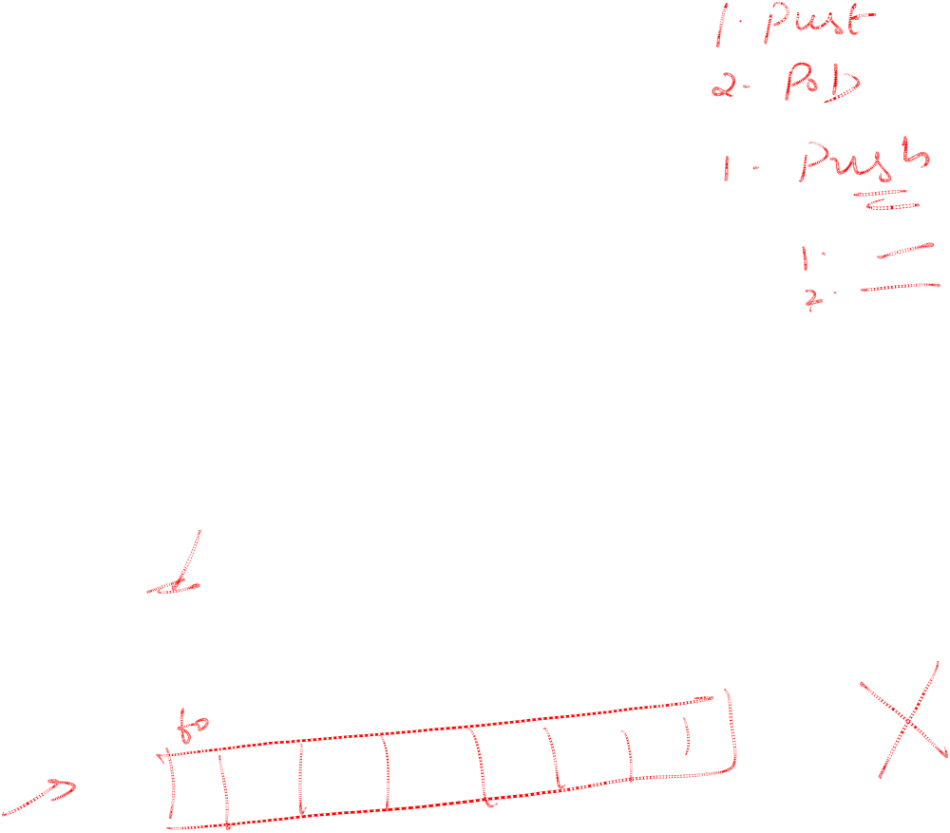
Implementing a Queue Using an Array (Contd.)
Request number generated
15
1. IF(FRONT==-1)
1.1 FRONT = 0
2. REAR = REAR+1
3. QUEUE[REAR] = ITEM
FRONT = 0
REAR = 3
REAR = 4
3
5
7
10
10
0
1
2
3
4

Slide 29
Implementing a Queue Using an Array (Contd.)
Request number generated
15
1. IF(FRONT==-1)
1.1 FRONT = 0
2. REAR = REAR+1
3. QUEUE[REAR] = ITEM
FRONT = 0
REAR = 4
3
5
7
10
15
10
0
1
2
3
4
Insertion complete
Notes:
In the problem statement, request numbers are generated in a descending order. As a result, in this case, the queue appears like a sorted list. To avoid confusion, tell the students that there is no such specific sequence in which the items are added in the queue.

Slide 30
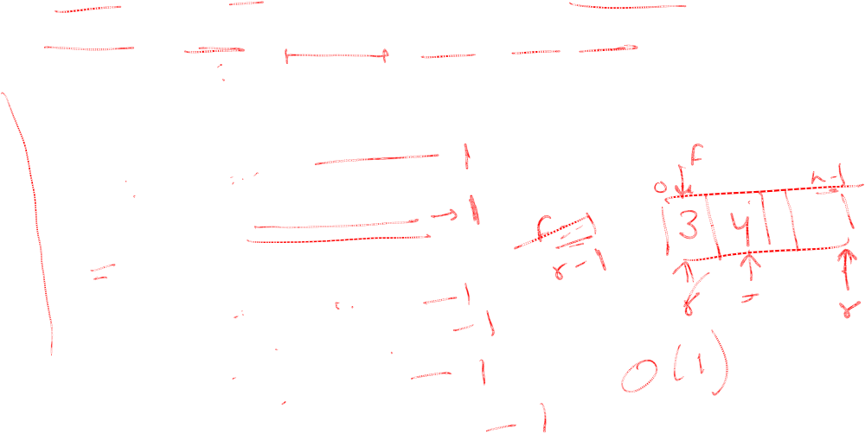
Algorithm to insert data in a Queue
FRONT = -1, REAR = -1, TO REPRESENT QUEUE IS EMPTY
Algorithm INSERT(QUEUE[N],FRONT,REAR,ITEM)
{
//QUEUE is an array of size N ,ITEM is element to be inserted.
1. if (REAR == N-1)
1.1 Print “OVERFLOW”
else
1.1 if (FRONT == -1)
1.1.1 FRONT = 0
1.2 REAR = REAR+1
1.3 QUEUE[REAR] = ITEM
}

Slide 31
The requests stored in the queue are served on a first-come-first-served basis.
As the requests are being served, the corresponding request numbers needs to be deleted from the queue.

Slide 32
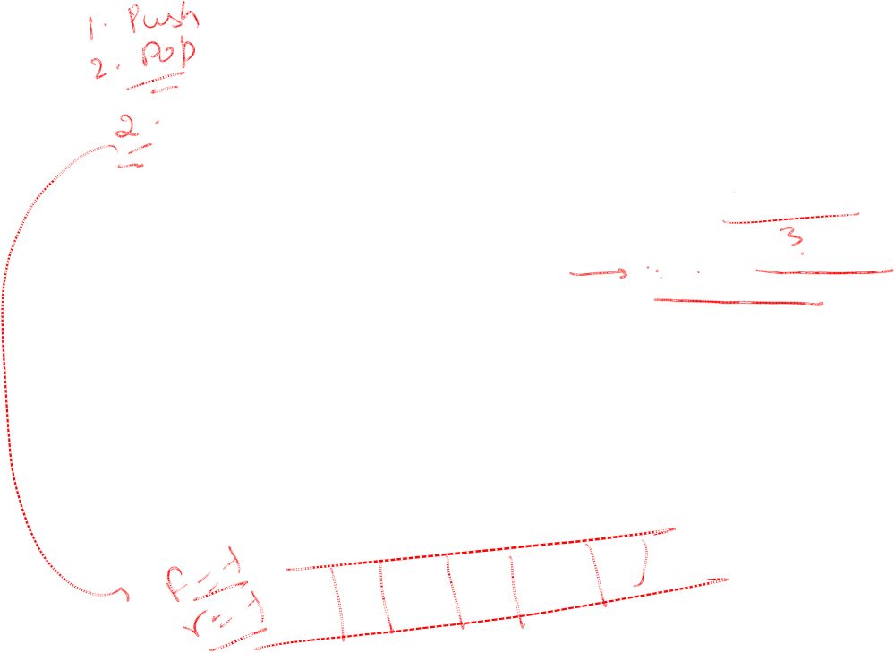
Implementing a Queue Using an Array (Contd.)
Let us see how requests are deleted from the queue once they get processed.
  1.If( FRONT == – 1 )
  1.1 print “QUEUE EMPTY”
  2. else
  2.1 ITEM = QUEUE[FRONT]
  2.2 FRONT = FRONT +1
FRONT = 0
REAR = 4
3
5
7
10
15
0
1
2
3
4

Slide 33
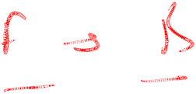
Implementing a Queue Using an Array (Contd.)
  One request processed
  1.If( FRONT == – 1 )
  1.1 print “QUEUE EMPTY”
  2. else
  2.1 ITEM = QUEUE[FRONT]
  2.2 FRONT = FRONT +1
FRONT = 0
REAR = 4
3
5
7
10
15
10
0
1
2
3
4

Slide 34
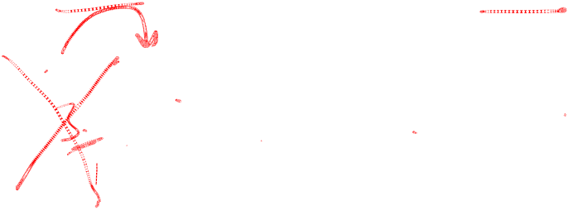
Implementing a Queue Using an Array (Contd.)
  One request processed
  1.If( FRONT == – 1 )
  1.1 print “QUEUE EMPTY”
  2. else
  2.1 ITEM = QUEUE[FRONT]
  2.2 FRONT = FRONT +1
FRONT = 1
REAR = 4
10
5
7
10
15
0
1
2
3
4

Slide 35
Implementing a Queue Using an Array (Contd.)
  1.If( FRONT == – 1 )
  1.1 print “QUEUE EMPTY”
  2. else
  2.1 ITEM = QUEUE[FRONT]
  2.2 FRONT = FRONT +1
FRNT = 0
FRONT = 1
REAR = 4
10
5
7
10
15
0
1
2
3
4
Delete operation complete

Slide 36
Implementing a Queue Using an Array (Contd.)
  1.If( FRONT == – 1 )
  1.1 print “QUEUE EMPTY”
  2. else
  2.1 ITEM = QUEUE[FRONT]
  2.2 FRONT = FRONT +1
FRONT = 1
FRONT = 2
REAR = 4
10
7
10
15
0
1
2
3
4
Delete operation complete

Slide 37
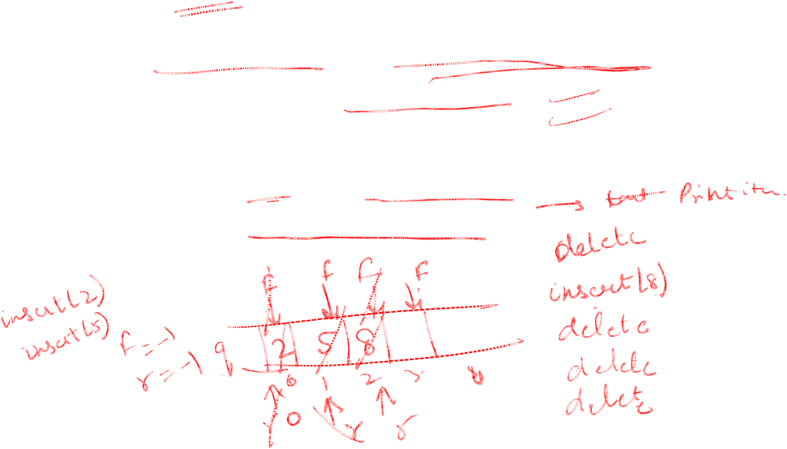
Write an algorithm to delete an element from a queue implemented through array.
Algorithm DELETE(QUEUE[N],ITEM,FRONT,REAR)
{
1. if (( FRONT == – 1 ) || (FRONT == REAR+1))
  1.1 Print “QUEUE EMPTY”
  2. else
  2.1 ITEM = QUEUE[FRONT]
  2.2 FRONT = FRONT +1
  }

Slide 38
Applications of Queues
Queues offer a lot of practical applications, such as:
  Printer Spooling
  CPU Scheduling
  Mail Service
  Keyboard Buffering
  Elevator

Slide 39
PRINTER SPOOLING
A printer may receive multiple print requests in a short span of time.
The rate at which these requests are received is much faster than the rate at which they are processed.
Therefore, a temporary storage mechanism is required to store these requests in the order of their arrival.
A queue is the best choice in this case, which stores the print requests in such a manner so that they are processed on a first-come-first-served basis.

Slide 40
CPU Scheduling
A CPU can process one request at a time.
The rate at which the CPU receives requests is usually much greater than the rate at which the CPU processes the requests.
Therefore, the requests are temporarily stored in a queue in the order of their arrival.
Whenever CPU becomes free, it obtains the requests from the queue.
Once a request is processed, its reference is deleted from the queue.
The CPU then obtains the next request in sequence and the process continues.
In a time sharing system, CPU is allocated to each request for a fixed time period.

Slide 41
CPU Scheduling (Contd.)
All these requests are temporarily stored in a queue.
CPU processes each request one by one for a fixed time period.
If the request is processed within that time period, its reference is deleted from the queue.
If the request is not processed within that specified time period, the request is shifted to the end of the queue.
CPU then processes the next request in the queue and the process continues.

Slide 42
Mail Service
In various organizations, many transactions are conducted through mails.
If the mail server goes down, and someone sends you a mail, the mail is bounced back to the sender.
To avoid any such situation, many organizations implement a mail backup service.
Whenever there is some problem with the mail server because of which the messages are not delivered, the mail is routed to the mail’s backup server.
The backup server stores the mails temporarily in a queue.
Whenever the mail server is up, all the mails are transferred to the recipient in the order in which they arrived.

Slide 43
Keyboard Buffering
Queues are used for storing the keystrokes as you type through the keyboard.
Sometimes the data, which you type through the keyboard is not immediately displayed on the screen.
This is because during that time, the processor might be busy doing some other task.
In this situation, the data is temporarily stored in a queue, till the processor reads it.
Once the processor is free, all the keystrokes are read in the sequence of their arrival and displayed on the screen.

Slide 44
Elevator
An elevator makes use of a queue to store the requests placed by users.
Suppose the elevator is currently on the first floor. A user on the ground floor presses the elevator button to request for the elevator. At almost the same time a user on the second floor also presses the elevator button.
In that case, the elevator would go to the floor on which the button was pressed earlier, that is, the requests will be processed on a FCFS basis.
However, if one of the users had been on the ground floor and the other had been on the ninth floor, then irrespective of who pressed the button first, the elevator would go to the ground floor first because the distance to the ground floor is much less than the distance to the ninth floor. In this case, some sort of a priority queue would be required.

Slide 46
Implementing a Queue Using an Array (Contd.)
To implement an insert or delete operation, you need to increment the values of REAR or FRONT by one, respectively.
However, these values are never decremented.
As you delete elements from the queue, the queue moves down the array.
The disadvantage of this approach is that the storage space in the beginning is discarded and never used again.
Consider the following queue.
FRONT = 3
REAR = 4
10
10
15
0
1
2
3
4
REAR is at the last index position.
Therefore, you cannot insert elements in this queue, even though there is space for them.
This means that all the initial vacant positions go waste.

Slide 47
Implementing a Queue Using an Array (Contd.)
How can you solve this problem?
  One way to solve this problem is to keep FRONT always at the zero index position.
  Refer to the following queue.
To maintain FRONT at zero index position, every delete operation would require you to shift all the succeeding elements in the array one position left.
Let us implement a delete operation on the following queue.
FRONT = 0
REAR = 3
3
5
7
10
10
0
1
2
3
4

Slide 48
Implementing a Queue Using an Array (Contd.)
To maintain FRONT at zero index position, every delete operation would require you to shift all the succeeding elements in the array one position left.
Let us implement a delete operation on the following queue.
FRONT = 0
REAR = 3
5
5
7
10
10
0
1
2
3
4

Slide 49
Implementing a Queue Using an Array (Contd.)
To maintain FRONT at zero index position, every delete operation would require you to shift all the succeeding elements in the array one position left.
Let us implement a delete operation on the following queue.
FRONT = 0
REAR = 3
5
7
7
10
10
0
1
2
3
4

Slide 50
Implementing a Queue Using an Array (Contd.)
To maintain FRONT at zero index position, every delete operation would require you to shift all the succeeding elements in the array one position left.
Let us implement a delete operation on the following queue.
FRONT = 0
REAR = 3
5
7
10
10
10
0
1
2
3
4

Slide 51
Implementing a Queue Using an Array (Contd.)
To maintain FRONT at zero index position, every delete operation would require you to shift all the succeeding elements in the array one position left.
Let us implement a delete operation on the following queue.
FRONT = 0
REAR = 2
REAR = 3
5
7
10
10
0
1
2
3
4

Slide 52
Implementing a Queue Using an Array (Contd.)
Advantage of this approach:
  It enables you to utilize all the empty positions in an array. Therefore, unlike the previous case, there is no wastage of space.
Disadvantage of this approach:
  Every delete operation requires you to shift all the succeeding elements in the queue one position left.
  If the list is lengthy, this can be very time consuming.
FRONT = 0
REAR = 2
5
7
10
10
0
1
2
3
4

Slide 53
Implementing a Queue Using an Array (Contd.)
An effective way to solve this problem is to implement the queue in the form of a circular array.
In this approach, if REAR is at the last index position and if there is space in the beginning of an array, then you can set the value of REAR to zero and start inserting elements from the beginning.
REAR = 0
FRONT = 3
REAR = 4
Insert 5
5
10
15
10
0
1
2
3
4

Slide 54
Implementing a Queue Using an Array (Contd.)
The cells in the array are treated as if they are arranged in a ring.
[ 0 ]
[ 4 ]
[ 1 ]
REAR = 3
10
7
FRONT = 2
[ 3 ]
[ 2 ]
Notes:
Tell the students that a queue implemented in the form of a circular array is represented as a circular structure for the sake of clarity. However, the students should not get confused by looking at its circular structure. The basic structure of the array remains the same.

Slide 55
Implementing a Queue Using an Array (Contd.)
Request number generated
15
FRONT = 1
REAR = 3
1. IF(FRONT==-1 )
1.1 FRONT = 0
1.2 REAR == 0
1.3 GO TO STEP 4
2. IF ( REAR == N-1 )
2.1 REAR = 0
2.2 GO TO STEP 4
3. REAR = REAR + 1
4. QUEUE[REAR] = ITEM
10
20
23
10
0
1
2
3
4

Slide 56
Implementing a Queue Using an Array (Contd.)
Let us now implement a few insert operations on the following circular queue:
Write an algorithm to insert values in a queue implemented as a circular array.
FRONT = 1
REAR = 3
1. IF(FRONT==-1 )
1.1 FRONT = 0
1.2 REAR = 0
1.3 GO TO STEP 4
2. IF ( REAR == N-1 )
2.1 REAR = 0
2.2 GO TO STEP 4
3. REAR = REAR + 1
4. QUEUE[REAR] = ITEM
10
20
23
10
0
1
2
3
4

Slide 57
Implementing a Queue Using an Array (Contd.)
Request number generated
15
FRONT = 1
REAR = 3
REAR = 4
1. IF(FRONT==-1 )
1.1 FRONT = 0
1.2 REAR = 0
1.3 GO TO STEP 4
2. IF ( REAR == N-1 )
2.1 REAR = 0
2.2 GO TO STEP 4
3. REAR = REAR + 1
4. QUEUE[REAR] = ITEM
10
20
23
10
0
1
2
3
4

Slide 58
Implementing a Queue Using an Array (Contd.)
Request number generated
15
FRONT = 1
REAR = 4
1. IF(FRONT==-1 )
1.1 FRONT = 0
1.2 REAR = 0
1.3 GO TO STEP 4
2. IF ( REAR == N-1 )
2.1 REAR = 0
2.2 GO TO STEP 4
3. REAR = REAR + 1
4. QUEUE[REAR] = ITEM
10
20
23
10
15
0
1
2
3
4
Insertion complete

Slide 59
Implementing a Queue Using an Array (Contd.)
Request number generated
17
FRONT = 1
REAR = 4
1. IF(FRONT==-1 )
1.1 FRONT = 0
1.2 REAR = 0
1.3 GO TO STEP 4
2. IF ( REAR == N-1 )
2.1 REAR = 0
2.2 GO TO STEP 4
3. REAR = REAR + 1
4. QUEUE[REAR] = ITEM
10
20
23
10
15
0
1
2
3
4

Slide 60
Implementing a Queue Using an Array (Contd.)
Request number generated
17
REAR = 0
FRONT = 1
1. IF(FRONT==-1 )
1.1 FRONT = 0
1.2 REAR = 0
1.3 GO TO STEP 4
2. IF ( REAR == N-1 )
2.1 REAR = 0
2.2 GO TO STEP 4
3. REAR = REAR + 1
4. QUEUE[REAR] = ITEM
17
20
23
10
15
10
0
1
2
3
4
Insertion complete

Slide 61
Implementing a Queue Using an Array (Contd.)
The conditions for queue full are as follows:
If FRONT == 0 and REAR is at the last index position
If FRONT == REAR + 1
OR
FRONT = 0
REAR = 4
REAR = 2
FRONT = 3
3
5
7
10
15
17
20
23
10
15
10
10
0
1
2
3
4
0
1
2
3
4
Notes:
Ask the student to modify the algorithm to incorporate the queue overflow condition.

Slide 62
Algorithm to insert data in a Circular Queue
FRONT = -1, REAR = -1, TO REPRESENT QUEUE IS EMPTY
Algorithm INSERT(QUEUE[N],FRONT,REAR,ITEM)
{
//QUEUE is an array of size N ,ITEM is element to be inserted.
1. if ((FRONT == REAR+1) || ((FRONT == 0) && (REAR == N-1)))
1.1 DISPLAY “QUEUE OVERFLOW”
1.2 exit
2. else
2.1 if(rear == -1)
2.1.1 FRONT = 0
2.1.2 REAR = 0
2.1 else if ( REAR == N-1 )
2.1.1 REAR = 0
2.1 else
2.1.1 REAR = REAR + 1
2.2 QUEUE[REAR] = ITEM
}
rear=(rear+1)%capacity

Slide 63
if ((FRONT == REAR+1) || ((FRONT == 0) && (REAR == N-1)))
1.1 DISPLAY “QUEUE OVERFLOW”
1.2 exit
OR
If((rear+1)%capacity)==front)
1.1 DISPLAY “QUEUE OVERFLOW”
1.2 exit

Slide 64
Implementing a Queue Using an Array (Contd.)
Now let us implement a delete operation on a queue implemented in the form of a circular array.
To delete an element, you need to increment the value of FRONT by one. This is same as that of a linear queue.
However, if the element to be deleted is present at the last index position, then the value FRONT is reset to zero.
If there is only one element present in the queue, then the value of FRONT and REAR is set to –1.
Write an algorithm to implement delete operation in a queue implemented as a circular array.

Slide 65
Implementing a Queue Using an Array (Contd.)
Algorithm to delete an element from a circular queue.
1. IF(FRONT== REAR)
1.1 FRONT = -1
1.2 REAR = -1
1.3 EXIT
2. IF ( FRONT == N-1 )
2.1 FRONT = 0
2.2 EXIT
3. FRONT = FRONT + 1
REAR = 1
FRONT = 4
17
20
15
10
0
1
2
3
4

Slide 66
Implementing a Queue Using an Array (Contd.)
  One request processed
1. IF(FRONT== REAR)
1.1 FRONT = -1
1.2 REAR = -1
1.3 EXIT
2. IF ( FRONT == N-1 )
2.1 FRONT = 0
2.2 EXIT
3. FRONT = FRONT + 1
REAR = 1
FRONT = 4
17
20
15
10
0
1
2
3
4

Slide 67
Implementing a Queue Using an Array (Contd.)
  One request processed
1. IF(FRONT== REAR)
1.1 FRONT = -1
1.2 REAR = -1
1.3 EXIT
2. IF ( FRONT == N-1 )
2.1 FRONT = 0
2.2 EXIT
3. FRONT = FRONT + 1
FRONT = 0
REAR = 1
17
20
10
0
1
2
3
4
Deletion complete

Slide 68
Implementing a Queue Using an Array (Contd.)
  One request processed
1. IF(FRONT== REAR)
1.1 FRONT = -1
1.2 REAR = -1
1.3 EXIT
2. IF ( FRONT == N-1 )
2.1 FRONT = 0
2.2 EXIT
3. FRONT = FRONT + 1
FRONT = 0
REAR = 1
17
20
10
0
1
2
3
4

Slide 69
Implementing a Queue Using an Array (Contd.)
  One request processed
1. IF(FRONT== REAR)
1.1 FRONT = -1
1.2 REAR = -1
1.3 EXIT
2. IF ( FRONT == N-1 )
2.1 FRONT = 0
2.2 EXIT
3. FRONT = FRONT + 1
FRONT = 1
REAR = 1
10
20
0
1
2
3
4

Slide 70
Implementing a Queue Using an Array (Contd.)
  One request processed
1. IF(FRONT== REAR)
1.1 FRONT = -1
1.2 REAR = -1
1.3 EXIT
2. IF ( FRONT == N-1 )
2.1 FRONT = 0
2.2 EXIT
3. FRONT = FRONT + 1
FRONT = 1
REAR = 1
10
20
0
1
2
3
4

Slide 71
Implementing a Queue Using an Array (Contd.)
  One request processed
1. IF(FRONT== REAR)
1.1 FRONT = -1
1.2 REAR =-1
1.3 EXIT
2. IF ( FRONT == N-1 )
2.1 FRONT = 0
2.2 EXIT
3. FRONT = FRONT + 1
FRONT = 1
REAR = 1
FRONT = –1
10
20
0
1
2
3
4

Slide 72
Implementing a Queue Using an Array (Contd.)
  One request processed
1. IF(FRONT== REAR)
1.1 FRONT = -1
1.2 REAR = -1
1.3 EXIT
2. IF ( FRONT == N-1 )
2.1 FRONT = 0
2.2 EXIT
3. FRONT = FRONT + 1
FRONT = –1
10
REAR = –1
0
1
2
3
4

Slide 73
Implementing a Queue Using an Array (Contd.)
  One request processed
1. IF(FRONT== REAR)
1.1 FRONT = -1
1.2 REAR = -1
1.3 EXIT
2. IF ( FRONT == N-1 )
2.1 FRONT = 0
2.2 EXIT
3. FRONT = FRONT + 1
FRONT = –1
10
REAR = –1
0
1
2
3
4
Deletion complete
Notes:
Ask the student to modify the above algorithm to check for queue empty condition.

Slide 74
Implementing a Queue Using an Array (Contd.)
At this stage, if you try to implement a delete operation, it will result in queue underflow.
The queue is now empty.
1. IF(FRONT== REAR)
1.1 FRONT = -1
1.2 REAR = -1
1.3 EXIT
2. IF ( FRONT == N-1 )
2.1 FRONT = 0
2.2 EXIT
3. FRONT = FRONT + 1
FRONT = –1
10
REAR = –1
0
1
2
3
4
Therefore, before implementing a delete operation, you first need to check whether the queue is empty or not.

Slide 75
Algorithm to delete data in a Circular Queue
FRONT = -1, REAR = -1, TO REPRESENT QUEUE IS EMPTY
Algorithm DELETE(QUEUE[N],FRONT,REAR,ITEM)
{
//QUEUE is an array of size N ,ITEM is element to be inserted.
1. if (FRONT == -1)
1.1 DISPLAY “QUEUE UNDERFLOW”
2. else
2.1 ITEM = QUEUE[FRONT]
2.2 if(FRONT== REAR)
2.2.1 FRONT = -1
2.2.2 REAR =-1
2.2.3 EXIT
2.2 else if ( FRONT == N-1 )
2.2.1 FRONT = 0
2.2.2 EXIT
2.2 else
2.4.1 FRONT = FRONT + 1
}
Front =(front+1)%capacity

Slide 76
Just a minute
What is the advantage of implementing a queue in the form of a circular array, instead of a linear array structure?
Answer:
  If you implement a queue in the form of a linear array, you can add elements only in the successive index positions. However, when you reach the end of the queue, you cannot start inserting elements from the beginning, even if there is space for them at the beginning. You can overcome this disadvantage by implementing a queue in the form of a circular array. In this case, you can keep inserting elements till all the index positions are filled. Hence, it solves the problem of unutilized space.
Notes:
In this slide you need to show the calculation to determine the sum of an arithmetic progression for bubble sort algorithm. Refer to student guide.

Slide 77
Implementing a Queue Using a Linked List
What is the disadvantage of implementing a queue as an array?
  To implement a queue using an array, you must know the maximum number of elements in the queue in advance.
To solve this problem, you should implement the queue in the form of a linked list.

Slide 78
APPLICATION OF CIRCULAR QUEUE
Process Scheduling of using round-robin technique

Slide 79
Complexity analysis
Time coplexity
Insertion:O(1)
Deletion:O(1)
display:o(n) worst case.

Slide 80
Implement queue & circular queue using linklist
INSERTIO AT END
DELETION FROM BEGINNING

Slide 81
DEQUEUE
Double-ended Queue (dequeue), often abbreviated to
Deque.
A data structure that implements a queue for which elements can be added to or removed from the front (head) or back (tail).
It is also often called a head-tail Linked List.
This differs from the queue or First-In-First-Out List (FIFO), where elements can only be added to one end and removed from the other.

Slide 82
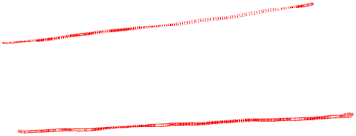
DEQUEUE
This general data class has some possible sub-types:
An input-restricted deque is one where deletion can be made from both ends, but insertion can only be made at one end.
An output-restricted deque is one where insertion can be made at both ends, but deletion can be made from one end only.

Slide 83
DEQUEUE
Various operations of Dequeu are:-
  1.Insertion / enque from rear
  2.Insertion / enque from front
  3.Deletion / deque from front
  4 Deletion / deque from rear
  5.display

Slide 84
Algorithm to Insert / enqueue from rear
FRONT = -1, REAR = -1, TO REPRESENT DEQUEUE IS EMPTY
Algorithm INSERTREAR(QUEUE[N],FRONT,REAR,ITEM)
{
//QUEUE is an array of size N ,ITEM is element to be inserted.
1. if (REAR == N-1)
1.1 PRINT “OVERFLOW”
2. else
2.1 IF(FRONT==-1)
2.1.1 FRONT = 0
2.2. REAR = REAR+1
2.3 QUEUE[REAR] = ITEM
}

Slide 85
Algorithm to Insert / enqueue from front
FRONT = -1, REAR = -1, TO REPRESENT DEQUEUE IS EMPTY
Algorithm INSERTFRONT(QUEUE[N],FRONT,REAR,ITEM)
{
//QUEUE is an array of size N ,ITEM is element to be inserted.
1. if( FRONT == 0)
  1.1 Print “CAN NOT INSERT”
2. else
  2.1 if (FRONT == -1)
2.1.1 FRONT = 0
2.1.2 REAR = 0
2.1 else
2.1.1 FRONT = FRONT-1
2.3 QUEUE[FRONT] = ITEM
}

Slide 86
Algorithm to Delete / dequeue from front
FRONT = -1, REAR = -1, TO REPRESENT DEQUEUE IS EMPTY
Algorithm DELETE(QUEUE[N],ITEM,FRONT,REAR)
{
1. if (( FRONT == – 1 )
1.1 Print “QUEUE EMPTY”
2.Else if(FRONT==REAR)
2.1 Front=-1
2.2 REAR=-1
3. else
3.1 ITEM = QUEUE[FRONT]
3.2 FRONT = FRONT +1
}

Slide 87
Algorithm to Delete / dequeue from rear
FRONT = -1, REAR = -1, TO REPRESENT DEQUEUE IS EMPTY
Algorithm DELETE(QUEUE[N],ITEM,FRONT,REAR)
{
1. if (( FRONT == – 1 )
1.1 Print “QUEUE EMPTY”
2. Else if(FRONT==REAR)
2.1 Front=-1
2.2 REAR=-1
3.
3.1 ITEM = QUEUE[REAR]
3.2 REAR = REAR - 1
}

Slide 88
APPLICATION OF DEQUEUE
The A-Steal job scheduling algorithm
This algorithm implements task scheduling for several processors.
To execute the next thread, the processor gets the first element from the deque (using the "remove first element" deque operation).
If the current thread forks, it is put back to the front of the deque ("insert element at front") and a new thread is executed.
When one of the processors finishes execution of its own threads (i.e. its deque is empty), it can "steal" a thread from another processor: it gets the last element from the deque of another processor

Slide 89
PRIORITY QUEUE
Is a collection of elements where the elements are stored according to their priority levels.
Following rules are applied to maintain a priority queue:-
  The elements with a higher priority is processed before any element of lower priority.
  If there are elements with a same priority ,then the element added first in the queue would get processed.

Slide 90
APPLICATION OF PRIORITY QUEUE
Job Scheduling Algorithm.

Slide 91
Algorithm to insert data in a priority Queue
f = -1, r = -1, TO REPRESENT QUEUE IS EMPTY
Algorithm INSERT(q[N], f, r, item( process no , priority))
{//q is an array of size N ,item is element to be inserted.
1. if(r==N-1)
Print “overflow"
2. if(f==-1)
2.1 f=0 , r=0
2.2 Enter process no and priority ,item // object of structure
2.3 q[r]=item
else
2.1 r=r+1
2.2 Enter process no and priority, item // object of structure
2.3 a[r]=item
2.2 j=r-1
}

Slide 92
2.4 while( q[j] . p < item . p && j >= F)
2.4.1q[j+1] = q[j]
2.4.2 j=j-1
2.5 q[j+1] = item;
}

Slide 93
Algorithm DELETE(q[N],item,f,r)
{
1. if (( f == – 1 ) || (f == r+1))
  1.1 Print “QUEUE EMPTY”
  else
  1.1 f = f +1
  }

Slide 94
Prioriry queue …worst case complexity=o(n)

