Slide 1
Objectives
In this session, you will learn to:
  Identify the features of linked lists
  Implement a singly-linked list
    Insertion in a linked List
    Deletion from a Linked List
    Traversing a Linked list

Slide 2


Linked List
Suppose you have to write an algorithm to generate and store all prime numbers between 1 and 10,00,000 and display them.
How will you solve this problem?

Slide 3
Linked List (Contd.)
Consider the following algorithm, which uses an array to solve this problem:
  Set I = 0
  Repeat step 3 varying N from 2 to 1000000
  If N is a prime number
    Set A[I] = N // If N is prime store it in an array
    I = I + 1
  Repeat step 5 varying J from 0 to I-1
  Display A[J] // Display the prime numbers // stored in the array

Slide 4
Linked List (Contd.)
What is the problem in this algorithm?
  The number of prime numbers between 1 and 10,00,000 is not known. Since you are using an array to store the prime numbers, you need to declare an array of arbitrarily large size to store the prime numbers.
  Disadvantages of this approach, suppose you declare an array of size N:
    If the number of prime numbers between 1 and 10,00,000 is more than N then all the prime numbers cannot be stored.
    If the number of prime numbers is much less than N, a lot of memory space is wasted.

Slide 5
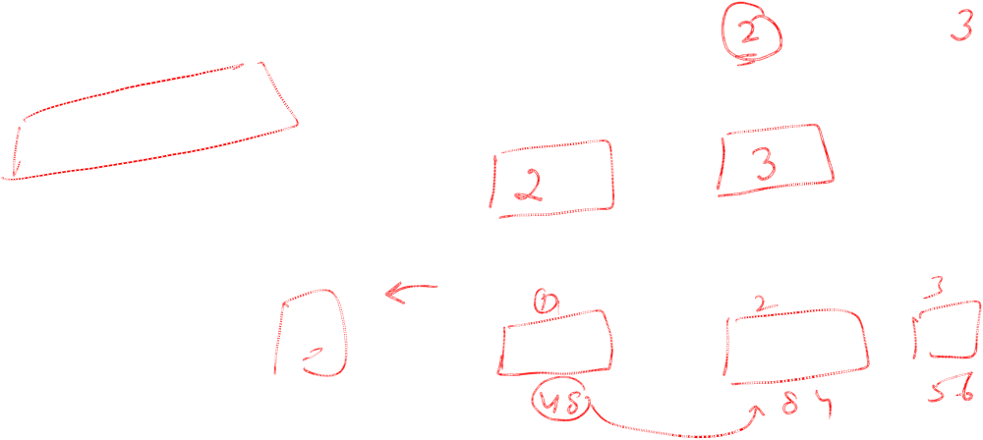
Linked List (Contd.)
Thus, you cannot use an array to store a set of elements if you do not know the total number of elements in advance.
How do you solve this problem?
  By having some way in which you can allocate memory as and when it is required.

Slide 6
Dynamic Memory Allocation
When you declare an array, a contiguous block of memory is allocated.
Let us suppose you declare an array of size 10 to store first 10 prime numbers.
If you know the address of the first element in the array you can calculate the address of any other elements as shown:
  Address of the first element + (size of the element × index of the element)
0
1000
1
1002
2
1004
One contiguous block of memory allocated for the array to store 10 elements.
3
1006
4
1008
5
1010
6
1012
7
1014
8
1016
9
1018
Memory representation

Slide 7
Dynamic Memory Allocation (Contd.)
When memory is allocated dynamically, a block of memory is assigned arbitrarily from any location in the memory.
Therefore, unlike arrays, these blocks may not be contiguous and may be spread randomly in the memory.
0
1000
1
1002
2
1004
One contiguous block of memory allocated for the array to store 10 elements.
3
1006
4
1008
5
1010
6
1012
7
1014
8
1016
9
1018
Memory representation

Slide 8
Dynamic Memory Allocation (Contd.)
Let us see how this happens by allocating memory dynamically for the prime numbers.
Allocate memory for 2
2
Memory allocated for 2
1002
Memory representation

Slide 9
Dynamic Memory Allocation (Contd.)
Let us see how this happens.
Allocate memory for 3
2
Memory allocated for 3
1002
3
1036
Memory representation

Slide 10
Dynamic Memory Allocation (Contd.)
Let us see how this happens.
Allocate memory for 5
2
Memory allocated for 5
1002
5
1008
3
1036
Memory representation

Slide 11
Dynamic Memory Allocation (Contd.)
Let us see how this happens.
Allocate memory for 7
2
Memory allocated for 7
1002
5
1008
7
1020
3
1036
Memory representation

Slide 12
Dynamic Memory Allocation (Contd.)
Let us see how this happens.
Allocate memory for 11
2
Memory allocated for 11
1002
5
1008
7
1020
11
1030
3
1036
Memory representation

Slide 13

Dynamic Memory Allocation (Contd.)
Now, if you know the address of the first element, you cannot calculate the address of the rest of the elements.
This is because, all the elements are spread at random locations in the memory.
To access any element, you need to know its address.
2
1002
5
1008
7
1020
11
1030
3
1036
Memory representation

Slide 14

Dynamic Memory Allocation (Contd.)
Therefore, it would be good if every allocated block of memory contains the address of the next block in sequence.
This gives the list a linked structure where each block is linked to the next block in sequence.
1002
2
1036
1008
5
1020
1020
7
1030
11
1030
1036
3
1008
Memory representation

Slide 15

Dynamic Memory Allocation (Contd.)
You can declare a variable, START, that stores the address of the first block.
You can now begin at START and move through the list by following the links.
An example of a data structure that implements this concept is a linked list.
START
2
1036
1002
1008
5
1020
1020
7
1030
1030
11
1036
3
1008
Memory representation

Slide 16

Defining Linked Lists
Realization of Linked list:
  Is a dynamic data structure.
  Allows memory to be allocated as and when it is required.
  Consists of a chain of elements, in which each element is referred to as a node.

Slide 17
Defining Linked Lists (Contd.)
A node is the basic building block of a linked list.
A node consists of two parts:
  Data: Refers to the information held by the node
  Link: Holds the address of the next node in the list
Data
Link
Node

Slide 18
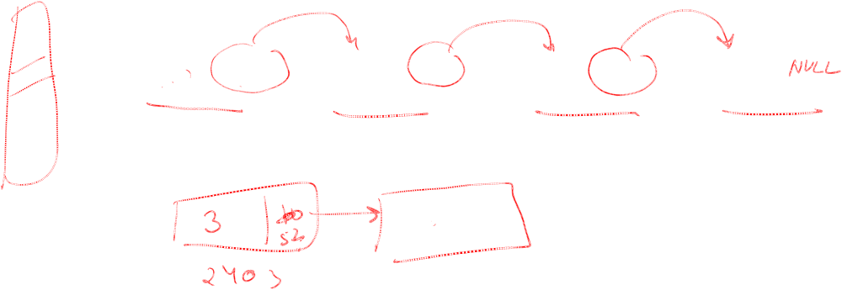
Defining Linked Lists (Contd.)
All the nodes in a linked list are present at arbitrary memory locations.
Therefore, every node in a linked list has link field that stores the address of the next node in sequence.
The last node in a linked list does not point to any other node. Therefore, it points to NULL.
NULL
10
10
10
10
Data
3352
Data
5689
Data
1012
Data
2403
3352
5689
1012

Slide 19
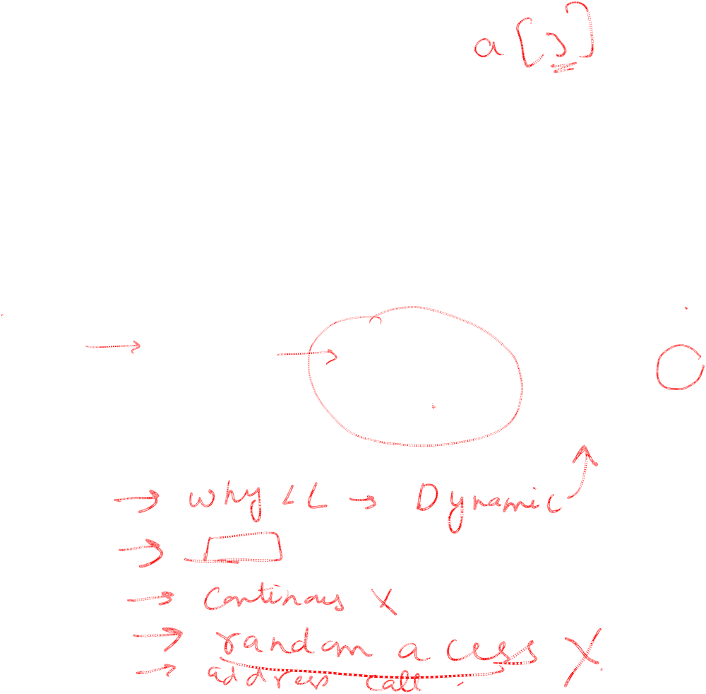
Defining Linked Lists (Contd.)
To keep track of the first node, declare a variable/pointer, START, which always points to the first node.
When the list is empty, START contains null.
NULL
START
10
10
10
10
Data
3352
Data
5689
Data
1012
Data
2403
3352
5689
1012

Slide 20
HOW TO CREATE A NODE IN C
struct node
{
int info;
struct node *next;
};
struct node *new1;
new1=(struct node*) malloc(sizeof(struct node))
new1->info=3;
new1->next=NULL;

Slide 21
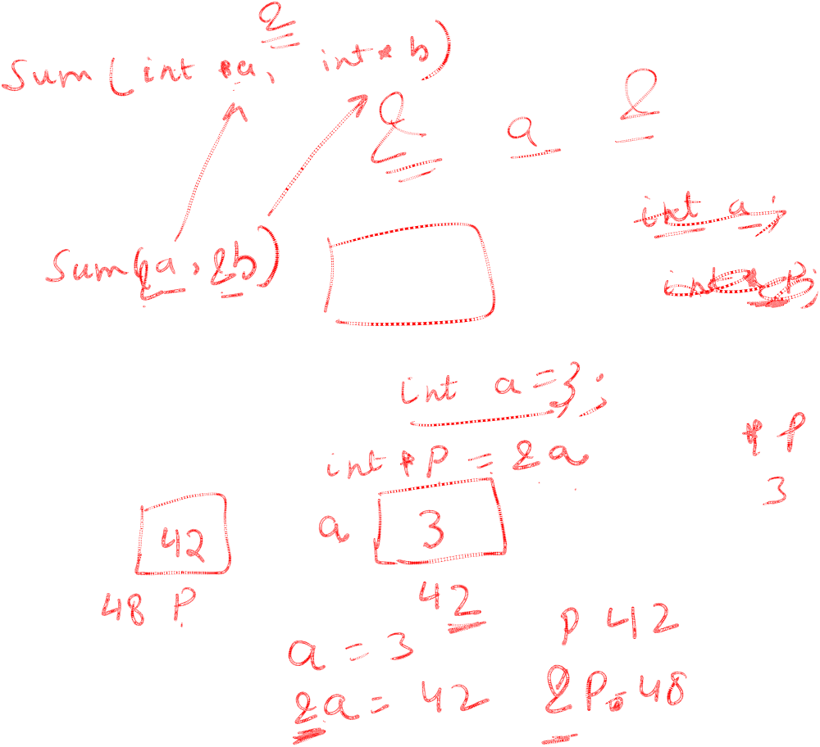
HOW TO CREATE A NODE
class node
{
int info;
node *next;
};
node *new1;
new1=new new1
new1->info=3;
new1->next=NULL;

Slide 22
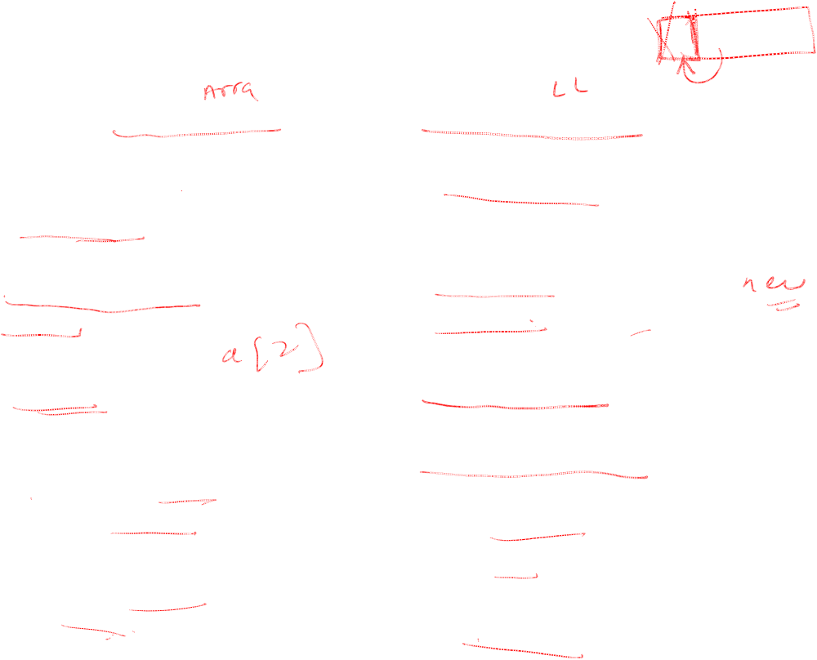
DIFFERENCE
SEQUENTAL ORGANISATION
1)CONTINOUS ALL0CATION.
2)STATIC MEMORY ALLOCATION.
3)DELETION IS LOGICAL NOT ACTUAL.
4)RANDOM ACCESS
5)FROM THE BASE ADDRESS ADDRESS OF EVERY VARIABLE CAN BE CALCULATED.
6)INSERTION ,DELETION IS DIFFICULT
LINKED ORGANISATION
1)ELEMENTS ARE ALLOCATED NON –CONTIGUOSLY
2)DYNAMIC MEMORY ALLOCATION SO NO WASTE.
3)ACTUAL DELETION IS POSSIBE.
4)SEQUENTIAL ACCESS.
5)EACH NODE STORE THE ADDRESS OF NEXT NODE
.
6)INSERTION ,DELETON IS EASY.
A[O] | A[1] | A[2]
DATA | ADDRESS

Slide 23
PRIMITIVE OPERATIONS ON LINKLIST
CREATION
INSERTION
DELETION
TRAVERSING

Slide 24
Link list ADT
Class linklist
{//collection of nodes and each node is having data and
//address to next node
^{Public:}
create(); //construct link list.
Insert();//using this function a node can be inserted at any specific position.
Delete(); //using this function a node can be deleted from specific position.
Search();// using this function specific node can be searched.
}

Slide 25
Dynamic Memory Management
Objectives
Overview of static memory management.
Introducing dynamic memory management.
Dynamic memory allocation.
Dynamic memory deallocation.

Slide 26
Overview of static memory management
In static memory allocation the amount of memory to be allocated
is decided during compile time itself.
This is known as static memory allocation.
Limitations:
It is rigid. The programmers are forced to predict the total amount of data the program will utilize.
During run time, if more memory is required, static memory allocation cannot fulfil the need.
Once a certain memory block is no longer of any use to the program, memory allocated to it cannot be released immediately.
The memory will continue to be held up until the end of the block in which the variable was created.

Slide 27
Dynamic memory management
Solution: Dynamic memory management overcomes the drawbacks of static
memory allocation.
Although memory gets allocated and deallocated during run time only, the decisions to do so can be taken dynamically in response to the requirements arising during run time itself.
Once a certain block of memory is no longer required, it can immediately be returned to the OS.
The OS can then allocate the deallocated memory block if the need arises.
For this, code utilizing the relevant functions and operators provided by C and C++ has to be explicitly written in the source code.

Slide 28
NEW AND DELETE OPERATOR IN C++
dynamically allocates memory on the heap.
In the C++ programming language, new is a language construct that dynamically allocates memory on the heap .
New attempts to allocate enough memory on the heap for the new data. If successful, it initializes the memory and returns the address to the newly allocated and initialized memory.
However if new cannot allocate memory on the heap it returns null or raise an exception.
A call to delete, which calls the destructor and returns the memory allocated by new back to the heap, must be made for every call to new .

Slide 29
Allocating memory dynamically
Syntax: p_var = new typename;
int *p = new int;
allocates an integer, set to 5.
int *p = new int(5);
int *p= new int[5];
Node

Slide 30
Allocating and releasing memory
node *p = new node;
delete p;

Slide 31
Releasing dynamically allocated memory
int *p_var = new int;
delete p_var;
int *p_array = new int[50];
delete[ ] p_array;

Slide 32
Example
#include <iostream.h>
Class student
{int n;
int * p;
Public:
student()
{ cin>>n;
p=new int[n];
if (p == null)
cout << "Error: memory could not be allocated";
}
if (p == null)
cout << "Error: memory could not be allocated";
Input()
{
for (n=0; n<i; n++)
{ cout << "Enter number";
cin >> p[n];
}
}

Slide 33
Dynamic Memory Deallocation
A block of memory allocated dynamically can be deallocated dynamically. Once it is not in use any more, a dynamically allocated block of memory should definitely be returned to the OS.
If they have not been returned to the OS, they will remain locked up. This is
known as a memory leak. If more memory is required, the OS will not allocate this block of memory.

Slide 34
Dynamic Memory Deallocation
Myth: A misconception about the delete operator is due to the commonly used phrase ‘deleting the pointer’. One may think that the memory being occupied by the pointer itself gets removed if the delete operator is used on the pointer.
Reality: When the delete operator is used on a pointer, the pointer continues to occupy its own block of memory and continues to have the same value that is the address of the first byte of the block of memory that has just got deallocated. Thus, the pointer continues to point at the same block of memory(dangling pointer). This will lead to run-time errors if the pointer is dereferenced.

Slide 35
PROBLEMS
Memory leak
Dangling pointers
Problem of memory allocation failure

Slide 36
Inserting a Node in a Singly-Linked List (Contd.)
A new node can be inserted at any of the following positions in the list:
  Beginning of the list
  End of the List
  At specific position
  In a Sorted Linked List

Slide 37
Inserting a Node a Singly-Linked LIST
Allocate memory for the new node.
Assign value to the data field of the new node.
If START is NULL, then (If the list is empty):
  Make START point to the new node.
  Make LAST point to the new node.
  Go to step 6.
Make the next field of LAST point to the new node.
Mark the new node as LAST.
Make the next field of the new node point to NULL.
Refer to the given algorithm to insert a node at the end of the linked list.

Slide 38
Inserting a Node in a Singly-Linked List (Contd.)
Allocate memory for the new node.
Assign value to the data field of the new node.
If START is NULL, then (If the list is empty):
  Make START point to the new node.
  Make LAST point to the new node.
  Go to step 6.
Make the next field of LAST point to the new node.
Mark the new node as LAST.
Make the next field of the new node point to NULL.
Consider that the list is initially empty.
START = NULL
LAST = NULL
Insert a prime number 2.

Slide 39
Inserting a Node in a Singly-Linked List (Contd.)
Allocate memory for the new node.
Assign value to the data field of the new node.
If START is NULL, then (If the list is empty):
  Make START point to the new node.
  Make LAST point to the new node.
  Go to step 6.
Make the next field of LAST point to the new node.
Mark the new node as LAST.
Make the next field of the new node point to NULL.
START = NULL
Insert a prime number 2.

Slide 40
Inserting a Node in a Singly-Linked List (Contd.)
Allocate memory for the new node.
Assign value to the data field of the new node.
If START is NULL, then (If the list is empty):
  Make START point to the new node.
  Make LAST point to the new node.
  Go to step 6.
Make the next field of LAST point to the new node.
Mark the new node as LAST.
Make the next field of the new node point to NULL.
START = NULL
LAST = NULL
2
10

Slide 41
Inserting a Node in a Singly-Linked List (Contd.)
Allocate memory for the new node.
Assign value to the data field of the new node.
If START is NULL, then (If the list is empty):
  Make START point to the new node.
  Make LAST point to the new node.
  Go to step 6.
Make the next field of LAST point to the new node.
Mark the new node as LAST.
Make the next field of the new node point to NULL.
START = NULL
LAST = NULL
2
10

Slide 42
Inserting a Node in a Singly-Linked List (Contd.)
Allocate memory for the new node.
Assign value to the data field of the new node.
If START is NULL, then (If the list is empty):
  Make START point to the new node.
  Make LAST point to the new node.
  Go to step 6.
Make the next field of LAST point to the new node.
Mark the new node as LAST.
Make the next field of the new node point to NULL.
START = NULL
LAST = NULL
START
2
10

Slide 43
Inserting a Node in a Singly-Linked List (Contd.)
Allocate memory for the new node.
Assign value to the data field of the new node.
If START is NULL, then (If the list is empty):
  Make START point to the new node.
  Make LAST point to the new node.
  Go to step 6.
Make the next field of LAST point to the new node.
Mark the new node as LAST.
Make the next field of the new node point to NULL.
LAST = NULL
START
LAST
2
10

Slide 44
Inserting a Node in a Singly-Linked List (Contd.)
Allocate memory for the new node.
Assign value to the data field of the new node.
If START is NULL, then (If the list is empty):
  Make START point to the new node.
  Make LAST point to the new node.
  Go to step 6.
Make the next field of LAST point to the new node.
Mark the new node as LAST.
Make the next field of the new node point to NULL.
START
LAST
2
10

Slide 45
Inserting a Node in a Singly-Linked List (Contd.)
Allocate memory for the new node.
Assign value to the data field of the new node.
If START is NULL, then (If the list is empty):
  Make START point to the new node.
  Make LAST point to the new node.
  Go to step 6.
Make the next field of LAST point to the new node.
Mark the new node as LAST.
Make the next field of the new node point to NULL.
START
LAST
2
10
Insertion complete

Slide 46
Inserting a Node in a Singly-Linked List (Contd.)
Allocate memory for the new node.
Assign value to the data field of the new node.
If START is NULL, then (If the list is empty):
  Make START point to the new node.
  Make LAST point to the new node.
  Go to step 6.
Make the next field of LAST point to the new node.
Mark the new node as LAST.
Make the next field of the new node point to NULL.
Insert a prime number 3.
START
LAST
2
10

Slide 47
Inserting a Node in a Singly-Linked List (Contd.)
Allocate memory for the new node.
Assign value to the data field of the new node.
If START is NULL, then (If the list is empty):
  Make START point to the new node.
  Make LAST point to the new node.
  Go to step 6.
Make the next field of LAST point to the new node.
Mark the new node as LAST.
Make the next field of the new node point to NULL.
Insert a prime number 3.
START
LAST
2
10

Slide 48
Inserting a Node in a Singly-Linked List (Contd.)
Allocate memory for the new node.
Assign value to the data field of the new node.
If START is NULL, then (If the list is empty):
  Make START point to the new node.
  Make LAST point to the new node.
  Go to step 6.
Make the next field of LAST point to the new node.
Mark the new node as LAST.
Make the next field of the new node point to NULL.
START
LAST
2
3
10
10

Slide 49
Inserting a Node in a Singly-Linked List (Contd.)
Allocate memory for the new node.
Assign value to the data field of the new node.
If START is NULL, then (If the list is empty):
  Make START point to the new node.
  Make LAST point to the new node.
  Go to step 6.
Make the next field of LAST point to the new node.
Mark the new node as LAST.
Make the next field of the new node point to NULL.
START
LAST
2
3
10
10

Slide 50
Inserting a Node in a Singly-Linked List (Contd.)
Allocate memory for the new node.
Assign value to the data field of the new node.
If START is NULL, then (If the list is empty):
  Make START point to the new node.
  Make LAST point to the new node.
  Go to step 6.
Make the next field of LAST point to the new node.
Mark the new node as LAST.
Make the next field of the new node point to NULL.
START
LAST
2
3
10
10

Slide 51
Inserting a Node in a Singly-Linked List (Contd.)
Allocate memory for the new node.
Assign value to the data field of the new node.
If START is NULL, then (If the list is empty):
  Make START point to the new node.
  Make LAST point to the new node.
  Go to step 6.
Make the next field of LAST point to the new node.
Mark the new node as LAST.
Make the next field of the new node point to NULL.
START
LAST
LAST
2
3
10
10

Slide 52
Inserting a Node in a Singly-Linked List (Contd.)
Allocate memory for the new node.
Assign value to the data field of the new node.
If START is NULL, then (If the list is empty):
  Make START point to the new node.
  Make LAST point to the new node.
  Go to step 6.
Make the next field of LAST point to the new node.
Mark the new node as LAST.
Make the next field of the new node point to NULL.
START
LAST
2
3
10
10
Insertion complete

Slide 53
Inserting a Node in a Singly-Linked List (Contd.)
Allocate memory for the new node.
Assign value to the data field of the new node.
If START is NULL, then (If the list is empty):
  Make START point to the new node.
  Make LAST point to the new node.
  Go to step 6.
Make the next field of LAST point to the new node.
Mark the new node as LAST.
Make the next field of the new node point to NULL.
Insert a prime number 5.
START
LAST
2
3
10
10

Slide 54
Inserting a Node in a Singly-Linked List (Contd.)
Allocate memory for the new node.
Assign value to the data field of the new node.
If START is NULL, then (If the list is empty):
  Make START point to the new node.
  Make LAST point to the new node.
  Go to step 6.
Make the next field of LAST point to the new node.
Mark the new node as LAST.
Make the next field of the new node point to NULL.
Insert a prime number 5.
START
LAST
2
3
10
10

Slide 55
Inserting a Node in a Singly-Linked List (Contd.)
Allocate memory for the new node.
Assign value to the data field of the new node.
If START is NULL, then (If the list is empty):
  Make START point to the new node.
  Make LAST point to the new node.
  Go to step 6.
Make the next field of LAST point to the new node.
Mark the new node as LAST.
Make the next field of the new node point to NULL.
START
LAST
2
3
5
10
10
10

Slide 56
Inserting a Node in a Singly-Linked List (Contd.)
Allocate memory for the new node.
Assign value to the data field of the new node.
If START is NULL, then (If the list is empty):
  Make START point to the new node.
  Make LAST point to the new node.
  Go to step 6.
Make the next field of LAST point to the new node.
Mark the new node as LAST.
Make the next field of the new node point to NULL.
START
LAST
2
3
5
10
10
10

Slide 57
Inserting a Node in a Singly-Linked List (Contd.)
Allocate memory for the new node.
Assign value to the data field of the new node.
If START is NULL, then (If the list is empty):
  Make START point to the new node.
  Make LAST point to the new node.
  Go to step 6.
Make the next field of LAST point to the new node.
Mark the new node as LAST.
Make the next field of the new node point to NULL.
START
LAST
2
3
5
10
10
10

Slide 58
Inserting a Node in a Singly-Linked List (Contd.)
Allocate memory for the new node.
Assign value to the data field of the new node.
If START is NULL, then (If the list is empty):
  Make START point to the new node.
  Make LAST point to the new node.
  Go to step 6.
Make the next field of LAST point to the new node.
Mark the new node as LAST.
Make the next field of the new node point to NULL.
START
LAST
LAST
2
3
5
10
10
10

Slide 59
Inserting a Node in a Singly-Linked List (Contd.)
Allocate memory for the new node.
Assign value to the data field of the new node.
If START is NULL, then (If the list is empty):
  Make START point to the new node.
  Make LAST point to the new node.
  Go to step 6.
Make the next field of LAST point to the new node.
Mark the new node as LAST.
Make the next field of the new node point to NULL.
START
LAST
2
3
5
10
10
10
Insertion complete

Slide 60
ALGORITHM TO INSERT NODE AT END
Start=NULL
Algorithm InsertAtEnd()
{
1.Create node new1 =new node
2. Enter data [new1 -> info =data]
3.if(Start == NULL)
3.1 Last=new1
3.2 Start=new1
else
3.1 Last -> next = new1
3.2 Last = new1
4. Last ->next = NULL
}

Slide 61
Traversing a Singly-Linked List
Write an algorithm to traverse a singly-linked list.
Algorithm for traversing a linked list.
Make NEW1 point to the first node in the list.
Repeat step 3 and 4 until NEW1 becomes NULL.
Display the information contained in the node marked as NEW1
Make NEW1 point to the next node in sequence.
START
2
3
5
7

Slide 62
Traversing a Singly-Linked List (Contd.)
Make NEW1 point to the first node in the list.
Repeat step 3 and 4 until NEW1 becomes NULL.
Display the information contained in the node marked as NEW1
Make NEW1 point to the next node in sequence.
Refer to the algorithm to display the elements in the linked list.
START
2
3
5
7
10
10
10
10
NEW1

Slide 63
Traversing a Singly-Linked List (Contd.)
Make NEW1 point to the first node in the list.
Repeat step 3 and 4 until NEW1 becomes NULL.
Display the information contained in the node marked as NEW1
Make NEW1 point to the next node in sequence.
Refer to the algorithm to display the elements in the linked list.
START
2
3
5
7
10
10
10
10
NEW1

Slide 64
Traversing a Singly-Linked List (Contd.)
Make NEW1 point to the first node in the list.
Repeat step 3 and 4 until NEW1 becomes NULL.
Display the information contained in the node marked as NEW1
Make NEW1 point to the next node in sequence.
START
2
3
5
7
10
10
10
10
NEW1
2

Slide 65
Traversing a Singly-Linked List (Contd.)
Make NEW1 point to the first node in the list.
Repeat step 3 and 4 until NEW1 becomes NULL.
Display the information contained in the node marked as NEW1
Make NEW1 point to the next node in sequence.
START
2
3
5
7
10
10
10
10
NEW1
2

Slide 66
Traversing a Singly-Linked List (Contd.)
Make NEW1 point to the first node in the list.
Repeat step 3 and 4 until NEW1 becomes NULL.
Display the information contained in the node marked as NEW1
Make NEW1 point to the next node in sequence.
START
2
3
5
7
10
10
10
10
NEW1
2
3

Slide 67
Traversing a Singly-Linked List (Contd.)
Make NEW1 point to the first node in the list.
Repeat step 3 and 4 until NEW1 becomes NULL.
Display the information contained in the node marked as NEW1
Make NEW1 point to the next node in sequence.
START
2
3
5
7
10
10
10
10
NEW1
2
3

Slide 68
Traversing a Singly-Linked List (Contd.)
Make NEW1 point to the first node in the list.
Repeat step 3 and 4 until NEW1 becomes NULL.
Display the information contained in the node marked as NEW1
Make NEW1 point to the next node in sequence.
START
2
3
5
7
10
10
10
10
NEW1
2
3
5

Slide 69
Traversing a Singly-Linked List (Contd.)
Make NEW1 point to the first node in the list.
Repeat step 3 and 4 until NEW1 becomes NULL.
Display the information contained in the node marked as NEW1
Make NEW1 point to the next node in sequence.
START
2
3
5
7
10
10
10
10
NEW1
2
3
5

Slide 70
Traversing a Singly-Linked List (Contd.)
Make NEW1 point to the first node in the list.
Repeat step 3 and 4 until NEW1 becomes NULL.
Display the information contained in the node marked as NEW1
Make NEW1 point to the next node in sequence.
START
2
3
5
7
10
10
10
10
NEW1
2
3
5
7

Slide 71
Traversing a Singly-Linked List (Contd.)
Make NEW1 point to the first node in the list.
Repeat step 3 and 4 until NEW1 becomes NULL.
Display the information contained in the node marked as NEW1
Make NEW1 point to the next node in sequence.
START
2
3
5
7
10
10
10
10
NEW1 = NULL
2
3
5
7
Traversal complete

Slide 72
TRAVERSING IN LIST
Algorithm traversing()
{
1.new1 = Start
2.while(new1 != NULL)
2.1 Print new1 -> info
2.2 new1 = new1 -> next
}

Slide 73
Inserting a Node in a Singly-Linked List (Contd.)
Write an algorithm to insert a node in the beginning of a linked list.

Slide 74
Inserting a Node in a Singly-Linked List (Contd.)
Allocate memory for the new node.
Assign value to the data field of the new node.
Make the next field of the new node point to the first node in the list.
Make START, point to the new node.
Algorithm to insert a node in the beginning of a linked list
START
10
15
17
20

Slide 75
Inserting a Node in a Singly-Linked List (Contd.)
Allocate memory for the new node.
Assign value to the data field of the new node.
Make the next field of the new node point to the first node in the list.
Make START, point to the new node.
Insert 7
new1
START
10
15
17
20
10

Slide 76
Inserting a Node in a Singly-Linked List (Contd.)
Allocate memory for the new node.
Assign value to the data field of the new node.
Make the next field of the new node point to the first node in the list.
Make START, point to the new node.
Insert 7
new1
7
START
10
15
17
20
10

Slide 77
Inserting a Node in a Singly-Linked List (Contd.)
Allocate memory for the new node.
Assign value to the data field of the new node.
Make the next field of the new node point to the first node in the list.
Make START, point to the new node.
new1
7
START
10
15
17
20
10
new1 -> next = START

Slide 78
Inserting a Node in a Singly-Linked List (Contd.)
Allocate memory for the new node.
Assign value to the data field of the new node.
Make the next field of the new node point to the first node in the list.
Make START, point to the new node.
new1
7
START
10
15
17
20
10
Insertion complete
New1 -> next = START
START = new1

Slide 79
Inserting a Node in a Singly-Linked List (Contd.)
Allocate memory for the new node.
Assign value to the data field of the new node.
Make the next field of the new node point to the first node in the list.
Make START, point to the new node.
START
7
10
15
17
20
10
Insertion complete
New1 -> next = START
START = new1

Slide 80
ALGORITHM TO INSERT NODE AT BEGINING
Start=NULL
Algorithm InsertAtBEG()
{
1. Create node [(new1=new node
2. Enter data [new1 -> info = data]
3. If (Start == NULL)
3.1 new1 -> next = NULL
3.2 Last=new1
3.3 Start=new1
else
3.1 new1 -> next=Start
3.2 Start = new1
}

Slide 81
Inserting a Node in a Singly-Linked List (Contd.)
Write an algorithm to insert a node at the particular position in a linked list.

Slide 82
Inserting a Node in a Singly-Linked List (Contd.)
1.Allocate memory for the new node.
2. Assign value to the data field of the new node.
3. Identify the nodes after which the new node is to be inserted. Mark it as previous
  a. Make previous node point to the first node and set count=1
  b. Repeat step c and step d until count becomes equal to location-1
  c. Count=count+1.
  d. Make previous point to next node in sequence
4. Make the next field of the new node point to the next of previous node
5.Make the next field of previous point to the new node.
Insert 16 At LOC = 3
START
10
5
17
2

Slide 83
Inserting a Node in a Singly-Linked List (Contd.)
1.Allocate memory for the new node.
2. Assign value to the data field of the new node.
3. Identify the nodes after which the new node is to be inserted. Mark it as previous
  a. Make previous node point to the first node and set count=1
  b. Repeat step c and step d until count becomes equal to location-1
  c. Count=count+1.
  d. Make previous point to next node in sequence
4. Make the next field of the new node point to the next of previous node
5.Make the next field of previous point to the new node.
new1
START
10
5
17
2
10

Slide 84
Inserting a Node in a Singly-Linked List (Contd.)
1.Allocate memory for the new node.
2. Assign value to the data field of the new node.
3. Identify the nodes after which the new node is to be inserted. Mark it as previous
  a. Make previous node point to the first node and set count=1
  b. Repeat step c and step d until count becomes equal to location-1
  c. Count=count+1.
  d. Make previous point to next node in sequence
4. Make the next field of the new node point to the next of previous node
5.Make the next field of previous point to the new node.
new1
Insert 16
LOC = 3
16
START
10
5
17
2
10

Slide 85
Inserting a Node in a Singly-Linked List (Contd.)
1.Allocate memory for the new node.
2. Assign value to the data field of the new node.
3. Identify the nodes after which the new node is to be inserted. Mark it as previous
  a. Make previous node point to the first node and set count=1
  b. Repeat step c and step d until count becomes equal to location-1
  c. Count=count+1.
  d. Make previous point to next node in sequence
4. Make the next field of the new node point to the next of previous node
5.Make the next field of previous point to the new node.
new1
Insert 16
LOC = 3
16
START
10
5
17
2
10

Slide 86
Inserting a Node in a Singly-Linked List (Contd.)
1.Allocate memory for the new node.
2. Assign value to the data field of the new node.
3. Identify the nodes after which the new node is to be inserted. Mark it as previous
  a. Make previous node point to the first node and set count=1
  b. Repeat step c and step d until count becomes equal to location-1
  c. Count=count+1.
  d. Make previous point to next node in sequence
4. Make the next field of the new node point to the next of previous node
5.Make the next field of previous point to the new node.
new1
16
START
10
5
17
2
10
previous
Count=1

Slide 87
Inserting a Node in a Singly-Linked List (Contd.)
1.Allocate memory for the new node.
2. Assign value to the data field of the new node.
3. Identify the nodes after which the new node is to be inserted. Mark it as previous
  a. Make previous node point to the first node and set count=1
  b. Repeat step c and step d until count becomes equal to location-1
  c. Count=count+1.
  d. Make previous point to next node in sequence
4. Make the next field of the new node point to the next of previous node
5.Make the next field of previous point to the new node.
new1
16
START
10
5
17
2
10
previous
Count=1

Slide 88
Inserting a Node in a Singly-Linked List (Contd.)
1.Allocate memory for the new node.
2. Assign value to the data field of the new node.
3. Identify the nodes after which the new node is to be inserted. Mark it as previous
  a. Make previous node point to the first node and set count=1
  b. Repeat step c and step d until count becomes equal to location-1
  c. Count=count+1.
  d. Make previous point to next node in sequence
4. Make the next field of the new node point to the next of previous node
5.Make the next field of previous point to the new node.
new1
16
START
10
5
17
2
10
previous
Count=2

Slide 89
Inserting a Node in a Singly-Linked List (Contd.)
1.Allocate memory for the new node.
2. Assign value to the data field of the new node.
3. Identify the nodes after which the new node is to be inserted. Mark it as previous
  a. Make previous node point to the first node and set count=1
  b. Repeat step c and step d until count becomes equal to location-1
  c. Count=count+1.
  d. Make previous point to next node in sequence
4. Make the next field of the new node point to the next of previous node
5.Make the next field of previous point to the new node.
new1
Insert 16
16
START
10
5
17
2
10
previous
Nodes located

Slide 90
Inserting a Node in a Singly-Linked List (Contd.)
1.Allocate memory for the new node.
2. Assign value to the data field of the new node.
3. Identify the nodes after which the new node is to be inserted. Mark it as previous
  a. Make previous node point to the first node and set count=1
  b. Repeat step c and step d until count becomes equal to location-1
  c. Count=count+1.
  d. Make previous point to next node in sequence
4. Make the next field of the new node point to the next of previous node
5.Make the next field of previous point to the new node.
new1
16
START
10
5
17
2
10
previous
new1 -> next = previous->next

Slide 91
Inserting a Node in a Singly-Linked List (Contd.)
1.Allocate memory for the new node.
2. Assign value to the data field of the new node.
3. Identify the nodes after which the new node is to be inserted. Mark it as previous
  a. Make previous node point to the first node and set count=1
  b. Repeat step c and step d until count becomes equal to location-1
  c. Count=count+1.
  d. Make previous point to next node in sequence
4. Make the next field of the new node point to the next of previous node
5.Make the next field of previous point to the new node.
new1
16
START
10
5
17
2
10
previous
new1 -> next = previous->next
previous -> next = new1

Slide 92
Inserting a Node in a Singly-Linked List (Contd.)
1.Allocate memory for the new node.
2. Assign value to the data field of the new node.
3. Identify the nodes after which the new node is to be inserted. Mark it as previous
  a. Make previous node point to the first node and set count=1
  b. Repeat step c and step d until count becomes equal to location-1
  c. Count=count+1.
  d. Make previous point to next node in sequence
4. Make the next field of the new node point to the next of previous node
5.Make the next field of previous point to the new node.
16
START
10
5
17
2
10
previous
new1 -> next = previous->next
previous -> next = new1
Insertion complete

Slide 93
ALGORITHM TO INSERT NODE At PARTICULAR POSITION IN A LINKED LIST
Algorithm InsertAtSpec()
{
1. Create node [(new1=(struct node*) malloc(sizeof(struct node))]
2. Enter Data and Location
3. new1->info=Data
4. If (Location == 1)
4.1 new1 -> next = Start
4.2 Start = new1
Else
4.1 Previous = Start
4.2 Count = 1
4.3 While( Count < Location - 1 && Previous !=NULL)
  4.3.1 Previous = Previous -> next
4.3.2 Count++
4.4 new1 -> next = Previous -> next
4.5 Previous -> next = new1
}

Slide 94
Inserting a Node in a Singly-Linked List (Contd.)
Write an algorithm to insert a node in a Sorted linked list.

Slide 95
Inserting a Node in a Singly-Linked List (Contd.)
1. Allocate memory for the new node.
2. Assign value to the data field of the new node.
3. If data of newnode is less than the data of start node, Then
a. make newnode point to the
start node
b. make start point to the
newnode
4. Otherwise,Identify the nodes between which the new node is to be inserted. Mark them as previous and current. To locate previous and current, execute the following steps:
  Make current point to the first node.
  Make previous point to NULL.
  Repeat step d and step e until current.info becomes greater than newnode.info or current becomes equal to NULL.
  Make previous point to current.
  Make current point to the next node in sequence.
5. Make the next field of the new node point to current.
6. Make the next field of previous point to the
new node.
Insert 16
START
10
15
17
20
10

Slide 96
Inserting a Node in a Singly-Linked List (Contd.)
1. Allocate memory for the new node.
2. Assign value to the data field of the new node.
3. If data of newnode is less than the data of start node, Then
a. make newnode point to the
start node
b. make start point to the
newnode
4. Otherwise,Identify the nodes between which the new node is to be inserted. Mark them as previous and current. To locate previous and current, execute the following steps:
  Make current point to the first node.
  Make previous point to NULL.
  Repeat step d and step e until current.info becomes greater than newnode.info or current becomes equal to NULL.
  Make previous point to current.
  Make current point to the next node in sequence.
5. Make the next field of the new node point to current.
6. Make the next field of previous point to the
new node.
new1
START
10
15
17
20
10

Slide 97
Inserting a Node in a Singly-Linked List (Contd.)
1. Allocate memory for the new node.
2. Assign value to the data field of the new node.
3. If data of newnode is less than the data of start node, Then
a. make newnode point to the
start node
b. make start point to the
newnode
4. Otherwise,Identify the nodes between which the new node is to be inserted. Mark them as previous and current. To locate previous and current, execute the following steps:
  Make current point to the first node.
  Make previous point to NULL.
  Repeat step d and step e until current.info becomes greater than newnode.info or current becomes equal to NULL.
  Make previous point to current.
  Make current point to the next node in sequence.
5. Make the next field of the new node point to current.
6. Make the next field of previous point to the
new node.
new1
16
START
10
15
17
20
10

Slide 98
Inserting a Node in a Singly-Linked List (Contd.)
1. Allocate memory for the new node.
2. Assign value to the data field of the new node.
3. If data of newnode is less than the data of start node, Then
a. make newnode point to the
start node
b. make start point to the
newnode
4. Otherwise,Identify the nodes between which the new node is to be inserted. Mark them as previous and current. To locate previous and current, execute the following steps:
  Make current point to the first node.
  Make previous point to NULL.
  Repeat step d and step e until current.info becomes greater than newnode.info or current becomes equal to NULL.
  Make previous point to current.
  Make current point to the next node in sequence.
5. Make the next field of the new node point to current.
6. Make the next field of previous point to the
new node.
new1
16
START
10
15
17
20
10

Slide 99
Inserting a Node in a Singly-Linked List (Contd.)
1. Allocate memory for the new node.
2. Assign value to the data field of the new node.
3. If data of newnode is less than the data of start node, Then
a. make newnode point to the
start node
b. make start point to the
newnode
4. Otherwise,Identify the nodes between which the new node is to be inserted. Mark them as previous and current. To locate previous and current, execute the following steps:
  Make current point to the first node.
  Make previous point to NULL.
  Repeat step d and step e until current.info becomes greater than newnode.info or current becomes equal to NULL.
  Make previous point to current.
  Make current point to the next node in sequence.
5. Make the next field of the new node point to current.
6. Make the next field of previous point to the
new node.
new1
16
START
10
15
17
20
10

Slide 100
Inserting a Node in a Singly-Linked List (Contd.)
1. Allocate memory for the new node.
2. Assign value to the data field of the new node.
3. If data of newnode is less than the data of start node, Then
a. make newnode point to the
start node
b. make start point to the
newnode
4. Otherwise,Identify the nodes between which the new node is to be inserted. Mark them as previous and current. To locate previous and current, execute the following steps:
  Make current point to the first node.
  Make previous point to NULL.
  Repeat step d and step e until current.info becomes greater than newnode.info or current becomes equal to NULL.
  Make previous point to current.
  Make current point to the next node in sequence.
5. Make the next field of the new node point to current.
6. Make the next field of previous point to the
new node.
new1
16
START
10
15
17
20
10
current

Slide 101
Inserting a Node in a Singly-Linked List (Contd.)
1. Allocate memory for the new node.
2. Assign value to the data field of the new node.
3. If data of newnode is less than the data of start node, Then
a. make newnode point to the
start node
b. make start point to the
newnode
4. Otherwise,Identify the nodes between which the new node is to be inserted. Mark them as previous and current. To locate previous and current, execute the following steps:
  Make current point to the first node.
  Make previous point to NULL.
  Repeat step d and step e until current.info becomes greater than newnode.info or current becomes equal to NULL.
  Make previous point to current.
  Make current point to the next node in sequence.
5. Make the next field of the new node point to current.
6. Make the next field of previous point to the
new node.
new1
16
START
10
15
17
20
10
current
previous = NULL

Slide 102
Inserting a Node in a Singly-Linked List (Contd.)
1. Allocate memory for the new node.
2. Assign value to the data field of the new node.
3. If data of newnode is less than the data of start node, Then
a. make newnode point to the
start node
b. make start point to the
newnode
4. Otherwise,Identify the nodes between which the new node is to be inserted. Mark them as previous and current. To locate previous and current, execute the following steps:
  Make current point to the first node.
  Make previous point to NULL.
  Repeat step d and step e until current.info becomes greater than newnode.info or current becomes equal to NULL.
  Make previous point to current.
  Make current point to the next node in sequence.
5. Make the next field of the new node point to current.
6. Make the next field of previous point to the
new node.
new1
16
START
10
15
17
20
10
current
previous = NULL

Slide 103
Inserting a Node in a Singly-Linked List (Contd.)
1. Allocate memory for the new node.
2. Assign value to the data field of the new node.
3. If data of newnode is less than the data of start node, Then
a. make newnode point to the
start node
b. make start point to the
newnode
4. Otherwise,Identify the nodes between which the new node is to be inserted. Mark them as previous and current. To locate previous and current, execute the following steps:
  Make current point to the first node.
  Make previous point to NULL.
  Repeat step d and step e until current.info becomes greater than newnode.info or current becomes equal to NULL.
  Make previous point to current.
  Make current point to the next node in sequence.
5. Make the next field of the new node point to current.
6. Make the next field of previous point to the
new node.
new1
16
START
10
15
17
20
10
previous
current

Slide 104
Inserting a Node in a Singly-Linked List (Contd.)
1. Allocate memory for the new node.
2. Assign value to the data field of the new node.
3. If data of newnode is less than the data of start node, Then
a. make newnode point to the
start node
b. make start point to the
newnode
4. Otherwise,Identify the nodes between which the new node is to be inserted. Mark them as previous and current. To locate previous and current, execute the following steps:
  Make current point to the first node.
  Make previous point to NULL.
  Repeat step d and step e until current.info becomes greater than newnode.info or current becomes equal to NULL.
  Make previous point to current.
  Make current point to the next node in sequence.
5. Make the next field of the new node point to current.
6. Make the next field of previous point to the
new node.
new1
16
START
10
15
17
20
10
previous
current

Slide 105
Inserting a Node in a Singly-Linked List (Contd.)
1. Allocate memory for the new node.
2. Assign value to the data field of the new node.
3. If data of newnode is less than the data of start node, Then
a. make newnode point to the
start node
b. make start point to the
newnode
4. Otherwise,Identify the nodes between which the new node is to be inserted. Mark them as previous and current. To locate previous and current, execute the following steps:
  Make current point to the first node.
  Make previous point to NULL.
  Repeat step d and step e until current.info becomes greater than newnode.info or current becomes equal to NULL.
  Make previous point to current.
  Make current point to the next node in sequence.
5. Make the next field of the new node point to current.
6. Make the next field of previous point to the
new node.
new1
16
START
10
15
17
20
10
previous
current

Slide 106
Inserting a Node in a Singly-Linked List (Contd.)
1. Allocate memory for the new node.
2. Assign value to the data field of the new node.
3. If data of newnode is less than the data of start node, Then
a. make newnode point to the
start node
b. make start point to the
newnode
4. Otherwise,Identify the nodes between which the new node is to be inserted. Mark them as previous and current. To locate previous and current, execute the following steps:
  Make current point to the first node.
  Make previous point to NULL.
  Repeat step d and step e until current.info becomes greater than newnode.info or current becomes equal to NULL.
  Make previous point to current.
  Make current point to the next node in sequence.
5. Make the next field of the new node point to current.
6. Make the next field of previous point to the
new node.
new1
16
START
10
15
17
20
10
previous
current

Slide 107
Inserting a Node in a Singly-Linked List (Contd.)
1. Allocate memory for the new node.
2. Assign value to the data field of the new node.
3. If data of newnode is less than the data of start node, Then
a. make newnode point to the
start node
b. make start point to the
newnode
4. Otherwise,Identify the nodes between which the new node is to be inserted. Mark them as previous and current. To locate previous and current, execute the following steps:
  Make current point to the first node.
  Make previous point to NULL.
  Repeat step d and step e until current.info becomes greater than newnode.info or current becomes equal to NULL.
  Make previous point to current.
  Make current point to the next node in sequence.
5. Make the next field of the new node point to current.
6. Make the next field of previous point to the
new node.
new1
16
START
10
15
17
20
10
previous
current

Slide 108
Inserting a Node in a Singly-Linked List (Contd.)
1. Allocate memory for the new node.
2. Assign value to the data field of the new node.
3. If data of newnode is less than the data of start node, Then
a. make newnode point to the
start node
b. make start point to the
newnode
4. Otherwise,Identify the nodes between which the new node is to be inserted. Mark them as previous and current. To locate previous and current, execute the following steps:
  Make current point to the first node.
  Make previous point to NULL.
  Repeat step d and step e until current.info becomes greater than newnode.info or current becomes equal to NULL.
  Make previous point to current.
  Make current point to the next node in sequence.
5. Make the next field of the new node point to current.
6. Make the next field of previous point to the
new node.
new1
16
START
10
15
17
20
10
previous
current
Nodes located

Slide 109
Inserting a Node in a Singly-Linked List (Contd.)
1. Allocate memory for the new node.
2. Assign value to the data field of the new node.
3. If data of newnode is less than the data of start node, Then
a. make newnode point to the
start node
b. make start point to the
newnode
4. Otherwise,Identify the nodes between which the new node is to be inserted. Mark them as previous and current. To locate previous and current, execute the following steps:
  Make current point to the first node.
  Make previous point to NULL.
  Repeat step d and step e until current.info becomes greater than newnode.info or current becomes equal to NULL.
  Make previous point to current.
  Make current point to the next node in sequence.
5. Make the next field of the new node point to current.
6. Make the next field of previous point to the
new node.
new1
16
START
10
15
17
20
10
previous
current
new1 -> next = current

Slide 110
1. Allocate memory for the new node.
2. Assign value to the data field of the new node.
3. If data of newnode is less than the data of start node, Then
a. make newnode point to the
start node
b. make start point to the
newnode
4. Otherwise,Identify the nodes between which the new node is to be inserted. Mark them as previous and current. To locate previous and current, execute the following steps:
  Make current point to the first node.
  Make previous point to NULL.
  Repeat step d and step e until current.info becomes greater than newnode.info or current becomes equal to NULL.
  Make previous point to current.
  Make current point to the next node in sequence.
5. Make the next field of the new node point to current.
6. Make the next field of previous point to the
new node.
new1
16
START
10
15
17
20
10
previous
current
new1 -> next = current
previous -> next = new1
Insertion complete

Slide 111
1. Allocate memory for the new node.
2. Assign value to the data field of the new node.
3. If data of newnode is less than the data of start node, Then
a. make newnode point to the
start node
b. make start point to the
newnode
4. Otherwise,Identify the nodes between which the new node is to be inserted. Mark them as previous and current. To locate previous and current, execute the following steps:
  Make current point to the first node.
  Make previous point to NULL.
  Repeat step d and step e until current.info becomes greater than newnode.info or current becomes equal to NULL.
  Make previous point to current.
  Make current point to the next node in sequence.
5. Make the next field of the new node point to current.
6. Make the next field of previous point to the
new node.
newnode
16
START
10
15
17
20
10
previous
current
new1 -> next = current
previous -> next = new1
Insertion complete

Slide 112
ALGORITHM TO INSERT NODE IN A SORTED LINKED LIST
Algorithm InsertAtSorted()
{
1. Enter Data
2. Create node [(new1=(struct node*) malloc(sizeof(struct node))]
3. new1->info=Data
4. If (Data <= Start -> info)
4.1 new1 -> next = Start
4.2 Start = new1
Else
4.1 Current = Start
4.2 Previous = NULL
4.3While( Data >= Current -> info && Current != NULL)
  4.3.1 Previous = Current
4.3.2 Current = Current -> next
4.4 new1 -> next = Current
4.5 Previous -> next = new1
}

Slide 113
Deleting a Node from a Singly-Linked List
Delete operation in a linked list refers to the process of removing a specified node from the list.
You can delete a node from the following places in a linked list:
  Beginning of the list
  Between two nodes in the list
  End of the list

Slide 114
Deleting a Node From the Beginning of the List
Write an algorithm to delete the first node in a linked list.

Slide 115
Deleting a Node From the Beginning of the List (Contd.)
Mark the first node in the list as current.
Make START point to the next node in its sequence.
Release the memory for the node marked as current.
Algorithm to delete a node from the beginning of a linked list.
START
10
15
17
20
Notes:
Explain the difference between the delete operation in a linked list in C# and C++.

Slide 116
Deleting a Node From the Beginning of a Linked List (Contd.)
Mark the first node in the list as current.
Make START point to the next node in its sequence.
Release the memory for the node marked as current.
START
10
15
17
20
10
current
current = START

Slide 117
Deleting a Node From the Beginning of a Linked List (Contd.)
Mark the first node in the list as current.
Make START point to the next node in its sequence.
Release the memory for the node marked as current.
START
START
10
15
17
20
10
current
current = START
START = START -> next

Slide 118
Deleting a Node From the Beginning of a Linked List (Contd.)
Mark the first node in the list as current.
Make START point to the next node in its sequence.
Release the memory for the node marked as current.
START
10
15
17
20
current
Memory released
current = START
START = START -> next
Delete operation complete
Notes:
Explain the difference between the delete operation in a linked list in C# and C++.
While explaining the “Release memory” step in the given algorithm, explain that in C# you do not need to explicitly release the memory. This is done automatically by garbage collector.
Ask the student:
Will the same algorithm work when the node to be deleted is the only node in the list?
Explain that in that case when you execute the statement “Make START point to the next node in its sequence”, the next part of the node marked as START will be NULL. Therefore, START will be made to point to NULL to indicate that the list is empty.

Slide 119
ALGORITHM TO DELETE A NODE FROM THE BEGINING
Algorithm DeleteAtBeg()
{
1. If (Start == NULL)
1.1 Print "underflow“
else
1.1 Current = Start
1.2 Start = Start -> next
1.3 Current -> next = NULL
1.4 Release the memory [ free (Current) ]
}

Slide 120
Deleting a Node From the Beginning of the List
Write an algorithm to delete the End node in a linked list.

Slide 121
Deleting a Node From the Beginning of the List (Contd.)
Mark the first node in the list as current..
Repeat step 3 untill current becomes Last node.
Make current point to the next node in its sequence.
Release the memory for the node marked as Last.
Make Current point to the last node
Algorithm to delete a node from the End.
START
Last
10
15
17
20
Notes:
Explain the difference between the delete operation in a linked list in C# and C++.

Slide 122
Deleting a Node From the Beginning of a Linked List (Contd.)
Mark the first node in the list as current..
Repeat step 3 untill current becomes Last node.
Make current point to the next node in its sequence.
Release the memory for the node marked as Last.
Make Current point to the last node
START
Last
10
15
17
20
10
current
current = START

Slide 123
Deleting a Node From the Beginning of a Linked List (Contd.)
Mark the first node in the list as current..
Repeat step 3 untill current becomes Last node.
Make current point to the next node in its sequence.
Release the memory for the node marked as Last.
Make Current point to the last node
START
Last
10
15
17
20
10
current

Slide 124
Deleting a Node From the Beginning of a Linked List (Contd.)
Mark the first node in the list as current..
Repeat step 3 untill next of current becomes Last node.
Make current point to the next node in its sequence.
Release the memory for the node marked as Last.
Make Current point to the last node
START
Last
10
15
17
20
10
current

Slide 125
Deleting a Node From the Beginning of a Linked List (Contd.)
START
Last
10
15
17
20
10
current

Slide 126
Deleting a Node From the Beginning of a Linked List (Contd.)
Mark the first node in the list as current..
Repeat step 3 untill next of current becomes Last node.
Make current point to the next node in its sequence.
Release the memory for the node marked as Last.
Make Current point to the last node
START
Last
10
15
17
20
10
current

Slide 127
Deleting a Node From the Beginning of a Linked List (Contd.)
Mark the first node in the list as current..
Repeat step 3 untill next of current becomes Last node.
Make current point to the next node in its sequence.
Release the memory for the node marked as Last.
Make Current point to the last node
START
Last
10
15
17
20
10
current
Delete operation complete

Slide 128
ALGORITHM TO DELETE A NODE FROM THE END
Algorithm DeleteAtEnd()
{
1. If (Start == NULL)
1.1 Print "underflow“
else If (Start -> next == NULL )
1.1 Release the memory [ free (Start) ]
1.2 Start == NULL
else
1.1 Current = Start
1.2 while ( Current -> next != Last )
1.2.1 Current = Current -> next
1.3 Current -> next = NULL
1.4 Release the memory [ free (Last) ]
1.5 Last = Current
}

Slide 129
Deleting a Node Between two Nodes in the List
Write an algorithm to delete a node from a specific position in a linked list.

Slide 130
Deleting a Node Between two Nodes in the List (Contd.)
Locate the node to be deleted. Mark the node to be deleted as current and its predecessor as previous. To locate current and previous, execute the following steps:
    Set previous = NULL
    Set current = START
    Repeat step d and e until either the node is found or current becomes NULL.
    Make previous point to current .
    Make current point to the next node in sequence.
Make the next field of previous point to the successor of current.
Release the memory for the node marked as current.
Algorithm to delete a node from a specific position.
Delete 17
START
10
15
17
20

Slide 131
Deleting a Node Between two Nodes in the List (Contd.)
Locate the node to be deleted. Mark the node to be deleted as current and its predecessor as previous. To locate current and previous, execute the following steps:
    Set previous = NULL
    Set current = START
    Repeat step d and e until either the node is found or current becomes NULL.
    Make previous point to current.
    Make current point to the next node in sequence.
Make the next field of previous point to the successor of current.
Release the memory for the node marked as current.
Delete 17
START
10
15
17
20
10

Slide 132
Deleting a Node Between two Nodes in the List (Contd.)
Locate the node to be deleted. Mark the node to be deleted as current and its predecessor as previous. To locate current and previous, execute the following steps:
    Set previous = NULL
    Set current = START
    Repeat step d and e until either the node is found or current becomes NULL.
    Make previous point to current.
    Make current point to the next node in sequence.
Make the next field of previous point to the successor of current.
Release the memory for the node marked as current.
Delete 17
START
10
15
17
20
10
Previous = NULL

Slide 133
Deleting a Node Between two Nodes in the List (Contd.)
Locate the node to be deleted. Mark the node to be deleted as current and its predecessor as previous. To locate current and previous, execute the following steps:
    Set previous = NULL
    Set current = START
    Repeat step d and e until either the node is found or current becomes NULL.
    Make previous point to current.
    Make current point to the next node in sequence.
Make the next field of previous point to the successor of current.
Release the memory for the node marked as current.
Delete 17
START
10
15
17
20
10
current
Previous = NULL

Slide 134
Deleting a Node Between two Nodes in the List (Contd.)
Locate the node to be deleted. Mark the node to be deleted as current and its predecessor as previous. To locate current and previous, execute the following steps:
    Set previous = NULL
    Set current = START
    Repeat step d and e until either the node is found or current becomes NULL.
    Make previous point to current.
    Make current point to the next node in sequence.
Make the next field of previous point to the successor of current.
Release the memory for the node marked as current.
Delete 17
START
10
15
17
20
10
current
Previous = NULL

Slide 135
Deleting a Node Between two Nodes in the List (Contd.)
Locate the node to be deleted. Mark the node to be deleted as current and its predecessor as previous. To locate current and previous, execute the following steps:
    Set previous = NULL
    Set current = START
    Repeat step d and e until either the node is found or current becomes NULL.
    Make previous point to current.
    Make current point to the next node in sequence.
Make the next field of previous point to the successor of current.
Release the memory for the node marked as current.
Delete 17
START
10
15
17
20
10
previous
current

Slide 136
Deleting a Node Between two Nodes in the List (Contd.)
Locate the node to be deleted. Mark the node to be deleted as current and its predecessor as previous. To locate current and previous, execute the following steps:
    Set previous = NULL
    Set current = START
    Repeat step d and e until either the node is found or current becomes NULL.
    Make previous point to current.
    Make current point to the next node in sequence.
Make the next field of previous point to the successor of current.
Release the memory for the node marked as current.
Delete 17
START
10
15
17
20
10
previous
current
current

Slide 137
Deleting a Node Between two Nodes in the List (Contd.)
Locate the node to be deleted. Mark the node to be deleted as current and its predecessor as previous. To locate current and previous, execute the following steps:
    Set previous = NULL
    Set current = START
    Repeat step d and e until either the node is found or current becomes NULL.
    Make previous point to current.
    Make current point to the next node in sequence.
Make the next field of previous point to the successor of current.
Release the memory for the node marked as current.
Delete 17
START
10
15
17
20
10
previous
current

Slide 138
Deleting a Node Between two Nodes in the List (Contd.)
Locate the node to be deleted. Mark the node to be deleted as current and its predecessor as previous. To locate current and previous, execute the following steps:
    Set previous = NULL
    Set current = START
    Repeat step d and e until either the node is found or current becomes NULL.
    Make previous point to current.
    Make current point to the next node in sequence.
Make the next field of previous point to the successor of current.
Release the memory for the node marked as current.
Delete 17
START
10
15
17
20
10
previous
previous
current

Slide 139
Deleting a Node Between two Nodes in the List (Contd.)
Locate the node to be deleted. Mark the node to be deleted as current and its predecessor as previous. To locate current and previous, execute the following steps:
    Set previous = NULL
    Set current = START
    Repeat step d and e until either the node is found or current becomes NULL.
    Make previous point to current.
    Make current point to the next node in sequence.
Make the next field of previous point to the successor of current.
Release the memory for the node marked as current.
Delete 17
START
10
15
17
20
10
previous
current
current

Slide 140
Deleting a Node Between two Nodes in the List (Contd.)
Locate the node to be deleted. Mark the node to be deleted as current and its predecessor as previous. To locate current and previous, execute the following steps:
    Set previous = NULL
    Set current = START
    Repeat step d and e until either the node is found or current becomes NULL.
    Make previous point to current.
    Make current point to the next node in sequence.
Make the next field of previous point to the successor of current.
Release the memory for the node marked as current.
Delete 17
START
10
15
17
20
10
previous
current

Slide 141
Deleting a Node Between two Nodes in the List (Contd.)
Locate the node to be deleted. Mark the node to be deleted as current and its predecessor as previous. To locate current and previous, execute the following steps:
    Set previous = NULL
    Set current = START
    Repeat step d and e until either the node is found or current becomes NULL.
    Make previous point to current.
    Make current point to the next node in sequence.
Make the next field of previous point to the successor of current.
Release the memory for the node marked as current.
Delete 17
START
10
15
17
20
10
previous
current
Previous -> next = current -> next

Slide 142
Deleting a Node Between two Nodes in the List (Contd.)
Locate the node to be deleted. Mark the node to be deleted as current and its predecessor as previous. To locate current and previous, execute the following steps:
    Set previous = NULL
    Set current = START
    Repeat step d and e until either the node is found or current becomes NULL.
    Make previous point to current.
    Make current point to the next node in sequence.
Make the next field of previous point to the successor of current.
Release the memory for the node marked as current.
Delete 17
Delete operation complete
START
10
15
17
20
10
previous
current
Previous -> next = current -> next

Slide 143
ALGORITHM TO DELETE A NODE FROM THE SPECIFIC POSITION
Algorithm DeleteAtSpec()
{
1. Enter the Location
2. Current = Start
3. Previous = NULL
4. If (Start == 0)
4.1 Print "underflow“
else If ( Location == 1)
4.1 Start = Start -> next
4.2 Current -> next = NULL
4.3 Release the memory [ free (Current) ]
else
4.1 for (i=1 to Location-1)
      4.1.1 Previous = Current
      4.1.2 Current = Current -> next
4.2 Previous -> next = Current -> next
4.3 Current -> next = NULL
4.4 Release the memory [ free (Current) ]
}

Slide 144
Group Discussion
Problem Statement
  Discuss the advantages and disadvantages of linked lists.
Notes:
Tell the students that till this point, they have learnt about singly-linked list in which every node holds the address of the next node in sequence

Slide 145
Group Discussion (Contd.)
Problem Statement
  Discuss the differences between arrays and linked lists.

Slide 146
Just a minute
Linked lists allow _________ access to elements.
Answer:
  sequential

