Slide 1
XGBoost
MSCA 31010 Linear and Non-Linear Models Presentation Group 6:
Siddarth Balasubramani, Joshua Dai, Oluwafemi Fabiyi, Elly Yang, Mike Wu

Slide 2
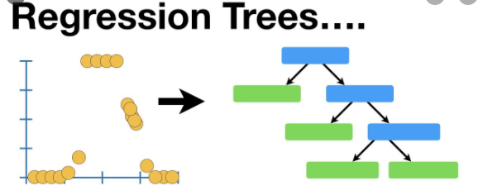
Tree Algorithm & Boosting
What is tree model
How it works
The Con of the tree model
Unstable
Prone to over fit
What can we do to improve?
Implement strategy such as ensemble algorithm or, bagging, boosting to overcome the con of tree algorithm
Boosting
- combining several weak learners into stronger leaner
- training predictors sequentially, and each trying to correct its predecessor

Slide 3
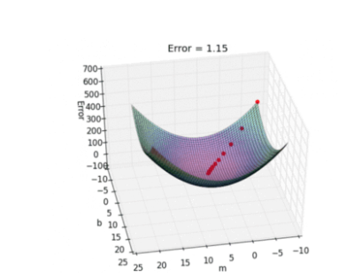

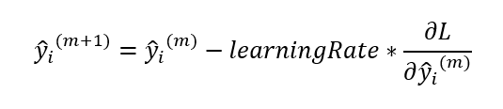
Gradient Boosting Intuition from Gradient Descent
Squared Residuals
Gradient Descent Formula

Slide 4
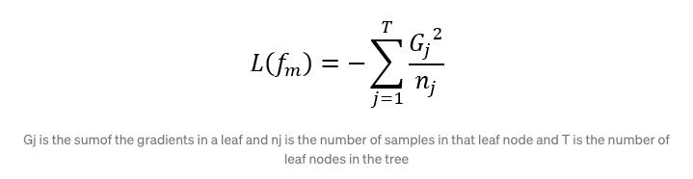
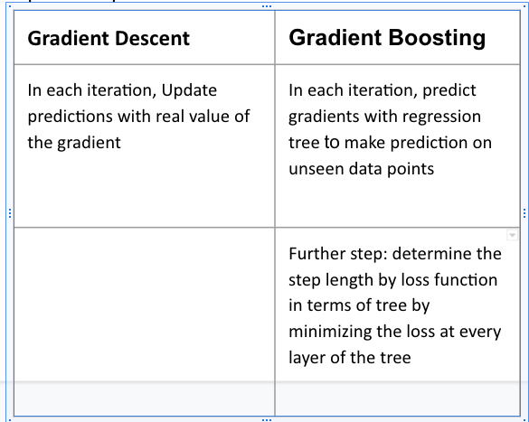
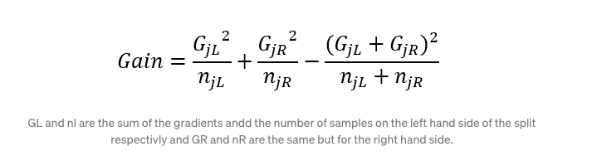
Classic Gradient Boosting
Classic Gradient Boosting Definition:
Sequentially adding predictors to an ensemble, each one correcting its predecessor
Fit the new predictor to the residual errors made by previous predictor
To determine the step length (pm) that the will be taken in the direction

Slide 5
How XGBoost Works ? Why It is so Popular?
“XGBoost” builds upon the foundations of gradient boosting by introducing regularization to combat over fitting along with numerous other additions. so its another name is “regularized gradient boosting”
Improvements based on the natural gradient boosting:
1.Newton Raphson Method Boosting
2.Regularization
3.Handling Missing Values
4.Weighted Quantiles Sketch
5.Custom loss Function
6.Parallel Processing- Core Algorithm is Parallelizable
Benefit:
Speed and Performance
Consistently Outperforms single-algorithm methods
State-of-the-art performance in many ML tasks/datasets

Slide 6
XGBoost Implementation
Credit Default Classification Model

Slide 7
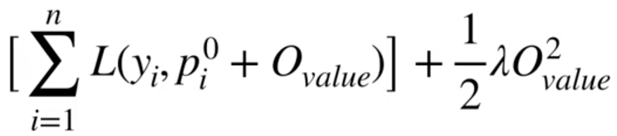
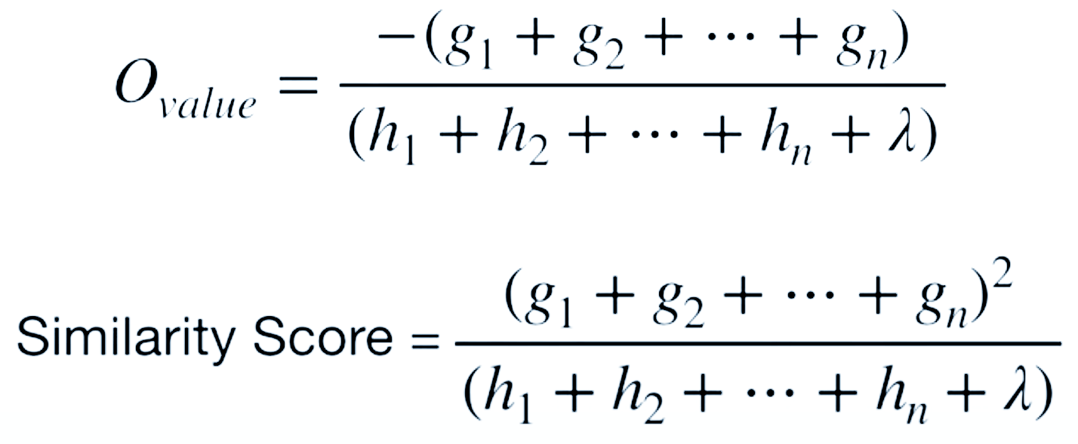
Algorithms
XGBoost builds trees by finding the O_value that minimizes this equation:
Solve for O_value and Similarity Score and configure equations for regression or classification by plugging in the first derivative (gradient) g and the second derivative (hessian) h of the loss function:
Loss Function
Regularization

Slide 8
Data description - Auto insurance fraud claims
Policy
28836 obs. of 10 variables
Containing insurance policy limits, deductibles, coverage, premium and etc.
Demographics
28836 obs. of 10 variables
Containing customer age, gender, education, occupation, hobbies, and etc.
Claims
28836 obs. of 19 variables
Containing incident type, date, location, injury, property damage, witness, and etc.
Vehicles
115344 obs. of 3 variables
Containing vehicle attributes and details

Slide 9
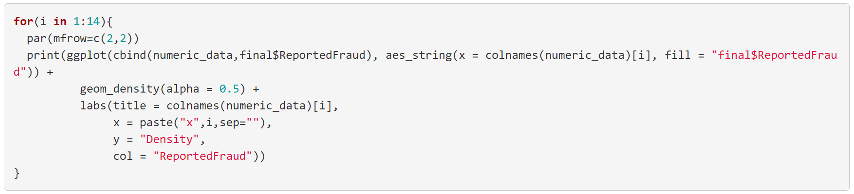

Various steps taken in the process
Data Variable Distribution and Correlations
Our dataset’s y variable is extremely unbalanced with 21,000 observations of non-fraud cases and 7,785 of fraud cases, and 40 different columns.
Correlation plot: The correlations between variables are hugely minimal.
Data Imputation: Imputed Gender based on relationship and then Performed a central Imputation
Feature Engineering:
Divided Zip code by 1000
Days remaining for insurance
Days insurance has been active
Two Main Visualization Methods:
5. Density plots for numerical variables
WOE Binning and IV scores for variable selection
IV - Classically this serves as variable ranking method and allows us to perform feature selection

Slide 10
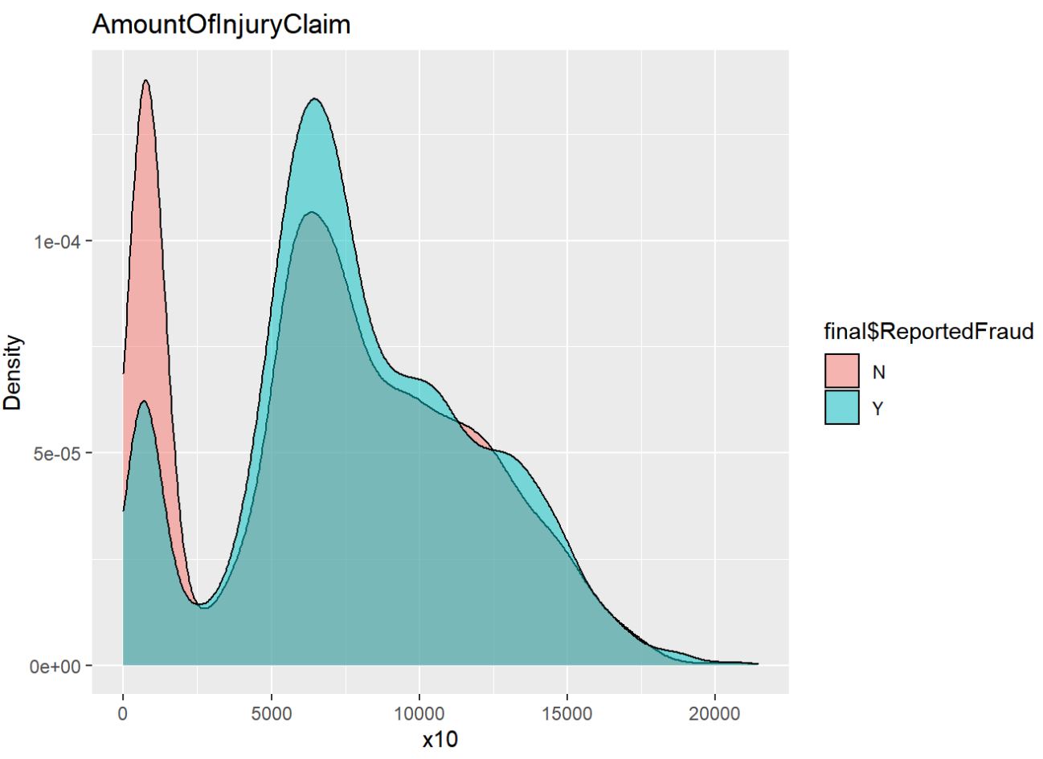
Visualization - Density Plot for All Numeric Variables
Density plot
X axis represents the numeric scale of the variable
Y axis represents the density of fraud and non-fraud data
The interfering area represents the similar y output given x.
Insights
We don’t see massive differences between the N & Y given all 14 variables
We can see from the left that the lower the amount of injury claims the higher the probability that there will be no reported fraud

Slide 11
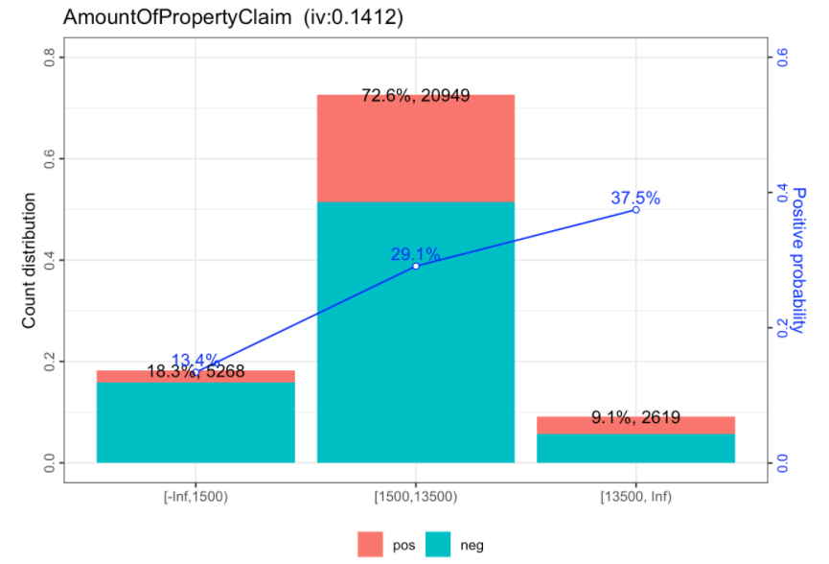
Visualization - WOE Binning with IV Scores
Bar/Line Charts
X axis represents the categorical data of x variables
Y axis represents the count of fraud and non-fraud data (good & bad)
Bad probability represents the possibility that given a data within the x category, it will be a fraud
Insights
We can see from the left that the longer the customer loyalty period does not necessarily represent the good credits. The bad probability rate tends to go up

Slide 12
Library and Hyper-Parameters used
We used the H2O Library to the run the xgboost model, as it’s the most efficient and fastest package for model building
Hyper parameters
Booster - Sets the booster type (gbtree, gblinear etc) to use. We used gbtree
ETA - controls learning rate. [0,1]. default = 0.3., we used 0.151
Nrounds - controls maximum number of iterations.For a lower eta increase nrounds.
Gamma - controls the loss reduction required (regularization). More the gamma conservative the model. [0,Inf]
Max_depth - controls depth of tree. [0,Inf], we used 8
min_child_weight - minimum sum of instance weights in child node. Prevents overfitting. [0,Inf]
Subsample - Number of samples supplied to tree. [0,1]
colsample_bytree- controls number of features supplied
to the tree. [0,1]
lambda- controls L2 regularization
alpha- controls l1 regularization
Eval_metric - Metric for validation of data. We used the AUC scores to validate
Notes:
Hyper parameters

Slide 13
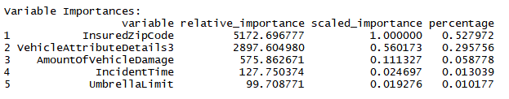
Results
Top 5 Variable Importance
Model Performance compared to GLM
Metric | XGBOOST | GLM (family = “Binomial”)
AUC score | 0.90 | 0.74
Accuracy | 0.91 | 0.75
F1 Score | 0.83 | 0.67

Slide 14
Thank You and Question ?

