Slide 1
HACKATHON - real-time care Clothes

Slide 2
Purpose
Target population
Part-I: Health care
Elder people, especially for the part that has some heart disease
People with high pressure
Part-II: Fashion
People doing some actions with irritant
People like fashions
Goal
Give directly feedback when those people face high pressure or heart beating too quickly, make them feel relax or drive them to make some relax.
Sending data to cloud and share with others

Slide 3
Part-i: Health care
Feedback to elder people
Notify them to take some drugs
Send message to their children
Send help to people nearby
Feedback to high pressure people
New driver
Change car light
Play music
ITer, Consulter
Send alert
Play some music

Slide 4
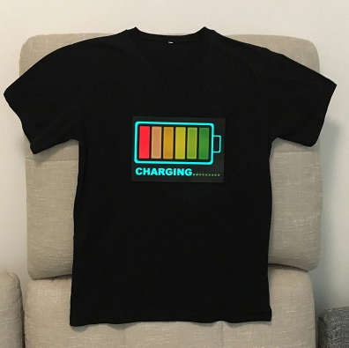
Part-II: Fashion

Slide 5
MAIN technology
IOT development knowledge
Mobile application development knowledge
Azure service knowledge
Design

