Slide 1
Automatic Code Verification by Formal Analysis
Szilvási, Krisztián Fenyvesi, Róbert krisztian.szilvasi.3@gmail.com fenyvesr@gmail.com
December 11, 2019

Slide 2
Project Information
Project acronym: ACROSS
Project full title: Automatic Code Verification by Formal Analysis
Grant agreement no.: FP7-199502
Date of preparation of Annex I (latest version): 2019.11.23

Slide 3
Project Architecture

Slide 4
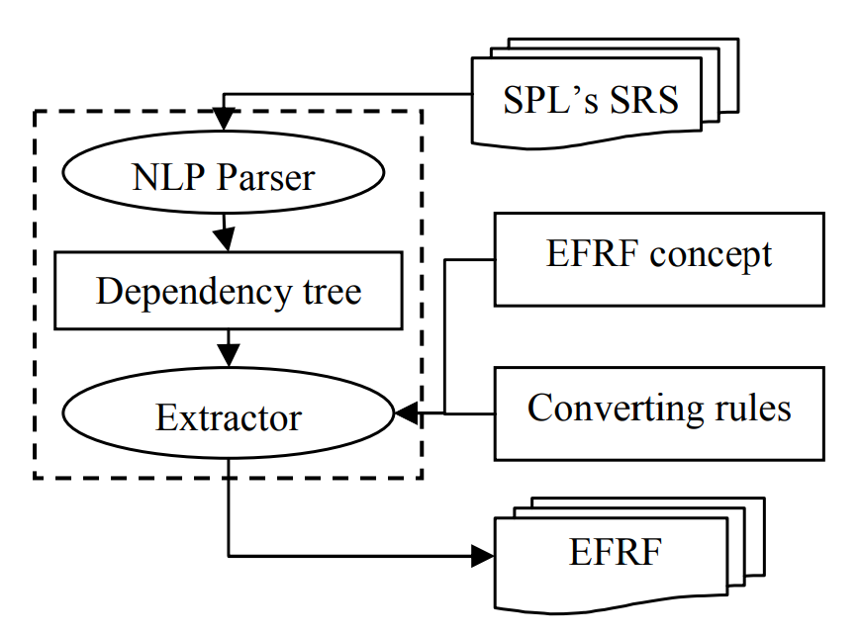
SRS Analysis

Slide 5
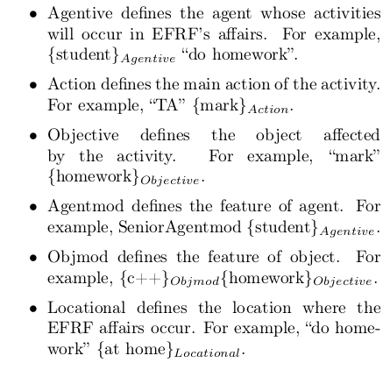
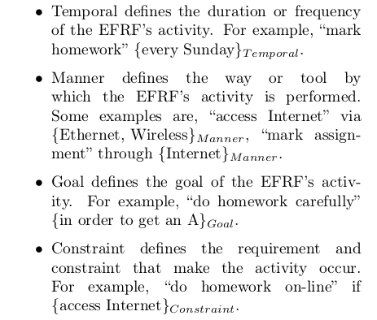
SRS Analysis

Slide 6
Semantic Analyzer
State of the Art:
Charles McEwen Ellison III’s “A Formal Semantics of C with Applications”
Formal Analysis of MISRA C
Problems with _Complex and _Imaginary

Slide 7
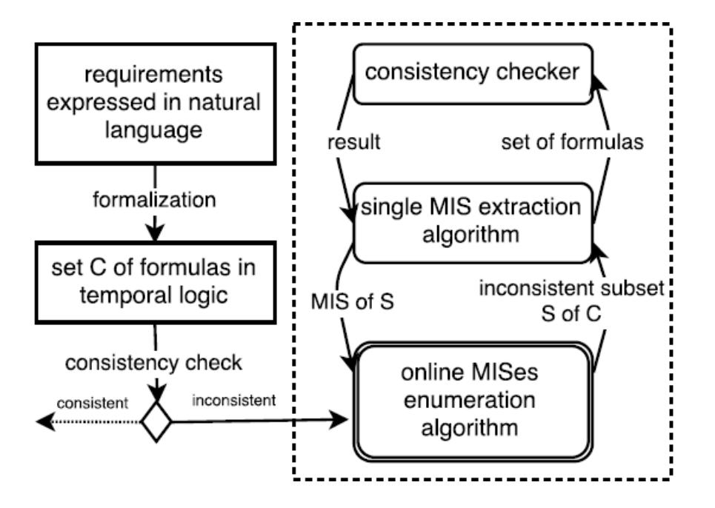
Consistency Check
MIS Analysis

Slide 8
Verifier
Compassing both formal outputs
Fix suggestions

Slide 9
Conclusions and future work
Extend training set of RNN’s input
Research of non-functional requirements extension
Extend architecture with semantic analyzers of different languages

