Slide 1
Countdown++
Felix Sun

Slide 2
Rules
Calculators allowed
After I finish reading, you have 1 minute to answer each question.
You may buzz in before I finish reading.
All answers must be in simplest, exact form, unless otherwise noted.

Slide 3
Q1
Find, where i is the imaginary constant:

Slide 4
A1
0

Slide 5
Q2
A point is randomly selected in the rectangle bounded by (0,0), (8,0), (8,6), and (0,6). What is the probability that the point is closer to (1,4) than it is to (5,0)?

Slide 6
A2
1/2

Slide 7
Q3
Find the seventh smallest positive integer with exactly 6 divisors (including one and itself).

Slide 8
A3
63 (12,18,20,28,45,50,63)

Slide 9
Q4
Bob tried doing 123,123 x 456,456 on his calculator, but all he got was 5.620023209 x 10^10. Find the exact value of 123,123 x 456,456.

Slide 10
A4
56,200,232,098

Slide 11
Q5
Solve for x to the nearest 0.01:

Slide 12
A5
-9.83

Slide 13
Q6
I have a cone of radius 4 and height 4√3. What is the radius of the largest sphere that fits within this cone?

Slide 14
A6
4√3 / 3

Slide 15
Q7
A factory gets an order for 5724 folding chairs. The problem is, all the workers are new and inexperienced, so they can only make 4 chairs on the first day. For each day afterward, they gain experience, and can make 4 more chairs than they did the day before. So, on the second day, the factory makes 8 chairs, bringing its total to 12. After how many days will the factory finish its order?

Slide 16
A7
53

Slide 17
Q8
I have gallon of a mix of grape, apple, and orange juice. If I add a quart of grape juice and 5.5 cups of orange juice to the mix, then the resulting drink will be exactly a third of each of the juices. What percent of the original drink was orange juice? Express your answer exactly.

Slide 18
A8
18.75%

Slide 19
Q9
Circle A of radius 8 and circle B of radius 18 are externally tangent in the diagram. What is the length of CD (their common tangent)?
D
C
A
B

Slide 20
A9
24

Slide 21
Q10
A phone number is cool if it is either of the form abc-abcd or of the form abc-dabc (or both) for some digits a ≠ 0, b, c, and d. If numbers are assigned randomly, what is the chance that you will get a cool phone number? (Note: For the purposes of this problem, the 1st digit of any phone number cannot be 0, but there is no such restriction on the remaining digits.)

Slide 22
A10
1999/1,000,000

Slide 23
Q11
A window has 9 panes in the form of a square 3 x 3 grid. In how many ways can one color 6 of these panes yellow, so that the window looks the same from inside and outside the house?

Slide 24
A11
10

Slide 25
Q12
How many different ways are there to place seven rooks on a chessboard so that no two attack each other or occupy the same square?
Recall that a chessboard is an 8 by 8 grid. A rook attacks all the squares in the row and column that it occupies, a total of 15 squares.

Slide 26
A12
322560

Slide 27
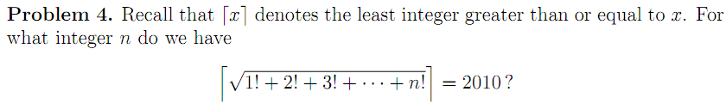
Q13

Slide 28
A13
10

Slide 29
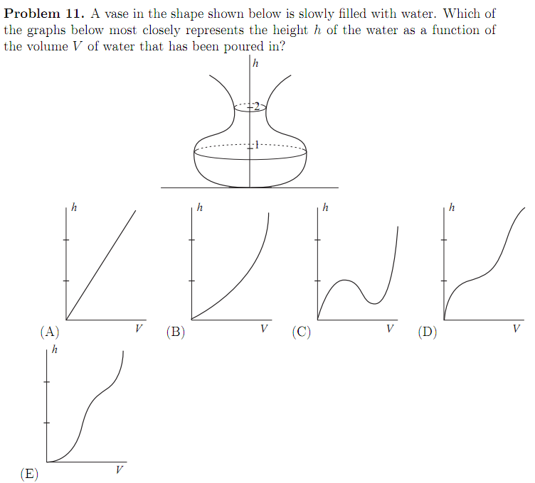
Q14

Slide 30
A14
D

Slide 31
Q15
Let S be the sum of all seven-digit numbers whose digits are some permutation of 1, 2, 3, 4, 5, 6, and 7. Find the next-to-last (“tens”) digit of S.

Slide 32
A15
6

Slide 33
Q16
What is the smallest positive integer that cannot be written as the sum of 6 or fewer factorials?

Slide 34
A16
47

Slide 35
Q17
A triangle has two sides of 8 and 7. If I want the area of the triangle to be as large as possible, what length should I make the third side? Express your answer as a decimal to the nearest hundredths.

Slide 36
A17
10.63

Slide 37
Q18
If x! is divisible by 3¹⁹, find the minimum possible value of x.

Slide 38
A18
42

Slide 39
Q19
Find the remainder when 9 x 99 x 999 x … x 99…999 is divided by 1000.
999 9’s

Slide 40
A19
109

Slide 41
Q20
A Segway has 2 wheels, both with a diameter of 10 inches. They are spaced 20 inches apart. The inner wheel spins at 30 rotations per minute, and the outer one spins at 45 rotations per minute. How many seconds does it take for the Segway to make a complete circle?

Slide 42
A20
16

Slide 43
Q21
Two points are picked at random on the circle x^2 + y^2 = 1. What is the probability that the chord they determine is longer than 1?

Slide 44
A21
2/3

Slide 45
Q22
A circle of radius 1 inch rolls inside a circle of radius 12 inches. How many full revolutions does it make before returning to its original position?

Slide 46
A22
11

Slide 47
Q23
How many different primes appear as entries in the first 20 rows of Pascal's triangle?

Slide 48
A23
8

Slide 49
Q24
How many integers between 1 and 2010 inclusive are divisible by neither 3 nor 5?

Slide 50
A24
1072

Slide 51
Q25
The number 811_ in base 9 is a perfect square. What base 9 digit goes in the blank?

Slide 52
A25
7

Slide 53
Q26
John has a bunch of shoes in his closet, but only 2/3 of the left shoes have matching right shoes, and only 3/5 of the right shoes have matching left shoes. What fraction of the shoes are parts of matching pairs? (No shoe is part of two pairs.)

Slide 54
A26
12/19

Slide 55
Q27
If a child is born in 2009, what will be the next year that both her age and the year are perfect squares?

Slide 56
A27
2025

Slide 57
Q28
Archimedes shouts “Eureka!” once every 2 minutes. Pythagoras shouts “Integer!” once every 5 minutes. They both shout their respective words for the first time at noon. At what time will they both shout at the same time for the 20th time?

Slide 58
A28
3:10 PM

Slide 59
Q29
All the positive integers up to n are added. What is the probability that the sum is divisible by three?

Slide 60
A29
2/3

Slide 61
Q30
Adding 10 to both the numerator and denominator of a fraction equal to ¾ results in a fraction equal to 8/9. What is the sum of the numerator and denominator of the original fraction?

Slide 62
A30
14

Slide 63
Q31
Consider the number 15! = 1 · 2 · 3 · · · 14 · 15 Add its digits to obtain a new number. Add its digits to obtain a new number, and continue this process until you get a single digit. What is it?

Slide 64
A31
9

Slide 65
Q32
Let n be the greatest number that is the product of some positive integers (possibly not distinct), such that the sum of these integers is 2009. Find the last digit of n.

Slide 66
A32
6

Slide 67
Q33
A group of hikers went on a 3.5-hour hike. In any consecutive one-hour period during their hike, they covered exactly two miles. What is the most distance they could have covered (in miles)?

Slide 68
A33
8

Slide 69
Q34
If a star is born in 2009, how many times will it happen that both its age and the year are perfect squares?

Slide 70
A34
3

Slide 71
Q35
2009 kittens are sleeping in their individual crates, numbered 1 through 2009. A veterinary assistant decides to open all 2009 doors in order while the cats are asleep. He then goes back to the beginning and closes all the even-numbered doors. He then goes back to the beginning and changes every door divisible by three (i.e., if it’s open, he closes it, and if it’s closed, he opens it). He then continues this process for every integer k ≤ 2009, so that on the last trip, he changes precisely the 2009th door. When the kittens awake in the morning, what is the largest numbered crate whose kitten will roam free?

Slide 72
Q35
1936

Slide 73
Q36
Each inhabitant of Tiebreak Island is either a truth-teller or a liar. You come across three inhabitants of the island.
Rick says “Randy is telling the truth.”
Randy says “Rick and Rose are lying.”
Rose says “Rick is lying.”
Name all the people who are lying.

Slide 74
A36
Rick, Randy

Slide 75
Q37
A coin is weighted in such a way that it will come up heads 60% of the time. If this coin is flipped three times, what is the probability that it will come up heads fewer than two times? Express your answer as an exact percent.

Slide 76
A37
35.2%

Slide 77
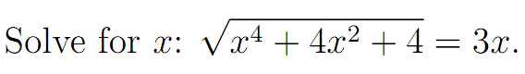
Q38
Name all solutions.

Slide 78
A38
1, -1, 2, -2

Slide 79
Q39
Groups A, B and C have 10, 12 and 14 members, respectively. The total population is 25. If 6 members belong to both A and B, 4 members belong to both A and C, and 5 members belong to both B and C, then how many members belong to all three groups?

Slide 80
A39
4

Slide 81
Q40
The sixth term of a geometric series is 3072. The third term is 48. Find the first term.

Slide 82
A40
3

Slide 83
Q41
How many whole numbers between 1000 and 2008 include a 2 and a 5 as consecutive digits, in that order? (For example, we would count 1258, since the 2 and 5 appear consecutively. We would not count 1528, since the digits 2 and 5 are consecutive but in the wrong order. We would not count 1285, since the digits 2 and 5 appear but are not consecutive.)

Slide 84
A41
20

Slide 85
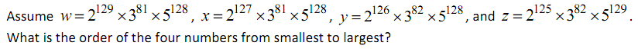
Q42
Use the letters w, x, y, and z to answer.

Slide 86
A42
x, y, z, w

Slide 87
Q43
Find the area of the region bounded by the graph of y = ||x|-5| and the graph of y = 5.

Slide 88
A43
25

Slide 89
Q44
A jar contains only red and only yellow jelly beans. If a child eats 1 red jelly bean, 1/7 of the remaining candies will be red. If instead the child eats 5 yellow jelly beans, 1/6 of the remaining candies will be red. How many jelly beans are in the jar?

Slide 90
A44
71

Slide 91
Q45
Three rugs have a combined area of 200 square meters. By overlapping the rugs to cover a floor area of 140 square meters, the area which is covered by exactly two layers of rug is 24 square meters. How many square meters of floor are covered by three layers of rug?

Slide 92
A45
18

Slide 93
Q46
A dog is tied to a leash that is hooked to the outside corner of a barn that measures 12 ft. x 20 ft. The length of the leash is 16 ft. What is the maximum area in which the dog can wander outside while on his leash?

Slide 94
A46
196π

Slide 95
Q47
Suppose you are jogging at a constant speed. It takes you 2 minutes to jog 480 feet. You start jogging at 10:47 a.m. and your destination is 7 miles away. At what time will you reach your destination?

Slide 96
A47
1:21pm

Slide 97
Q48
The lengths of the height and sides of a triangle are four consecutive integers. The height is the first integer and the base is the third integer. The perimeter of the triangle is 42 inches. Find the area of the triangle.

Slide 98
A48
84 (sq in)

Slide 99
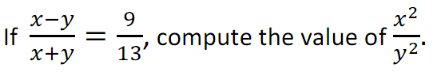
Q49

Slide 100
A49
121/4

Slide 101
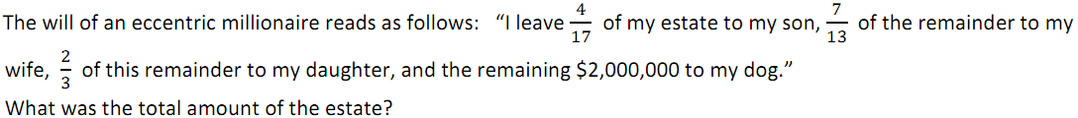
Q50

Slide 102
A50
17,000,000

