Slide 1
System Requirements Review
Team 10

Slide 2
Contents
Introduction
Requirements
Project Management
Programme Risks
Costs

Slide 3
Introduction
Design of a competitive aircraft:​
Fuelled by 100% SAF​
Mid-size (300 passenger payload)
Medium range:
  Design 5000 NM
  Economic 3000 NM
2040 entry into service

Slide 4
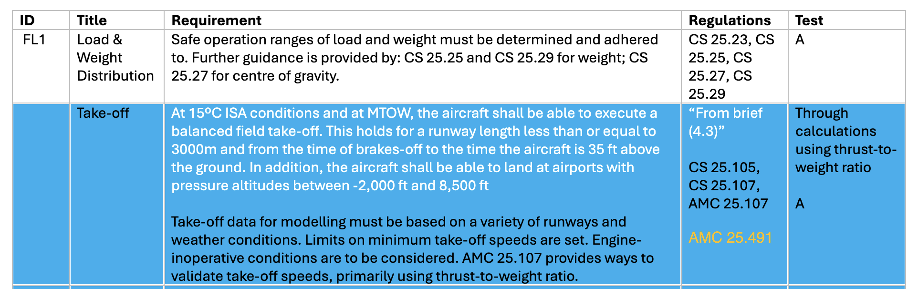
Requirements: The Need
ID
Title
Requirement
Regulation(s)
Verification
Aim?
To design an aircraft that flies
Example of requirement tables (see supplementary material) REPLACE IMG once AF done
Design
PDR/CDR
Airworthiness
See regulations
Analysis
Demonstration
Inspection
Test
EASA
CS-25
ICAO
Annexes
FAA
[fill]
ADIT verification framework [1]
Notes:
Spoken about aircraft already but more specifically, what does the aircraft need to do?
Fly <- airworthiness <- CS-25, ICAO regulations
So what have we done to make sure fits?
How have we structured our info: id for reference, align to CS-25 sections, title, requirement, reference and way to show compliance - put pic of Excel spreadsheet/doc/table maybe (supplementary material only)
ADIT framework from NASA pg 215 Expanded Guidance for NASA Systems Engineering
Analysis: mathematical modeling and analytical techniques, model/simulation
Demonstration: end use achieves req. Could be physical model or one time flight performance. Less info than test
Inspection: visual examination of realised end product
Test: use an end product for detailed analysis, for sufficient info

Slide 5

Requirements: Categories I
Flight
Safety
stability, flight envelope
safe operation, emergency, system -, - factors, performance margins
Compatibility
Communications & Navigation
existing infrastructure: wingspan, airports
air traffic control, airspace access, collision avoidance
Notes:
FLIGHT: Stability, Flight envelope, communications, emissions and noise
SAFETY: Safe operation/safety and emergency/system safety, safety factors, performance margins
FATIGUE: link to both safety and cost, could make subcategory I guess
COST: DOC, maintenance etc (say more later in presentation)
This also covers brief requirements, we could spread out and make two slides with two topics

Slide 6


Requirements: Categories II
Noise
Emissions
ICAO Annex 16 Vol I, FAA Stage 3, Quota Count system
ICAO Annex 16 Vol II and III
Fatigue
Cost
repeated cyclic loads, 25-year lifespan
R & D, Manufacturing, DOC, SAF
Notes:
FLIGHT: Stability, Flight envelope, communications, emissions and noise
SAFETY: Safe operation/safety and emergency/system safety, safety factors, performance margins
FATIGUE: link to both safety and cost, could make subcategory I guess
COST: DOC, maintenance etc (say more later in presentation)
This also covers brief requirements, we could spread out and make two slides with two topics

Slide 7
Project Management
Project Tasks
Requirements
Design
Risk Management
Verification Planning
Project Management
Costs
Design constraints
Design options considered
Risk Ratings
Compliance Matrix
Project timeline
Direct Operating Costs
Airworthiness
Constraints and formulas
Risk mitigation
Risk-linked verification
Team organisation
Manufacturing and Materials
System characteristics
Progress Monitoring

Slide 8
Timeline
SRR
Sem 1 · Week 4
PDR
Sem 1 · Week 11
CDR
Sem 2 · Week 7
CDR
SRR
PDR
Task | Required in
Requirements Analysis | SSR
Project Risk Management | SSR,PDR,CDR
Project Management | SSR,PDR,CDR
Programme Costs | SSR,PDR,CDR
Algorithms/Formulae/Constraints used | PDR,CDR
Current Design Concepts and Predicted System Characteristics | PDR,CDR
Design Options Considered | PDR,CDR
Verification Planning | PDR,CDR
Interface List | PDR,CDR
Configuration Management List and Changes since Initial Design | CDR
Conclusions and Further Improvements | CDR
Next focus should be on an initial design concept
  Sub-teams focusing on chapters linked to design (Costs, Algorithms, Risk Management…)

Slide 9
Team Organisation
Work breakdown structure and timeline created
Weekly team meetings alongside sub-team meetings
Excel spreadsheet tracking tasks and deadlines

Slide 10
Risks - Overview
What are potential risks? Where do they come from?
What is our plan, how have we considered them:
  Ratings
  Mitigations

Slide 11
Risks - Overview
Risk matrix (proposed ratings)
5
Where do risks come from?
4
R1
3
Likelihood→
R2
R4
R3
2
R5
R8
1
R7
R6
How we manage them
1
2
3
4
5
Identify
Rate
Mitigate
Monitor
Consequence→
Risk Score = Likelihood x Consequence
Notes:
Purpose: show we understand where risk comes from at this stage. We haven't chosen a concept yet, so the risks come from the brief, the regulations, the 2040 EIS date and our own limits (data, tools, time).
Process: identify risks from the brief, CS-25 and our WBS; rate each on likelihood x severity (1-5 each); give each a mitigation and an owner subteam; keep a risk register and reassess at SRR, PDR and CDR. Ratings are proposed and preliminary.
Matrix: R1-R8 plotted. Red = score 15+, amber 8-14, green below 8. Top risks: performance shortfall, immature 2040 tech / unjustified concept, CS-25 non-compliance.

Slide 12
Risks
ID | Risk | Origin | Risk Score | Mitigation
R1 | Aerodynamics and Performance shortfall | Fuel burn goal, 5,000 NM range, take off < 3,000 m, landing < 2,700 m | 16 | Early aerodynamic performance and analysis. Apply Airbus uncertainty margins and iterative optimizing of wing and engine sizing.
R2 | Poor Maintainability and Reliability | High operational availability Rapid fault resolution and efficient aircraft utilisation | 9 | Prioritise component accessibility, system reliability and efficient maintenance procedures.
R3 | CS-25 non-compliance | Structural safety, system integration and emergency evacuation. | 15 | CS-25 compliance matrix and early verification checks
R4 | Noise & emissions non compliance | Stage 3-25 EPNdB noise target CAEP6 emissions with 40% margin | 12 | Early qualitative assessment. Favor a low noise, low NOx engine choice
R5 | 100% SAF Fuel Systems Incompatibility | Engines and fuel systems must operate on 100% SAF. | 8 | Verify 100% SAF compatibility of engines, fuel system components and materials using manufacturer data.
R6
Not all risks can be eliminated at SRR, remaining uncertainties will be monitored and progressively mitigated through PDR and CDR
Notes:
Walk through the top risks briefly, don't read the table. Key message: these come straight from the brief, so they show we've read and understood it.
Be upfront that we haven't chosen a concept, so concept-specific risks (e.g. gate span for a high-aspect-ratio wing, evacuation for a BWB) will be added once we select one. Noise & emissions and airport compatibility are also in the full register.
Limitations: we can't plan for or resolve everything at this stage. What we've done: requirements from CS-25, project broken down into a WBS and subteams so it's manageable.
Biggest overall risk: not fulfilling the brief, which means cost. Bridge: we've acknowledged the risks - next is how we make it a reality on a practical level, which leads into costs.

Slide 13
Risks
Examples of risks (maybe pic of example from some kind of risk table)
Also acknowledge that we have limitations, can't plan for/resolve everything but recap what we've done to try to avoid:
  Reqs from CS-25
  Project breakdown and organisation to make manageable
Acknowledged it, now how are we going to make it a reality? How will be bring to life what we introduced in intro on a practical level?
Risk of not fulfilling brief - costs

Slide 14
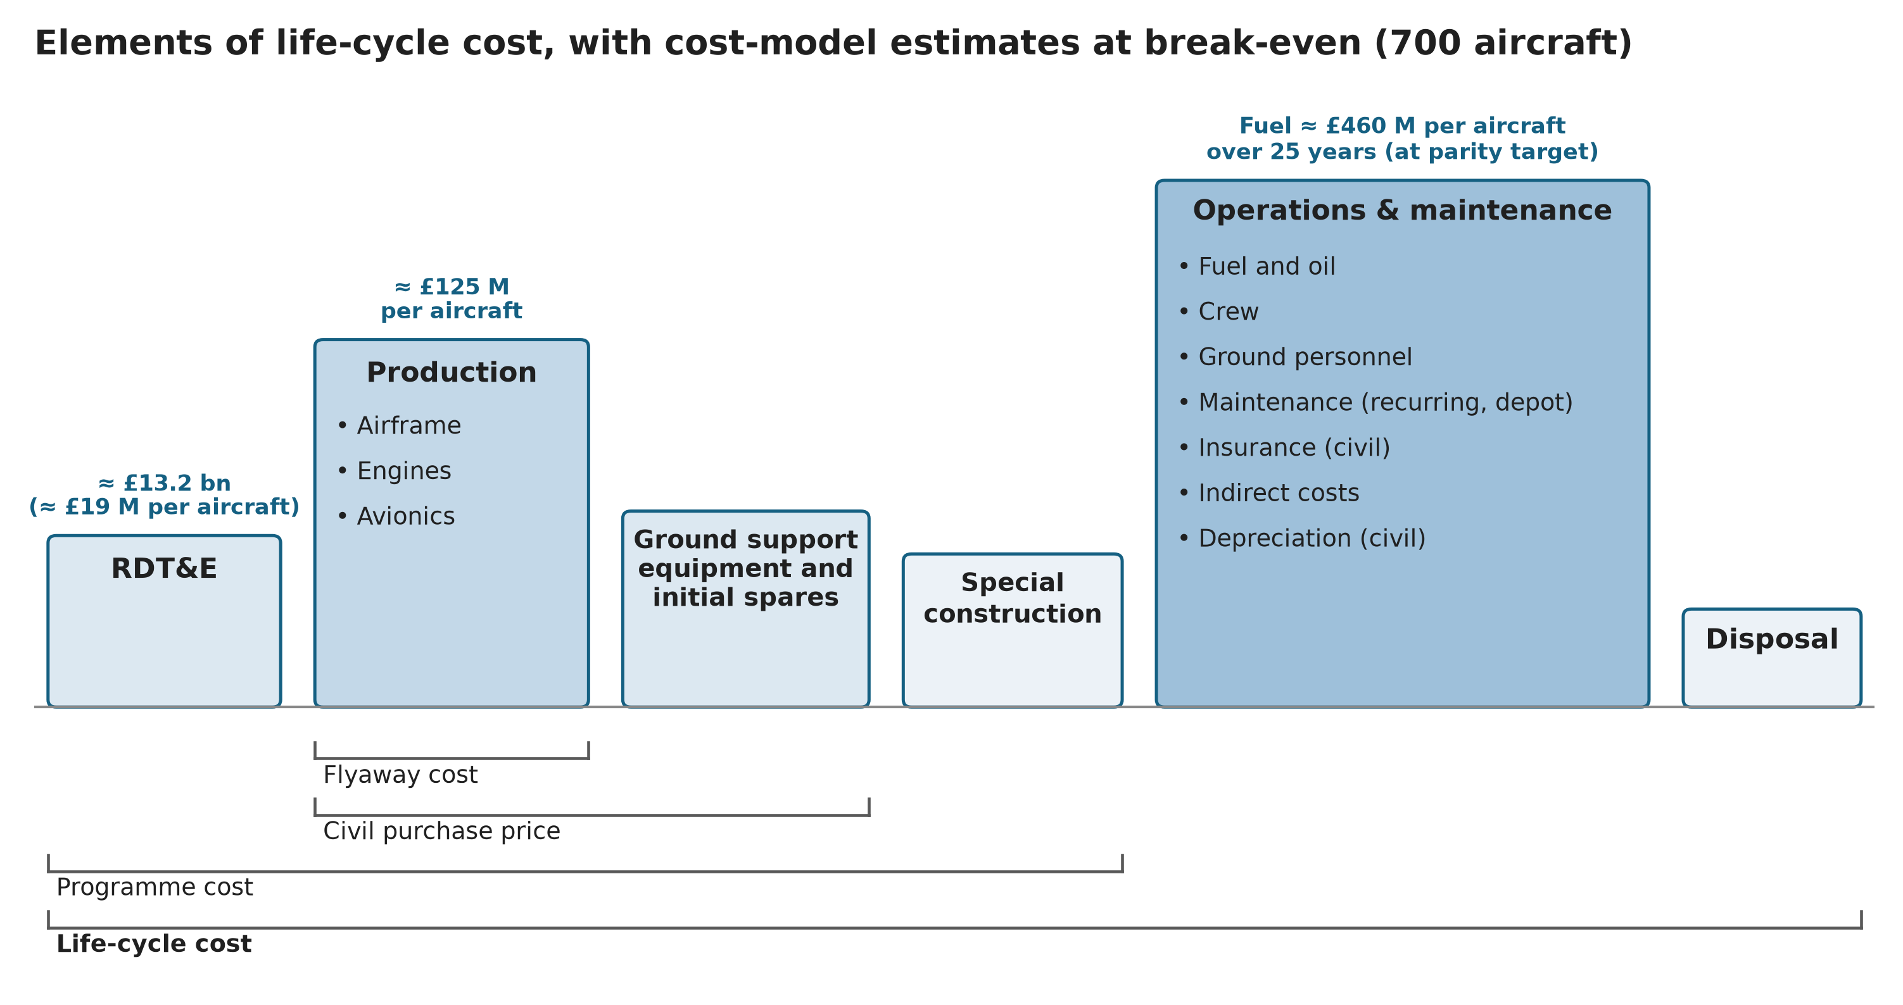
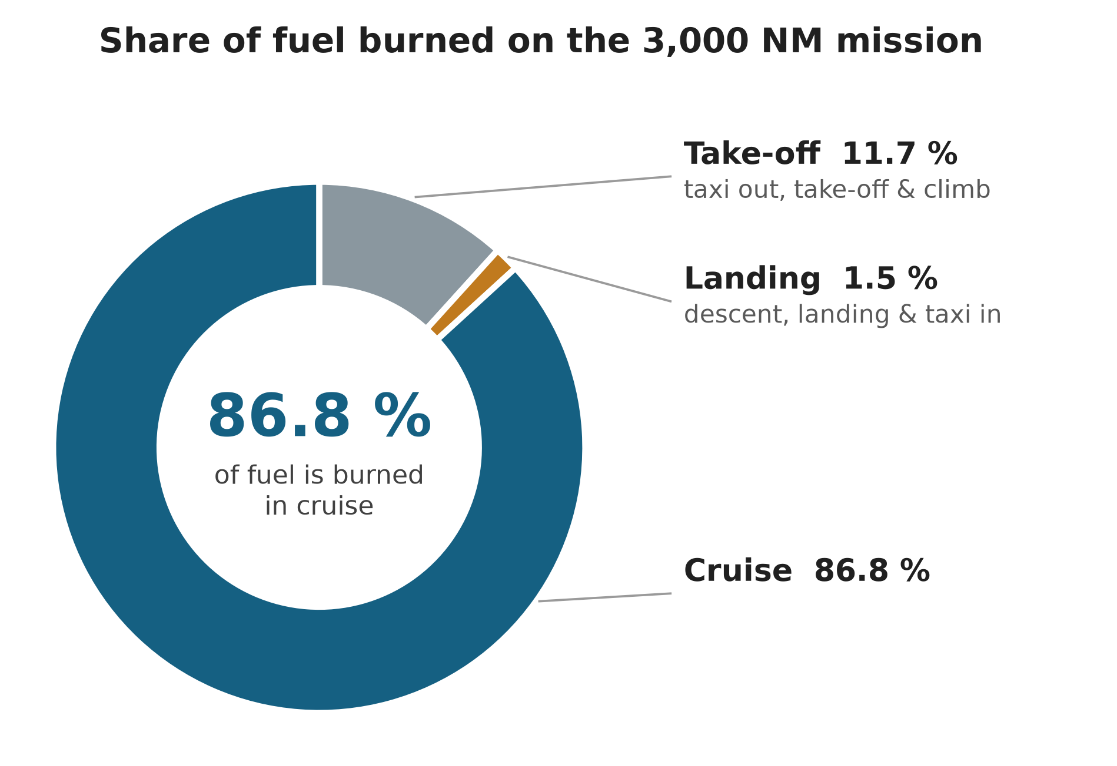
Maintenance checks over the 25-year life
Costs: DOC
Check type | Typical interval (for long‑haul use) | Rough cost per event | Notes
A‑check | ~ 400 - 600 flight hours | £16k - £32k | Routine line maintenance, 1 day
C‑check | ~ 18 - 36 months | £1.2M - £3.2M | Major structural/systems inspection
D‑check | ~ 6 - 10 years | £6.4M - £12M | Full heavy overhaul, months in hangar
25-year total | 4,500 FH/yr assumed | ≈ £25M - £110M | Mid ≈ £60M per aircraft: ≈ 1/8 of fuel cost (£460M)
Fuel is the largest share of DOC; on SAF at brief prices DOC rises ≈ 10-17 %
Typical airline operating-cost split
Fuel: ≈ 25 - 40 % of DOC (× 41 % SAF premium = +10-17 %)
Maintenance: ≈ 20 - 30 % of DOC
Crew: ≈ 10 – 20 % of DOC
Ownership: ≈ 10 - 20 % of DOC
Sources: Raymer [3], ICAO [5], AEA [6], Airbus [7]
Notes:
Message: fuel dominates DOC, so the SAF requirement is first and foremost a cost problem.
Typical split from Raymer, ICAO and AEA: fuel 25-40 %, maintenance 20-30 %. With SAF about 41 % dearer per unit energy, DOC rises by roughly 0.25-0.40 × 41 %, i.e. 10-17 %.
Maintenance: scheduled checks over 25 years come to about £25-110 M per aircraft, mid-estimate £60 M, assuming 4,500 flight hours a year. That is about one-eighth of the £460 M fuel bill, so fuel is the lever.
The pie shows 87 % of mission fuel is burned in cruise, so cruise efficiency matters most; this sets up the innovation options on slide 17.
Life-cycle chart (Raymer): our cost model gives RDT&E ≈ £13.2 bn and ≈ £125 M production cost per aircraft at the 700-aircraft break-even.

Slide 15
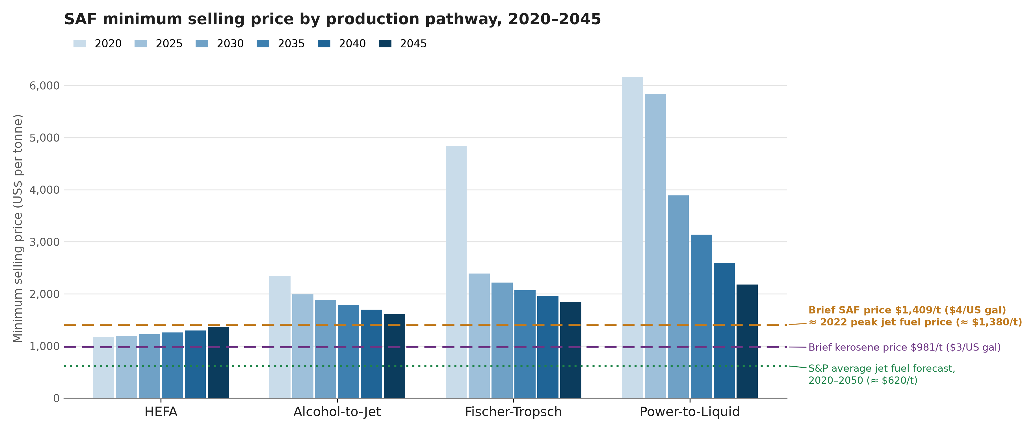
Costs: SAF Fuels
How is SAF made?
Hydro processed Esters and Fatty Acids (HEFA) (dominant method today)
Alcohol-to-Jet (AtJ)
Gasification Fischer-Tropsch (GFT)
Power-to-Liquid (PtL/eSAF)
Waste oils must be chemically processed to remove oxygen and produce stable jet-grade hydrocarbons.
Drop-in only up to a 50 % blend (ASTM D7566 [11]), no tank, pipe or truck changes. The brief needs 100 % SAF: risk R5
≈ 6 % less energy per gallon (0.75 vs 0.81 kg/L), a range penalty if tanks limit range. Parity needs ≈ 29 % less fuel energy per seat (1 - 22.7/32.1)
Total SAF production cost (EASA SAF production cost model): C_{SAF} = C_{CAPEX} + C_{OPEX} - C_{co-products}
CAPEX plant construction: EPC, inside (ISBL) and outside (OSBL) battery limits
OPEX feedstock, utilities, labour, maintenance; co-product credits (naphtha, diesel) are subtracted
Conversion factors for each pathway (HEFA, FT, AtJ, PtL) set how much feedstock each tonne of SAF needs
For us: at brief prices SAF costs ≈ 41 % more per unit energy than kerosene. By 2040 only HEFA (≈ $1,300/t) is under the brief price, but waste-oil feedstock caps its volume, so AtJ (≈ 1.2×) and PtL (≈ 1.8×) set the marginal price [10]
100 % SAF design implications (R5)
Seals: D7566 [11] needs ≥ 8 % aromatics in a blend; neat SPK has none, so nitrile seals shrink: use fluorosilicone
Tanks: 0.75 vs 0.81 kg/L → ≈ 8 % more volume for the same fuel mass; recalibrate gauging
Cost: carry SAF price as a DOC sensitivity case into PDR
Rolls-Royce 100 % SAF (2023)
Every in-production Rolls-Royce engine ran on 100 % SAF with no loss of performance: evidence for mitigating R5 [12]
Notes:
Message: the brief's 100 % SAF requirement drives both cost and design.
Four production pathways. At 2040 only HEFA is under the brief price of $1,409/t, but it is limited by waste-oil feedstock, so the marginal SAF price will be set by AtJ or PtL at about 1.2-1.8 times the brief price. We will therefore carry SAF price as a sensitivity case.
Today's drop-in limit is a 50 % blend. Neat synthetic fuel has no aromatics, which is why D7566 sets a minimum aromatic content in blends: aromatics swell nitrile seals. Our fuel system therefore needs seal materials that don't rely on aromatics, plus about 8 % more tank volume and recalibrated gauging because of the lower density.
Evidence that R5 is manageable: Rolls-Royce ran its in-production engines on 100 % SAF with no performance loss.
Cost parity needs about 29 % less fuel energy per seat: that number becomes the target on slide 17.

Slide 16
Costs: Manufacturing & Materials
Break-even ≈ 700 aircraft in Western Europe; each 10 % cut in labour cost lowers it by ≈ 100
Materials
Composites over aluminium: 787 and A350 airframes ≈ 50 % composite by weight - lighter, but dearer per kg to make
Thermoplastic composites: Clean Sky 2 fuselage demonstrator (2024): ≈ 10 % lighter, up to 10 % cheaper in high-rate production [13]; welded, not riveted; recyclable
Why weight matters: every tonne saved cuts fuel by ≈ 0.5 - 0.7 % (estimate), easing the SAF cost gap
End of life: life extension and freighter conversion sold as Airbus services, then part-out and recycling
Next step: material choice is a cost-vs-weight trade study for PDR (DAPCA only scales labour hours by a material factor)
Candidate sites (choice deferred to PDR)
Site | For | Against
Toulouse (FR) | Airbus's only widebody line (A330, A350); skilled workforce | Highest labour cost
Tianjin (CN) | Wages ≈ 20 % of US [14]; A320 line there; near a major widebody market | No widebody built there; tech transfer, export controls
Mobile (US) | Avoids US tariffs; near US airlines | Labour no cheaper than Europe
Poland | ≈ €19/h vs EU average ≈ €35/h [14]; inside the EU | No Airbus line yet
Split sites (today) | Wings UK, fuselage DE/FR/ES | Transport cost; supply-chain risk
DAPCA IV [4], 2025 £; price = 50 % of A330-900 list [8]; rate [9]
Notes:
Message: programme break-even is about 700 aircraft in Western Europe, and labour cost is the strongest lever.
DAPCA IV gives the cost per aircraft as a function of production run. The dashed line is the unit price, taken as 50 % of the A330-900 list price to reflect typical airline discounts. Each 10 % cut in labour cost moves break-even down by about 100 aircraft. 700 aircraft is about 19 years at current A330 rates.
Materials: composites cut weight but cost more per kg; thermoplastics are now demonstrated at fuselage scale. Each tonne saved cuts fuel by about 0.5-0.7 %, which helps close the SAF gap. Material choice will be a PDR trade study.
Sites: the decision is deferred to PDR. Toulouse has the widebody experience; Poland and Tianjin are cheaper but carry capability and export-control risks.

Slide 17
Costs: Innovation
Engine ≈ 10 % fuel
Wing 3 - 10 % fuel
Take-off thrust ≤ 8.2 % fuel
Geared ultra-high-bypass fan (UltraFan type): 10 % more fuel efficient than Trent XWB [15]
Demonstrator ran to maximum power on 100 % SAF (2023)
Ceramic parts ≈ ⅓ the weight of metal, < ½ the cooling air (GE9X) [16]
Penalty: heavier nacelle; costly CMC repairs
Long wing + load alleviation: up to 10 % fuel, 3.4 % cost [17]
Folding tips keep Code E gates (≤ 65 m): 777X 71.8 → 64.8 m [18]
Airbus extended-span wing flight tests from 2026 [18]
Penalty: fold mechanism mass and upkeep
Hybrid-electric assist (NASA study [19]):
8.2 % block-fuel cut: electric climb assist and e-taxi, no APU; overlaps ground ops
Penalty: batteries ≈ 3.5 % of TOW; 154-seat single-aisle data, widebody unproven
Less thrust → less hot-section wear, fewer shop visits
Cruise · 87 % of fuel
Cruise · 87 % of fuel
Take-off and climb
AI flight optimisation ≤ 5 % fuel
Ground operations < 1 % fuel
Bottom line ≈ 20 - 22 % of 29 % target
480,000 gallons saved in a 6-month trial; 3-5 % fuel on flights over 4 h (Alaska Airlines + Flyways AI) [20]
AI climb profiles: ≈ 73 kg saved per departure over 1.5 M A320-family flights [21]
Penalty: airline/ATC deliver it; used on ≈ 30 % of flights, so ≈ 1-2 % fleet-wide
Electric towing: ≈ 95 kg saved per departure (TaxiBot, narrowbodies) [22]
Ground power instead of APU: up to ≈ 210 kg/h saved at the gate (A330, IATA data)
Requirement: nose gear rated for towing
Penalty: tug fleet; towing loads on the nose gear
Target: 29 % less fuel energy per seat gives SAF cost parity (slide 15)
Savings multiply: 1 - (0.90 × 0.97 × 0.918) ≈ 20 % from design (wing at its 3 % end); + operations ≈ 21-22 %
Gap ≈ 7-9 points: PDR trade studies on cruise Mach (0.82 vs 0.85) and weight
Hits Raymer’s DOC drivers [4]: fuel burned and take-off thrust (maintenance)
Options for PDR - not yet selected
Climb and cruise
Taxi and gate
Notes:
Message: no single technology closes the 29 % SAF cost gap, but combined they get us to about 20-22 %.
Each card gives the fuel saving, the evidence and the penalty, tagged with the flight phase it acts on. Engine and wing act in cruise, which burns 87 % of the fuel.
Savings multiply rather than add: 0.90 × 0.97 × 0.918 leaves about 80 % of the fuel, a 20 % saving from design. Operations add 1-2 points, giving 21-22 %.
Caveats: the hybrid data are for a 154-seat single-aisle, and folding tips are needed to keep the long wing inside Code E gates, which links back to our airport-compatibility requirement.
The remaining 7-9 points go to PDR trade studies on cruise Mach and weight. None of these options are selected yet.

Slide 18
References
[1] - NASA (2016). Expanded Guidance for NASA Systems Engineering. Independently Published.
[2] European Union Aviation Safety Agency (2023). CS-25: Certification Specifications and Acceptable Means of Compliance for Large Aeroplanes, Amendment 28. Cologne: EASA. Available at: https://www.easa.europa.eu/en/document-library/certification-specifications/cs-25-amendment-28 (Accessed: 19 October 2026).
[3] Raymer, D. P. (1992) Aircraft Design: A Conceptual Approach. 2nd edn. Washington, DC: AIAA.
[4] Raymer, D. P. (2018) Aircraft Design: A Conceptual Approach. 6th edn. Reston, VA: AIAA, Ch. 18.
[5] ICAO (2017) Airlines Operating Costs and Productivity. ICAO MID Aviation Data and Analysis Seminar, Tehran.
[6] AEA (1989) DOC Method for Long Range Aircraft, via Scholz, D., Aircraft Design lecture notes, Ch. 14.
[7] Airbus (2004) Getting to Grips with Fuel Economy, Issue 4. Blagnac: Airbus.
[8] Airbus (2018) Airbus aircraft 2018 average list prices.
[9] Airbus (2026) Airbus reports 793 commercial aircraft deliveries in 2025. Press release, 12 January.
[10] IATA (2024) SAF minimum selling price by production pathway, 2020-2045, Chart 1.
[11] ASTM International ASTM D7566: Aviation Turbine Fuel Containing Synthesized Hydrocarbons.
[12] Rolls-Royce (2023) Rolls-Royce successfully completes 100% SAF test programme. Press release, 13 November.
[13] Fraunhofer IFAM (2024) Completion of the Clean Sky 2 Multifunctional Fuselage Demonstrator. Press release, 3 May.
[14] Eurostat (2025) Hourly labour costs; Apollo Academy (2023) US wages vs wages in China and India.
[15] Rolls-Royce (2023) UltraFan; FlightGlobal (2023) Rolls-Royce runs UltraFan at full power.
[16] GE Aerospace (n.d.) GE9X engine: ceramic matrix composites.
[17] Stanford University (n.d.) Long-span wing with active load alleviation. purl.stanford.edu/hz528zb1688.
[18] Boeing (n.d.) 777X folding wingtip; Aviation Week (2026) Airbus launches extended-wingspan A321neo test program.
[19] NASA (2023) Mild-hybrid electric single-aisle aircraft study, NTRS 20230005865.
[20] Alaska Airlines (2021) Alaska Airlines and Airspace Intelligence announce partnership. Press release, 25 May.
[21] SITA (2026) Two million ways to climb: which one saves the most fuel?.
[22] Royal Schiphol Group (2026) Electric TaxiBot starts operating at Schiphol.

Slide 19
Requirements: General
Category | Requirement | Regulations | Verification
Safety and Emergency | The aircraft shall be designed and equipped to protect occupants during emergencies. This covers factors such as emergency equipment, fire protection and emergency exits and lighting. | CS 25.785-25.789 , CS 25.791-25.795, CS 25.801-25.820, CS 25.851-859, CS 25.863-869, CS 25.899, CS 25.1441-1453 | A, D, T
System Safety | The aircraft systems shall work as intended, with catastrophic failures extremely improbable and never caused by a single failure. This covers engines, fuel, power, flight controls, autopilot, flight deck, cabin air, ice protection and landing gear. | CS 25.1301, CS 25.1309, AMC 25.1309, CS 25.901-903, CS 25.951-999, CS 25.1351-1365, CS 25.1435-1438, CS 25.1701-1731, CS 25.671, CS 25.1329, CS 25.1302, CS 25.1322, CS 25.831, CS 25.841, CS 25.1419, CS 25.729, CS 25.735 | A, D, I, T
Comms and Navigation | The aircraft shall communicate and navigate with two independent systems each, be seen by ATC and other aircraft, and warn the crew of traffic and terrain. This covers voice, data link, RNP, RVSM, Mode S/ADS-B, ACAS II, TAWS, flight recorders and ELT. | CS 25.1307(d)-(e), CS 25.1431, CS 25.1457-1460, CS-ACNS (B.VCS, C.PBN, D.ELS, D.EHS, D.ADSB, E.RVSM, E.TAWS, E.LAD), ICAO Annex 6 Pt I 6.3, 6.15, 6.17-6.20, Ch 7, ICAO Annex 10 Vol I, III and IV | A, D, I , T
Notes:
Could be cont. of last slide, move around text a bit
Then how have we found to make sure regs comply, intro to IDAT framework?
Summary of requirements we found: e.g. stability always needed, safe operation of aircraft etc.
Next brief requirements
Safe operation (Flight)
Mention safety factors from brief
Communications/alerts etc.

Slide 20
Requirements: General
Add fatigue somewhere in requirements subsection, can link to and talk about MAINTENANCE v. imp.
Category | Requirement | Regulations | Verification
Stability | The aircraft shall be longitudinally, directionally and laterally stable. Oscillations must be damped and aeroelastic stability evaluated. | CS 25.173, AMC 25.173(c), CS 25.175, CS 25.177, AMC 25.177(c), AMC 25.177(d), CS 25.181, AMC 25.181, AMC 25.21(g), CS 25.629, AMC 25.629 | A, D, T
Flight Envelope | Expected and potential loads shall be used to define the aircraft's flight envelope and structural design. | CS 25.305, CS 25.307, AMC 25.307, CS 25.331, AMC 25.331, CS 25.333, AMC 25.333, CS 25.337, CS 25.341, AMC 25.341, CS 25.391, CS 25.393, AMC 25.393(a), CS 25.395, CS 25.397, CS 25.407, CS 25.409, CS 25.427, CS 25.445 | A, T
Safe Operation | The aircraft shall always operate safely over flight, load and weather ranges within limits, regardless of operating conditions. Safety factors must be used. | CS 25.23, CS 25.25, CS 25.27, CS 25.29, CS 25.143, AMC 25.143, CS 25.305, CS 25.307, AMC 25.307, CS 25.303, CS 25.603, AMC 25.603, AMC No.1 to CS25.603(a), CS 25.581, AMC 25.581 | A, D, T
Emissions and Noise | The aircraft shall be compliant with ICAO regulations regarding noise and emissions (CO2, NOx, nvPM etc) | ICAO Annex 16 Vol I, II and III | A, T
Notes:
Could be cont. of last slide, move around text a bit
Then how have we found to make sure regs comply, intro to IDAT framework?
Summary of requirements we found: e.g. stability always needed, safe operation of aircraft etc.
Next brief requirements
Safe operation (Flight)
Mention safety factors from brief
Communications/alerts etc.

Slide 21
Requirements: Brief
remember that big part of project is to work with existing infrastructure (3.2) KEY REQ – link to wingspan, airports etc.
Cost should be less KEY REQ
safety – performance margins and fatigue linked? KEY REQ
Now we can layout how we are planning to fulfill requirements i.e.project management
Notes:
What it says on tin, be careful with phrasing
Don’t need to include stuff that is to be calculated or stuff mentioned in intro e.g. passenger payload
Ideally show graphically
Also remember that big part of project is to work with existing infrastructure (3.2)
Incorporate safety factors to show we’re thinking about operational aspect
Now we can layout how we are planning to fulfill requirements i.e.project management

