Slide 1
Week 6 – 3/11/2026
Team 10

Slide 2
Planning - NB
PDR
Initial Designs
Down-selection
Structure
Metrics
Documentation
SRR requirements compliance
Evaluation matrices
Weight: MTOW, MWE
Aerodynamic values: eg. C_{L}, C_{D}
Individual logbooks
Tail
Risk consideration
Efficien
Shared Teams resources
Weighted criteria
Wings: e.g. size, sweep angle
Landing gear
Technical tracking spreadsheet
Estimated parameters: e.g. MTOW, C_{L}
Metrics
Fuselage: cabin size/layout, cockpit etc.
Organisational roles rota
Configuration: wing, engine etc.
Engines: e.g. size, position, number
Team meeting agenda & minutes
Avionics

Slide 3
Team Organisation - NB
Team focused on different wing options
Took A330neo as reference aircraft
Aim: calculate how much aerodynamic performance could be improved (aerodynamic savings -> fuel burn reduction -> DOC reduction)
3 subteams:
  Box wing
  Folding wing
  Blended wing

Slide 4
Criterion | Weight | Score
Aerodynamic performance | 15%
Fuel | 10%
Weight | 15%
Operating cost | 15%
Structural efficiency | 10
Airport compatibility | 10%
Manufacturing complexity | 10
Maintenance | 5
Certification risk | 5
Technology readiness | 5
Passenger acceptance | 5
Rough weightings please change if you want
Would say main brief things are performance (to cut DOC) and compatibility so a bit more weighting there

Slide 5
1. Aerodynamic Performance
These are usually some of the highest-weighted criteria.
Cruise lift-to-drag ratio (L/D)
Induced drag
Parasite drag
Wave drag at cruise
Fuel efficiency
Range capability
Endurance
Climb performance
Take-off performance
Landing performance
Stall characteristics
High-lift performance
Wing loading
Overall aerodynamic efficiency
2. Structural Performance
Very important when comparing box wings and BWBs.
Structural weight
Empty weight
Bending moment reduction
Structural efficiency
Fatigue life
Damage tolerance
Load path simplicity
Pressurisation compatibility
Aeroelastic performance
Wing deflection
Flutter risk
Buckling resistance
Ultimate load capability
3. Aircraft Performance
Maximum range
Payload-range capability
Cruise speed
Maximum operating Mach number
Fuel burn per passenger
Fuel burn per seat-km
Maximum payload
Take-off field length
Landing field length
Climb rate
Ceiling
4. Airport Compatibility
This category is often overlooked and can heavily influence the decision.
Wingspan compliance
ICAO code compatibility
Gate compatibility
Taxiway compatibility
Jet bridge compatibility
Hangar compatibility
Runway compatibility
Ground handling complexity
Turnaround time
5. Stability and Control
Markers often like to see this.
Static stability
Dynamic stability
Longitudinal stability
Lateral stability
Directional stability
Trim drag
Control effectiveness
Handling qualities
Fly-by-wire requirements
A BWB often scores lower here due to higher control complexity.
6. Manufacturing
This is a major real-world concern.
Manufacturing complexity
Tooling requirements
Production rate capability
Production cost
Assembly complexity
Supply chain maturity
Composite manufacturing requirements
Production risk
Scalability
7. Maintenance
Airlines care enormously about this.
Ease of inspection
Ease of repair
Component accessibility
Lifecycle maintenance cost
Spare parts requirements
Reliability
Dispatch reliability
8. Certification Risk
This is often one of the most important PDR criteria.
Certification complexity
Novel technology risk
Regulatory uncertainty
Safety approval complexity
Testing burden
Flight test requirements
Historical precedent
9. Technology Readiness
A powerful category for design decisions.
Technology readiness level (TRL)
Existing flight demonstrations
Existing aircraft examples
Development risk
Maturity of supporting technologies
12. Passenger Experience
Particularly relevant for a BWB.
Cabin comfort
Cabin volume
Seat layout flexibility
Window availability
Passenger acceptance
Motion sickness potential
Evacuation performance
Accessibility

Slide 6
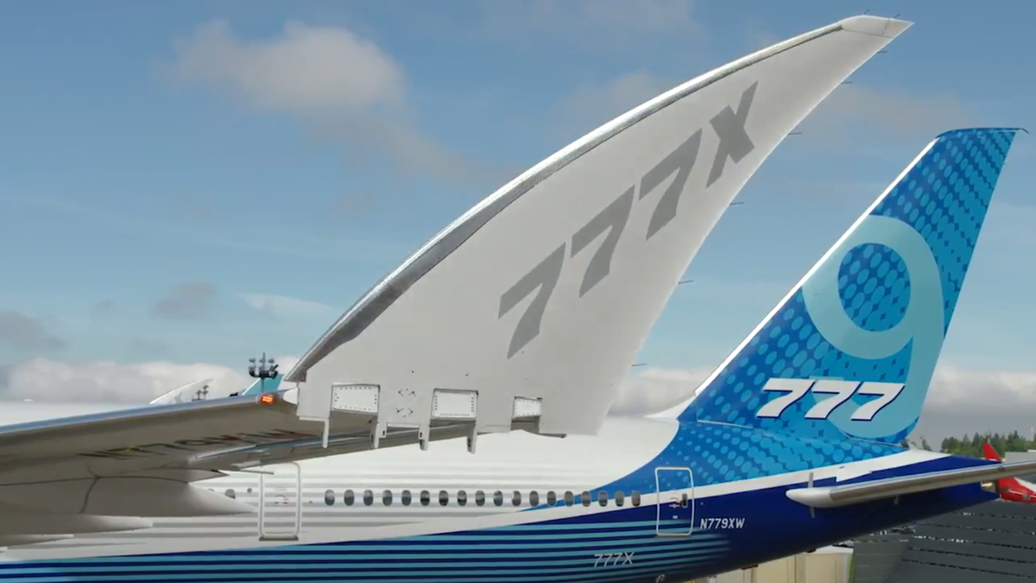
Folding wing Compatibility (BT)
Airport Compatibility
A wider wingspan can require a greater separation distance, wider taxiways and larger gate areas.
The Boeing 777X’s folded wing means it is fully compatible with ICAO code E airports.
Aircraft | Wingspan in flight | Wingspan on ground
777X | 71.8m | 64.8m (wings folded)
A330neo | 64.8m | 64.8m
Engine Compatibility
Very large engines create:
High bending moments at the wing root.
Strong vibration loads.
Significant weight concentrations.
The GE9X engines are mounted on the fixed portion of the wing on Boeing 777X.
Engine fuel, hydraulic, pneumatic, and electrical systems do not have to cross the hinge.
Reduces complexity and possible maintenance costs

Slide 7
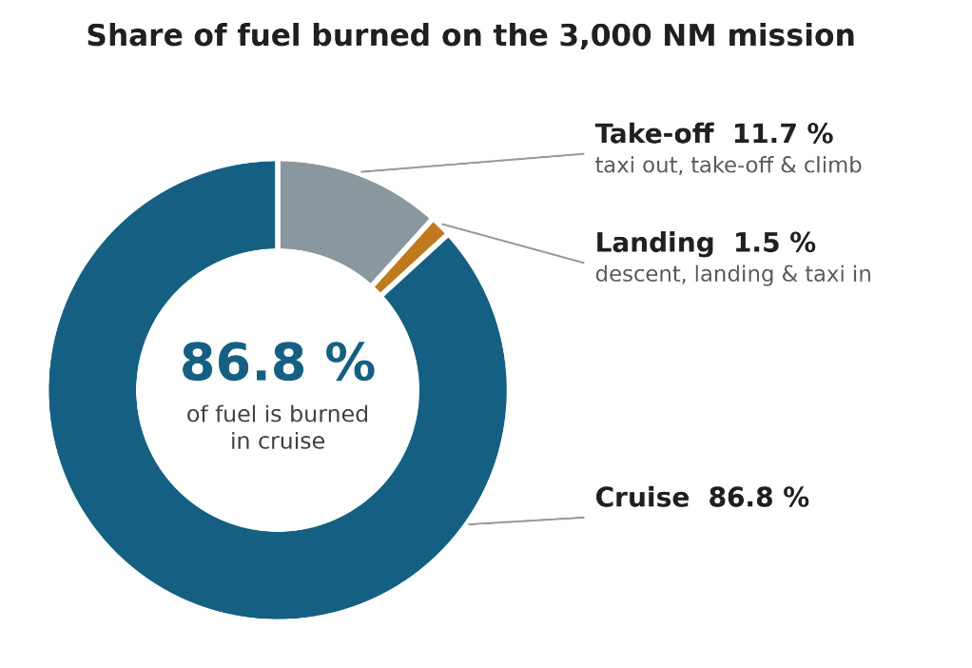
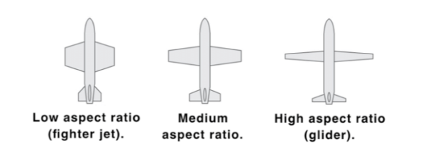
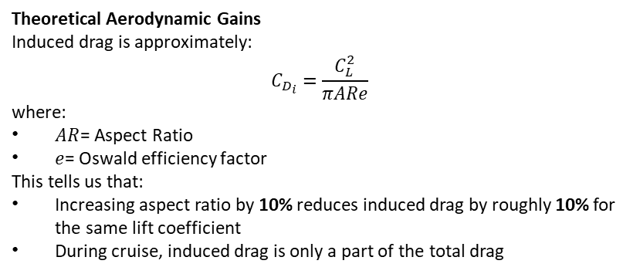
Folded Wing Aerodynamics (BT)
Boeing 777X Statistics
The new wing provides roughly 15% more wing area than the previous 777 wing (Jamil, O. 2026).
Boeing states the 777X gives a 10% reduction in fuel burn per seat (Simple Flying, 2026)
Boeing believe that the benefit of thousands of gallons of jet fuel saved per flight offsets the weight gain and added line-maintenance checks (required for rotary actuators, locking pins and hinge seals
What extra checks did EASA create (Simple Flying, 2026):
FAA mandated 10 specific special conditions
Wingtips need to withstand ground gusts of up to 65 Knots (75 mph)
Wingtips need to withstand severe icing conditions along the hinge line
Had to prove no single failure, or combination of improbable multi-system failures could cause wingtips to unlock while airborne
Theoretical Aerodynamic Gains
Induced drag is approximately:
$$C_{D_{i}}=\frac{C_{L}^{2}}{πARe}$$
where:
$AR$= Aspect Ratio
$e$= Oswald efficiency factor
This tells us that:
Increasing aspect ratio by 10% reduces induced drag by roughly 10% for the same lift coefficient
During cruise, induced drag is only a part of the total drag
Simple Flying. (2026) The Boeing 777X's Folding Wingtips: Why No Other Airliner Has Ever Had This. Published 10 September 2026. Available at: https://simpleflying.com/boeing-777x-commercial-airliner-folding-wingtips/ (Accessed: 2 November 2026).
Jamil, O. (2026) The Engineering Behind the 777X's Folding Wingtips. AeroXplorer, 17 September. Available at: https://aeroxplorer.com/articles/the-engineering-behind-the-777xs-folding-wingtips (Accessed: 2 November 2026).

Slide 8
Proposed A330-900 baseline with 70 m folding wingtips
A high AR wing with a folding wingtip offers reduced induced drag and potential fuel efficiency benefits while still being code E compliant during ground operations. However, increasing AR comes with some drawbacks as the increased root bending moment requires additional strengthening. A stiffer material (such as CFRP) is also necessary to maintain aeroelastic stability. Methods based on Kretov & Tiniakov (2022)
70.0 m
64.9 m
64.0 m
Span in flight
folded span
baseline span* (A330-900)
METHODS USED FOR THIS ANALYSIS
1 Geometry comparison
Compared 70 m proposed span with the 64 m A330-900 reference span. Holding wing area constant; aspect ratio scales with span squared. This would mean an AR of ~13.5, Airbus claims the A330neo's AR of ~11 is already the highest of any airliner in production today.
AR ~11.33 → ~13.55 (361.63 m² wing area, 64 m span vs 70 m span)
2 Induced-drag relationship
Cᴅᵢ = Cʟ² / (π · e · AR). If lift coefficient and span efficiency factor e are unchanged, induced-drag coefficient is inversely proportional to AR.
3 Cruise drag proxy
Applied the paper’s statement that induced drag can represent up to ~30% of total drag in cruise. This gave an indicative total-drag change.
Composite and folding-wing mass estimate
The paper evaluates composite wing structures and folding tips. Its folding-tip reference case estimates ~1% additional wing mass when the folding portion totals ~10% of span. The mass penalty from the fold alone is not substantial.
Source: Kretov, A. and Tiniakov, D. (2022) ‘Evaluation of the Mass and Aerodynamic Efficiency of a High Aspect Ratio Wing for Prospective Passenger Aircraft’, Aerospace, 9(9), p. 497. Available at: https://doi.org/10.3390/aerospace9090497.
1

Slide 9
Is this enough for a 25% fuel-efficiency gain?
FIRST-ORDER CALCULATION
Ratio of ARs assuming wing area is held constant
AR₇₀ / AR₆₄ = (70 / 64)² = 1.196 → approximately +19.6%
Induced-drag coefficient
Cᴅᵢ,₇₀ / Cᴅᵢ,₆₄ ≈ 1 / 1.196 = 0.836 → approximately −16.4%
Total cruise-drag proxy
0.30 × 16.4% ≈ 4.9% reduction in total cruise drag, if induced drag is 30% of total (from the paper).
PAPER BENCHMARKS
Note: These are useful benchmarks but not 1:1 analogues in any way
Narrowbody cases
The paper uses a more advanced method to estimate efficiency gains from a higher AR composite wing; for its A320neo / 737 MAX 8 examples (10.5 and 10 to 11.5) it reports ~8–10% fuel-efficiency improvements.
ASSESSMENT
25% fuel-efficiency gain?
Unlikely. The paper found that the estimated % fuel efficiency gain of the hypothetical high AR folding wing concepts was about 1.4-1.9 times the overall % drag reduction, if applied to this basic calculation it would mean a fuel efficiency gain of 6.9-9.3%. This is quite far from what is required; however, combining this with a next gen propulsion scenario (eg UltraFan) and more extensive use of composites (eg a composite fuselage, the A330-900 has a fuselage that is primarily aluminium) might help.
ASSESSMENT
Continued
This is before accounting for the increased mass from the additional reinforcement required to go from an AR of ~11 to 13.5 as the root bending moment would increase by at least ~9% using an elliptical lift distribution. This would lead to a significant increase in mass for a cantilever wing.
This is one of the reasons why truss braced wing designs are being explored; they have the potential to enable increased wing aspect ratio at a lower mass than would be typical for a cantilever wing aircraft of the same span.
Source: Kretov, A. and Tiniakov, D. (2022) ‘Evaluation of the Mass and Aerodynamic Efficiency of a High Aspect Ratio Wing for Prospective Passenger Aircraft’, Aerospace, 9(9), p. 497. Available at: https://doi.org/10.3390/aerospace9090497.
2

Slide 10
Regulations - IS

Slide 11
Blended Wing Body – Design Process

Slide 12
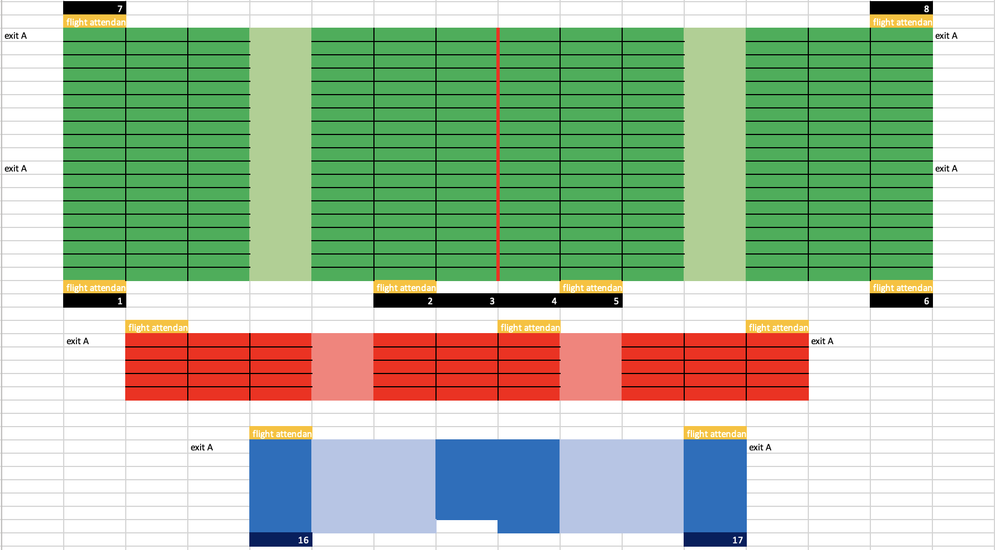
Blended Wing Body: Cabin Layout - NB
From brief, calculated:
  passenger class distribution
  number of flight attendants
  number of lavatories
  storage for catering
Features:
  trapezoidal layout
  8 type A exits
~7.60m
v
~53.47m
~5.49m

Slide 13
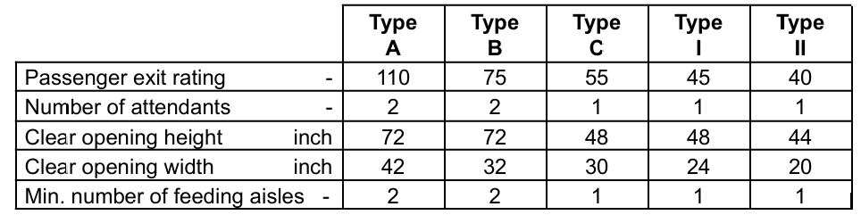
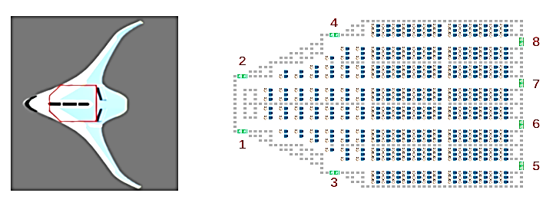
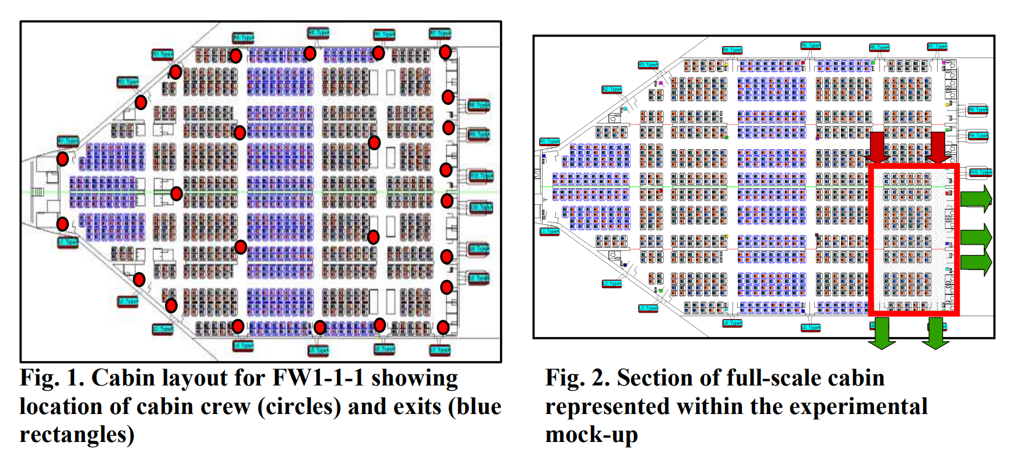
Blended Wing Body: Emergency Exits - BD
CS-25 Requirements
Passengers and crew must evacuate within 90s using half the available exits
University of Greenwich & Cranfield University Simulation
This experiment modelled a high-capacity BWB with 1020 passengers, 25 cabin crew and 20 floor level Type-A exits
Only the 10 exits on the left side of the aircraft were used with an opening time of 11.1 seconds per door
airEXODUS Simulations (10 runs)
Out-of-aircraft times ranged from 80.6s – 92.8s, averaging 85.9s (on-ground time could be 3s longer)
The exits located in the rear corner experienced very low passenger usage
  The worst exits only evacuating 30 & 56 passengers on average
This is though to be because passengers are required to bypass other functioning exits to reach them, the locations of these exits also have a small natural catchment area, and the location of the exits provides poor visual access within the cabin
The exits in the middle of the cabin were over-utilised
Passengers spent 40% of their time in congestion
Full-Scale Trials (at Cranfield University)
Four trials over two days with participants aged between 20-50 (only the first trial is reported)
The mock-up covered the rear section only, 88 seated participants and 146 fed in through two cross-aisles
The exit use in the trial matched the simulations: the corner exits were least used, whereas the first exit the passengers met was heavily used
Of the 146 participants in the cross-aisle, 39.3% bypassed the first exit, 6.9% the second, 2.1% the third and none bypassed the fourth (Galea et al., 2010)
University of Tokyo & Beijing University of Technology Simulation
This study evaluated how cabin layout could affect evacuation efficiency
A cellular automaton (CA) model was developed simulating a BWB aircraft with a capacity of 370 passengers
The simulations found that aisle width had the biggest impact on evacuation speed
  The aisles must be wide enough to accommodate two parallel lanes of passengers
  The cabin should also allow small open areas near the exits (especially the middle exits with the highest footfall)
Changing the locations or increasing the size of the exits had very limited influence on the overall evacuation time
(Dong et al., 2025)
Galea, E.R. & Filippidis, Lazaros & Wang, Zhaozhi & Lawrence, Peter & Ewer, John. (2010). Evacuation Analysis of 1000+ Seat Blended Wing Body Aircraft Configurations: Computer Simulations and Full-scale Evacuation Experiment. Available at: https://www.researchgate.net/publication/228824877_Evacuation_Analysis_of_1000_Seat_Blended_Wing_Body_Aircraft_Configurations_Computer_Simulations_and_Full-scale_Evacuation_Experiment (Accessed 01/11/2026)
Dong, Y., Jia, X., Yanagisawa, D., and Ninshinari, K. (2010). Evacuation simulations accounting for properties of the blended wing body aircraft. Available at: https://amca-admin.rachel.puxdesign.cz/PED25/media/amca/2025/abstrakta/ped_2025_extended_abstract_65.pdf (Accessed 01/11/2026)

Slide 14
Advantages
Reduced induced drag could lower cruise fuel burn, which is directly relevant to the project DOC target.
High span efficiency may allow aerodynamic gains without relying only on a larger wingspan, which is useful under gate/taxi constraints.
The PARSIFAL concept demonstrates that a high passenger capacity can be combined with a constrained airport footprint.
A box-wing layout may therefore provide a route to larger aerodynamic gains than small incremental changes to a conventional wing.
Box-Wing Aircraft - AF
Box-Wing Layout
Main risks
Structural complexity: two lifting surfaces and their connecting structure create different load paths and additional structural design challenges.
Weight trade-off: aerodynamic improvement is only useful if added structural mass does not cancel the fuel-burn benefit.
Stability and control: front/rear lifting-surface interaction must be designed carefully to achieve acceptable trim, stability and handling.
Integration: engine position, landing gear, fuselage connection and wing-junction geometry are less straightforward than on a conventional aircraft.
Certification and maturity: the configuration is much less mature in commercial service than conventional tube-and-wing layouts, increasing development and certification risk.
Mission sensitivity: benefits depend strongly on the aircraft size, mission, payload and optimisation assumptions.

Slide 15
Published Box-Wing and Integration Assessment - AF

Slide 16
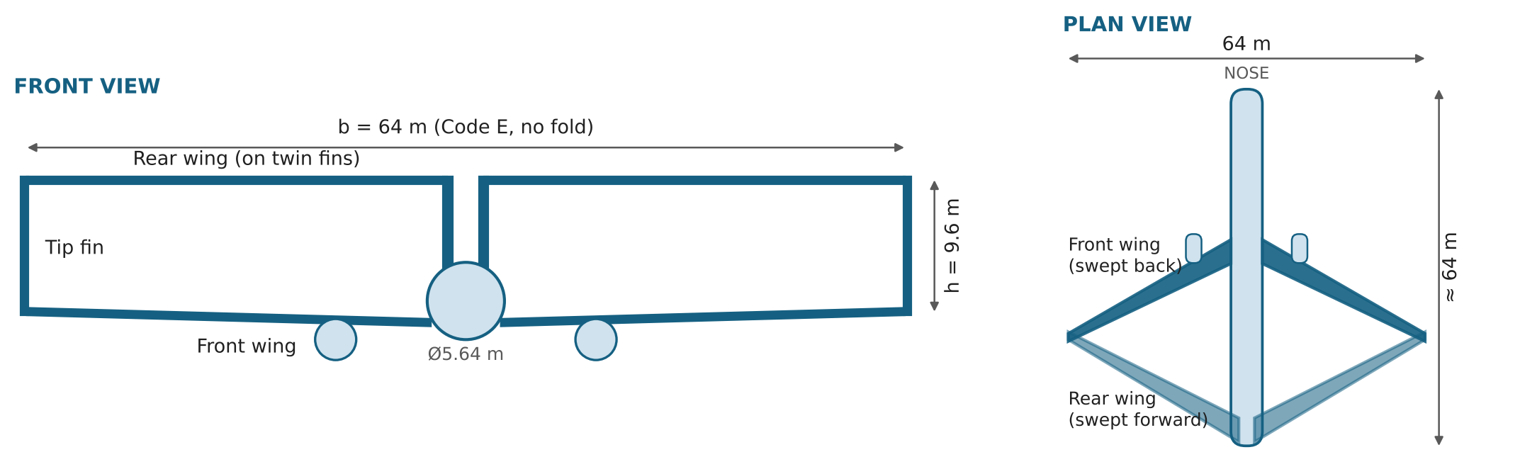
Box Wing Concept - NE
Two wings joined at the tips: the lowest induced drag for a given span, inside the 64 m gate limit
Front + rear wing, joined by tip fins
Front wing low and swept back; rear wing swept forward on twin fins at the tail
Gap h = 9.6 m (h/b = 0.15)
Induced drag ≈ 27 % lower than a 64 m wing; acts like a 75 m conventional wing
Same cabin, engine and span
Conventional Ø5.64 m tube; front wing box under the floor between doors 2 and 3
Group 10 concept sketch to scale (64 m span, 9.6 m gap, Ø5.64 m fuselage, ≈ 64 m long); layout after the PrandtlPlane (Frediani). Not a final geometry: sweep, chords and fin positions to be set at PDR.

Slide 17
Box Wing Research - NE
A330-900 with a 64 m box wing, compared with the 70 m folding wing on the same basis
Folding wing vs box wing (same A330-900 baseline)
Induced drag vs gap between the wings
 | A330-900 | 70 m folding tips | 64 m box wing
Span in flight / at gate (m) | 64.0 / 64.0 | 70.0 / 64.9 | 64.0 / 64.0
Wing area (m²) | 361.63 | 361.63 | 361.63 (2 × ≈ 181)
Aspect ratio b²/S | 11.33 | 13.55 | 11.33 (each wing 22.7)
Induced drag vs A330-900 | - | -16.4 % | -27.0 % (h/b 0.15)
Total cruise drag (30 % induced) | - | -4.9 % | -5.0 % net of tip fins
Fuel efficiency (× 1.4-1.9) | - | 6.9-9.3 % | 7.0-9.5 %
Extra structure | - | ≈ 1 % wing mass; root bending +9 % | joints + fins ≈ +1 % MTOW (assumed)
Code E at the gate | yes | yes, folded (hinge) | yes, always (no hinge)
Method
Key findings
Cᴅᵢ,box / Cᴅᵢ,mono = k = (1 + 0.45 h/b) ÷ (1.04 + 2.81 h/b) (Prandtl, same span and lift)
≈ 5 % less drag, 7-9.5 % less fuel
Same band as the 70 m folding wing, but inside 64 m with no hinge
Same chain as the folding wing: induced-drag cut × 0.30 share = -8.1 % total drag, less the tip fins (≈ 96 m² wetted, +3.1 %) = -5.0 %; × 1.4-1.9 for fuel (Kretov & Tiniakov 2022).
Assumed: h/b 0.15 (h ≈ 9.6 m), fin chord 2.5 m, aircraft wetted area ≈ 6 × wing area.
A 4.4 m gap matches the folding wing
h/b ≈ 0.07 already gives its -16 % induced drag; we propose 9.6 m
Structure decides it
The saving is gone above ≈ +3 t of joints, fins and stiffening
Sources: Prandtl (1924) NACA TN 182; h/b vs induced drag from Frediani (2003) via HAW Hamburg; Kretov & Tiniakov (2022) Aerospace 9(9) 497; folding-wing figures from slides 8-9.

Slide 18
Box Wing: Enough for 25 %? - NE
No: ≈ 6-9.5 % less fuel, about the same as the 70 m folding wing
First-order ≈ 7-9.5 % fuel
Sizing model ≈ 6 % fuel
Literature ≤ 20 % per seat
Induced drag -27 % at h/b 0.15 (k = 0.73)
× 0.30 share: -8.1 % total; tip fins +3.1 %, net -5.0 %
× 1.4-1.9 drag-to-fuel factor, as for the folding wing
k = (1 + 0.45 h/b) ÷ (1.04 + 2.81 h/b) (Prandtl); fins 2.5 m chord
Penalty: ignores the extra mass
Our Raymer sizing: same engine, Mach, 300 seats, 5000 NM
L/D 19.0 → 20.2 (+6 %); MTOW 198 → 194 t
Includes +0.01 OWE/MTOW for the structure
Best gap h/b 0.15-0.20; taller fins cost more than they save
PARSIFAL PrandtlPlane (EU): 10-22 % less fuel per passenger-km
Same span, more seats: most of the gain is extra capacity
Penalty: a fixed 300 seats cannot claim it; it also cruises slower
Structure break-even ≈ +3 t
Fuel volume ≈ ½ in the wings
Bottom line for PDR
Assumed ≈ +2 t (+0.01 OWE/MTOW) for joints, fins and stiffening
Above +0.015 (≈ 3 t) the box wing saves no fuel
Penalty: no published mass model fits our size yet
Two thin wings (each AR ≈ 23) hold ≈ 40 of 76 m³ SAF (Torenbeek)
Rest in a centre-section tank; bags need only ≈ 8 LD3
Penalty: tank mass and less cargo volume
25 % is out of reach for any wing alone, folding or box
Box ≈ folding on fuel, but Code E at all times and no hinge
Next: structural mass estimate, wing-interference CFD, trim (front/rear lift split)
Sources: Kretov & Tiniakov (2022) Aerospace 9(9) 497; CORDIS (2023) PARSIFAL results; Torenbeek (1982); Group10_BoxWing_Sweep.xlsx.

Slide 19
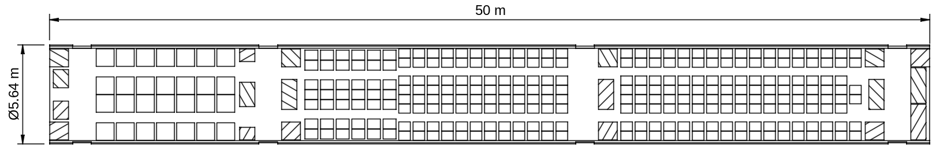
Box Wing: Cabin Layout - NE
300 seats to the brief's 3-class rules; the box wing keeps a conventional Ø5.64 m tube
Galleys and toilets
From the brief (App. 1, 3-class MR rules)
Key findings
Item | Rule | Our cabin
Seats | BC 8-10 %, YC+ 14-16 % | BC 28 (9.3 %), YC+ 42 (14.0 %), YC 230
Pitch / layout | 45 / 35 / 32 in | 1-2-1 / 2-3-2 / 2-4-2
Trolleys | BC 10, YC 3 trays each; 28 per trolley | 40 needed, 41 fitted
Lavatories | BC ≤ 20, YC ≤ 40 per lav | 2 + 7 = 9
Walkways | ≥ 26 in between galleys / lavs | 28.4 in
Cabin crew | service or exits, whichever is more | 11 (as App. 2)
Doors within 60 ft
10.6 / 18.0 / 17.8 m apart (CS 25.807); D2-D3 is the tight one
Neither wing cuts the cabin
Front wing box under the floor between D2 and D3; rear wing on twin fins over the tail
Room for the extra tank
Bags need ≈ 8 LD3, so the hold can take the centre fuel tank
Sources: Task Specification ME2618655 App. 1-2; CS-25.807. Drawing G10-PDR-CAB-001 and 3D model in docs/pdr/cabin.

