Slide 1
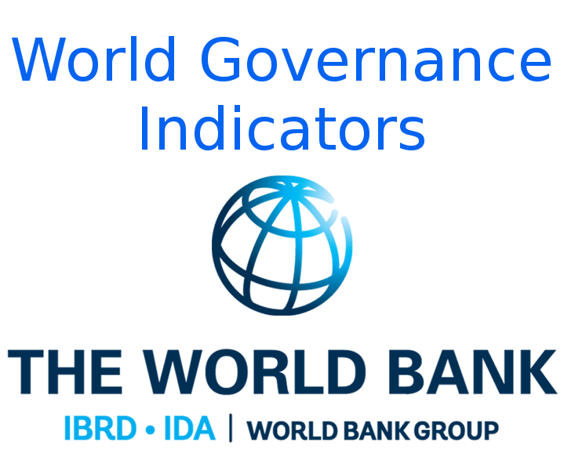
Predicting Sovereign credit ratings using Worldwide Governance Indicators (WGI)
A Predictive model
Presented by:
Fernando aguilar islaS
DisClaimer: I do not work for nor hold any affiliation to the World Bank. The views and findings expressed in this presentation are mine and mine alone. All product names, trademarks and registered trademarks are property of their respective owners.

Slide 2
Agenda
Background
Data
Findings
The Model
Conclusion and Recommendations
Further Work

Slide 3
Background
The World Bank Mission: To end extreme poverty and to promote shared prosperity.
Provides loans for development focused projects and programs in middle-income and creditworthy lower-income countries, which pay them back with interest.
The Issue
How to ensure that the World Bank is repaid sufficiently well on the loans it makes?
Currently, the WGI are not used by the World Bank to allocate resources.
From the 205 countries included in the WGI, in 2018, 81 did not get a sovereign credit rating in 2018

Slide 4
The data
The Worldwide Governance Indicators (WGI) project reports aggregate and individual governance indicators for over 200 countries and territories over the period 1996–2018, for six dimensions of governance:
Voice and Accountability
Political Stability and Absence of Violence
Government Effectiveness
Regulatory Quality
Rule of Law
Control of Corruption
Sovereign credit rating is an independent assessment of the creditworthiness of a country or sovereign entity. Sovereign credit ratings can give investors insights into the level of risk associated with investing in the debt of a country, including any political risk. Ratings are grouped in the following grades:
Prime
High Grade
Upper medium grade
Lower medium grade
Non-investment grade speculative
Highly speculative
Substantial risks
Extremely speculative

Slide 5
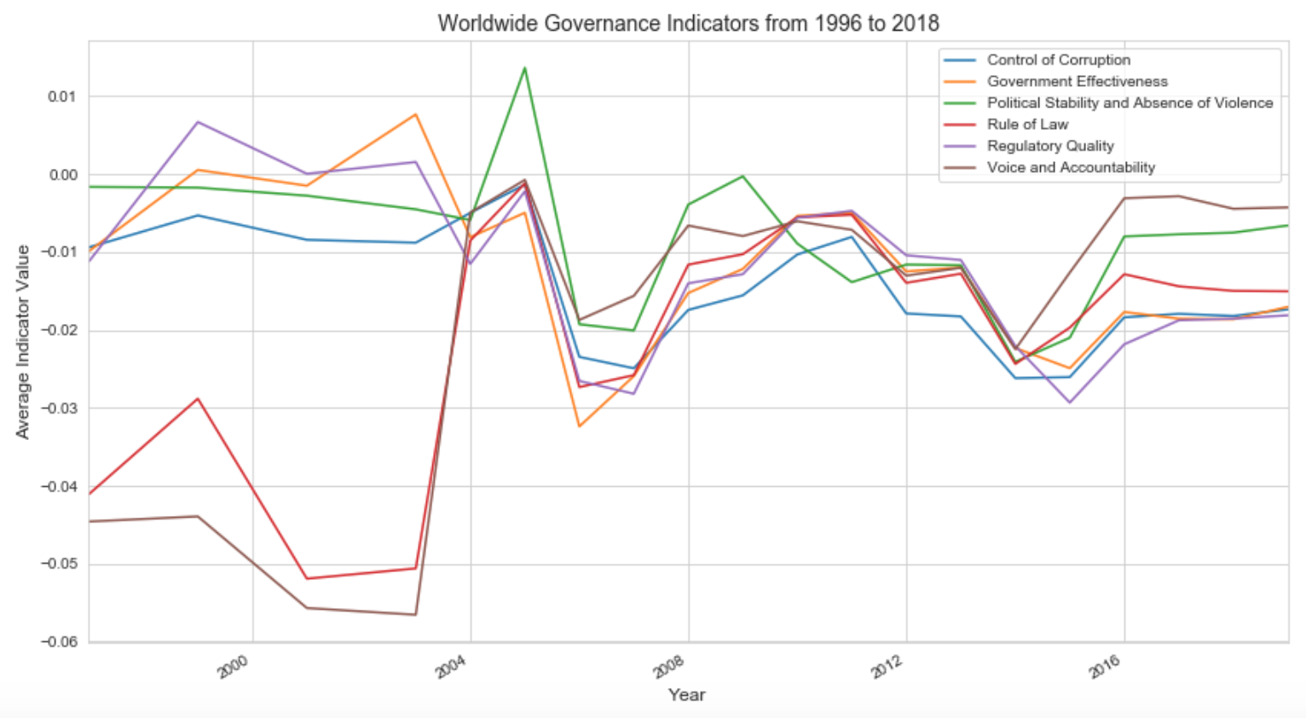
Governance Indicators Through Time

Slide 6
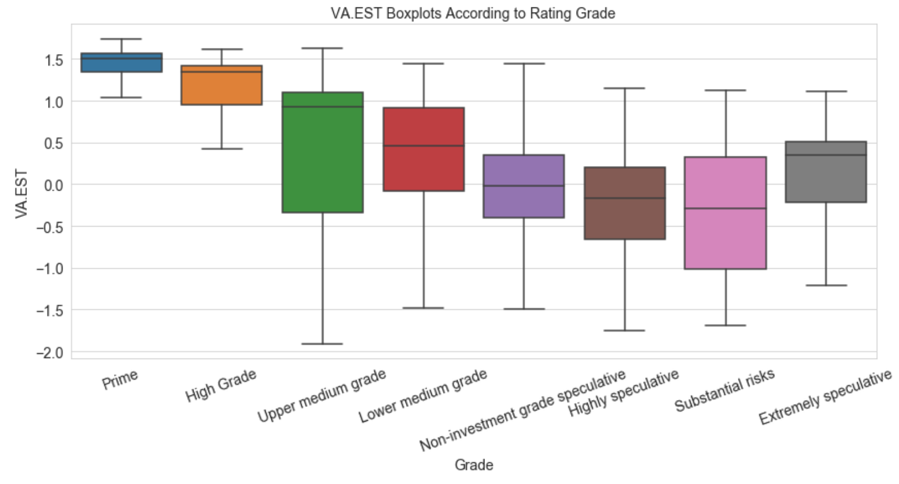
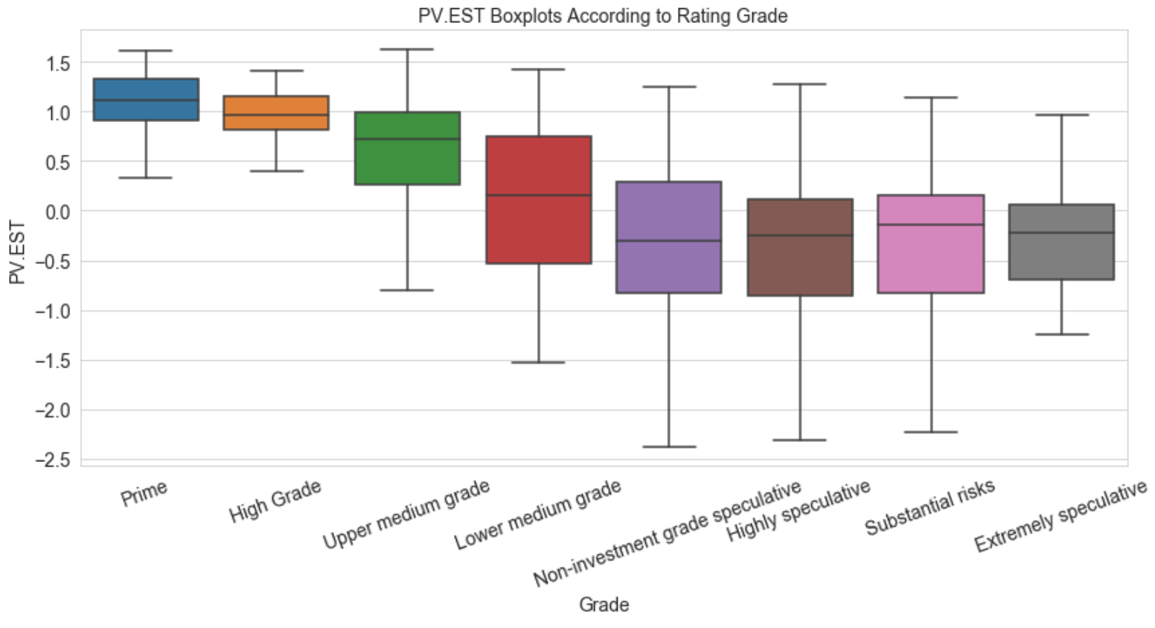
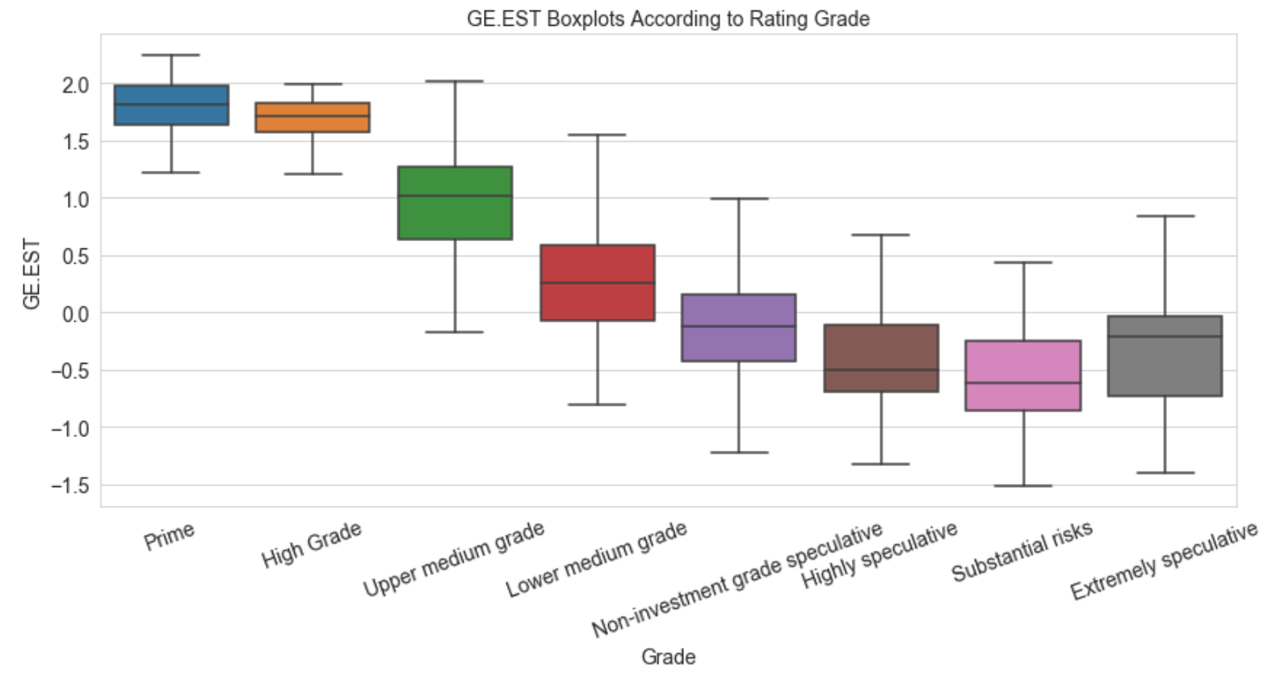
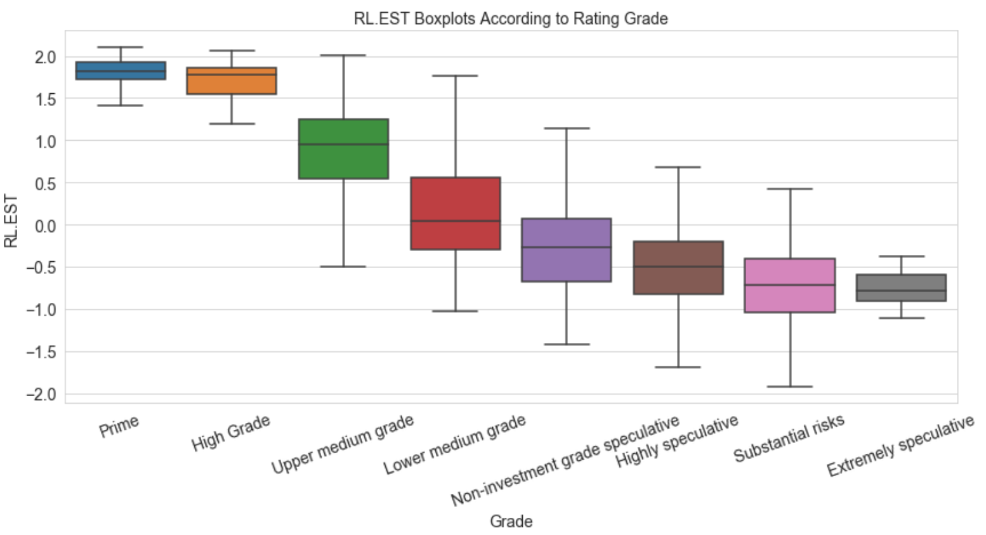
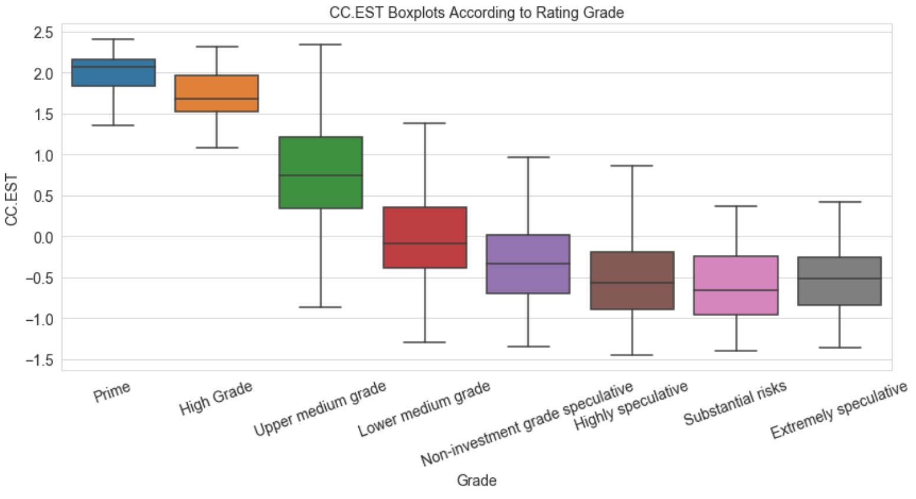
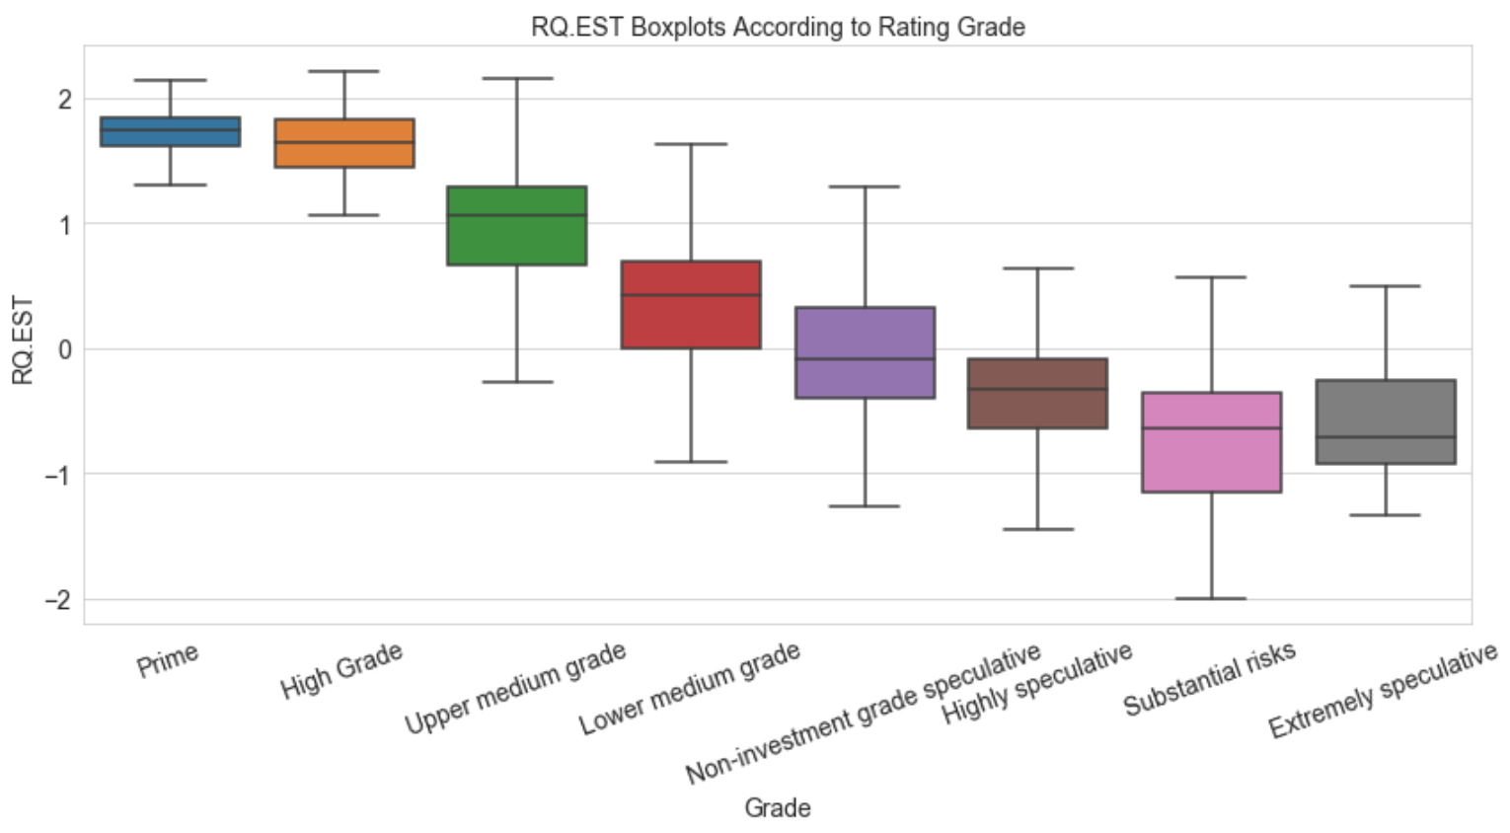
WGI for each of the rating categories

Slide 7
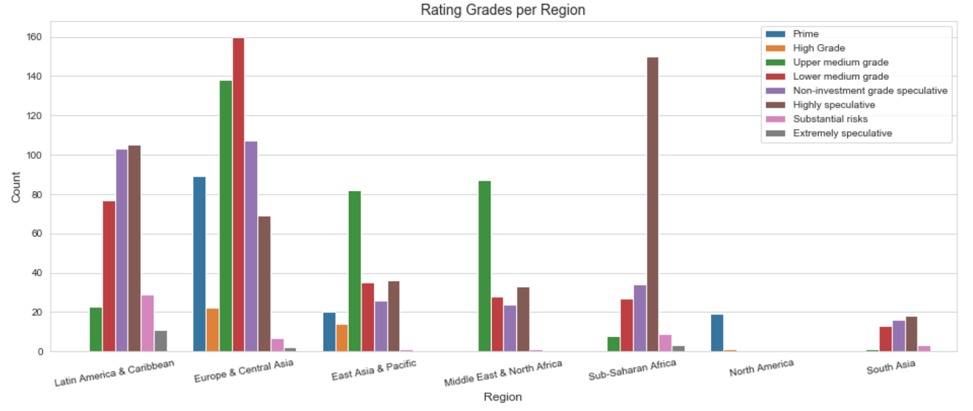
How Are rating grades allocated per region?

Slide 8
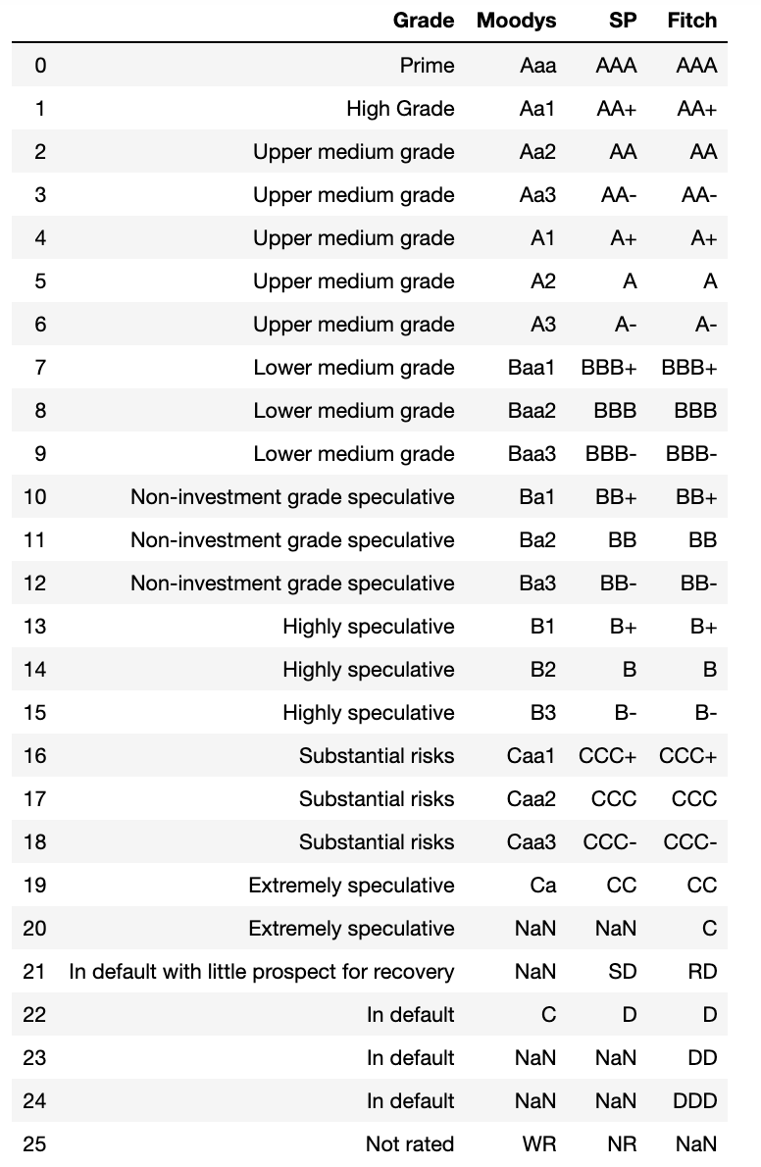
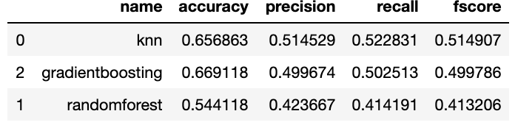
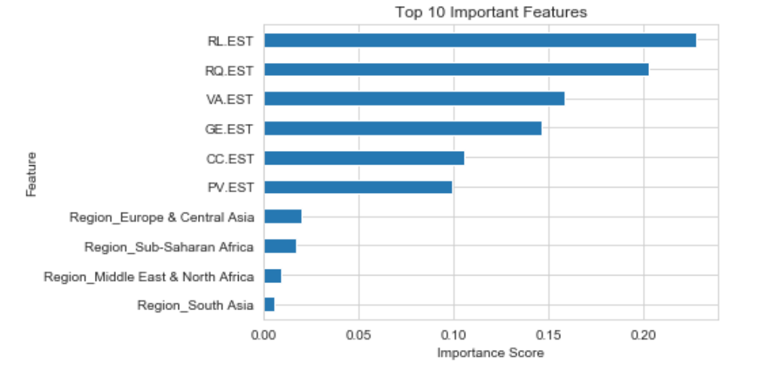
The Classification Model

Slide 9
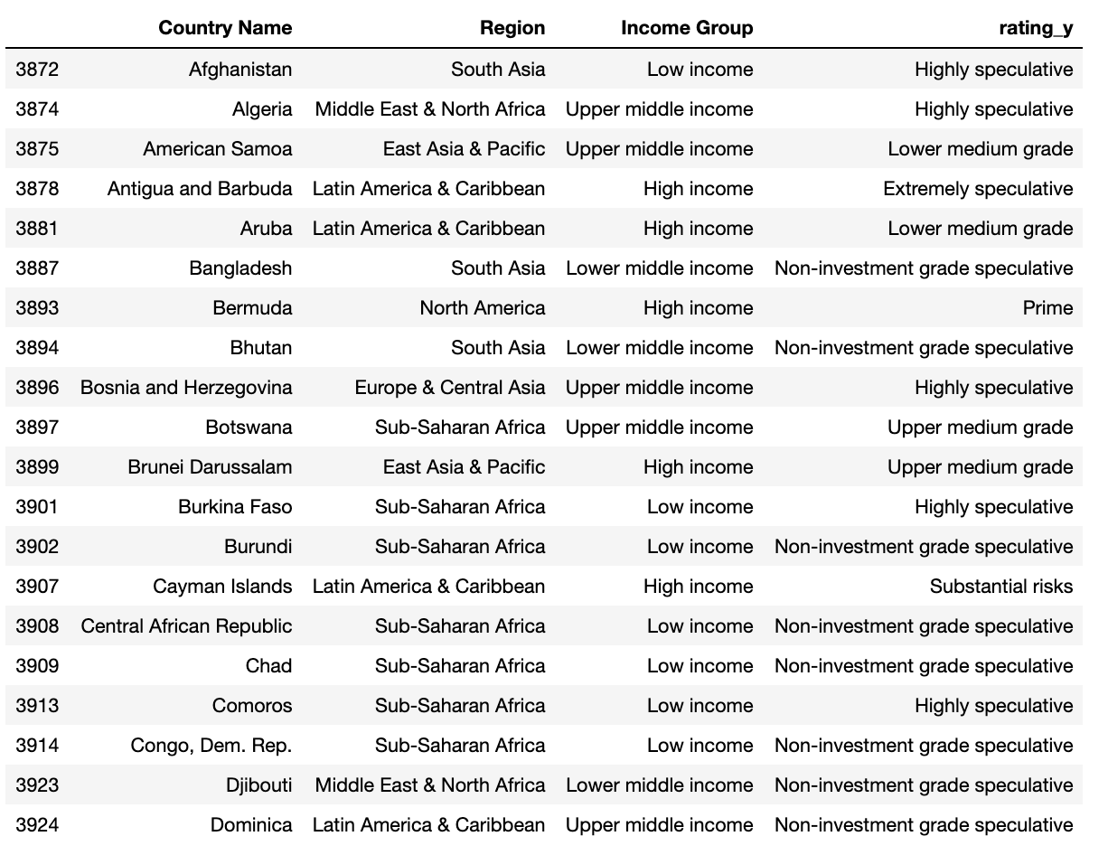
Conclusion and Recommendations
2018 Predictions (sample)
The model achieves a precision score of about 52%.
This model does not replace current more complete models, but it could be used as a feature engineering model that outputs a new feature to be used in existing models and increase their performance.

Slide 10
Further Work
Take into account income level for each of the countries in each year.
Perform time series analysis on the WGI.
Carry out hypothesis testing to find out if differences in WGI among regions, income levels, and rating grades are statistically significant.

Slide 11

Thank you
Any questions
For the full project notebook please visit: https://github.com/feraguilari/WorldBank_Capstone/blob/master/notebook.ipynb

