Slide 1

Time Series Analysis
Recommended Zip Codes to Develop New Rental Properties
Presented by: Fernando Aguilar Islas

Slide 2
Agenda
Zip Code Selection
Zip codes were filtered according to median home price, historical return on investment to date, and urbanization.
Time Series Analysis
Calculate monthly returns from the historical median home prices and build a time series model to forecast 10-year returns.
Recommendations
Recommendations are issued according to forecasts derived from the predictive models.

Slide 3
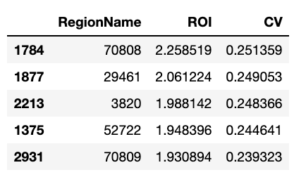
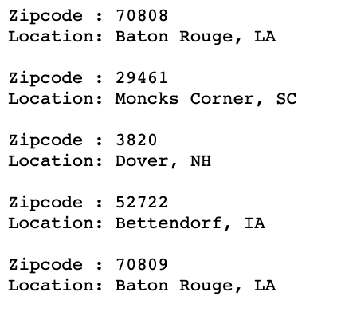
Zip code selection
Urbanization (Top 20% Size Rank)
Median Price Level (35 - 60 percentile)
Risk Profile (1 decile above median COV)
Historical ROI (Top 5 ROI)

Slide 4
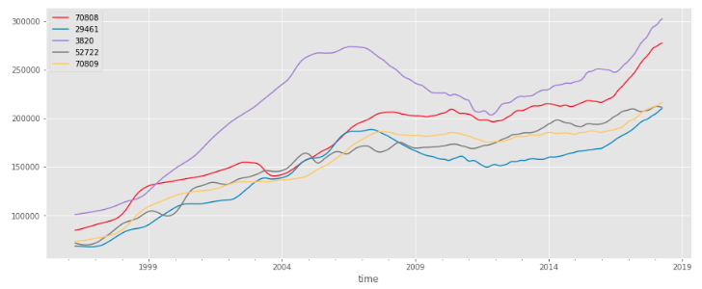
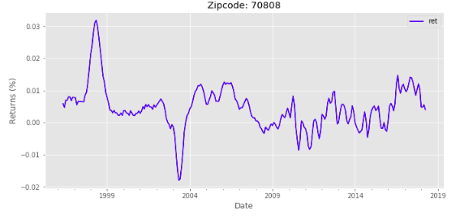
Time Series Analysis
Time series data was transformed into monthly returns.
Monthly returns are a better feature to rank zip codes.

Slide 5
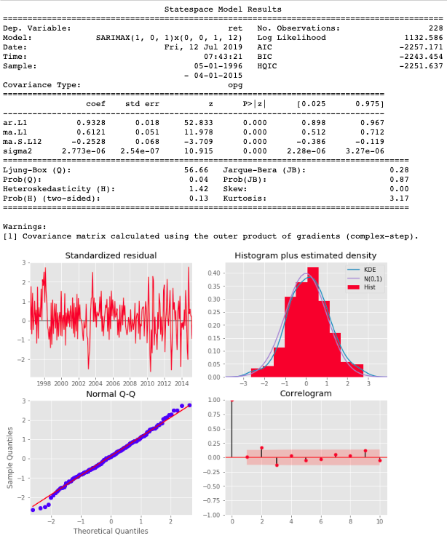
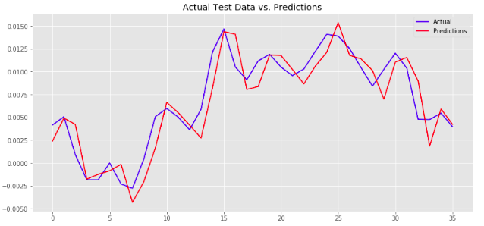
SARIMA Model
Estimated the best SARIMA parameters for each zip code to capture most of the data’s signal.

Slide 6
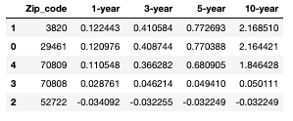
Forecasts and Recommendations
Invest in:
3820: Dover, NH (216.85% 10-year total return)
29461: Moncks Corner, SC (216.44% 10-year total return)
70809: Baton Rouge, LA (184.64% 10-year total return)

Slide 7
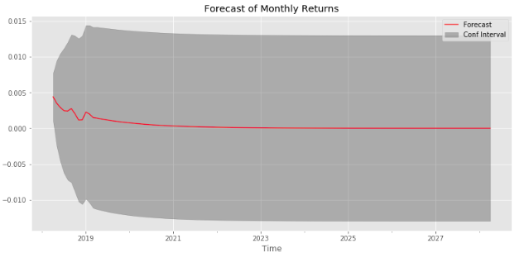
Further Work
Forecasts are solely based on historic monthly returns, and past performance does not necessarily predict future results. To improve the models and ultimately the quality of the forecasts, other external factors should be taken into account.

Slide 8

Thank you
Any questions?

