Slide 1
RPi provides full power
 | RCBR | RCBL |  | RCBB | RCBF
RCMS - | RCMS+ |  |  | RCMP- | RCM+
RCB-
RCB+
Motor
Controller
 |  |  | GPIO 14 (12) | GPIO 15 (10) | GPIO 18 (12) |  | GPIO 17 (11) | GPIO 27 (13) | GPIO 22 (15)

Slide 2
RC provides power to Motor controller
 | RCBR | RCBL |  | RCBB | RCBF
RCMS - | RCMS+ |  |  | RCMP- | RCM+
RC battery -
RCB-
RCB+
RC battery +
Motor
Controller
 |  |  | GPIO 14 (12) | GPIO 15 (10) | GPIO 18 (12) |  | GPIO 17 (11) | GPIO 27 (13) | GPIO 22 (15)

Slide 3
 | GPIO (4) 5V | GPIO (6) GND |  | SONAR 5V | SONAR GND
ADC
GPIO (1) 3.3V | GPIO (3) SDA1 | GPIO (5) SCL1 |  | GPIO (9) GND

Slide 4
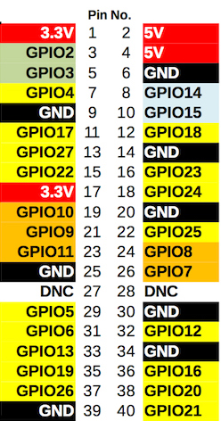
VCC – RADAR (White)
GND – RADAR (Green)
GPIO8 (24) SPI CE0 (Orange/Yellow)
RCB = RC Car Main Board
RCMP = RC Car Power Motor
RCMS = RC Car Steer Motor
Example: GPIO 14 (8): GPIO14, pin number 8

