Slide 1
DJONGO-EXCHANGE
MONGODB PROJECT
MADE BY:
FERANMI OJO

Slide 2
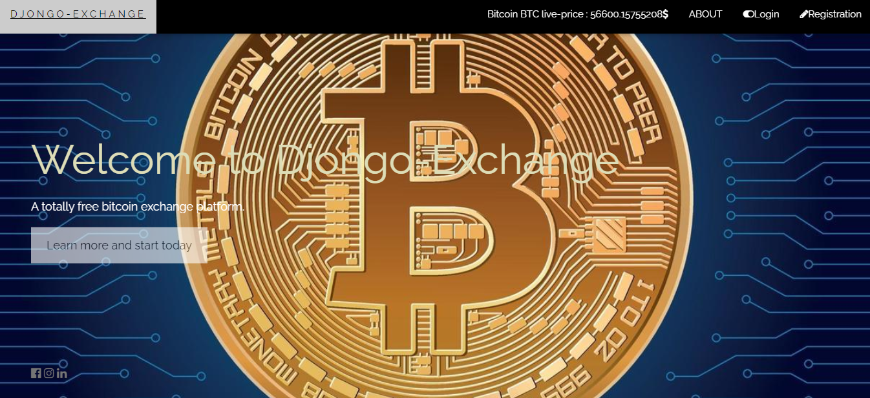
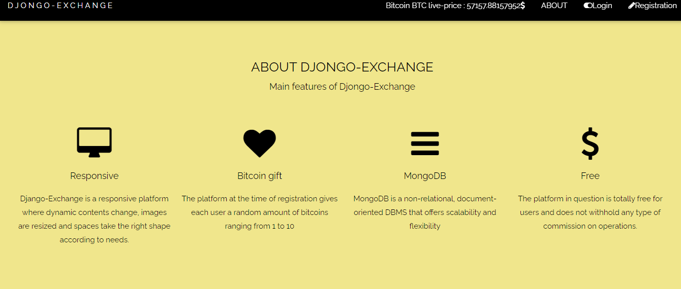
WHAT IS DJONGO-EXCHANGE?
Djongo-Exchange is a simple bitcoin exchange platform,
The platform in question is totally free for users and does not withhold any type of commission on operations.

Slide 3
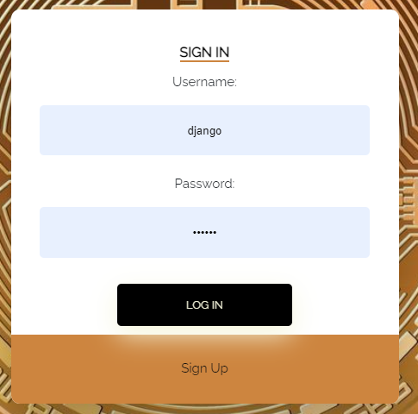
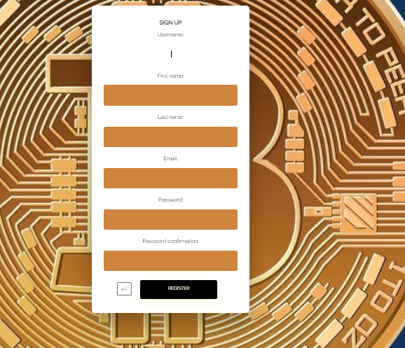
SIGN UP & SIGN IN
To enter the platform and start buying or selling bitcoins there are two pages for user registration and login.
The platform at the time of registration gives each user a random amount of bitcoins ranging from 1 to 10

Slide 4
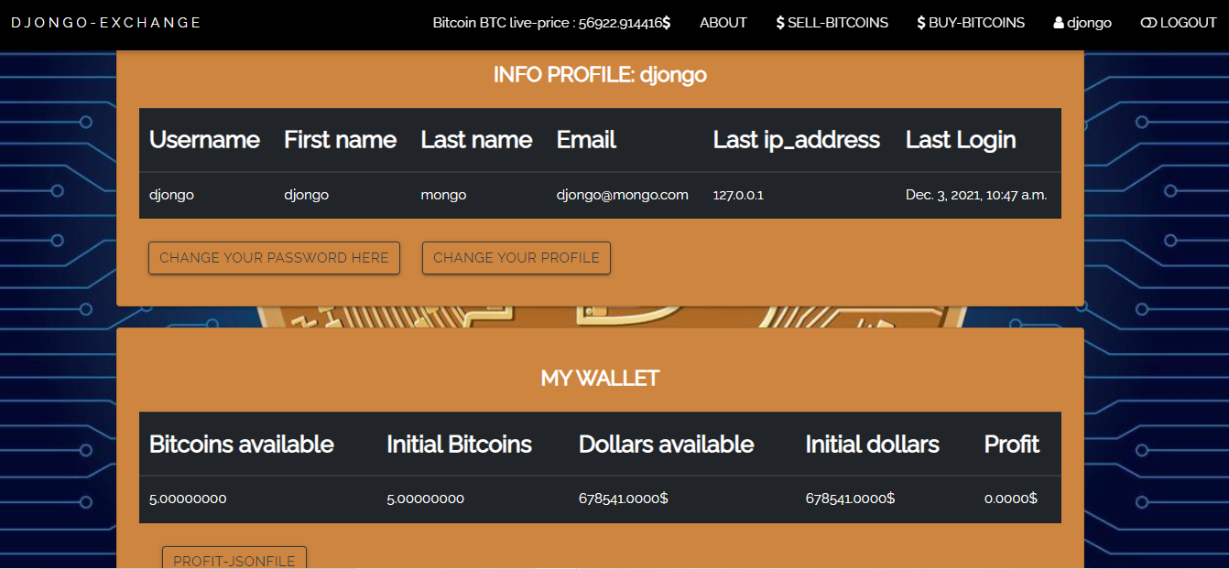
PROFILE
When you register or log in, the platform redirects you to the user's profile page where you can see the personal data of the respective user and his wallet with the amount of bitcoin he received for free and also you can see the profits you earn from sales and from bitcoin purchases.

Slide 5

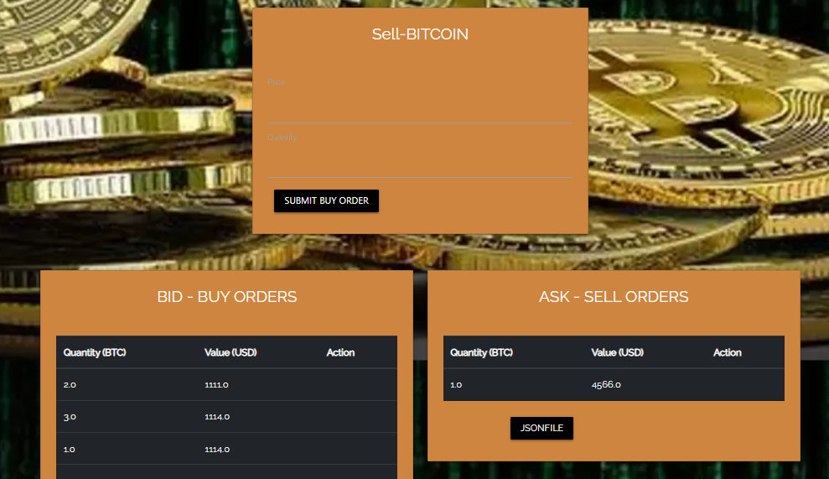
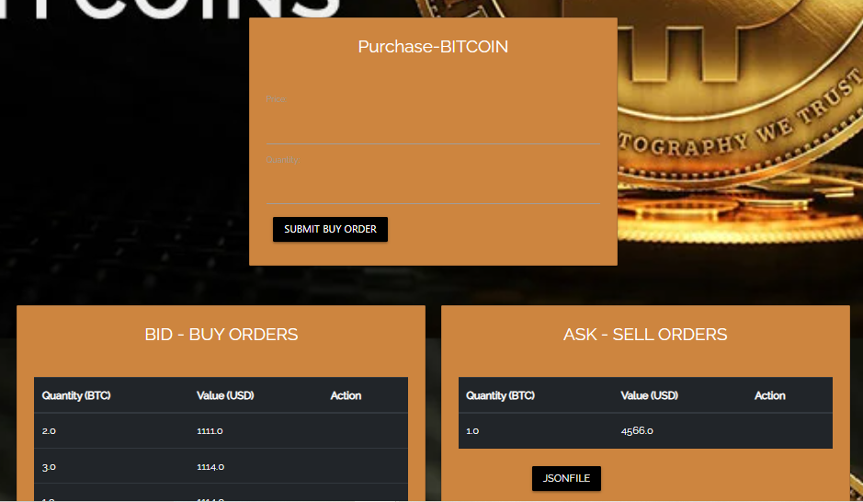
SELL & BUY
Once logged into the platform, the user can start buying and selling bitcoins.
Each user can post one or more sell or buy orders for a certain amount of bitcoins at a certain price

Slide 6
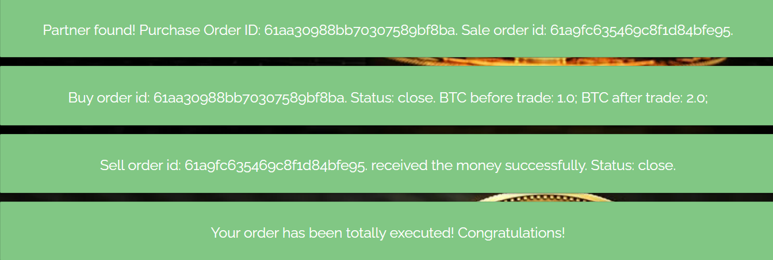
SELL & BUY
Djongo-Exchange has a very special feature,At the time of publication, if the purchase price of the order is equal to or greater than the selling price of any other user, record the transaction and mark both orders as executed.
The same is true if the user tries to sell a quantity of bitcoin,the platform looks for the active buy order with the same or similar characteristics

Slide 7

JSON FILE
Djongo-exchange allows you to view JSON reports that return all active buy and sell orders.

Slide 8
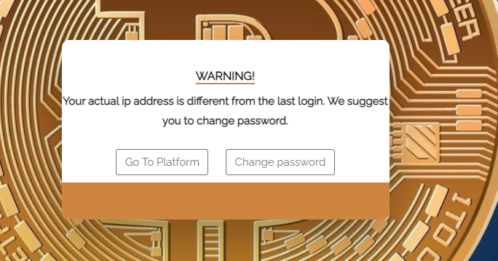
IP ADDRESS CONTROL
DJongo-Exchange presents a security system in which every time you access the platform with an ip address other than the last ip with which you logged in, it sends you a message that warns you of what has happened and advises you to change your password.

Slide 9

GITHUB
https://github.com/feranmi-oj/Progetto-MongDB-Feranmi-Ojo.git

