Slide 1
START2LIMITED_SHOES_EDITION
Final Project Blockchain
MADE BY:
FERANMI OJO

Slide 2

WHAT IS DJONGO-EXCHANGE?
START2LIMITED_SHOES_EDITION is a platform to manage the sale of limited edition shoes through a charity auction.

Slide 3
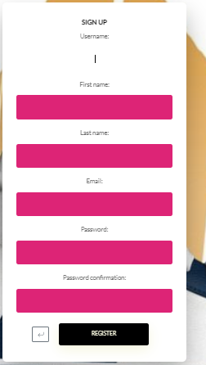
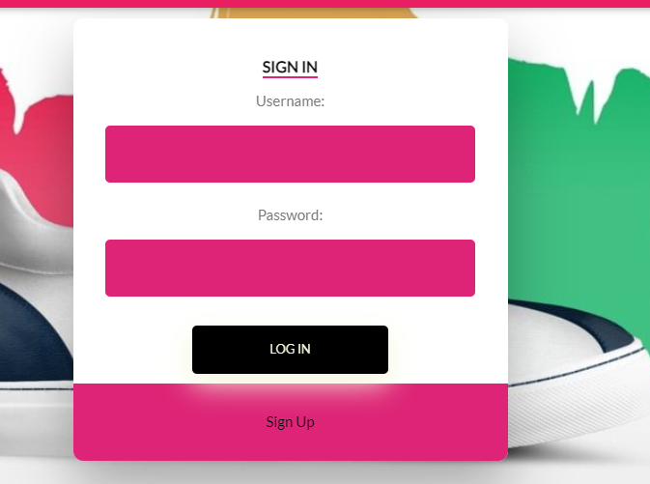
SIGN UP & SIGN IN
To enter the platform and start bidding and buying limited edition shoes, there are two pages for user registration and login.
The platform provides each user with a random amount of $ upon registration

Slide 4
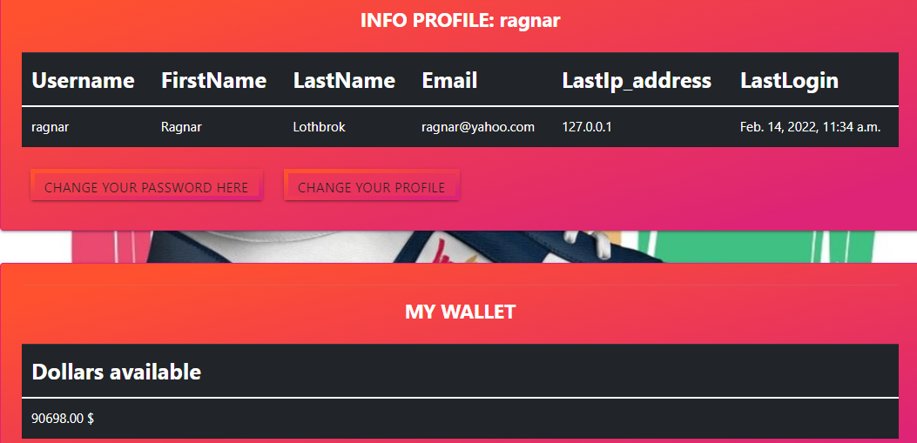
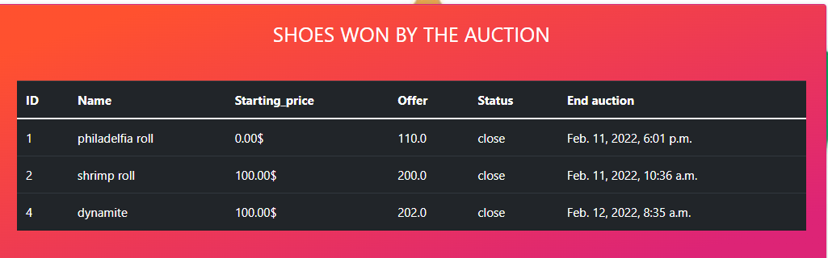
PROFILE
When you register or log in, the platform redirects you to the user's profile page where you can see the personal data of the respective user and his wallet and can see the list of auctions he has won.

Slide 5
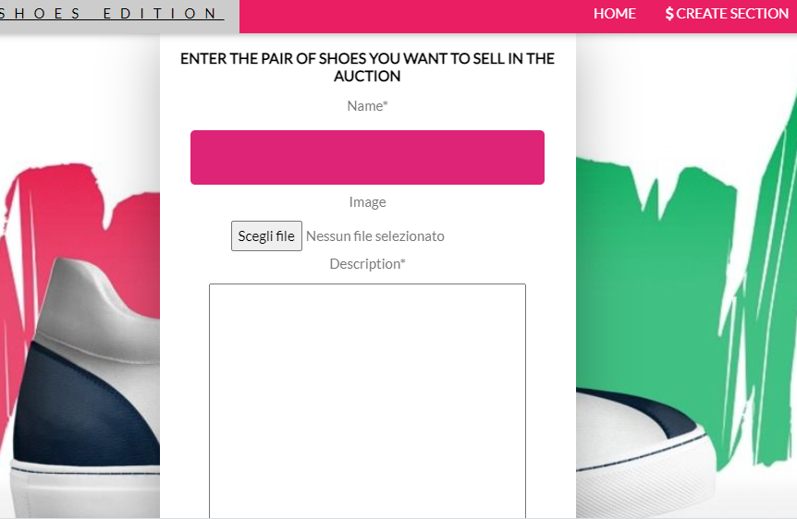
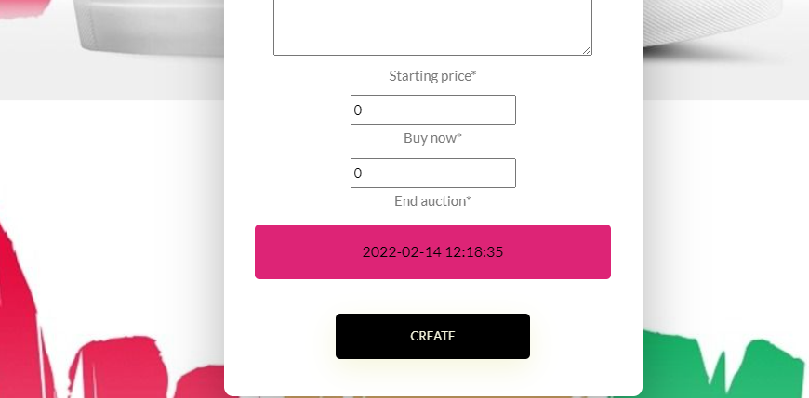
CREATE SECTION
only administrators can access this page and create auctions

Slide 6
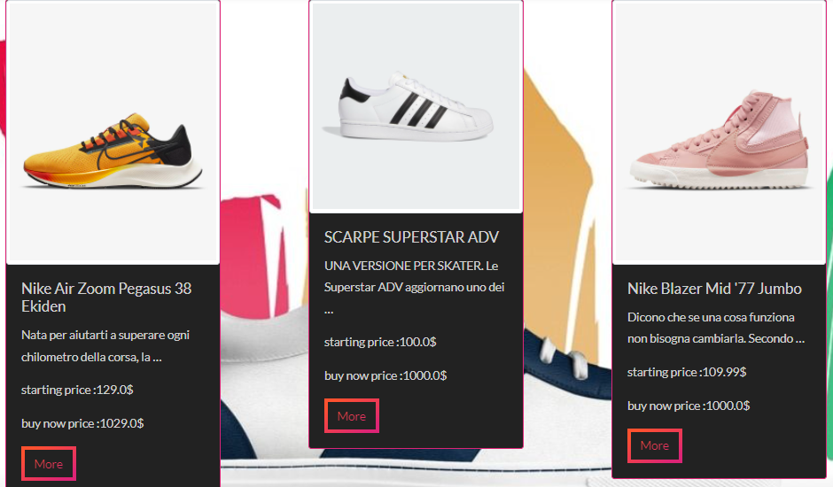
Page active auctions

Slide 7
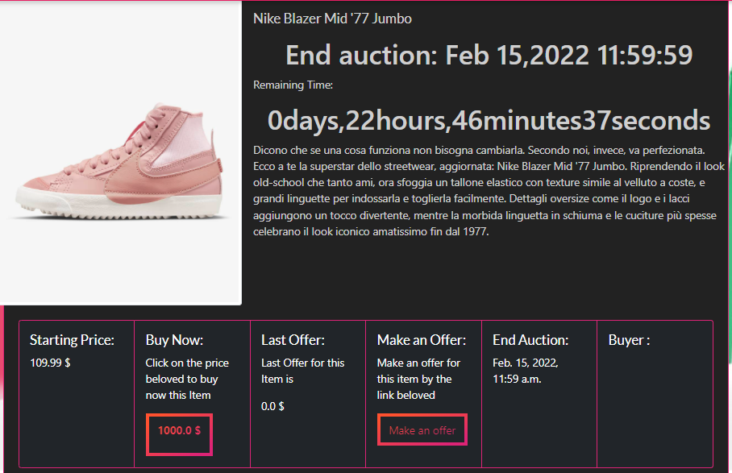

show_section
on this page you can see more details of the object in auction.
you can see the description of the item, how much is missing at the end of the auction, the initial sale price, the last bid they made for this auction, and there is a button or to immediately buy the auction item or to bid

Slide 8

DATABASE
the platform uses two databases: it uses Redis as the main database. In fact, if the platform in the future can generate a lot of attention and be used by an ever-increasing number of users who may require having to scale horizontally to handle the traffic, it needs a very fast database to manage the various bets, to then store the outcome of the auction, like all other user data, on a relational database.

Slide 9

GITHUBenter the platform and start buying or selling bitcoins there are two pages for user registration and login. The platform at the time of registration gives each user a random amount of bitcoins ranging from 1 to 10 r the platform and start buying or selling bitcoins there are two pages for user registration and login. The platform at the time of registration gives each user a random amount of bitcoins ranging from 1 to 10
https://github.com/feranmi-oj/Progetto_Finale_Blockchain_Feranmi_Ojo

