Slide 1

Microsoft Business Analytics and AI
Building Solutions – Modeling
Microsoft Machine Learning and Data Science Team
aka.ms/BusinessAnalyticsAndAI
Notes:
Main page – https://aka.ms/businessanalyticsandai
To begin this module, you should have:
Basic Math and Stats skills
Business and Domain Awareness
General Computing Background
NOTE: These workbooks contain many resources to lead you through the course, and provide a rich set of references that you can use to learn much more about these topics. If the links do not resolve properly, type the link address in manually in your web browser. If the links have changed or been removed, simply enter the title of the link in a web search engine to find the new location or a corollary reference.

Slide 2
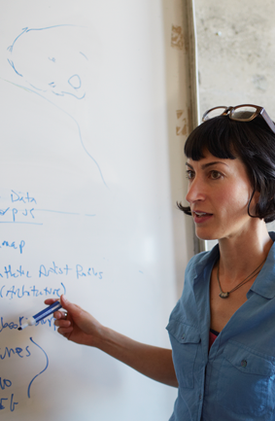
Learning Objectives
Understand Machine Learning
Be able to use the Azure ML Environment
Create and Deploy a Machine Learning Solution
Notes:
At the end of this Module, you will:
Understand Machine Learning
Be able to use the Azure ML Environment
Create and Deploy a Machine Learning Solution

Slide 3
The Data Science Process and Platform
Notes:
This process largely follows the CRISP-DM model - http://www.sv-europe.com/crisp-dm-methodology/

Slide 4
The Team Data Science Process
Business Understanding
Define Objectives
Identify Data Sources
Data Acquisition and Understanding
Ingest Data
Explore Data
Modeling
Feature Selection
Create and Train Model
Deployment
Customer Acceptance
Operationalize
Testing and Validation
Update Data
Handoff
Re-train and re-score
Notes:
It also references the Microsoft Business Analytics and AI process - https://azure.microsoft.com/en-us/documentation/articles/data-science-process-overview/
A complete process diagram is here - https://azure.microsoft.com/en-us/documentation/learning-paths/cortana-analytics-process/
Some walkthrough’s of the various services - https://azure.microsoft.com/en-us/documentation/articles/data-science-process-walkthroughs/
An integrated process and toolset allows for a more close-to-intent deployment
Iterations are required to close in on the solution – but are harder to manage and monitor
Data Science Blog - https://buckwoody.wordpress.com/

Slide 5
The Azure Platform for Analytics and AI
Big Data
Intelligence and Advanced Analytics
Information Management
Solutions
Visualization
Data Catalog
Data Factory
Event Hubs
Data Lake
SQL Data Warehouse
Cosmos DB
Cortana, Bot Service, Cognitive Framework
HDInsight
Data Lake
Azure Storage
Stream Analytics
Analysis Services
Power BI
R
Templates and Gallery
Machine Learning
Notes:
Azure Data Catalog - http://azure.microsoft.com/en-us/services/data-catalog (Doc It)
Azure Data Factory - http://azure.microsoft.com/en-us/services/data-factory/ (Move It)
Azure Event Hubs - http://azure.microsoft.com/en-us/services/event-hubs/ (Bring It)
Platform and Storage - Microsoft Azure – http://microsoftazure.com Storage - https://azure.microsoft.com/en-us/documentation/services/storage/ (Host It)
Azure Data Lake - http://azure.microsoft.com/en-us/campaigns/data-lake/ (Store It)
Azure SQL Data Warehouse - http://azure.microsoft.com/en-us/services/sql-data-warehouse/ (Relate It)
Azure Cosmos DB - https://docs.microsoft.com/en-us/azure/cosmos-db/introduction
Cortana - http://blogs.windows.com/buildingapps/2014/09/23/cortana-integration-and-speech-recognition-new-code-samples/ and https://blogs.windows.com/buildingapps/2015/08/25/using-cortana-to-interact-with-your-customers-10-by-10/ and https://developer.microsoft.com/en-us/Cortana (Say It)
Cognitive Services - https://www.microsoft.com/cognitive-services
Bot Framework - https://dev.botframework.com/
Azure Machine Learning - http://azure.microsoft.com/en-us/services/machine-learning/ (Learn It)
Azure HDInsight - http://azure.microsoft.com/en-us/services/hdinsight/ (Scale It)
Azure Stream Analytics - http://azure.microsoft.com/en-us/services/stream-analytics/ (Stream It)
Analysis Services - https://docs.microsoft.com/en-us/azure/analysis-services/analysis-services-overview
Power BI - https://powerbi.microsoft.com/ (See It)
All of the components within the suite - https://www.microsoft.com/en-us/server-cloud/cortana-intelligence-suite/what-is-cortana-intelligence.aspx
Templates - https://gallery.cortanaintelligence.com/browse?orderby=freshness%20desc&skip=0&categories=%5B%2210%22%5D and https://caqs.azure.net/#gallery

Slide 6
Azure ML
Notes:
Example paths for using Azure ML: https://azure.microsoft.com/en-us/documentation/articles/machine-learning-data-science-plan-sample-scenarios/

Slide 7
Machine Learning in 5 Minutes
The Formal one:
“A computer program is said to learn from experience E with respect to some class of tasks T and performance measure P if its performance at tasks in T, as measured by P, improves with experience E.”
A Practical Example:
Look at data. Do the thing. Better? No? Look at the data. Do something different. Better? Yes? Do that again. (Repeat)
Notes:
Choosing an Algorithm for Machine Learning: https://azure.microsoft.com/en-us/documentation/articles/machine-learning-algorithm-choice/

Slide 8
Machine Learning Capabilities
Which category
(Classification)
How much/many
(Regression)
Which group
(Clustering,
Recommender)
Is it odd
(Anomaly)
Which action
(Reinforcement Learning)
Notes:
Regression: Predict a real value for each item (stock/currency value, temperature). – How much/how many?
Classification: Assign a category to each item (Chinese | French | Indian | Italian | Japanese restaurant). – Which Category?
Clustering/Recommendation: Partition items into homogeneous groups (clustering twitter posts by topic). – Which Groups?
Anomaly: Identify when something unexpected happens. – Is this weird?
Reinforcement Learning: Make an appropriate action for some new data. – Which action?

Slide 9
Machine Learning Algorithms
Split into two main categories:
Supervised learning
Predicting the future
Learn from known past examples to predict future
Labels provided
Unsupervised learning
Making sense of data
Understanding the past
Learning the structure of data
Labels no provided
Notes:
Algorithm Documentation: https://msdn.microsoft.com/library/dn905974.aspx
Exploring: https://azuremlsimpleds.azurewebsites.net/simpleds/

Slide 10
The Azure ML Environment
Development Environment
Creating Experiments
Sharing a Workspace
Deployment Environment
Publishing the Model
Using the API
Consuming in various tools
Notes:
Guided tutorials: https://azure.microsoft.com/en-us/documentation/services/machine-learning/
Microsoft Azure Virtual Academy course: https://mva.microsoft.com/en-US/training-courses/microsoft-azure-machine-learning-jump-start-8425?l=ehQZFoKz_7904984382

Slide 11
Basic Azure ML Elements
Import Data
Preprocess
Algorithm
Split Data
Train Model
Score Model
Notes:
Designing an experiment in the Studio: https://azure.microsoft.com/en-us/documentation/articles/machine-learning-what-is-ml-studio/

Slide 12
Creating an Experiment
Create
Workspace
Build and Model
Deploy Model
Consume Model
Get/Prepare Data
Evaluate Model Results
Build/Edit Experiment
Create/Update Model
Notes:
Beginning Series: https://azure.microsoft.com/en-us/documentation/articles/machine-learning-data-science-for-beginners-the-5-questions-data-science-answers/

Slide 13
Measuring Effectiveness and Efficiency in ML
Notes:
Train and Evaluate your Model: https://azure.microsoft.com/en-us/documentation/articles/machine-learning-walkthrough-4-train-and-evaluate-models/

Slide 14
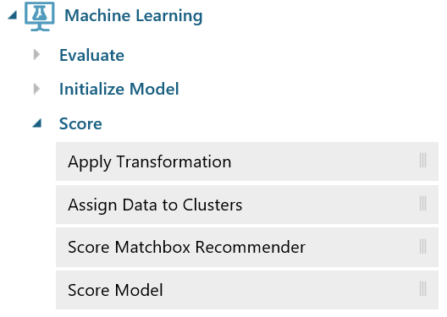
Azure Machine Learning
Score
Apply a trained model to:
A list of recommended items
Forecasts for time series models
Estimates of projected demand, volume, or other numeric quantity, for regression models
Cluster assignments
A predicted class or outcome, for classification models
Probability scores associated with these outputs
Notes:
Understanding Scoring:
Algorithm Choice - https://azure.microsoft.com/en-us/documentation/articles/machine-learning-algorithm-choice/
Overview of Scoring a ML Model - https://msdn.microsoft.com/en-US/library/azure/dn906012.aspx/
Apply Transformation - https://msdn.microsoft.com/en-us/library/azure/dn913055.aspx/
Score Matchbox Recommender - https://msdn.microsoft.com/en-us/library/azure/dn905970.aspx/
Score Model - https://msdn.microsoft.com/en-us/library/azure/dn905995.aspx/

Slide 15
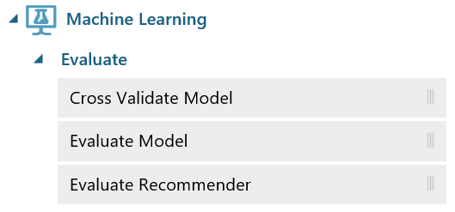
Azure Machine Learning
Evaluate
Metrics for Classification Models
Accuracy, Recall, Precision, F1-Score
AUC
Average Log Loss
Training Log Loss
Metrics for Regression Models
Mean absolute error (MAE)
Root mean squared error (RMSE)
Relative absolute error (RAE)
Relative squared error (RSE)
Coefficient of determination
Notes:
Simple explanation of the ROC Curve: http://blog.revolutionanalytics.com/2016/08/roc-curves-in-two-lines-of-code.html
Evaluation Overview - https://msdn.microsoft.com/en-us/library/azure/dn906026.aspx
Model Performance - https://azure.microsoft.com/en-us/documentation/articles/machine-learning-evaluate-model-performance/
Cross-validate Model - https://msdn.microsoft.com/library/azure/75fb875d-6b86-4d46-8bcc-74261ade5826
Evaluate Model - https://msdn.microsoft.com/library/azure/927d65ac-3b50-4694-9903-20f6c1672089
Evaluate Recommender - https://msdn.microsoft.com/library/azure/e9ad68a7-e91b-4ae6-800e-b5ee7e22cd17

Slide 16



Lab:
Create and Run an Experiment in Azure ML
Notes:
Open this reference and work through all steps: https://docs.microsoft.com/en-us/azure/machine-learning/machine-learning-create-experiment

Slide 17
The Microsoft R Server Platform Parallelization & Data Constructs
ConnectR
High-speed & direct connectors
Available for:
High-performance XDF
SAS, SPSS, delimited & fixed format text data files
Hadoop HDFS (text & XDF)
Teradata Database & Aster
EDWs and ADWs
ODBC
R+CRAN
Open source R interpreter
R 3.1.2
Freely-available huge range of R algorithms
Algorithms callable by RevoR
Embeddable in R scripts
100% Compatible with existing R scripts, functions and packages
MRS, SQL Srvr, HDI
DevelopR
ConnectR
DeployR
R+CRAN
Microsoft R
ScaleR
DistributedR
DistributedR
Distributed computing framework
Delivers cross-platform portability
Available on:
Windows Servers
Red Hat and SuSE Linux Servers
IBM Platform LSF Linux
Microsoft HPC Clusters
Teradata Database
Cloudera Hadoop
Hortonworks Hadoop
MapR Hadoop
Microsoft R
Performance enhanced R interpreter
Based on open source R
Adds high-performance math library to speed up linear algebra functions
ScaleR
Ready-to-Use high-performance big data big analytics
Fully-parallelized analytics
Data prep & data distillation
Descriptive statistics & statistical tests
Range of predictive functions
User tools for distributing customized R algorithms across nodes
Wide data sets supported – thousands of variables
Notes:
Getting started with Microsoft R Server: https://msdn.microsoft.com/en-us/microsoft-r/microsoft-r-get-started-node

