Slide 1

Microsoft Business Analytics and AI
Building Solutions – Deployment
Microsoft Machine Learning and Data Science Team
aka.ms/BusinessAnalyticsAndAI
Notes:
Main page – https://aka.ms/businessanalyticsandai
To begin this module, you should have:
Basic Math and Stats skills
Business and Domain Awareness
General Computing Background
NOTE: These workbooks contain many resources to lead you through the course, and provide a rich set of references that you can use to learn much more about these topics. If the links do not resolve properly, type the link address in manually in your web browser. If the links have changed or been removed, simply enter the title of the link in a web search engine to find the new location or a corollary reference.

Slide 2

Learning Objectives
Deploy a solution using storage
Deploy a solution using an API
Deploy a solution using Code
Deploy a solution using the Service Bus
Notes:
At the end of this Module, you will be able to:
Deploy a solution using storage
Deploy a solution using an API
Deploy a solution using Code
Deploy a solution using the Service Bus

Slide 3
The Data Science Process and Platform
Notes:
This process largely follows the CRISP-DM model - http://www.sv-europe.com/crisp-dm-methodology/

Slide 4
The Team Data Science Process
Business Understanding
Define Objectives
Identify Data Sources
Data Acquisition and Understanding
Ingest Data
Explore Data
Modeling
Feature Selection
Create and Train Model
Deployment
Customer Acceptance
Operationalize
Testing and Validation
Update Data
Handoff
Re-train and re-score
Notes:
It also references the Microsoft Business Analytics and AI process - https://azure.microsoft.com/en-us/documentation/articles/data-science-process-overview/
A complete process diagram is here - https://azure.microsoft.com/en-us/documentation/learning-paths/cortana-analytics-process/
Some walkthrough’s of the various services - https://azure.microsoft.com/en-us/documentation/articles/data-science-process-walkthroughs/
An integrated process and toolset allows for a more close-to-intent deployment
Iterations are required to close in on the solution – but are harder to manage and monitor
Data Science Blog - https://buckwoody.wordpress.com/

Slide 5
The Azure Platform for Analytics and AI
Big Data
Intelligence and Advanced Analytics
Information Management
Solutions
Visualization
Data Catalog
Data Factory
Event Hubs
Data Lake
SQL Data Warehouse
Cosmos DB
Cortana, Bot Service, Cognitive Framework
HDInsight
Data Lake
Azure Storage
Stream Analytics
Analysis Services
Power BI
R
Templates and Gallery
Machine Learning
Notes:
Azure Data Catalog - http://azure.microsoft.com/en-us/services/data-catalog (Doc It)
Azure Data Factory - http://azure.microsoft.com/en-us/services/data-factory/ (Move It)
Azure Event Hubs - http://azure.microsoft.com/en-us/services/event-hubs/ (Bring It)
Platform and Storage - Microsoft Azure – http://microsoftazure.com Storage - https://azure.microsoft.com/en-us/documentation/services/storage/ (Host It)
Azure Data Lake - http://azure.microsoft.com/en-us/campaigns/data-lake/ (Store It)
Azure SQL Data Warehouse - http://azure.microsoft.com/en-us/services/sql-data-warehouse/ (Relate It)
Azure Cosmos DB - https://docs.microsoft.com/en-us/azure/cosmos-db/introduction
Cortana - http://blogs.windows.com/buildingapps/2014/09/23/cortana-integration-and-speech-recognition-new-code-samples/ and https://blogs.windows.com/buildingapps/2015/08/25/using-cortana-to-interact-with-your-customers-10-by-10/ and https://developer.microsoft.com/en-us/Cortana (Say It)
Cognitive Services - https://www.microsoft.com/cognitive-services
Bot Framework - https://dev.botframework.com/
Azure Machine Learning - http://azure.microsoft.com/en-us/services/machine-learning/ (Learn It)
Azure HDInsight - http://azure.microsoft.com/en-us/services/hdinsight/ (Scale It)
Azure Stream Analytics - http://azure.microsoft.com/en-us/services/stream-analytics/ (Stream It)
Analysis Services - https://docs.microsoft.com/en-us/azure/analysis-services/analysis-services-overview
Power BI - https://powerbi.microsoft.com/ (See It)
All of the components within the suite - https://www.microsoft.com/en-us/server-cloud/cortana-intelligence-suite/what-is-cortana-intelligence.aspx
Templates - https://gallery.cortanaintelligence.com/browse?orderby=freshness%20desc&skip=0&categories=%5B%2210%22%5D and https://caqs.azure.net/#gallery

Slide 6
Options for Operationalization
API Sources
Storage Sources
Coding access/REST
Service Bus
Notes:
REST Documentation: https://msdn.microsoft.com/en-us/library/azure/dd179355.aspx
Data Science Blog: https://buckwoody.wordpress.com/

Slide 7
Azure ML - Publish as a Web Service
Build the model
Run the Experiment
Create a Predictive Experiment
A. Click on Web Service set up button
B. Click on Create a Predictive Experiment
Modify the predictive experiment
A. Connect the Web Service Input to Score
B. Add a Project Columns after Score and only allow Scored Labels and Probabilities
C. Move the Web Service Output to after Project Columns module
Run, then deploy the Web Service
Test the Web Service using the Test Dialogue
Review Sample Code on the RRS Help Page
Notes:
Publishing Steps: https://azure.microsoft.com/en-us/documentation/articles/machine-learning-walkthrough-5-publish-web-service/

Slide 8




Lab:
Create an Azure ML API
Notes:
Open this resource https://docs.microsoft.com/en-us/azure/machine-learning/machine-learning-publish-a-machine-learning-web-service and work through the steps until you see “Test your New web service”. We’ll complete that step in another lab.

Slide 9


Cortana and the Bot Framework
Notes:
What Developers Need To Know About the Cortana API - https://channel9.msdn.com/Blogs/Dev-Inspiration/What-Developers-Need-To-Know-About-the-Cortana-API
Full Training Course: https://mva.microsoft.com/en-US/training-courses/universal-windows-app-development-with-cortana-and-the-speech-sdk-8487
Quickstart - https://code.msdn.microsoft.com/Voice-Commands-Quickstart-64ce68ce (Note - will install Windows Phone emulator in your VS)
App Dev with Cortana - https://channel9.msdn.com/Shows/Visual-Studio-Toolbox/App-Development-with-Cortana
Cortana Interactions (XAML) - https://msdn.microsoft.com/en-us/library/windows/apps/xaml/dn974230.aspx?f=255&MSPPError=-2147217396
Speech Recognition and Synthesis Samples - https://github.com/Microsoft/Windows-universal-samples/tree/master/Samples/SpeechRecognitionAndSynthesis
Cortana Voice Command - https://github.com/Microsoft/Windows-universal-samples/tree/master/Samples/CortanaVoiceCommand
Building with Cortana - http://www.slideshare.net/ActiveNick/building-windows-10-universal-apps-with-speech-and-Cortana
Azure Bot Framework Tutorial: https://docs.microsoft.com/en-us/bot-framework/azure/azure-bot-service-quickstart

Slide 10
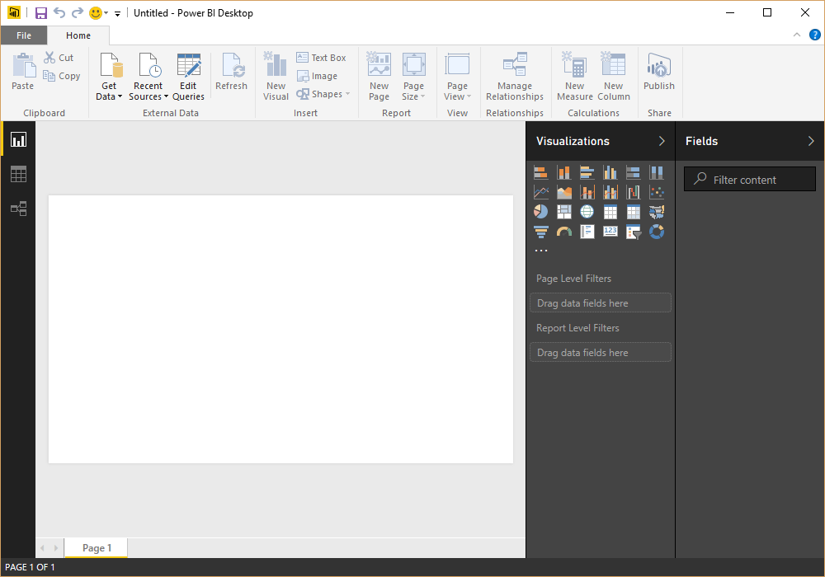
Power BI
A Reporting System for Multiple Data Sources
Available in:
Web Portal
Power BI Desktop
Microsoft Excel
Mobile apps (iOS, Android, Windows)
Author
Connect to Data
Shape the Data
Model the Data
Report on the Data
Publish
Local
To Service
Notes:
Getting Started: https://powerbi.microsoft.com/en-us/documentation/powerbi-desktop-getting-started/
Guided Learning: https://powerbi.microsoft.com/en-us/guided-learning/
4-part online course for Power BI in Excel 2013: https://mva.microsoft.com/en-US/training-courses/data-visualizations-with-power-bi-in-excel-2013-8889?l=kBrlM2A3_104984382
Web Portal – http://powerbi.com
Power BI Desktop - https://powerbi.microsoft.com/en-us/documentation/powerbi-desktop-latest-update/
Excel - https://support.office.com/en-us/article/Get-Transform-in-Excel-2016-881c63c6-37c5-4ca2-b616-59e18d75b4de?ui=en-US&rs=en-US&ad=US
Mobile Apps - https://powerbi.microsoft.com/en-us/Mobile

Slide 11

Creating a Useful Report
Power BI
Find and Verify your Source Data
Locate the most authoritative data
Get permission where required
Shape and Model the Data
Find the main message
Remove extraneous data
Change the types to be more effective in interactive layouts
Select the right Graphic
Scale, increments, axes
Simple is better
Tell a story
Notes:
From the book The Wall Street Journal Guide to Information Graphics: http://www.amazon.com/Street-Journal-Guide-Information-Graphics/dp/0393347281
Finding the right visualization: https://powerbi.microsoft.com/en-us/documentation/powerbi-service-visualization-best-practices/

Slide 12
Lab:
Analyzing data in Power BI
Notes:
Follow this example: https://powerbi.microsoft.com/en-us/documentation/powerbi-desktop-tutorial-analyzing-sales-data-from-excel-and-an-odata-feed/
In Task 4, Step 1 there are a couple of changes needed:
When you drag UnitsInStock to the fields pane, you will need to change it from a "Count" to a "Sum" in the drop-down.
When you drag OrderDate to the canvas, you will need to change it from "Date Hierarchy" to "OrderDate" in the drop-down.
When you drag LineTotal into the Map Chart, drag it to the "Size" field, not the "Values" field.
Optional: (Experienced users): Open Power BI or Excel, and use this data source: http://services.odata.org/V4/Northwind/Northwind.svc/
Define Relationships
Change the data types to be appropriate for location, summation, etc.
Create linked graphics based on those relationships and data elements
Tell a single story with your report

Slide 13
Code and Storage
Query Tools
Code
3rd Party
Notes:
Access and read through this page: https://support.office.com/en-us/article/Connect-to-Microsoft-Azure-Blob-Storage-Power-Query-f8165faa-4589-47b1-86b6-7015b330d13e?ui=en-US&rs=en-US&ad=US&fromAR=1
Access and read through this page: http://social.technet.microsoft.com/wiki/contents/articles/2128.azure-and-sql-database-tutorials-tutorial-1-using-azure-web-role-and-azure-table-service.aspx
Data Science Blog: https://buckwoody.wordpress.com/

Slide 14
Lab:
Connecting to an Azure SQL Database
Notes:
On your DSVM, you can connect to Azure SQL DB after you open the firewall.
Read this and follow all steps: https://docs.microsoft.com/en-us/azure/sql-database/sql-database-design-first-database

Slide 15
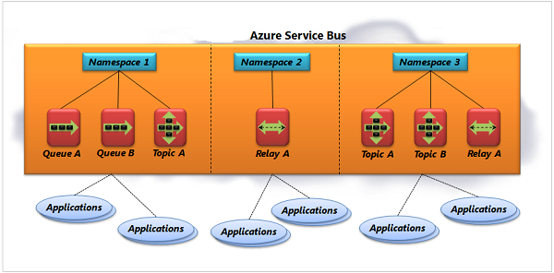
Azure Service Bus
Notes:
Message Delivery - https://docs.microsoft.com/en-us/azure/service-bus-messaging/service-bus-messaging-overview
Service Bus Fundamentals - https://docs.microsoft.com/en-us/azure/service-bus-messaging/service-bus-fundamentals-hybrid-solutions

Slide 16
Lab:
Work with the Azure Service Bus
Notes:
Optional: Follow the lab you see here - https://docs.microsoft.com/en-us/azure/service-bus-messaging/service-bus-dotnet-get-started-with-queues

