Slide 1

Microsoft Business Analytics and AI
Building Solutions – Customer Acceptance
Microsoft Machine Learning and Data Science Team
aka.ms/BusinessAnalyticsAndAI
Notes:
Main page – https://aka.ms/businessanalyticsandai
To begin this module, you should have:
Basic Math and Stats skills
Business and Domain Awareness
General Computing Background
NOTE: These workbooks contain many resources to lead you through the course, and provide a rich set of references that you can use to learn much more about these topics. If the links do not resolve properly, type the link address in manually in your web browser. If the links have changed or been removed, simply enter the title of the link in a web search engine to find the new location or a corollary reference.

Slide 2
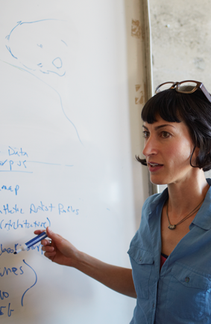
Learning Objectives
Alter your solution
Work with your customer to use the solution
Hand over the solution to the customer
Notes:
At the end of this Module, you will be able to:
Alter your solution
Work with your customer to use the solution
Hand over the solution to the customer

Slide 3
The Data Science Process and Platform
Notes:
This process largely follows the CRISP-DM model - http://www.sv-europe.com/crisp-dm-methodology/

Slide 4
The Team Data Science Process
Business Understanding
Define Objectives
Identify Data Sources
Data Acquisition and Understanding
Ingest Data
Explore Data
Modeling
Feature Selection
Create and Train Model
Deployment
Customer Acceptance
Operationalize
Testing and Validation
Update Data
Handoff
Re-train and re-score
Notes:
It also references the Microsoft Business Analytics and AI process - https://azure.microsoft.com/en-us/documentation/articles/data-science-process-overview/
A complete process diagram is here - https://azure.microsoft.com/en-us/documentation/learning-paths/cortana-analytics-process/
Some walkthrough’s of the various services - https://azure.microsoft.com/en-us/documentation/articles/data-science-process-walkthroughs/
An integrated process and toolset allows for a more close-to-intent deployment
Iterations are required to close in on the solution – but are harder to manage and monitor
Data Science Blog - https://buckwoody.wordpress.com/

Slide 5
The Azure Platform for Analytics and AI
Big Data
Intelligence and Advanced Analytics
Information Management
Solutions
Visualization
Data Catalog
Data Factory
Event Hubs
Data Lake
SQL Data Warehouse
Cosmos DB
Cortana, Bot Service, Cognitive Framework
HDInsight
Data Lake
Azure Storage
Stream Analytics
Analysis Services
Power BI
R
Templates and Gallery
Machine Learning
Notes:
Azure Data Catalog - http://azure.microsoft.com/en-us/services/data-catalog (Doc It)
Azure Data Factory - http://azure.microsoft.com/en-us/services/data-factory/ (Move It)
Azure Event Hubs - http://azure.microsoft.com/en-us/services/event-hubs/ (Bring It)
Platform and Storage - Microsoft Azure – http://microsoftazure.com Storage - https://azure.microsoft.com/en-us/documentation/services/storage/ (Host It)
Azure Data Lake - http://azure.microsoft.com/en-us/campaigns/data-lake/ (Store It)
Azure SQL Data Warehouse - http://azure.microsoft.com/en-us/services/sql-data-warehouse/ (Relate It)
Azure Cosmos DB - https://docs.microsoft.com/en-us/azure/cosmos-db/introduction
Cortana - http://blogs.windows.com/buildingapps/2014/09/23/cortana-integration-and-speech-recognition-new-code-samples/ and https://blogs.windows.com/buildingapps/2015/08/25/using-cortana-to-interact-with-your-customers-10-by-10/ and https://developer.microsoft.com/en-us/Cortana (Say It)
Cognitive Services - https://www.microsoft.com/cognitive-services
Bot Framework - https://dev.botframework.com/
Azure Machine Learning - http://azure.microsoft.com/en-us/services/machine-learning/ (Learn It)
Azure HDInsight - http://azure.microsoft.com/en-us/services/hdinsight/ (Scale It)
Azure Stream Analytics - http://azure.microsoft.com/en-us/services/stream-analytics/ (Stream It)
Analysis Services - https://docs.microsoft.com/en-us/azure/analysis-services/analysis-services-overview
Power BI - https://powerbi.microsoft.com/ (See It)
All of the components within the suite - https://www.microsoft.com/en-us/server-cloud/cortana-intelligence-suite/what-is-cortana-intelligence.aspx
Templates - https://gallery.cortanaintelligence.com/browse?orderby=freshness%20desc&skip=0&categories=%5B%2210%22%5D and https://caqs.azure.net/#gallery

Slide 6
Customer Handoff and Acceptance
Notes:
List of API’s: https://azure.microsoft.com/en-us/services/cognitive-services/

Slide 7
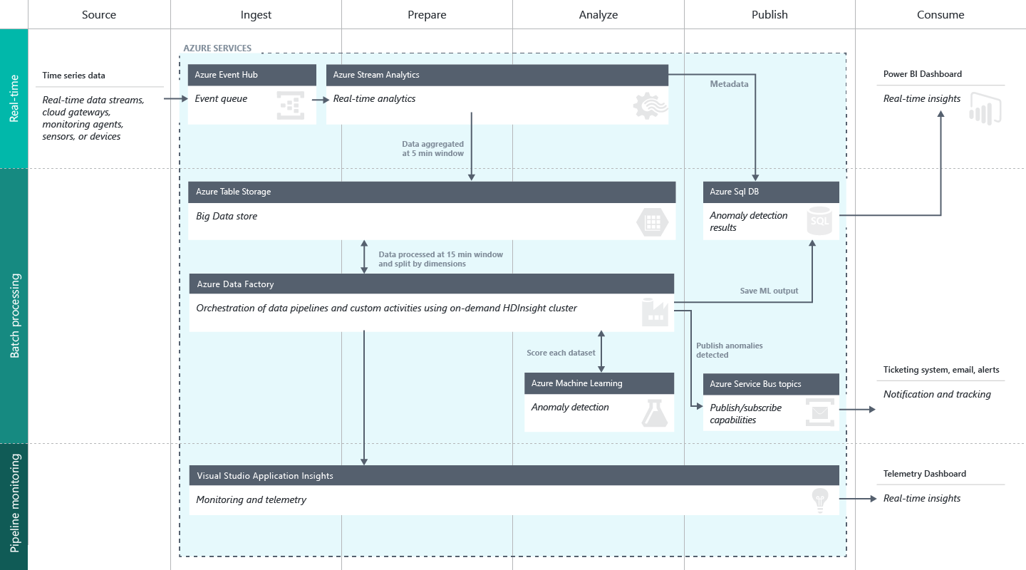
Altering and Maintaining the Solution
Notes:
Creating custom solutions: https://start.cortanaintelligence.com/CustomSolutions

Slide 8
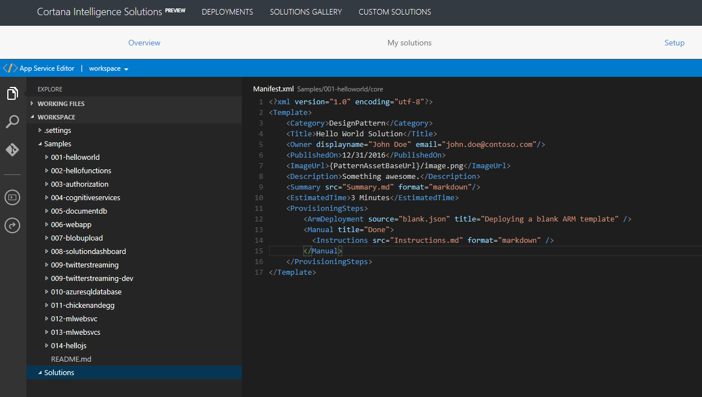
Creating and Maintaining a Custom Solution
Notes:
Creating custom solutions: https://start.cortanaintelligence.com/CustomSolutions

Slide 9
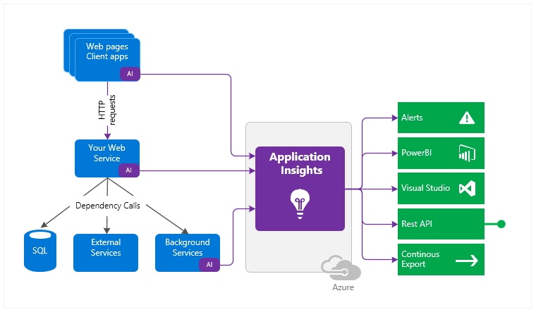
Monitoring and Reporting on the Solution
Application Insights
Notes:
Overview: https://docs.microsoft.com/en-us/azure/application-insights/app-insights-overview

Slide 10
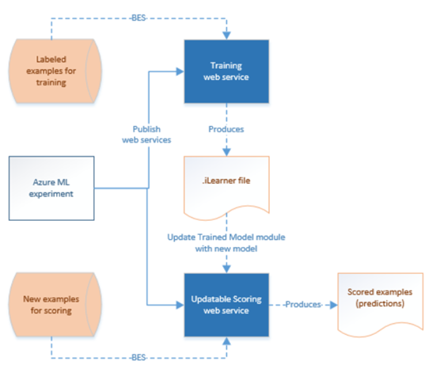
Re-Train an Azure ML Experiment
Notes:
Retrain using Azure Data Factory: https://azure.microsoft.com/en-us/blog/retraining-and-updating-azure-machine-learning-models-with-azure-data-factory/

Slide 11
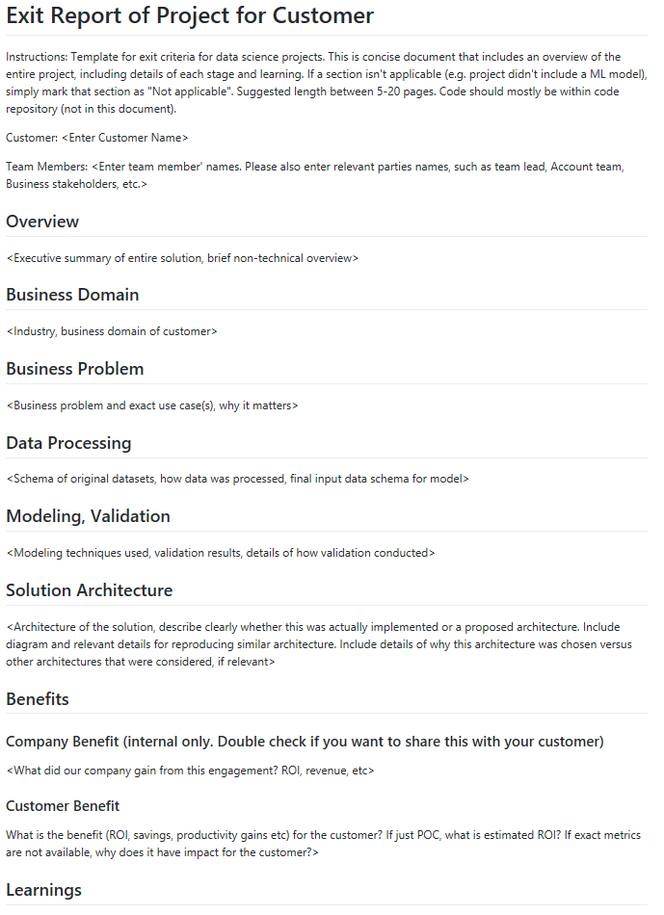
Project Close-Out Document
Notes:
Project Post-Mortem document: https://github.com/Azure/Azure-TDSP-ProjectTemplate/blob/master/Docs/Project/Exit%20Report.md

Slide 12
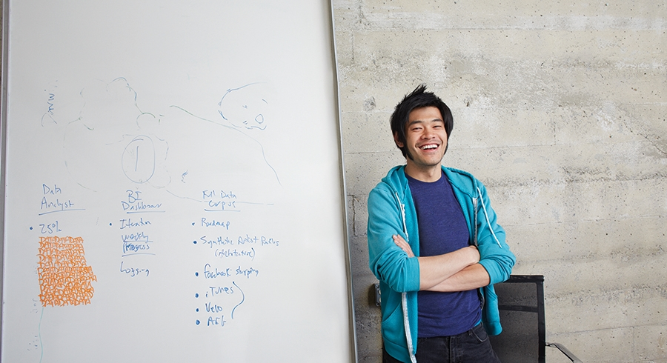


Lab:
Monitoring your solution
Notes:
Read this page - https://docs.microsoft.com/en-us/azure/application-insights/app-insights-overview
Review this video with the instructor - https://applicationanalytics-media.azureedge.net/home_page_video.mp4

Slide 13
Group Project
Read the following scenario.
Using this as a Business Case, highlight the “design statements” it contains.
Create a Decision Matrix of the options to solve the design statements.
Create a Solution Diagram.
Mail these to the instructor.
Be ready to discuss the reasons you chose each technology in your solution and how the data flow path will work. Be as detailed as you can. You can submit multiple documents or including them all in one – Word, PDF, PowerPoint or Visio are all acceptable tools.

Slide 14
Business Case
AdventureWorks is a company that makes and sells bicycles. The sales are conducted around the world. We also support our products. But as we’ve made more sales in the last 10 years, we’ve farmed out the support function to various companies that take in maintenance and support issues in call centers around the world.
We’re growing. And now we want to take our bicycles to several large retailers, but a few of them want to know a lot about our churn rate.
For over 10 years, we’ve collected a lot of information about our customers and of course we know a lot about our products. But since we’ve outsourced our call centers, we don’t own the databases that hold their data – they will give us an export, though. (They support multiple customers)
We’re not sure about our churn rate – we have the data of who has and has not bought again, and we think we can get the data from the call centers for the complaints and repairs, but we need a way to analyze a lot of data that has different formats to find a prediction of who will churn and who will not.
Ideally we want a list of customers we think will churn, in a structured database we could share out to our potential resellers sales staff, so they know how to target at-risk and new clients.
More on our in-house data: https://technet.microsoft.com/en-us/library/ms124501%28v=sql.100%29.aspx
Notes:
AdventureWorks Data Dictionary: https://technet.microsoft.com/en-us/library/ms124438(v=sql.100).aspx

