Slide 1
About me
Jeffre Feemster
Professional stuff:
jeff.feemster@feemcotech.solutions
IT since 2008
Cybersecurity since 2013
Laid off from IBM Dec 2025
Been working as Feemco Technologies since as sort of an independent contractror.
Certs:
Comptia (A+, net+, sec+, pentest+, CySA+)
Ine (eJPT)
TCM SEC (PNPT)
GIAC (GREM, GCFE)
Public Projects (started making public because we all knew IBM was going to start getting rid of more cloud folks, and having public reference helps people feel comfortable hiring apparently)
Pyscript xss poc (https://pyscript.com/@ferasdour/evil-poc-dont-use)
Versizon and spectrum default wifi password generators
Tracking a specific phishing toolkit (https://feemcotech.blogspot.com/2025/10/yara-hunting-phishing-samples.html)
Personal Automation Tools (https://github.com/ferasdour/automation_tools)
Some poc malware (https://github.com/ferasdour/dns_exfil_controller)
Dashboard that mimics my personal dashboard and cli setup (https://github.com/FeemcoTechnologies/cc-toolkit)
Other blog and youtube posts (https://blog.feemcotech.solutions/ | https://www.youtube.com/@FeemcoTech )
Who I actually am
Super antisocial / agoraphobic / avoidant / Unsociable. Thats the right word!
Only able to show up here because my wife helps me grow. Props to her.
Studier of things, live..er of life.
Much of my life was spent avoiding being public, to the point of killing off accounts because someone said my name, or generating usernames daily so I wouldn’t keep an account running.
I2p rocks, y’all should be using it.
I find weird jokes no one else understands funny sometimes.
Pretty sure I’ve been told I should show up here at least a decade before showing up.
I like being able to know oleandrin extraction techniques just as much as I like knowing you can put a boundary mic on a stink pipe to spy on an entire house from the outside (adjust for distortion).

Slide 2
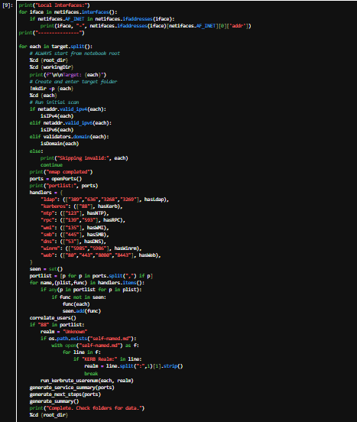
The Talk “Random Stuff”
Things to discuss
Every day I catch a phish or 20
The weeks spectrum sucked
Spooky Nextlink wifi
General network discussion and why we all suck
Hire me!
One or two slides each
Try not to take too much time
Try not to think the whole world operates on a level of negligence people don’t understand the impact of
Idk, insert joke here, I’m bad at this
See what fun things people have to say
Try not to let the existential dread set in.
There isn’t bad code here, why would there be?

Slide 3
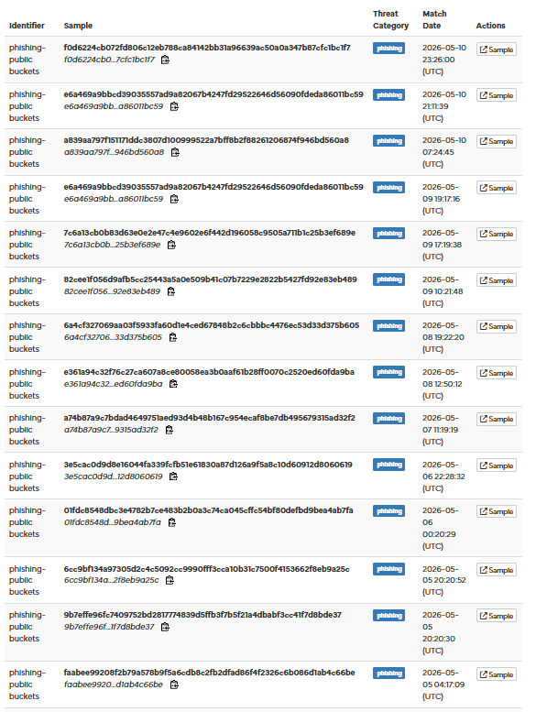

Every day I catch a phish or 20
No really, it’s every day (hybrid analysis yara hunt)
Created a quick and dirty yara rule last year in october for a phishing kit I found on some publicly accessible cloud storage buckets.
In the first few days it found 9 detections. Currently (while writing this) > 645
I go through every once in a while and click submit with the options of start internet explorer. Every single detection was correct and matched the expected structure. I’ve not seen any false positives as of this time.
Yara rule was super simple, so expected some extras/noise in here:
  One of a set of html header possibilities
  Used jquery
  Gets hash substring of window.location
  Also includes email, password, and a btn
  Specifies url and a type (method) of post
There has been some execution changes that have changed as this has grown but the core of sending that request is still the same and requires the same details, features, and structures.
Careful when viewing “Sample Content” text in hybrid analysis, twice now I’ve seen them run </div></div><h1> sort of nonsense and it actually get parsed when clicking view more. Should probably pester HA about that.
https://blog.feemcotech.solutions/2025/10/yara-hunting-phishing-samples.html

Slide 4
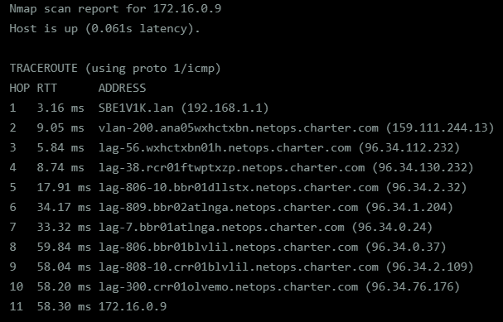
The weeks spectrum sucked
Around this time 2025
I accidentally stumbled on a routing issue exposing public networks to routing as a 172. ip
Had a hard time getting anyone to listen to me on this (unsurprising)
Learned that I should plan my conversations and some fancy graphs before trying to contact a company for their issues
Made my own detection tool that I like running on every network I connect to now, but nmap is probably quicker
Always enumerate extra before reporting
Yes, those are public ips routing a private range
https://feemcotech.blogspot.com/2025/06/isp-routing-hell.html

Slide 5
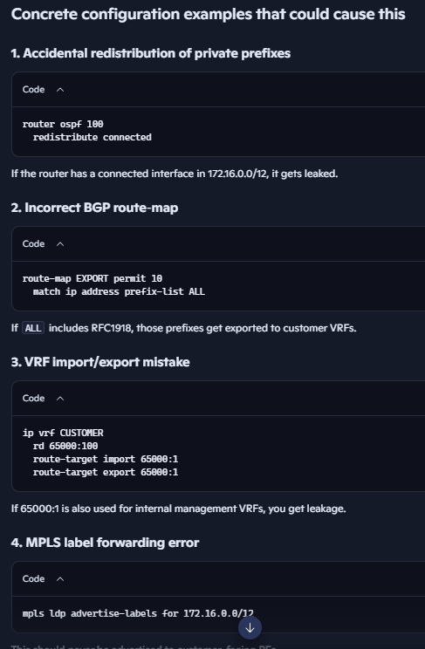
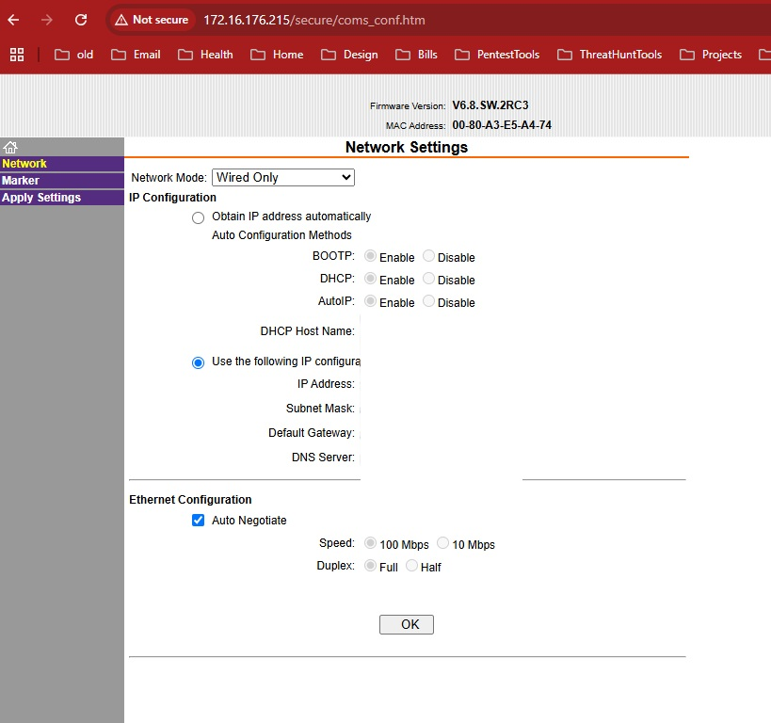
...Continued
Apparently there are a number of possible routing configurations that could cause this (vfs, ospf, bgp, mpls, and eigrp according to copilot (see side picture))
Iptables rules blocking all except 172. ip ranges incoming would have been bypassed due to this, allowing access to portals that were designed to be private
Like this guy’s router.
(it was redacted with white spaces)

Slide 6
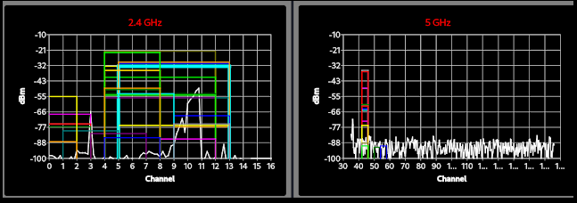
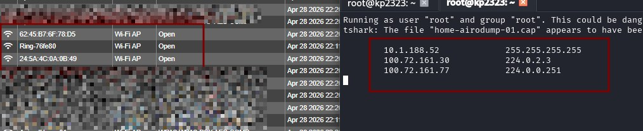
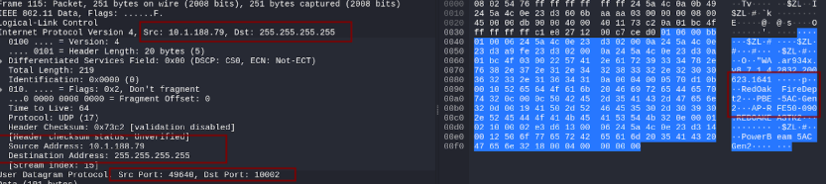
Spooky Nextlink wifi
Wifi is great
Except when multiple consumer grade routers are exposed through a completely unencrypted wifi
Doing casual wifi analysis found some interesting outliers
Open networks can see packets without connecting to the network. Yay passive sniffing(?)
Got concerned when I saw that users’ names and the red oak fire department was on some of the data being sent.
Could see ospf, roku api calls, and a stream of connections from PTP routers broadcasting who they are.
https://feemcotech.blogspot.com/2026/05/spooky-wifi.html

Slide 7
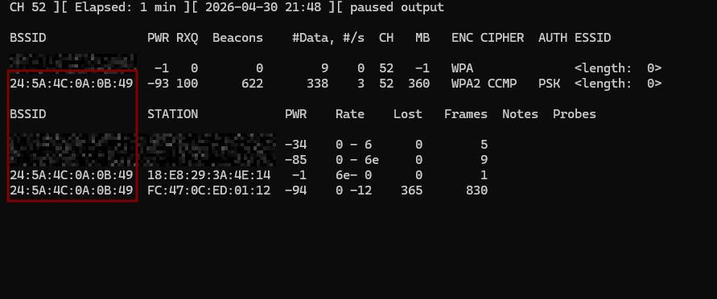
...Continued
After finding mostly 100. and 10. ip ranges, I finally found two ips that were different, both ARP requests for public ip addresses (no really, can’t make this up y’all)
Both IP addresses linked (whois/rdap) to nextlink
Called nextlink, assumed the escalation they did wouldn’t end up in calling me back, so emailed them (see spectrum incident) as well
Next day it was mitigated by turning into WPA2 CCMP PSK (again, can’t make this shit up).
Never got a response back from them. Didn’t assume I would.

Slide 8
General network discussion and why we all suck
Does your company tend to check the routes of it’s ISP?
Do you monitor for changes like this that include private ranges or accidental configuration drift?
Why are ISPs not able to be held responsible for this negligent nonsense outside of the ftc or fcc?
If our cloud storage is being abused, and we have frequent failures on our service providers, what can we do to help protect our staff or clients? (massively generated phishing tools → why does this bypass common webprotection tools? Do we have to monitor everything, or just zerotrust our routing? Darknetz anyone?)
Tools like ansible, terraform, puppet, etc… are great for automating infrastructure
  Bad at:
    (> .01%) configuration drift exists with all of these, including puppet which has a drift checker built in. Scalability is garbage if you have to redo something every push.
    Validating configuration drift from both sides (centralized server and local to the system)
    Managing Cisco and Juniper devices (we’ve all seen the accidental firewall drop between syncs, why does it happen MORE with ansible?)
Does your network have ways to protect against these? Protect you, or your clients?

Slide 9
Hire me!
Need stable income
Please hire
K thanks
Things I can do
  IR
  Forensics
  Pentesting
  Weird habit of stumbling on failures from the consume ISP level.
  Research things for funsies
  Tell you about my AT&T experiences next time
  Ask questions, make mistakes, get messy? That’s not the right quote.
  Fix printers and other home devices cause y’all don’t want to!

