Slide 1
Applied Statistics
week6
Dec 2017
All client case studies included in
this training are for internal use only

Slide 2
Testing the difference between population proportions

Slide 3
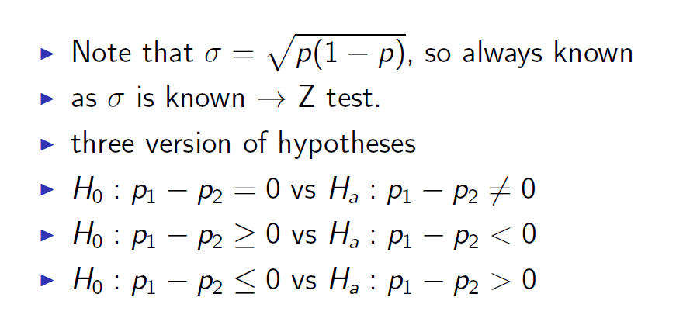
Testing the difference between population proportions
Notes:
3
3

Slide 4
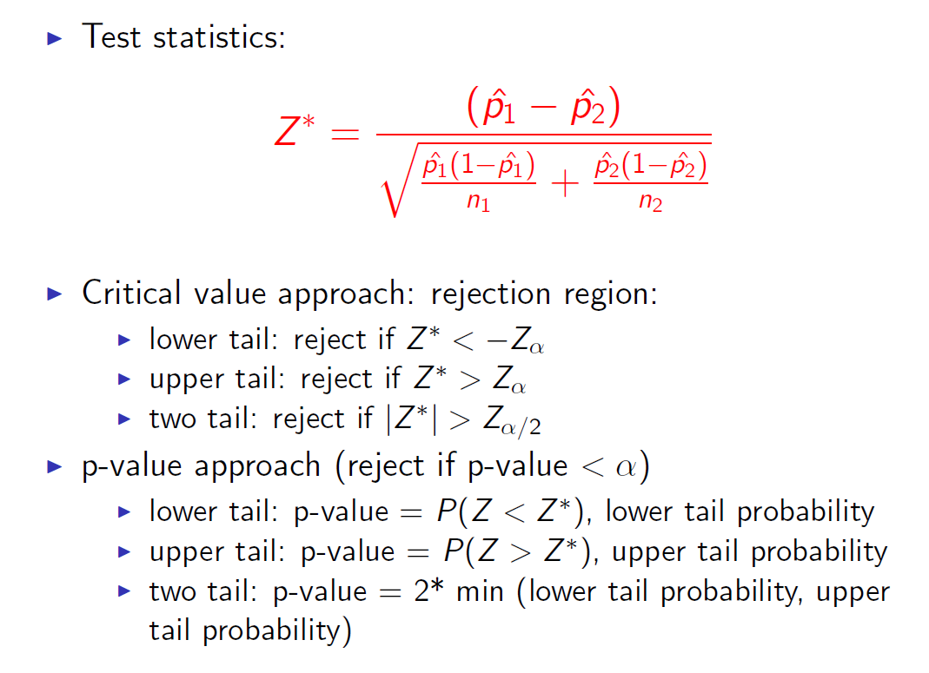
Testing the difference between population proportions
Notes:
4
4

Slide 5
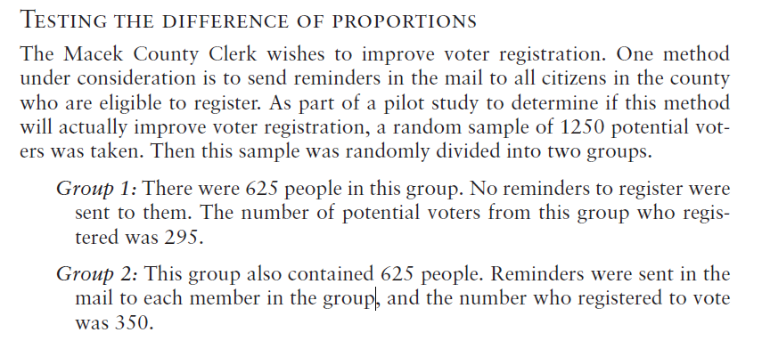
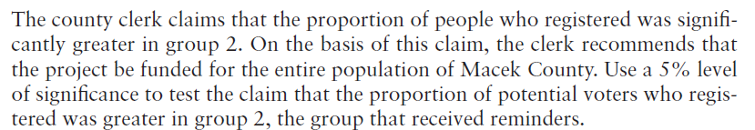
Testing the difference between population proportions
Notes:
5
5

Slide 6
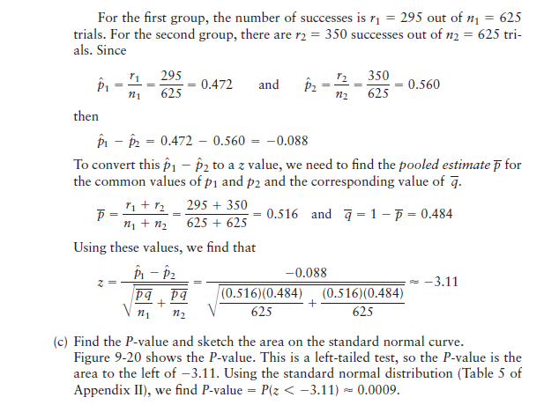
Testing the difference between population proportions
Notes:
6
6

Slide 7
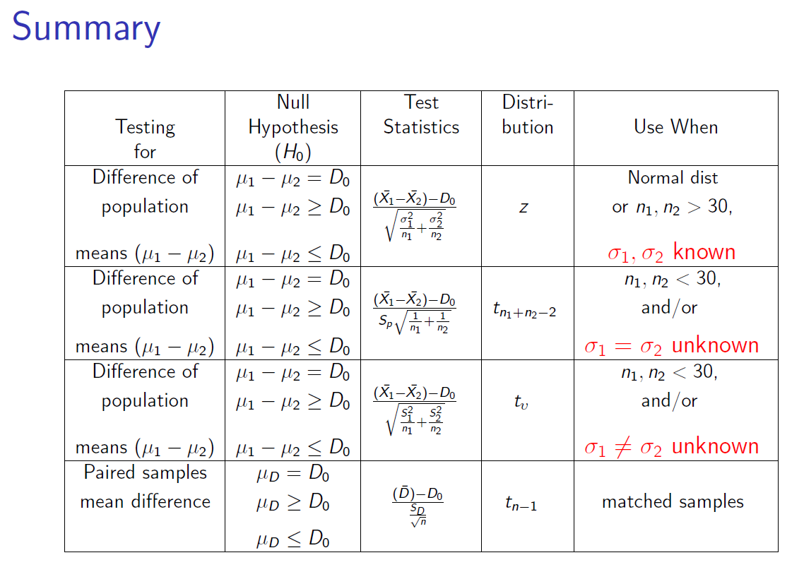
Notes:
7
7

Slide 8
Chi-Square Distribution

Slide 9
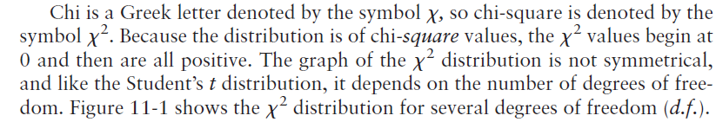
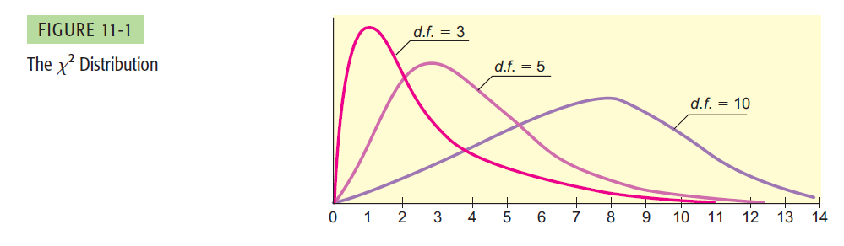
Chi-Square: Tests of Independence and of Homogeneity
Notes:
9
9
Sayısal olmayan değişkenler arasındaki ilişkinin varlığını test etme

Slide 10
Two main uses of the χ2 distribution
The χ2 probability distribution specializes in detecting when the results you get are significantly different from the results you expect. The probability distribution does this using the χ2 test statistic.
The χ2 distribution has two key purposes.
First of all, it’s used to test goodness of fit. This means that you can use it to test how well a given set of data fits a specified distribution.(Homogeneity test)
Another use of the χ2 distribution is to test the independence of two variables. It’s a way of checking whether there’s some sort of association.
Notes:
10
10
Sayısal olmayan değişkenler arasındaki ilişkinin varlığını test etme

Slide 11
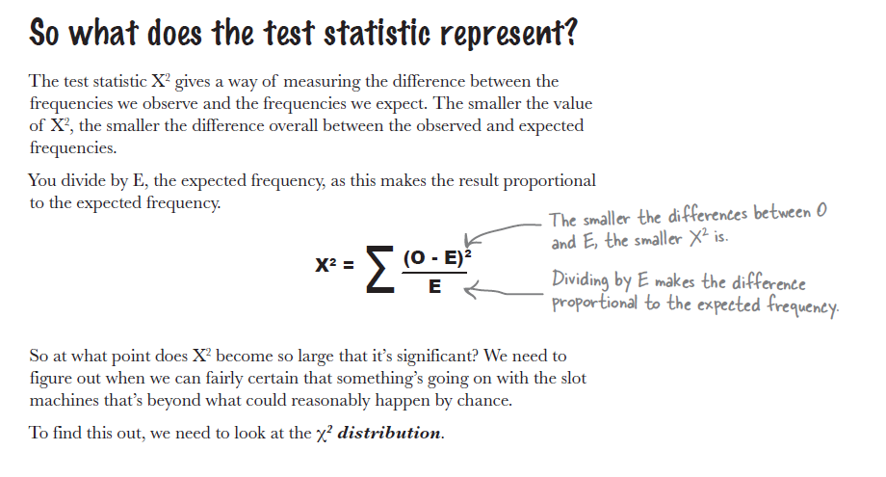
Chi-Square: Tests of Independence and of Homogeneity
Notes:
11
11
Sayısal olmayan değişkenler arasındaki ilişkinin varlığını test etme

Slide 12
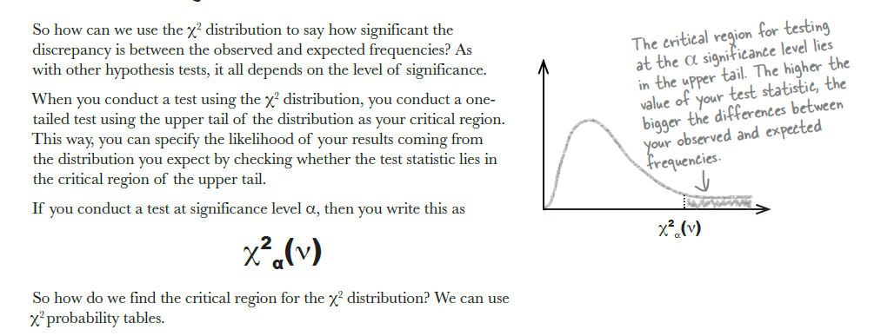
What’s the significance?
Notes:
12
12
Sayısal olmayan değişkenler arasındaki ilişkinin varlığını test etme

Slide 13
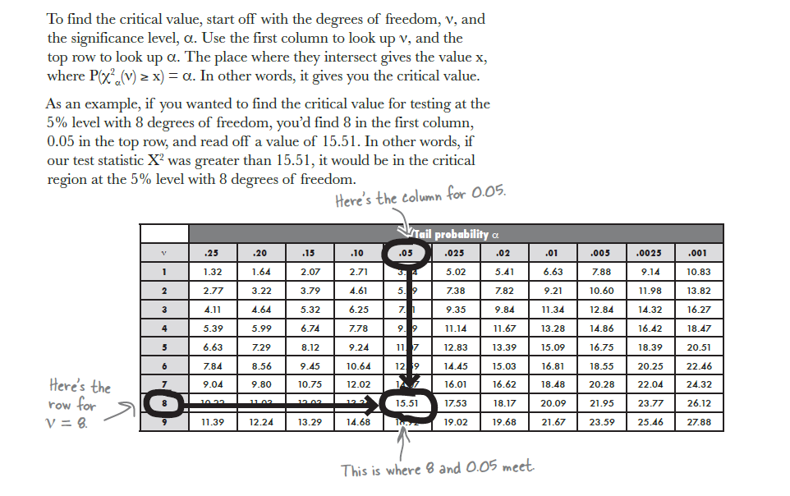
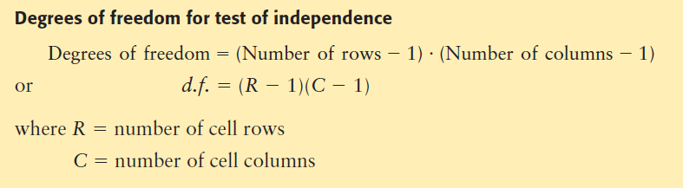
How to use χ2 probability tables?
Notes:
13
13

Slide 14
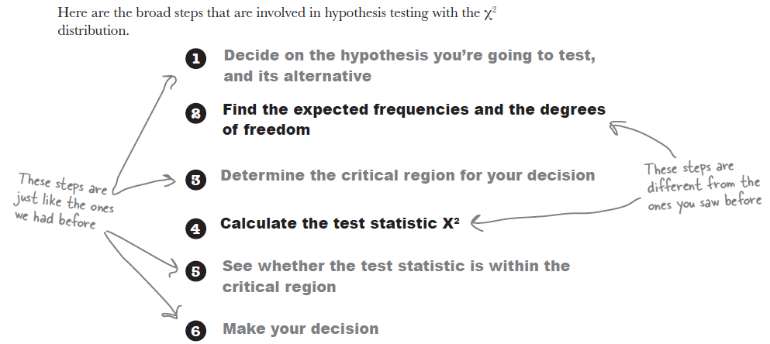
Hypothesis testing with χ2
Notes:
14
14

Slide 15
Tests of Independence

Slide 16
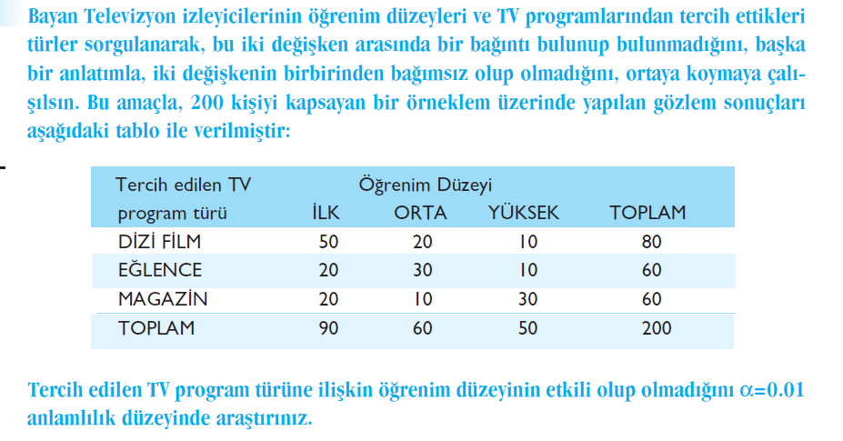
Example-1
Notes:
16
16

Slide 17
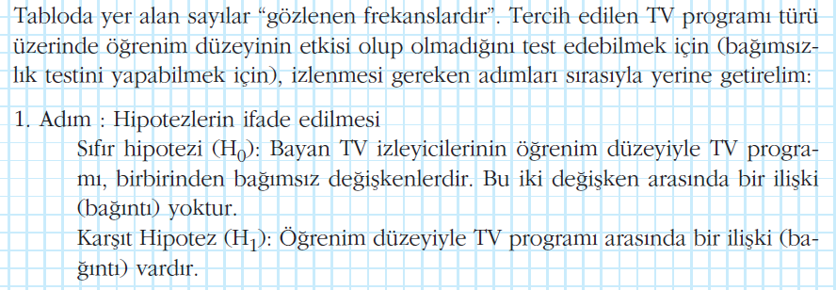
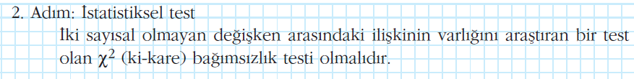
Example-1
Notes:
17
17

Slide 18
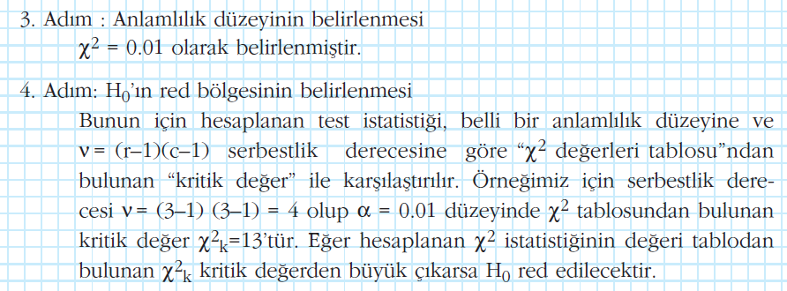
Example-1
Notes:
18
18

Slide 19
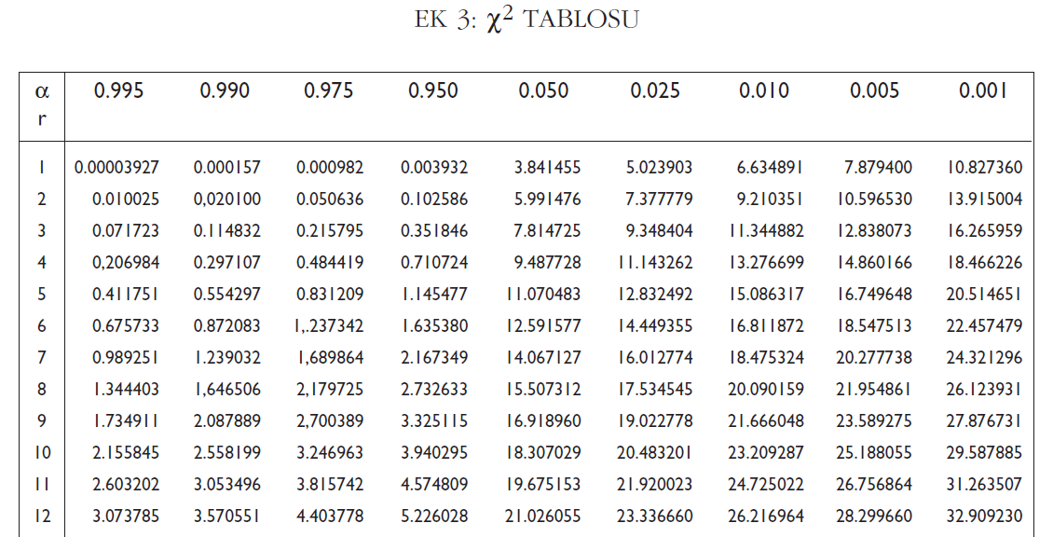

Example-1
Notes:
19
19

Slide 20
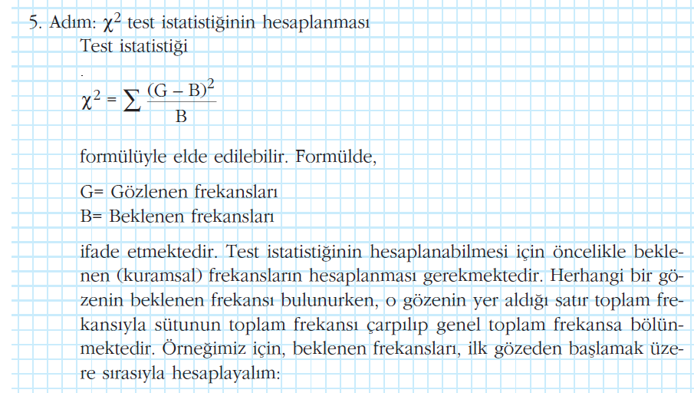
Example-1
Notes:
20
20

Slide 21
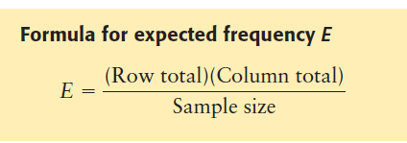
Expected Frequency
Notes:
21
21

Slide 22
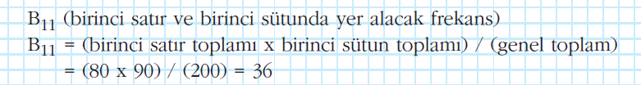
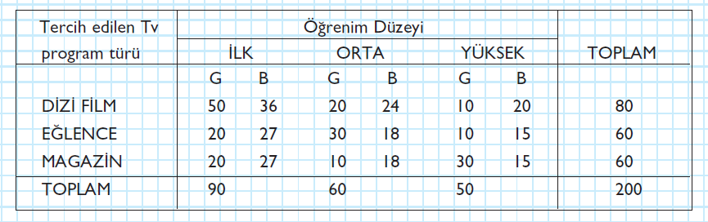
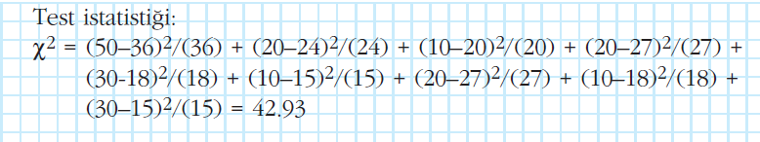
Example-1
Notes:
22
22

Slide 23
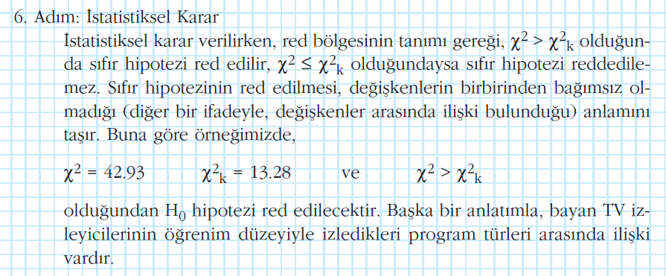

Example-1
Notes:
23
23

Slide 24
Tests of Homogeneity
Goodness of fit of the observed data to the expected values

Slide 25
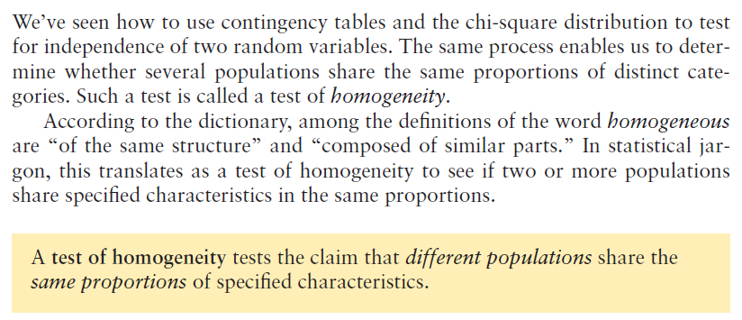
Tests of Homogeneity
Notes:
25
25

Slide 26
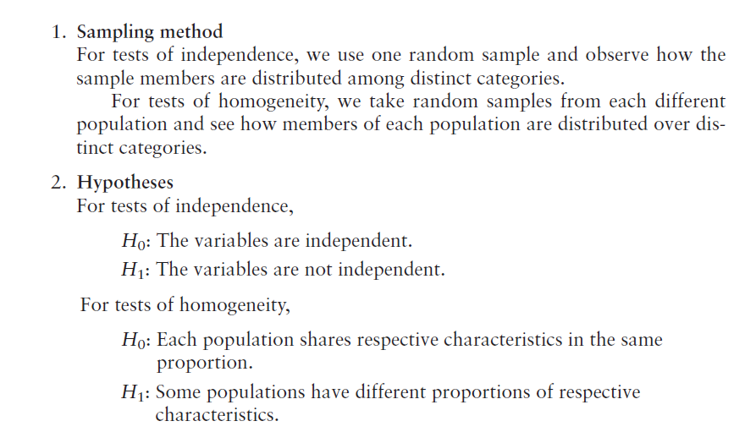
Tests of Homogeneity
Notes:
26
26

Slide 27
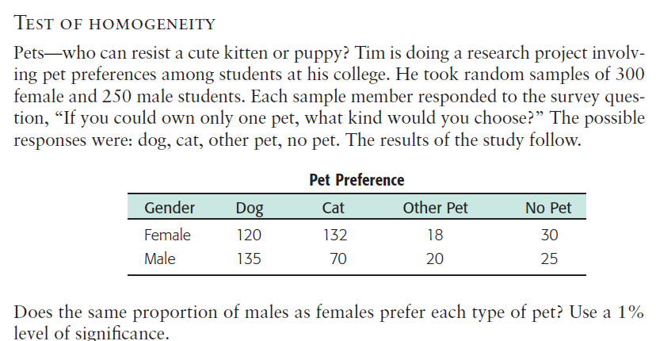
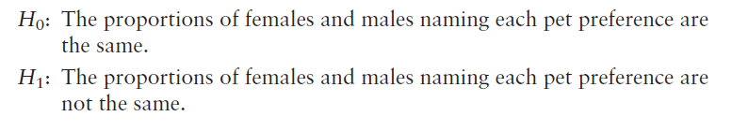
Example2
Notes:
27
27

Slide 28

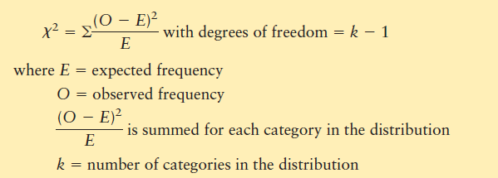
Chi-Square: Goodness of Fit
Notes:
28
28

Slide 29
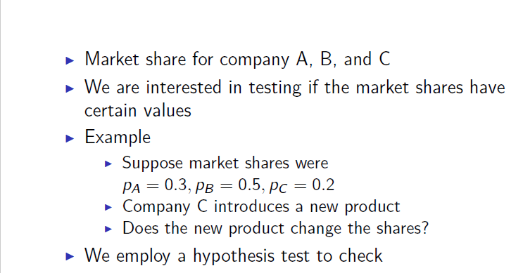
Example-3
Notes:
29
29

Slide 30
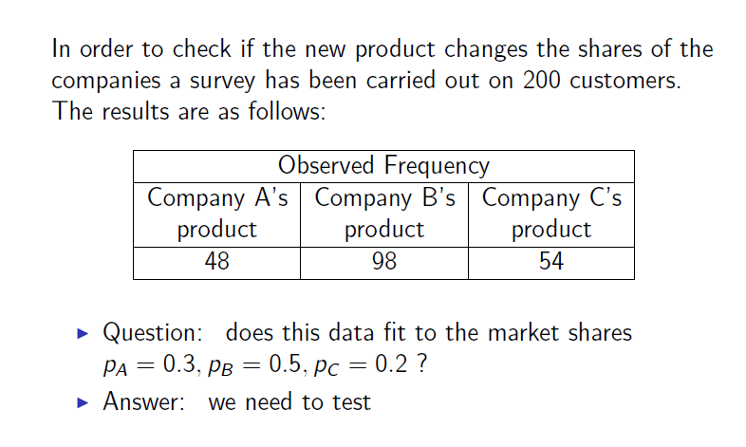
Example-3
Notes:
30
30

Slide 31
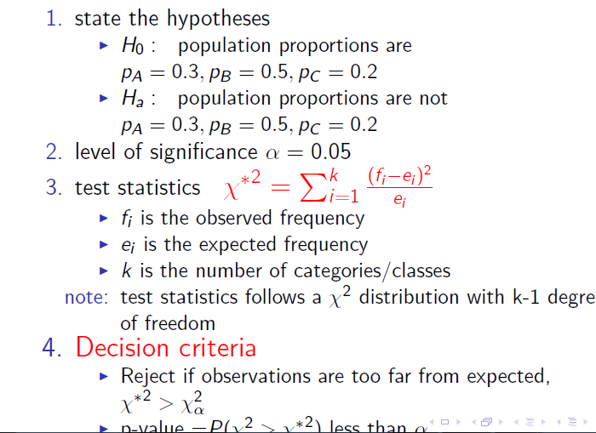
Example-3
Notes:
31
31

Slide 32
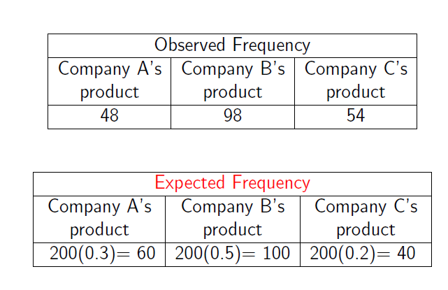
Example-3
Notes:
32
32

Slide 33
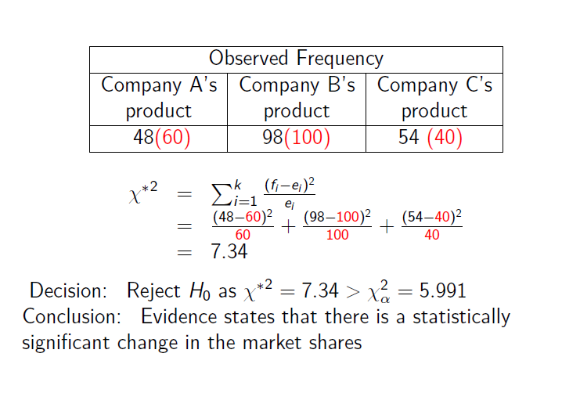
Example-3
Notes:
33
33

Slide 34
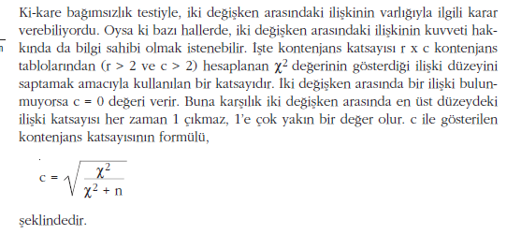
KONTENJANS KATSAYISI
Notes:
34
34

Slide 35
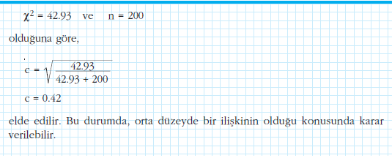
KONTENJANS KATSAYISI
Notes:
35
35

Slide 36
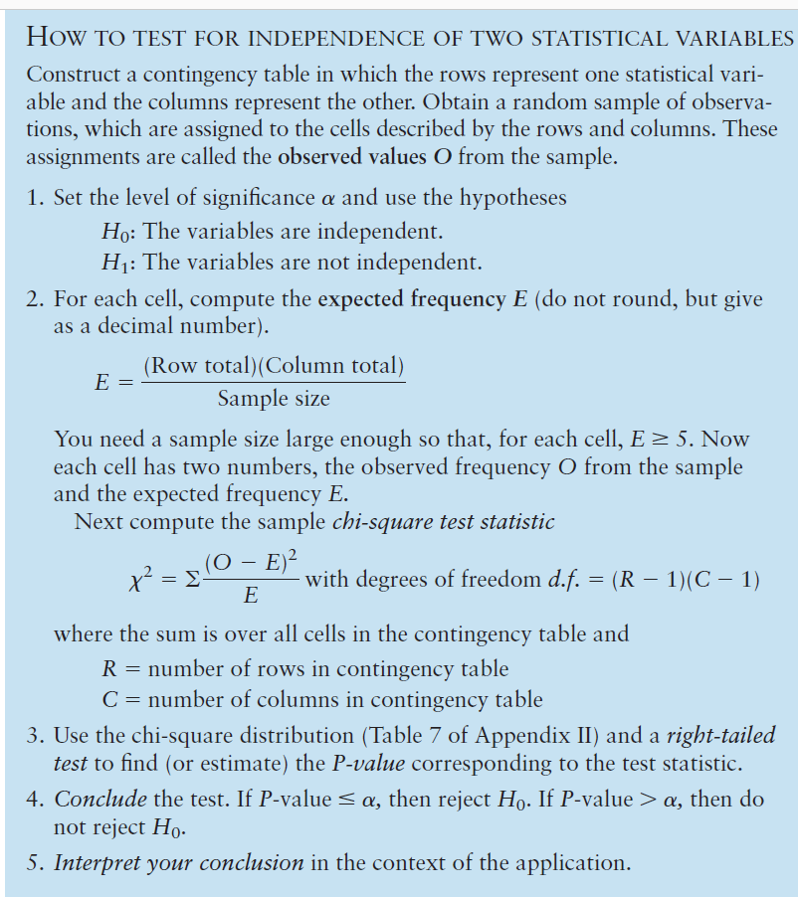
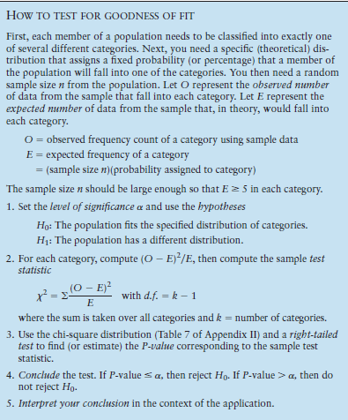
Notes:
36
36

