Slide 1
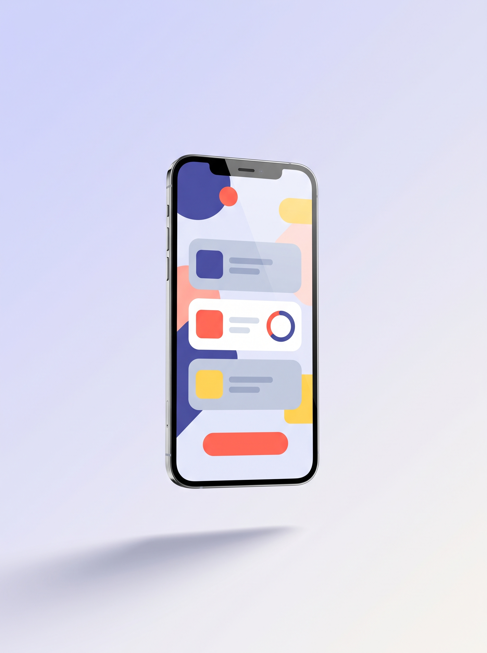
GFP 0009 · DIGITAL CREATIVITY
MicroMentor.
A LEARNING APP FOR STUDENTS
Turn a whole lecture into 3 minute lessons you actually remember.
A student micro-learning app that beats cramming and the forgetting curve. Built on the AMPLIFY model.
PRESENTED BY
● Aisyatun Nabiha binti Mohamed Husain 25004128
● [ Group member 2 ] [ matric ]
● [ Group member 3 ] [ matric ]
GFP 0009 Digital Creativity | Dr. Rafiza binti Abdul Razak | Universiti Malaya

Slide 2
GFP 0009 · DIGITAL CREATIVITY
THE PROBLEM
We cram. Then we forget.
● Lectures load everything at once, so our working memory overloads (Cognitive Load Theory, Sweller 1988).
● Without spaced review, we forget 50 to 80 percent within days (Ebbinghaus, 1885).
● So we cram before exams. High stress, shallow understanding, and fast forgetting after.
● Notes are long and passive. Reading is not the same as remembering.
50-80% forgotten within days without review
3-5 min the lesson length memory prefers
1 skill per lesson, not a whole chapter
MicroMentor · Beat the forgetting curve
02 / 12

Slide 3
GFP 0009 · DIGITAL CREATIVITY
SIGNIFICANCE & JUSTIFICATION
Why this matters to us
Personal
Every one of us has pulled an all nighter, then forgotten it a week later. This is our own problem. Real, not hypothetical.
Scale
Thousands of UM students juggle heavy content across many courses. A tool that fits their phone habits helps at scale.
Backed by research
Micro-learning is not a guess. It is supported by cognitive science and by AMPLIFY, a framework validated in Malaysian higher education.
On theme
GFP 0009 asks us to use creativity to design appropriate technology for a real problem. Learning is exactly that.
MicroMentor · Beat the forgetting curve
03 / 12

Slide 4
GFP 0009 · DIGITAL CREATIVITY
USE OF TECHNOLOGY IN THIS AREA
How students learn, then and now
ERA
TECHNOLOGY USED
STRENGTH AND LIMITATION
Then
Textbooks, printed notes, classroom only
Not portable, passive, forgotten fast
E-learning
LMS like Spectrum and Moodle, PDF slides, recorded lectures
Long courses on a screen, same overload
Video
YouTube, recorded webinars
Passive, no feedback, easy to zone out
Now
Micro-learning apps like Duolingo, Anki, Quizlet
Short, spaced, gamified, but generic and not tied to your course
The gap. Existing apps are not tied to your lectures. MicroMentor turns your own course material into micro-lessons.
MicroMentor · Beat the forgetting curve
04 / 12

Slide 5

OUR SOLUTION
MicroMentor turns your lecture notes into short, personalised lessons, with quizzes and spaced reminders so it sticks.
3-5 min lessons One idea at a time, on your phone.
Smart review Reminds you right before you would forget.
Learn together A class leaderboard and a Q&A wall.
MicroMentor · Beat the forgetting curve
05 / 12

Slide 6
GFP 0009 · DIGITAL CREATIVITY
APPLYING THE AMPLIFY MODEL
AMPLIFY, applied to MicroMentor
AMPLIFY is a microlearning model by Nurul Fitriah Alias (UM, 2024). Its seven components become our seven design decisions.
1
Clear learning objectives
One goal per lesson, like explain the light reaction.
2
Personalised content
Adapts to your course and your weak spots.
3
Continuous feedback
Instant answers plus spaced review reminders.
4
Efficient content delivery
3 to 5 minutes, mobile first, works offline.
5
Interactive experiences
Tap, drag and scenario questions. Never passive.
6
Social interaction
A class leaderboard and a peer Q&A wall.
7
Seamless curriculum integration
Lessons map to your real syllabus.
MicroMentor · Beat the forgetting curve
06 / 12

Slide 7
GFP 0009 · DIGITAL CREATIVITY
DESIGNING THE SOLUTION · STORYBOARD
Aina's story in six frames
1
The problem
2
Discovery
3
Learning
Aina faces 120 slides the night before her exam. Panic.
She opens MicroMentor. It says do three short lessons today.
A three minute lesson, one clear goal, tap to answer.
4
Feedback
5
Together
6
Outcome
Instant tick and a reason. A reminder brings it back tomorrow.
She checks the class leaderboard and asks a question on the wall.
Exam week arrives. She feels calm, confident, and actually remembers.
MicroMentor · Beat the forgetting curve
07 / 12

Slide 8
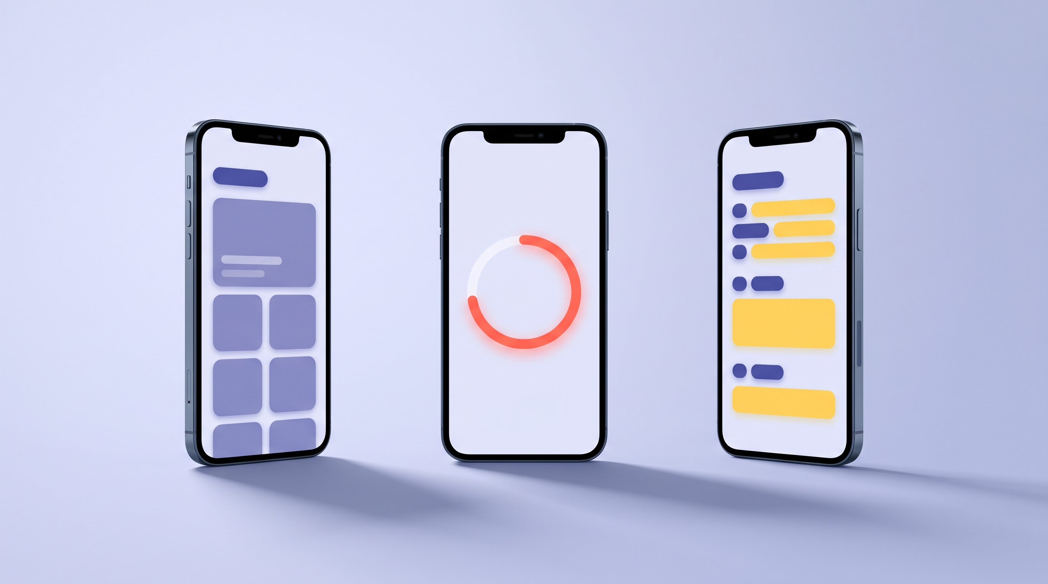
GFP 0009 · DIGITAL CREATIVITY
PROTOTYPE
The clickable prototype
● Built in Figma. Seven core screens, fully clickable.
· Onboarding. Pick your course and level, which feeds M.
· Today's lessons home, two or three bite sized cards (A, L).
· Lesson screen, a short visual plus a tap question (I).
· Instant feedback, the reason, and your streak (P).
· Class wall and leaderboard (F).
· Syllabus playlists mapped to the course (Y).
Home · progress · class wall
MicroMentor · Beat the forgetting curve
08 / 12

Slide 9
GFP 0009 · DIGITAL CREATIVITY
TESTING & EVALUATION
We tested with peers, then changed four things
WHAT USERS SAID
WHAT WE CHANGED
Feedback did not say why an answer was wrong.
We added a one line explanation to every result.
Making a lesson took too many steps.
We cut the create lesson flow from six steps to three.
The leaderboard felt stressful for some.
We made it opt in and class only.
People wanted a language choice.
We added a Bahasa Melayu and English toggle.
MicroMentor · Beat the forgetting curve
09 / 12

Slide 10
GFP 0009 · DIGITAL CREATIVITY
PROJECT MANAGEMENT
Timeline, sustainability and commercialisation
14 WEEK TIMELINE, ALIGNED TO THE COURSE SCHEDULE
Wk 1-4
Wk 5
Wk 6-7
Wk 8-9
Wk 10-11
Wk 12-14
Research
the problem
Map
AMPLIFY
Ideate,
Assign 1
Prototype,
storyboard
Usability
test
Iterate,
Assign 2
Sustainability
Free tools only, like Figma, Canva and the UM e-portfolio. No cost to the course. Going digital means no printed notes.
Commercialisation
Freemium. Free for the basics, a low fee for premium. Sell ready made lesson packs by course. Bilingual in BM and English.
Creativity extras
Bilingual with audio, an offline mode, and gentle analytics that coach you rather than rank you.
MicroMentor · Beat the forgetting curve
10 / 12

Slide 11
GFP 0009 · DIGITAL CREATIVITY
FUTURE USE & CONCLUSION
Where it is heading
● AI turns any PDF of notes into lessons and quizzes in minutes.
● It lives inside WhatsApp and Teams, so you learn where you already are.
● Micro-credentials and badges that follow you between courses.
● We design it responsibly. No notification fatigue, private data, always bilingual.
THE TAKEAWAY
Creativity is most powerful when it is aimed at a real problem and structured by a sound model.
MicroMentor applies AMPLIFY to make learning short, personal and sticky. Appropriate technology for students.
MicroMentor · Beat the forgetting curve
11 / 12

Slide 12
Terima kasih.
Questions? Let us MicroMentor your notes.
Aisyatun Nabiha binti Mohamed Husain · 25004128 | GFP 0009 · Dr. Rafiza binti Abdul Razak
MicroMentor · Beat the forgetting curve
12 / 12

