Slide 1












COMPUTER SECURITY
PROJECT PRESENTATION
Tool: gobuster
1905097: ABRAR MAHMUD
1905105: SHAHRIAR RAJ
SUPERVISED BY: A.K.M. MEHEDI HASAN

Slide 2





Introduction: gobuster
gobuster is a linux security tool used for busting vulnerable web files and directories. It is written in “go” language. Primary objective of using this tool is to find hidden web files.
Link To github: https://g﻿ithub.com/OJ/gobuster

Slide 3


Why use gobuster?
Challenges of Using gobuster
It is free and OpenSource
It is fast and easy to run
Can be used with customized wordlists
Supports various protocols beyond HTTP/HTTPS like FTP
If there are fluctuations in network or network speed is not that good, it doesn’t work well

Slide 4
Installation Guide
gobuster runs best in kali linux. We had some problems in running gobuster in other linux like: ubuntu.
Step 1 : First we have to install go
Command: sudo apt install golang-go
Step 2 : Then we need to install gobuster
Command: go install github.com/OJ/gobuster/v3@latest

Slide 5


FEATURES
dir
dns
vhost
used for directory and file brute-forcing
used for DNS subdomain enumeration
used for response from found DNS subdomains
fuzz
gcs
s3
tftp
used for detecting valid parameters
enumerate over google cloud storage and detect if a bucket of a certain name exists
same as gcs but for amazon s3
finding file existing in the root directory of the tftp server

Slide 6
Procedures OF Running gobuster
url of the site we are scanning
file containing wordlist
expanded flag
mode
gobuster dir -u https://cse.buet.ac.bd -w common.txt -t 4 -e >result4.txt
number of threads flag
flag that indicates the following string is an url
output file
flag that indicates the following string is the wordlist file

Slide 7
Now we will see more about the features of gobuster:
1. Directory Busting:
gobuster dir -u http:/cse.buet.ac.bd -w small.txt -t 20 -e > result.txt
Important Flags for this feature:
-u : url flag
-w : wordlist flag
-t : thread flag
-e : expanded flag
-b : block flag

Slide 8
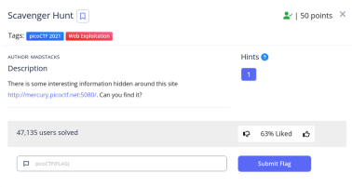

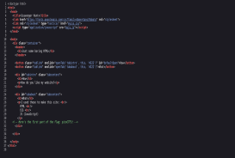
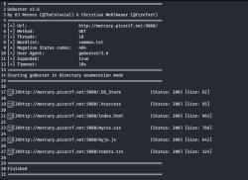

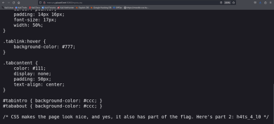


We will now see some output of directory busting:

Slide 9
2. DNS Busting
gobuster dns -d cse.buet.ac.bd -w small.txt -t 25 > result1.txt
Important Flags for this feature:
-d : domain flag
-w : wordlist flag
-t : thread flag
-i : ips flag

Slide 10
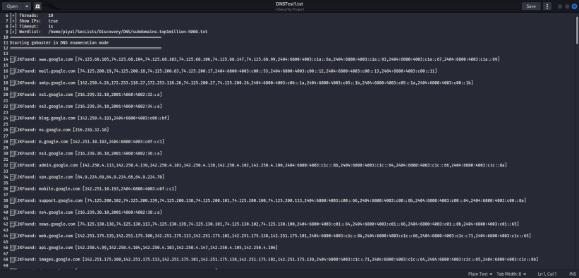
We will now see some output of dns busting:

Slide 11
3. Vhost Busting
gobuster vhost -u cse.buet.ac.bd -w small.txt -t 25 --append-domain > result2.txt
Important Flags for this feature:
-u: base url flag
-w : wordlist flag
-t : thread flag
--append-domain : puts the host name before the base url

Slide 12
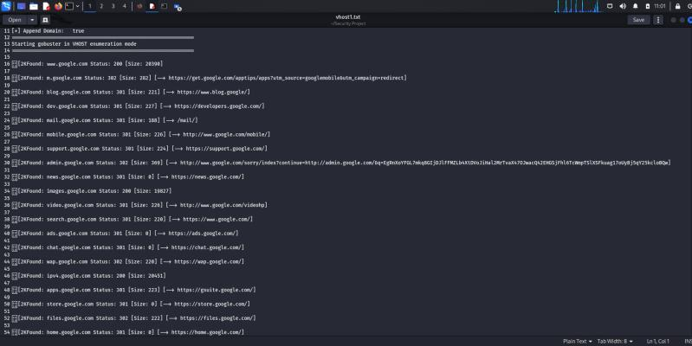
We will now see some output of vhost busting:

Slide 13
4. FUZZ
gobuster fuzz -u https://play.picoctf.org/practice?FUZZ=1 -w lowercase-headers -b 400,301 > fuzz2.txt
Important Flags for this feature:
-u : url flag
-w : wordlist flag
-t : thread flag
-e : expanded flag
-b : block flag

Slide 14
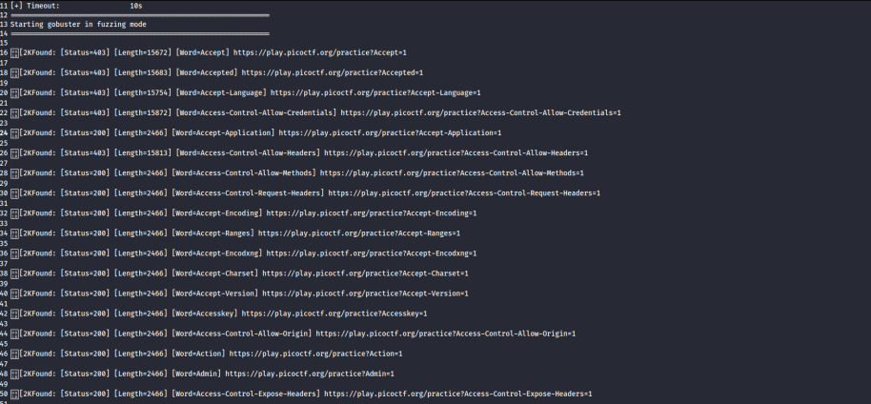
We will now see some output of fuzz:

Slide 15
5. GCS Bucket Busting
gobuster gcs -w s3words.txt -t 10 > gcs1.txt
Important Flags for this feature:
-u: base url flag
-w : wordlist flag
-t : thread flag

Slide 16
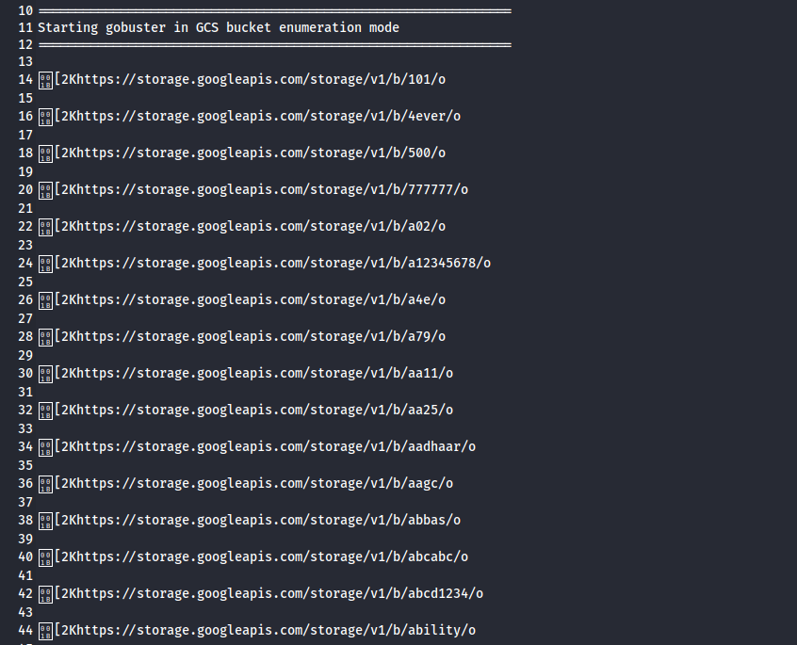
Output

Slide 17
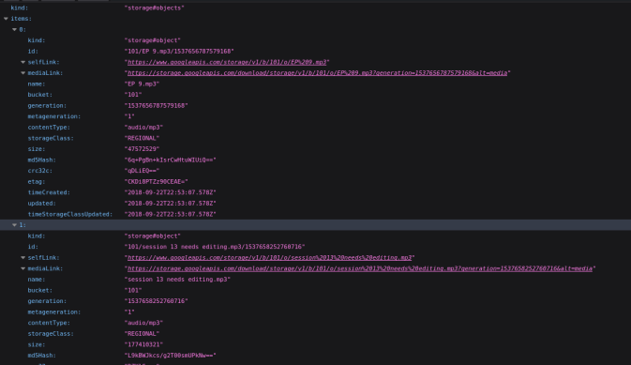
We can find the files in the mediaLink part.

Slide 18
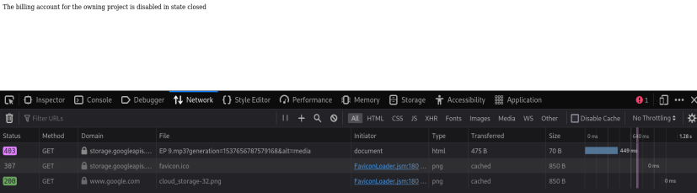
But most of them do not give us our desired file!!!!
We get Status 403!!!!

Slide 19
We ran a python code on the links and found the following files:
https://storage.googleapis.com/download/storage/v1/b/a12345678/o/sample.PNG?generation=1705057092753134&alt=media
https://storage.googleapis.com/download/storage/v1/b/aagc/o/files%2FAAGC%20Detailed%20Guidelines%20v6Feb24.docx?generation=1708307589385844&alt=media
https://storage.googleapis.com/download/storage/v1/b/aires/o/070.png?generation=1652453845302131&alt=media
https://storage.googleapis.com/download/storage/v1/b/ayla/o/Ayla-International-School.png?generation=1683854239215847&alt=media
https://storage.googleapis.com/download/storage/v1/b/backman/o/Test%2F?generation=1685960019315847&alt=media

Slide 20
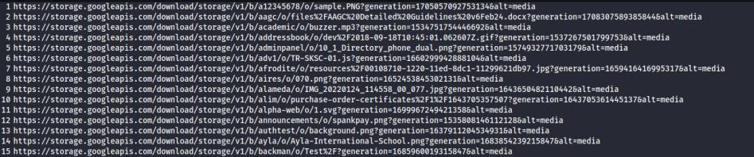
And many more............

Slide 21
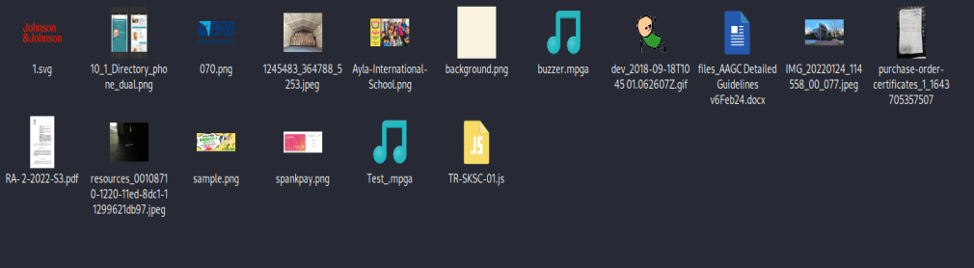
The files we found are shown below:

Slide 22
6. S3 Bucket Busting
gobuster s3 -w s3words.txt -t 10 > s31.txt
Important Flags for this feature:
-u: base url flag
-w : wordlist flag
-t : thread flag

Slide 23
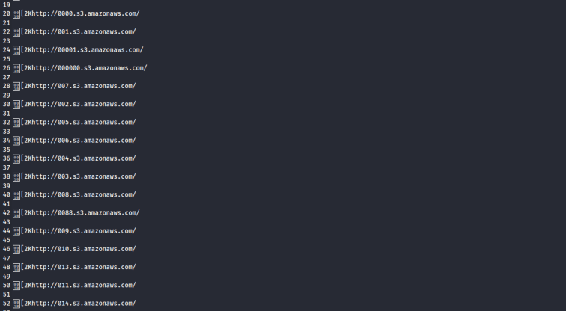
We will now see some output of s3 Bucket Busting:

Slide 24
7. TFTP Busting
gobuster tftp -s 127.0.0.1 -w tftpwords.txt
Important Flags for this feature:
-s: server flag
-w : wordlist flag
-t : thread flag
We can find the files in the tftp server of our localhost using this command

Slide 25
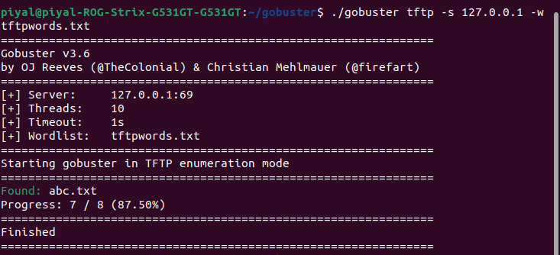
We found the following file on the tftp server:

Slide 26


THANK YOU VERY MUCH!

