Slide 1
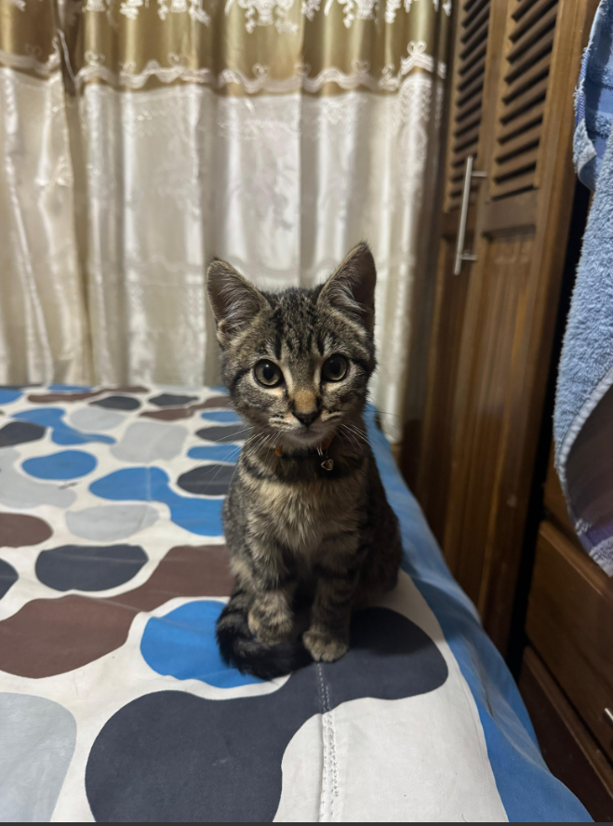
Hello!
Brayan Fernando Jiménez Murcia
And
Tamy
Video:
https://drive.google.com/file/d/1JImb-nCTibYR1K4C6Pep2BYV6zJO1RQq/view?usp=drive_link
Notes:
Hi! My name is Fernando, and this is my pet Tamy. 🐶 We are happy to introduce ourselves!

Slide 2
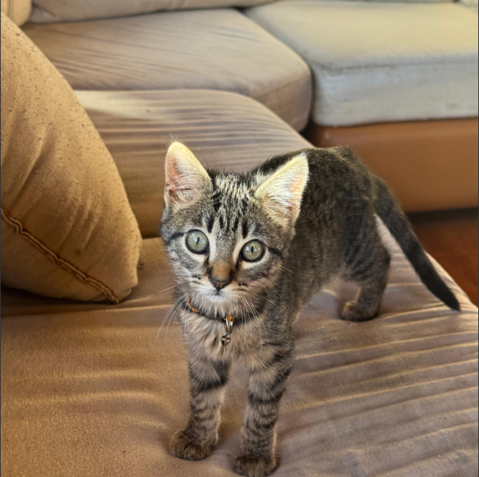
Meet Tamy
Tamy is 6 months old. She lives and sleeps with me.

Slide 3
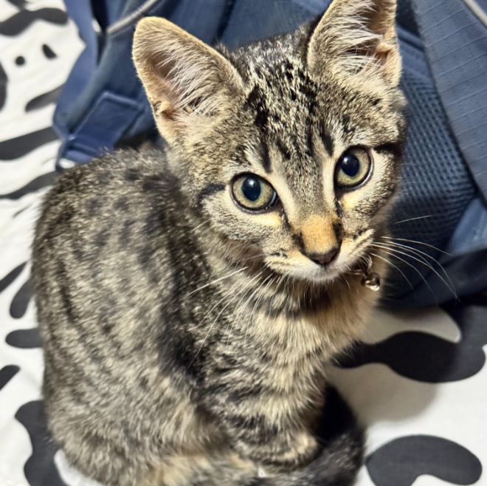
Our Story
I adopted her when she was 2 months old. It has been a difficult but beautiful journey. ❤️ Sometimes she makes a mess, but I still love her.

Slide 4
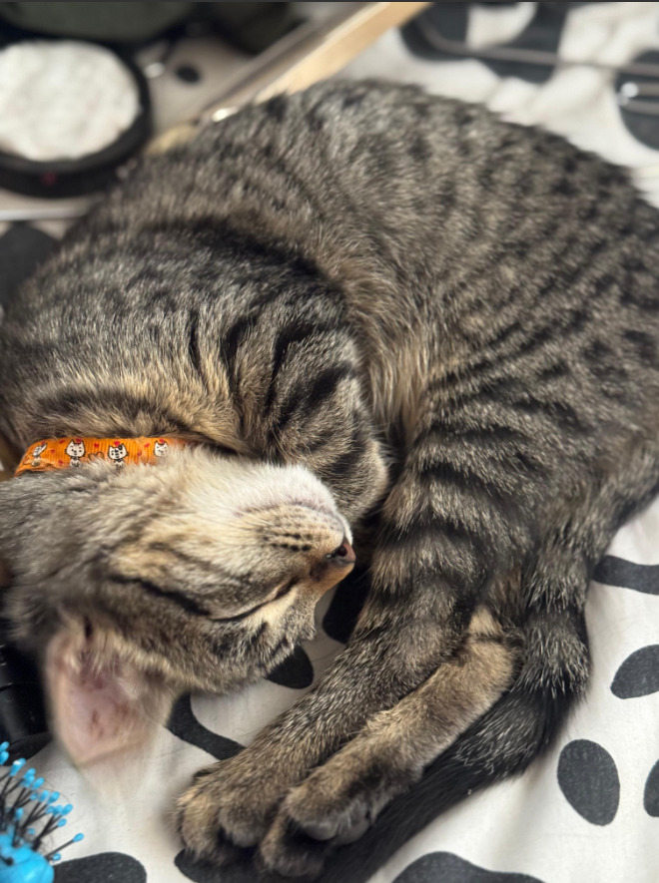
What Tamy Loves
Most of the time, she is either sleeping... or running all around the house! 🏃‍♀️💨 She is very loving and full of energy.

Slide 5
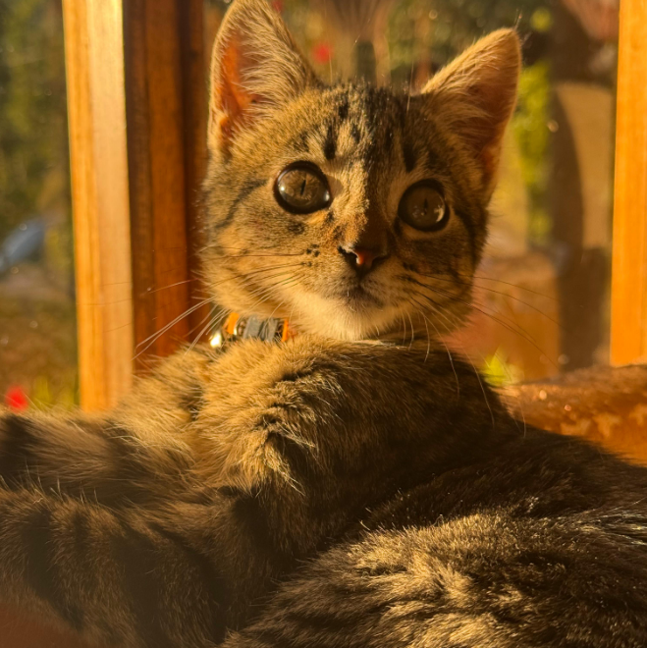
Why I Chose Tamy
I always wanted a loyal pet to keep me company. Tamy is very affectionate, and I hope to have her for many years. 🐾💕

