Slide 1
Jenkins
Configuring Jobs

Slide 2
What is Jenkins?
Originally called Hudson, it is an open source Continuous Integration tool written in Java.

Slide 3
Well what is Continuous Integration?
CI born to address the pitfalls of the Integration Phase of waterfall practices.

Slide 4
Continuous Integration attributes
Immediate change detection
Code base health (code quality/code coverage)
Automated acceptance tests
Communication
Automated deployment process

Slide 5
Continuous Integration summary
Essentially CI is about reducing risk by providing faster feedback by:
identify and fix integration/regression issues faster
better visibility for tech/non-tech on state of project
automation gets software to testers and end-users faster

Slide 6
Continuous Deployment
Automation of deployment process for pushing every successful build directly into production is generally known as Continuous Deployment.

Slide 7
Continuous Delivery
is a slight variation of Continuous Deployment where every successful build can potentially be deployed into production.

Slide 8
CI areas to address
time to get small code change out to production
problems due to conflicts between developers resolved earlier
labor intensive manual testing by QA teams
manual deployment steps where knowledge known by select few

Slide 9
Implementing Continuous Integration
CI is no “silver bullet”. Takes time to fully implement with incremental improvements to technical infrastructure as well as improvements to practices and culture of teams.

Slide 10
Jenkins
Branched from Hudson
Java based Continuous Build System
Runs in servlet container Glassfish, Tomcat or as service
Supported by hundreds plugins
SCM, Testing, Notifications, Reporting, Artifact Saving, Triggers, External Integration
Under development since 2005
http://jenkins-ci.org

Slide 11
What Jenkins offers
Building/testing software projects continuously
Jenkins provides an easy-to-use continuous integration system, easier for developers to integrate project changes, and easier to obtain a fresh build. The automated, continuous build increases the productivity.
Monitoring executions of externally-run jobs
Jenkins keeps those outputs and makes it easy for you to notice when something is wrong.

Slide 12
Why Jenkins?
Flexibility
Jenkins is highly configurable by itself
Community developed plugins offer more flexibility
Combine with Ant, Maven, Gradle, or other build systems

Slide 13
Why Jenkins?
Free / OSS
Jenkins is released under the MIT license
There is a large support community and thorough documentation
It’s easy to write plugins
Think something is wrong with it, you can fix it!

Slide 14
What can Jenkins do?
Generate test reports
Integrate with many different Version Control Systems
Push to various artifact repositories
Deploys directly to production or test environments
Notify stakeholders of build status
and more...

Slide 15
Jenkins out of the box
Associating with a version control server
Triggering builds
Polling, Periodic, Building based on other projects
Execution of shell scripts, bash scripts, Ant targets, and Maven targets
Artifact archival
Publish JUnit test results and Javadocs
Email notifications
As stated earlier, plugins expand the functionality even further

Slide 16
Jenkins pre-requisites
Java 6 or higher (JDK 1.6+)
Maven
Notes:
Discuss downloading maven in order to generate a skeleton project.
Also later show how Jenkins auto installs maven if you need it to.

Slide 17
Install JDK
go to http://www.oracle.com/technetwork/java/javase/downloads/index.html
download Java SE 7u51 JDK
create JAVA_HOME variable
Notes:
Linux:
Download jdk rpm from oracle
rpm -ivh <jdk rpm>
echo "export JAVA_HOME=/usr/java/default/" >> ~/.bashrc
source ~/.bashrc

Slide 18
Install Maven
go to: http://maven.apache.org/download.cgi
grab apache-maven-3.1.1-bin.zip/tar.gz
unzip into desired location: C:\apache-maven-3.1.1 or /root/apache-maven-3.1.1
add to Path
Notes:
Linux:
wget http://apache.mirrors.lucidnetworks.net/maven/maven-3/3.1.1/binaries/apache-maven-3.1.1-bin.tar.gz
tar -zxf apache-maven-3.1.1-bin.tar.gz
echo "PATH=$PATH:/root/apache-maven-3.1.1/bin" >> ~/.bashrc
source ~/.bashrc

Slide 19
Generate Maven Project
create project directory
C:\Projects or /root/Projects
run command
mvn archetype:generate \
-DgroupId=com.orasi \
-DartifactId=maven-training \
-Dversion=1.0 \
-DinteractiveMode=false
Notes:
hit enter

Slide 20
Let’s Install Jenkins
download jenkins.war
http://mirrors.jenkins-ci.org/war-stable/latest/jenkins.war
move to C:\ or /root
run war
java -jar <path to war file>
go to localhost:8080 in browser

Slide 21
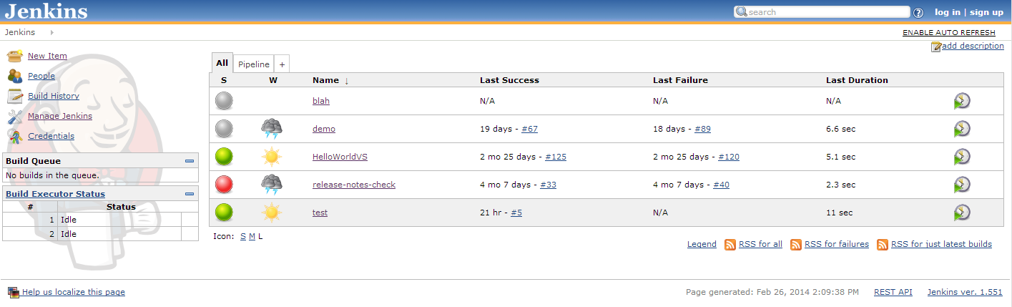
Jenkins Dashboard

Slide 22
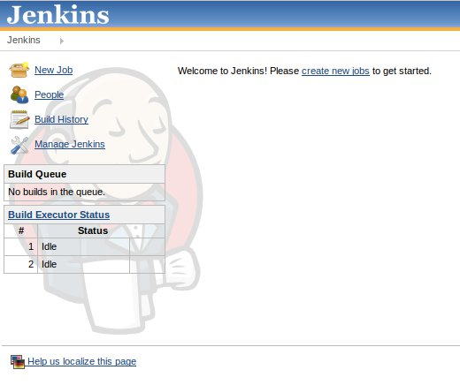
Click Manage Jenkins then Configure System

Slide 23
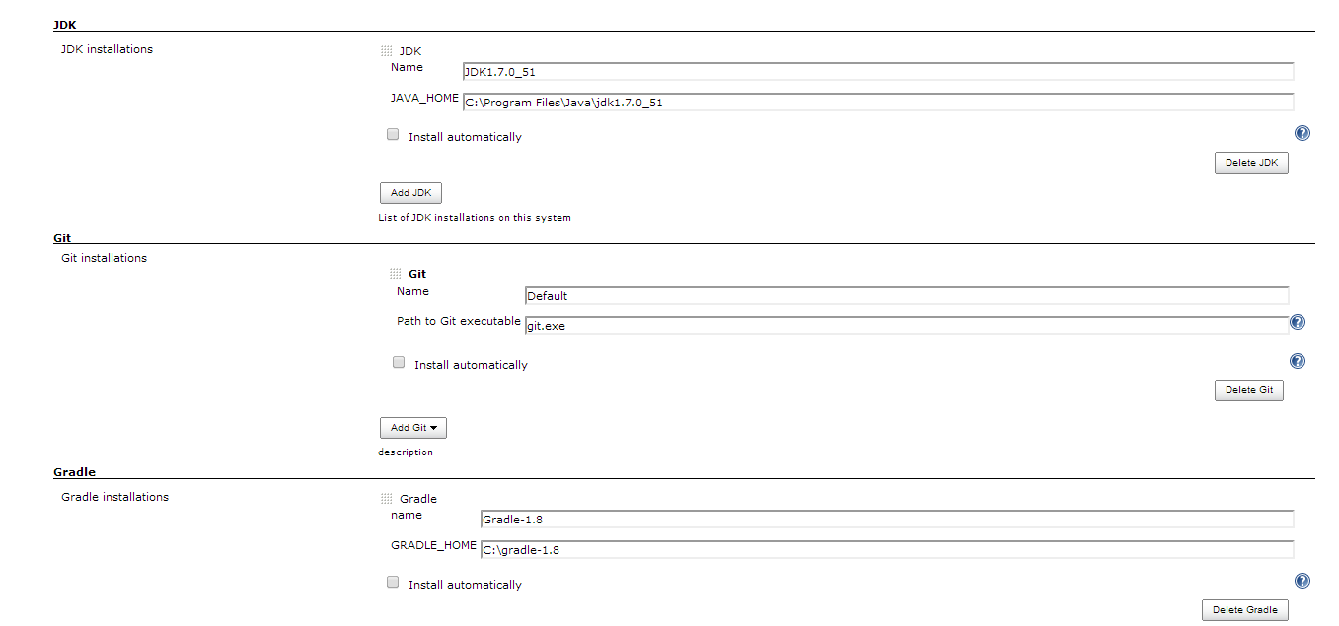
Need to point to JDK/Maven

Slide 24
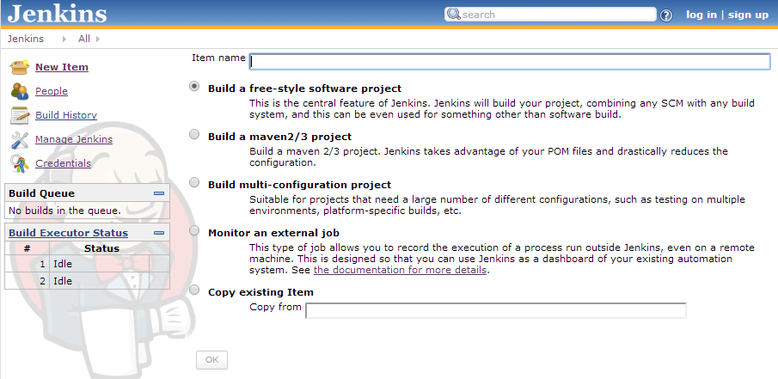

Slide 25
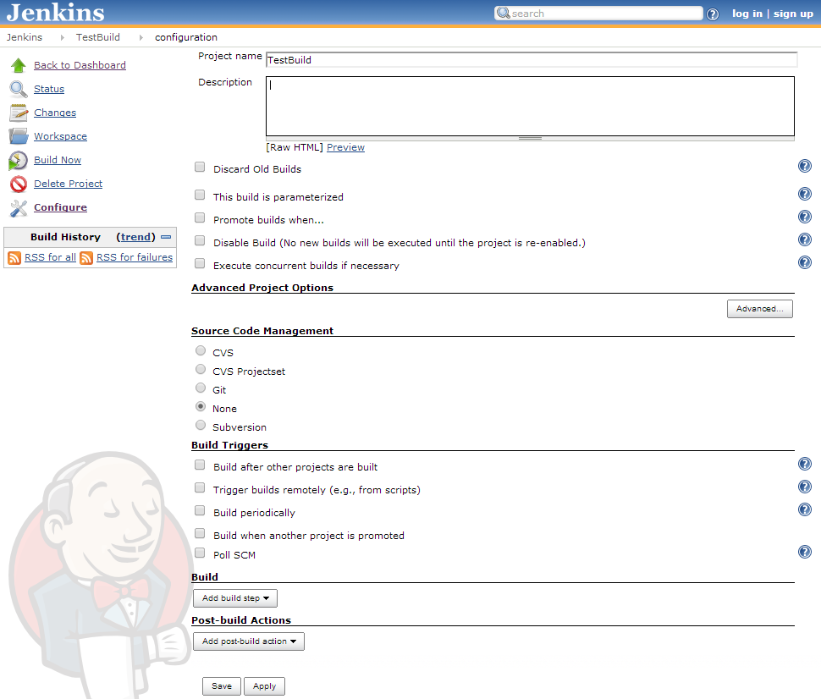

Slide 26
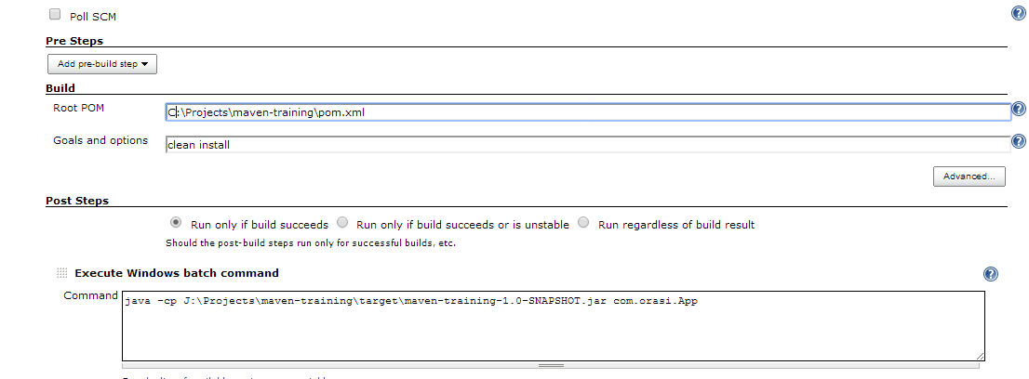

Slide 27
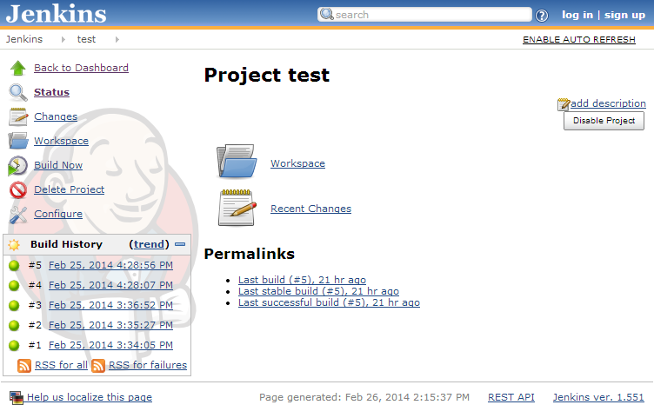
Job page

Slide 28
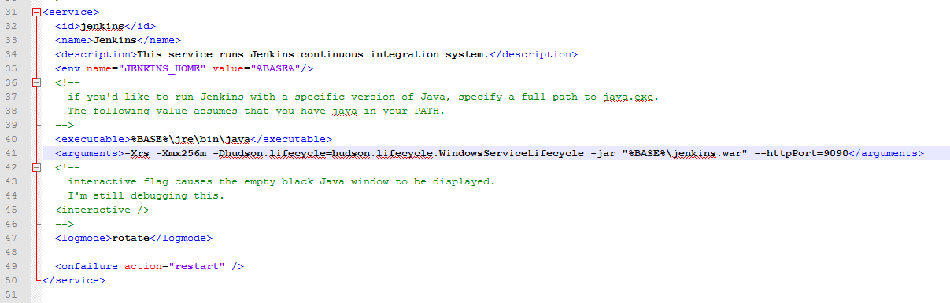
Changing Jenkins port in jenkins.xml

Slide 29
Extending Jenkins with Plugins
Manage Jenkins -> Manage plugins

Slide 30
Conclusion
Continuous integration is a necessity on complex projects due to the benefits it provides regarding early detection of problems
A good continuous build system should be flexible enough to fit into pre-existing development environments and provide all the features a team expects from such a system
Jenkins, a continuous build system, can be an integral part of any continuous integration system due to it’s core feature set and extensibility through a plugin system

