Slide 1
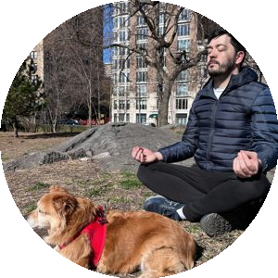
FAST
A simple formula for prompting.
You'll see a lot of posts online that talk about the "perfect prompt." Forget those. You don't need that. What you need is a "good enough prompt" that focuses exactly on what YOU need. Here's a framework I put together that you can use while prompting.
BY FERNANDO DE VEGA · AI IN THE PARK ai-in-the-park.vercel.app ↗
Frame
Ask
Set the role and the situation. What role is AI playing? What's the context?
The actual request. A single sentence with one action verb.
EXAMPLES
EXAMPLES
› You are a senior instructional designer.
› You are a UX writer helping me sharpen microcopy for a mobile onboarding flow.
› Draft a module-by-module outline for a training program.
› Rewrite these three module titles so they're parallel.
⚠ COMMON MISTAKE
⚠ COMMON MISTAKE
Flattering framing ("the best in the world at...") that pushes AI into generic authority voice.
Stacking Asks — "draft AND write AND suggest." Do them in three separate prompts.
Shape
Tune
Constraints, format, scope. Strong Shape sections always include explicit Don'ts.
Tells AI to push back, flag assumptions, or disagree with you.
EXAMPLES
EXAMPLES
› 4 to 6 modules. Each needs an outcome with a Bloom-level verb. Don't pad with filler.
› Under 15 words per line. No jargon. No exclamation marks.
› State your assumptions, and ask any clarifying questions.
› Before drafting, tell me anything you'd push back on.
⚠ COMMON MISTAKE
⚠ COMMON MISTAKE
Skipping the Don'ts. AI pads by default — you have to actively subtract.
Treating the first output as final. Tune turns generation into a conversation.
BEFORE YOU HIT SEND
The 10-second check
01
02
03
04
Did I frame with a real role?
Is my ask one sentence, one verb?
Did I include explicit Don'ts?
Did I tell it to push back first?
Not "you are an expert." A real role with real constraints.
If it needs a semicolon or an "AND," split it into two prompts.
AI pads by default. Name the filler you don't want.
State assumptions. Ask questions. Most people skip this.
If any answer is no — fix that move first, before hitting send.
I'm Fer. Argentinian, living in New York for the last five years, walking around Central Park with my dog Pericles most mornings. I've been an instructional designer for 15+ years. I've built things that worked and things that absolutely did not.
See you in the park.
AI IN THE PARK · AI-IN-THE-PARK.VERCEL.APP

