Slide 1


Tableau Analysis of Company Transactions
Ferdinand Leube
JUN, 10th | PARIS
DAFT MAY2022

Slide 2


Content
Data overview
Data cleaning and preparation
Code demo
Tableau widgets
Presentation of dashboard

Slide 3
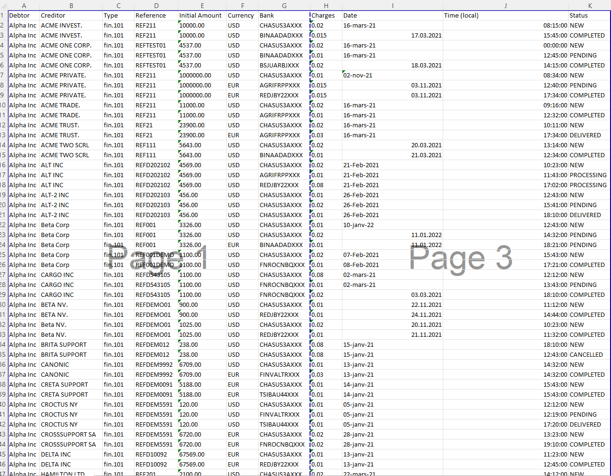


3 challenges:
Cleaning dates
Creating unique transaction IDS
Extracting countries from
Data overview

Slide 4
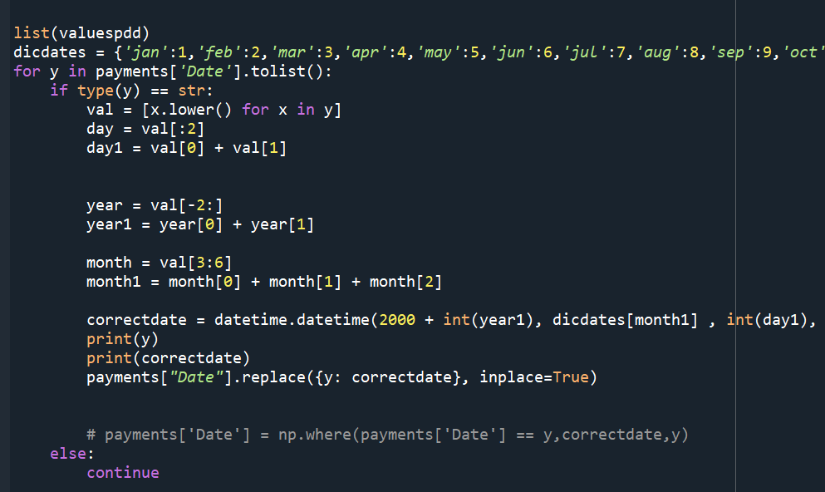
Data cleaning and prep
Clean data regarding the three factors described in previous slide
Shaping data to my needs:
Adding columns (e.g duration)
Pivot tables to perform calculations

Slide 5
Data cleaning and prep / Challenges
High amount of challenges due to the organization of data
Problem of missing completed statements
Extracting country of creditor
Forecasting → not high enough amount of data to make valid models
Updating data after realizing necessity of new calculations

Slide 6
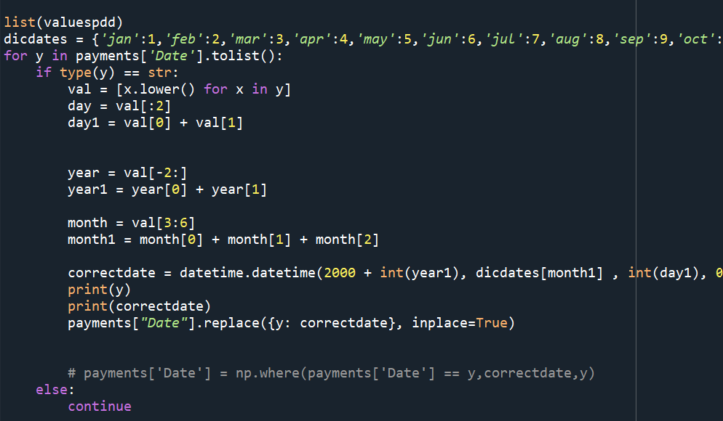
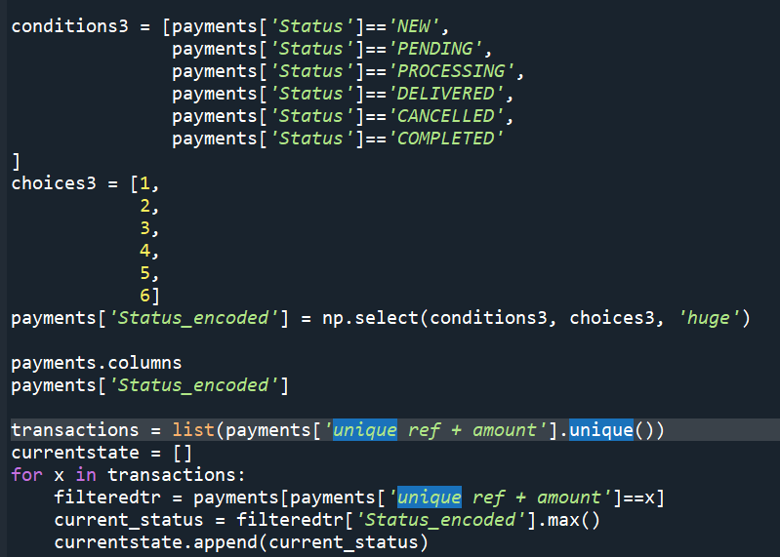
Data cleaning and prep / Highlights
Cleaning the date column
Extracting the country code
Looking for most recent state of transactions

Slide 7
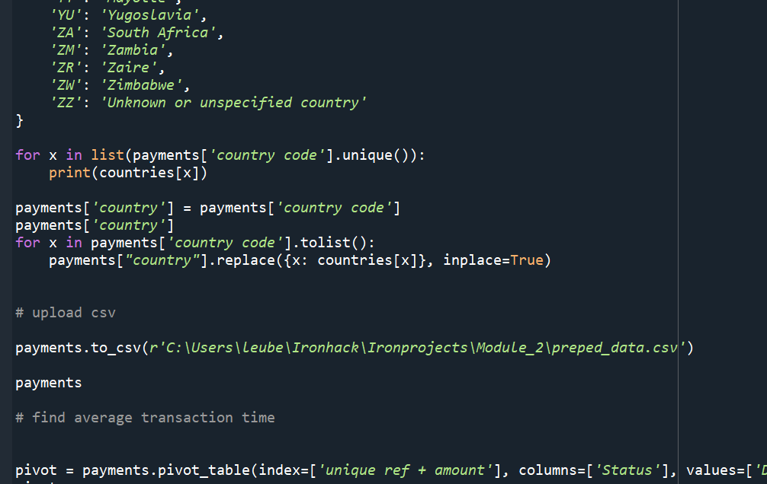
Code Demo

Slide 8

Tableau widgets and Dashboard presentation

Slide 9
Improvements for next time
Further checks regarind data cleaning
E.g number of transactions ID not equal to number of transactions with status „new“ → error?
What have been more obvious with greater domain knowledge

Slide 10
Any further questions?

