Slide 1

Bitcoin Price Prediction
Project 4
August 23, 2019
Ferdinand Wohlenberg

Slide 2


Introduction
Decentralized digital currency
Transactions recorded in distributed public ledger (blockchain)
Founder is a mystery (Satoshi Nakamoto)
Supply is finite
Notes:
Bitcoin is a decentralized digital currency (no need of central instance or third party)
All transactions recorded in distributed public ledger -> everyone has access to it
No one knows for sure who the founder of bitcoin is. Online people are talkong about pseudonym Satoshi Nakamoto
Supply is bitcoins are finite. Bitcoins are mined and only a total of 21mn will exist. Currently 16.4 mn bitcoin mined

Slide 3



Methodology
Lorem 1
Data Preprocessing
Sources:
Operations:
Clean up tweets
Compute daily Google SVI
Compute Bitcoin price differences (returns)
Notes:
To begin with, I had to prepare the sources for the Modelling process.
As sources I used, 1.8MM tweets, Google Trends over the past 3 years and Cryptodatadownload for hourly bitcoin prices
First, I cleaned all the tweets from hashtags, urls, punctuation, non-english language, stemming, etc.
Then turned towards Google Trends data.
Google Trends provide a Search Vector Index which represents the popularity of a search term at a specific time in proportion to the popularity of this search term over a whole timeframe. When the timeframe is more than 90 days, the SVI is given on a weekly basis, so I had to convert the weekly SVI‘s to daily SVI
Modelling process consisted of 2 steps
1. Unsupervised Machine Learning, engaging in Topic Modelling using NMF to reduce the dimensionality and categorize(cluster) tweets into topics.
Then Sentiment Analysis on Tweets using VADER
2. Step was Spervised Machine Learning buidling a Classifcation Model using Light GBM (a gradient boosting framework that makes use of tree based learning algorithms.
In the end, the model will predict whether the Bitcoin Price will increase or decrease over the next 24 hours, kind of giving a signal whether to buy or sell. The Timeframe can be adjusted for the model.

Slide 4
Methodology
Lorem 2
Lorem 1
Modelling
Data Preprocessing
Sources:
Operations:
Clean up tweets
Compute daily Google SVI
Compute Bitcoin price differences (returns)
1. Unsupervised ML (NLP)
Topic Modelling (NMF)
Sentiment Analysis (VADER)
2. Supervised ML (Classification)
Model: Light GBM
Metric: Precision
Notes:
To begin with, I had to prepare the sources for the Modelling process.
As sources I used, 1.8MM tweets, Google Trends over the past 3 years and Cryptodatadownload for hourly bitcoin prices
First, I cleaned all the tweets from hashtags, urls, punctuation, non-english language, stemming, etc.
Then turned towards Google Trends data.
Google Trends provide a Search Vector Index which represents the popularity of a search term at a specific time in proportion to the popularity of this search term over a whole timeframe. When the timeframe is more than 90 days, the SVI is given on a weekly basis, so I had to convert the weekly SVI‘s to daily SVI
Modelling process consisted of 2 steps
1. Unsupervised Machine Learning, engaging in Topic Modelling using NMF to reduce the dimensionality and categorize(cluster) tweets into topics.
Then Sentiment Analysis on Tweets using VADER
2. Step was Spervised Machine Learning buidling a Classifcation Model using Light GBM (a gradient boosting framework that makes use of tree based learning algorithms.
In the end, the model will predict whether the Bitcoin Price will increase or decrease over the next 24 hours, kind of giving a signal whether to buy or sell. The Timeframe can be adjusted for the model.

Slide 5
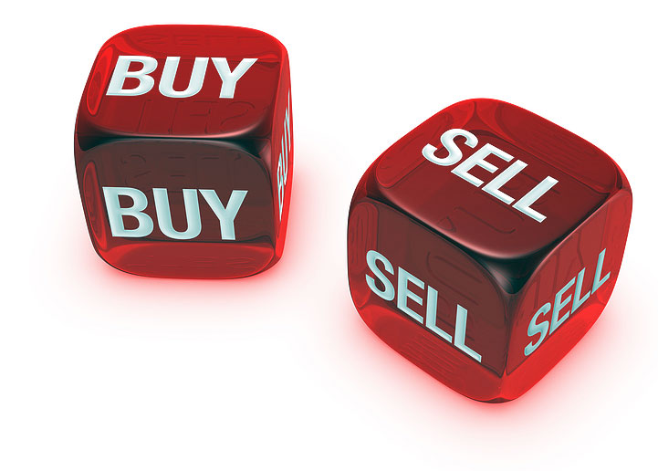
Methodology
Lorem 2
Modelling
Lorem 3
Lorem 1
Predictions
Data Preprocessing
Sources:
Operations:
Clean up tweets
Compute daily Google SVI
Compute Bitcoin price differences (returns)
1. Unsupervised ML (NLP)
Topic Modelling (NMF)
Sentiment Analysis (VADER)
2. Supervised ML (Classification)
Model: Light GBM
Metric: Precision
Will Bitcoin Price increase over the next 24 hours?
Output: Buy vs. Sell
Notes:
To begin with, I had to prepare the sources for the Modelling process.
As sources I used, 1.8MM tweets, Google Trends over the past 3 years and Cryptodatadownload for hourly bitcoin prices
First, I cleaned all the tweets from hashtags, urls, punctuation, non-english language, stemming, etc.
Then turned towards Google Trends data.
Google Trends provide a Search Vector Index which represents the popularity of a search term at a specific time in proportion to the popularity of this search term over a whole timeframe. When the timeframe is more than 90 days, the SVI is given on a weekly basis, so I had to convert the weekly SVI‘s to daily SVI
Modelling process consisted of 2 steps
1. Unsupervised Machine Learning, engaging in Topic Modelling using NMF to reduce the dimensionality and categorize(cluster) tweets into topics.
Then Sentiment Analysis on Tweets using VADER
Aggregated data on an hourly basis. So tweets occuring at the same hour
2. Step was Spervised Machine Learning buidling a Classifcation Model using Light GBM (a gradient boosting framework that makes use of tree based learning algorithms.
In the end, the model will predict whether the Bitcoin Price will increase or decrease over the next 24 hours, kind of giving a signal whether to buy or sell. The Timeframe can be adjusted for the model.

Slide 6
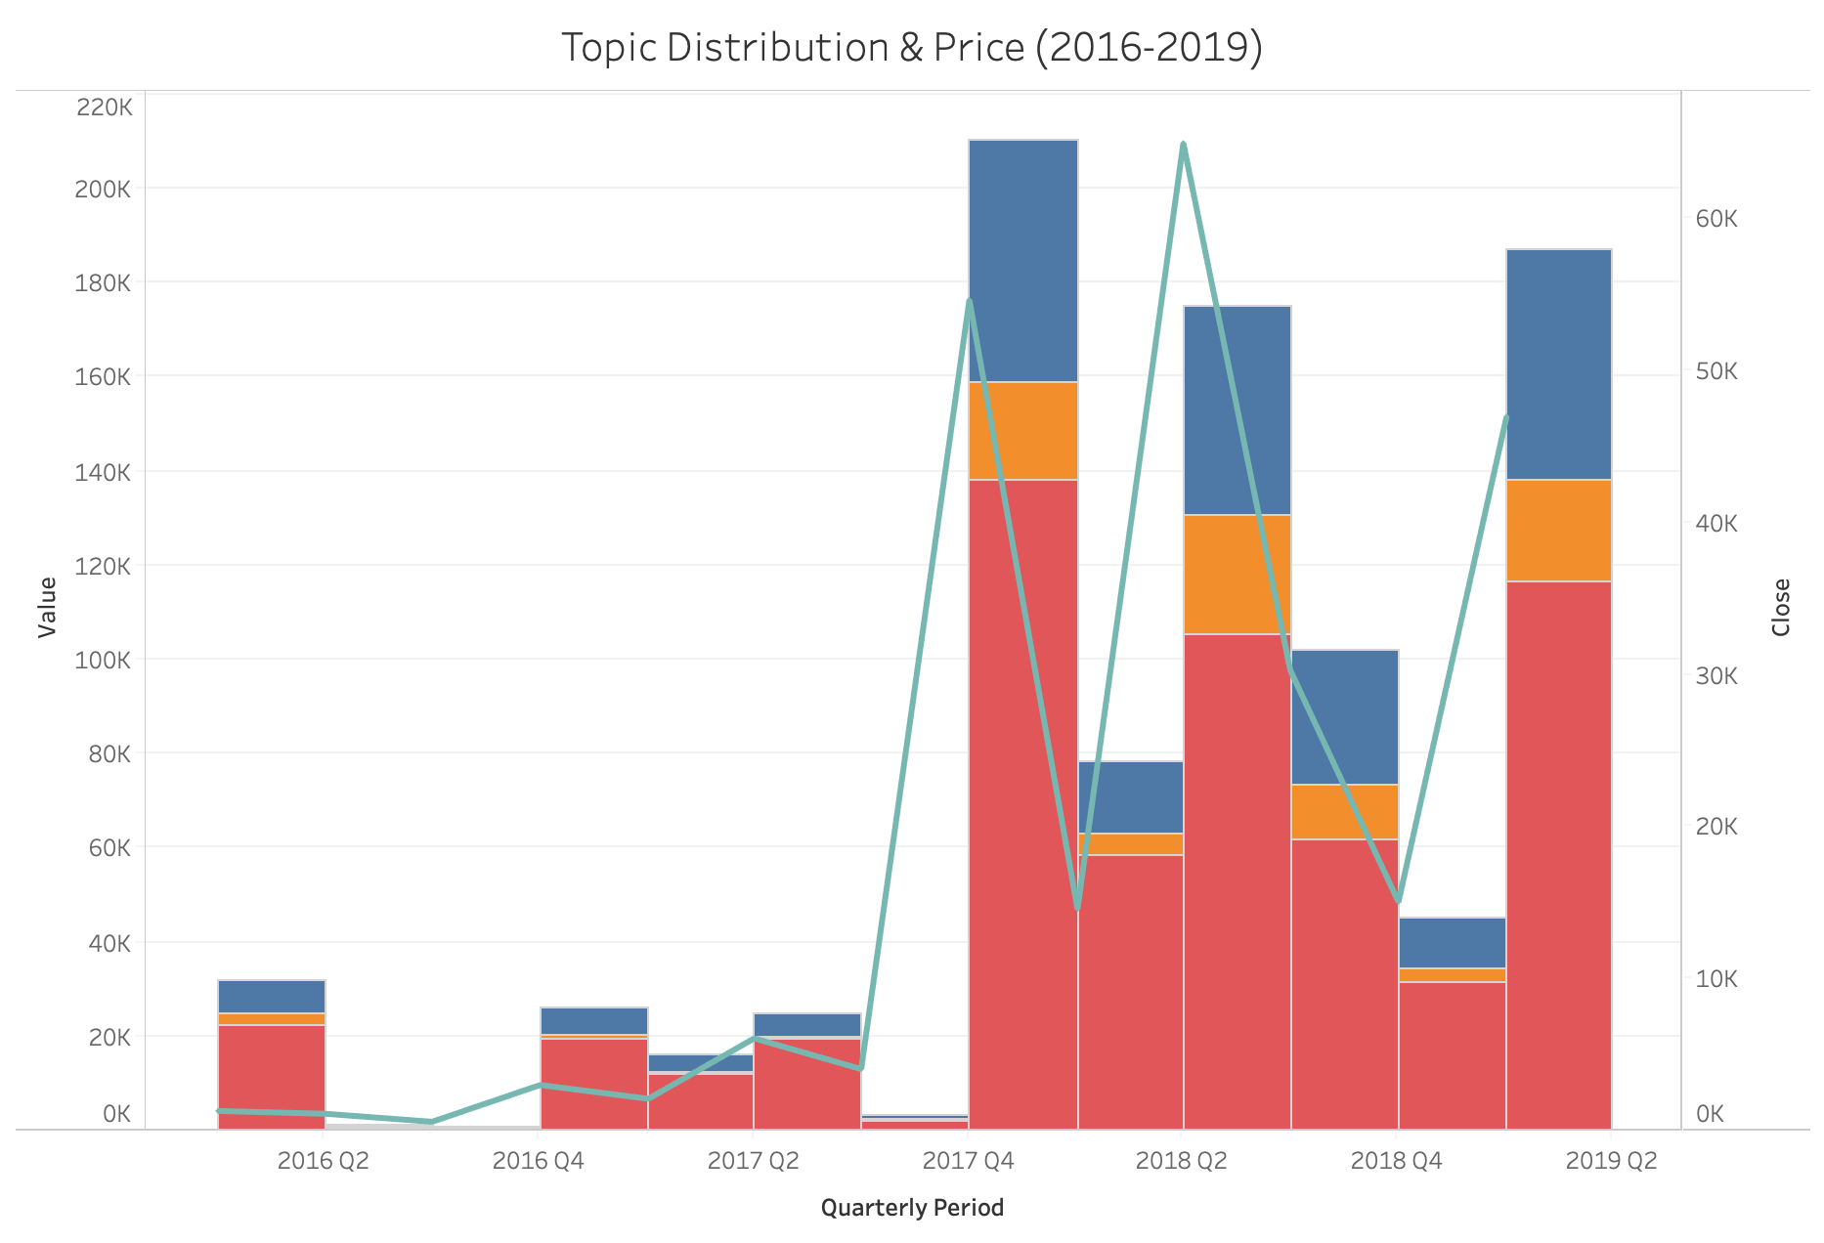
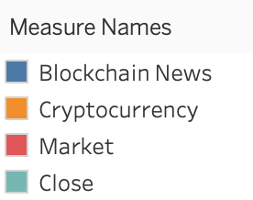
Topic Modelling - NMF
3 Topics in Tweets:
Blockchain News
Cryptocurrencies
Market News
Notes:
The topic Modelling resulted in mainly 3 Topics: Blockchain News, Cryptocurrencies and Market News, whereby most Tweets are associated to Market News. As I the tweets had some huge gaps, for visualization purposes i segmented the data in quartiles. The turqouise line represents the average price over the quarter and it seems there is some relationship, at least between the volume of tweets and the price.

Slide 7
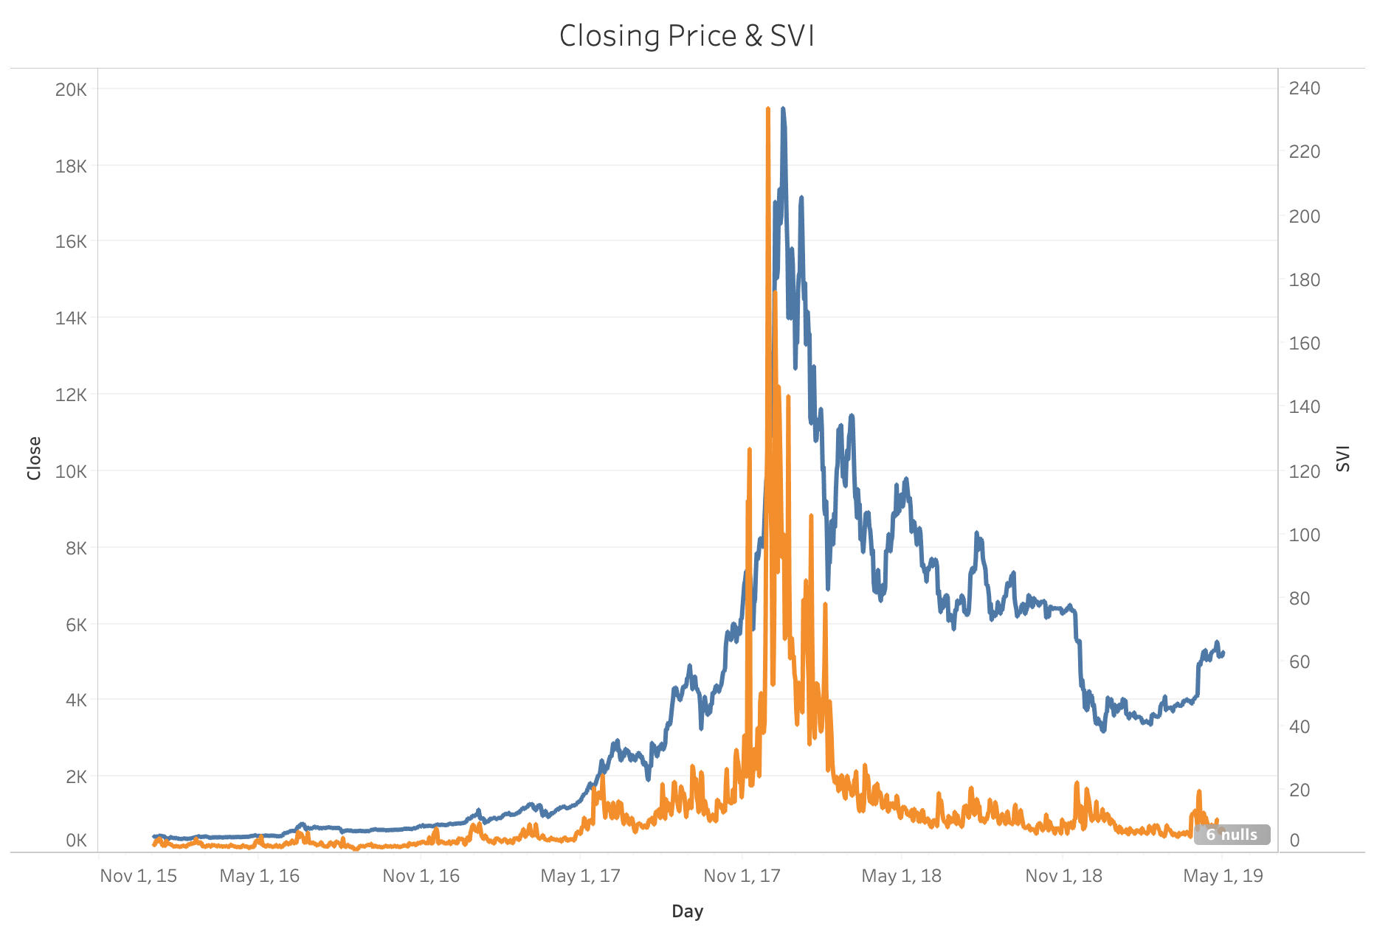
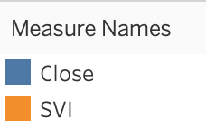
Bitcoin Price & Google SVI
Insight: Strong correlation during Bitcoin‘s peak
Notes:
This is a graphical representation of the Bitcoin Prices and daily Google SVI over the past 4 years.
- It can be taken from the graph that there is definitely some kind of relationship between price and svi

Slide 8
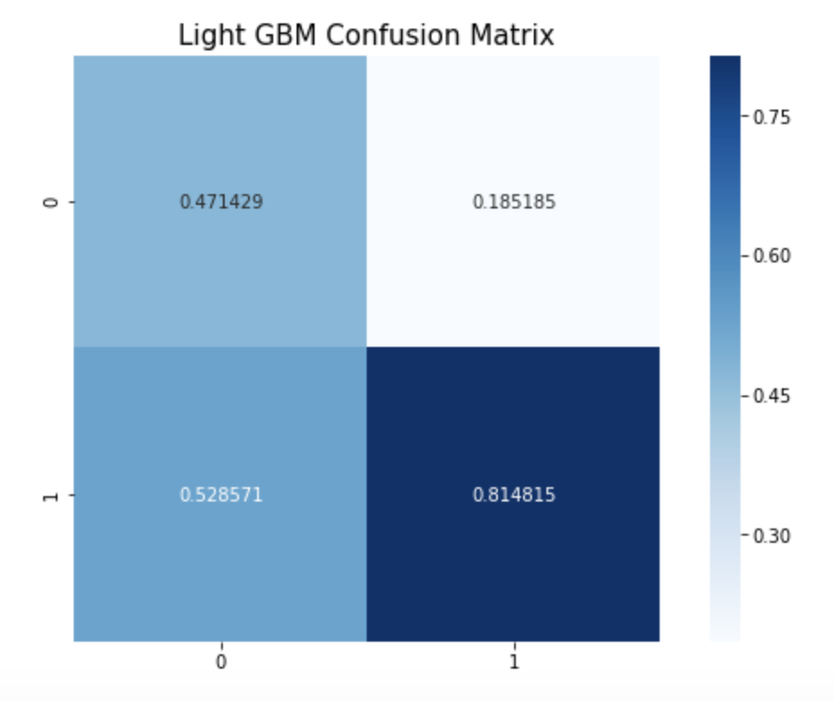



Classification Model – Light GBM
Probability Threshold = 0.277
Precision: 0.81
Recall: 0.37
Accuracy: 0.57
F1: 0.51
Application Benefits*
ROI: 125%
Timeframe: 01/2019 – 03/2019
Avg. ROI per Transaction: 2.3%
*Measured on Test Set
Notes:
The end product is a light GBM Model with a precision of 81%. I specifically concentrated on precisio because I‘m not planning on shorting bitcoin: Therefore, I only care about the buy signal of the model and that when the buy signal comes, it must be correct, otherwise the trader is losing money.
The consequence is a lot of lost profit, but better safe than sorry
The confusion matrix displays a high true positie rate but also a realtively high false negative.
When the model would have been applied to the test set which consists of a row for every timestamp where at least 1 tweet occured and gives a buy or sell signal at that time.

Slide 9
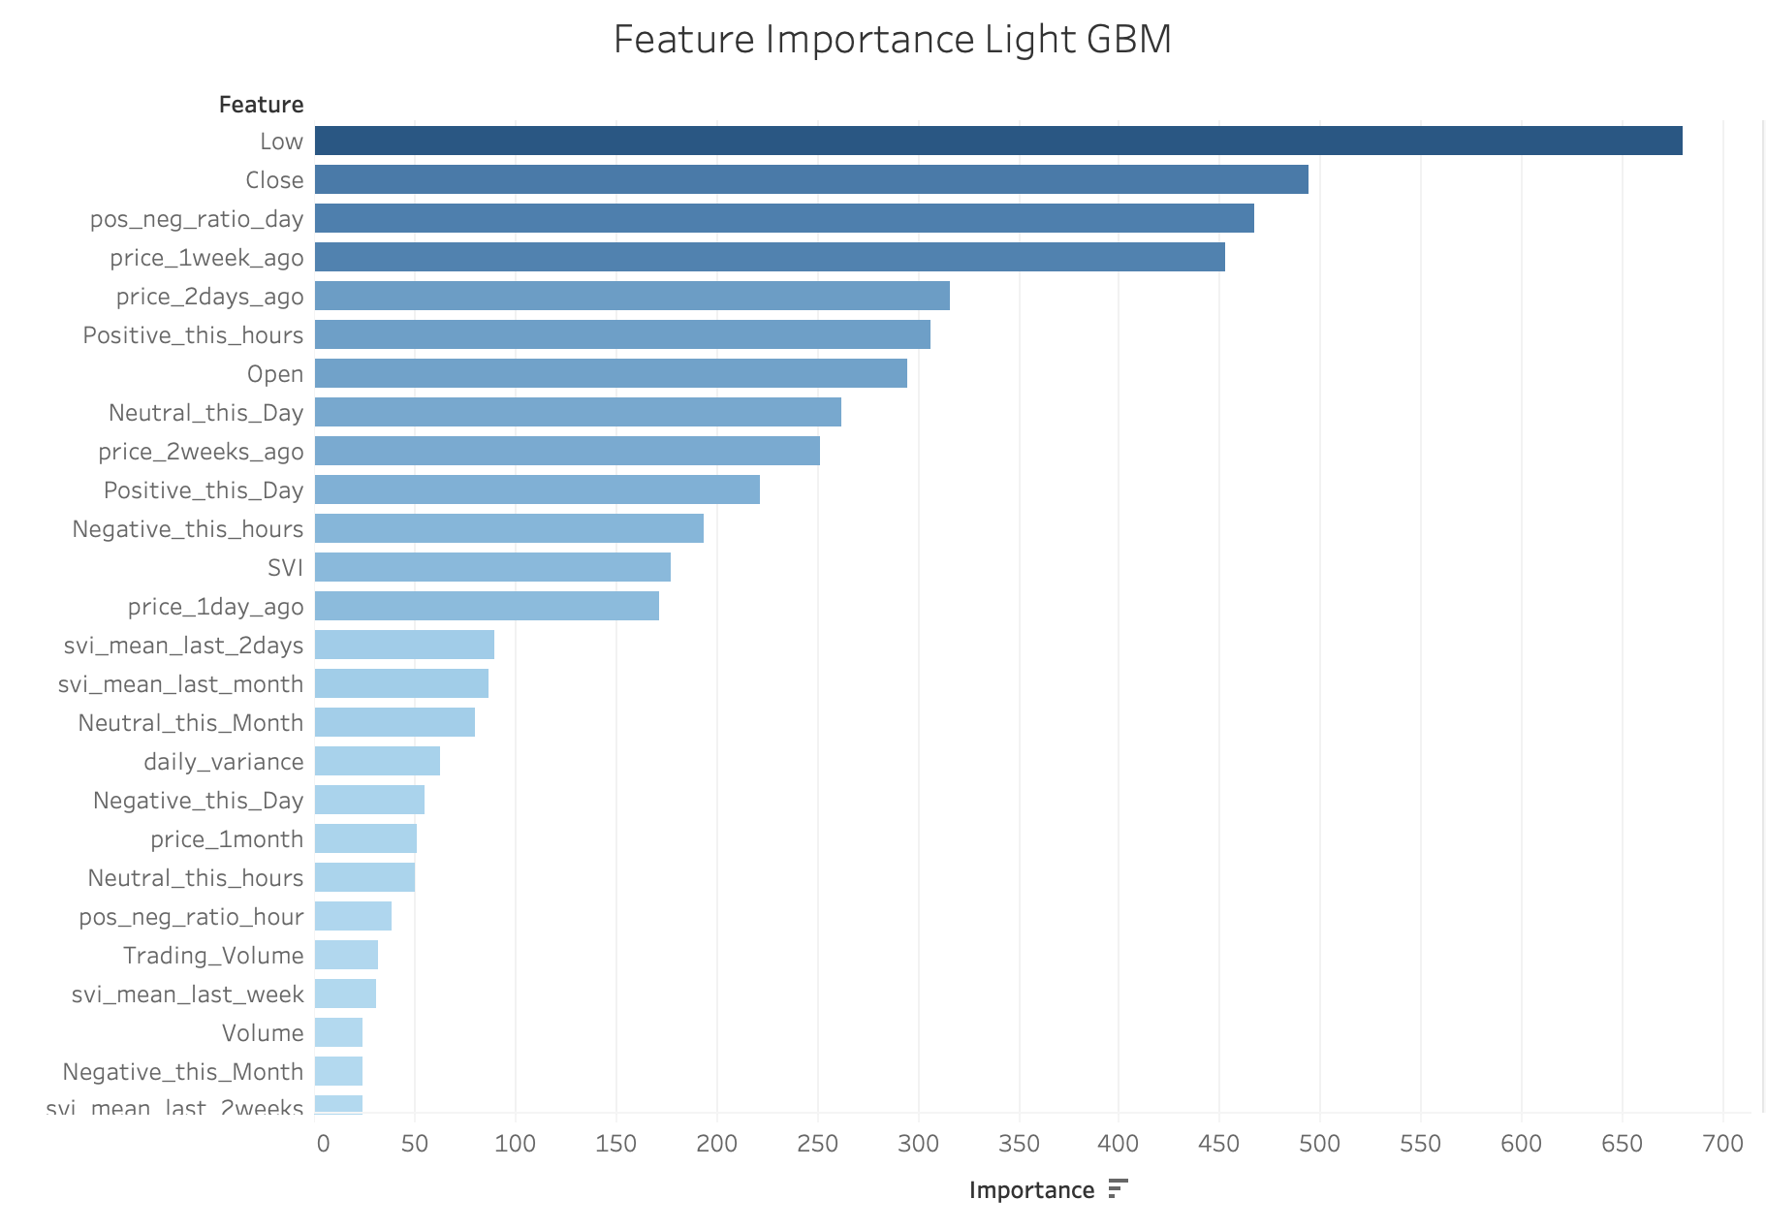
Model - Feature Importance (Gain)
Top 3:
Price Low (Day)
Closing Price(Day)
Positive/Negative Ratio (Sentiments)
Bottom 3:
Topic
Price High (Day)
Volume (Day)

Slide 10
Conclusion
Final Model: Light GBM (Precision = 81%)
Most important Features: Price Low (Day), Closing Price, Pos/Neg Sentiment Ratio
Potential ROI: 125% (01/2019 – 03/2019)
Tweet Topics don‘t give any signal -> Google SVI & Tweet Sentiment much better indicators

Slide 11
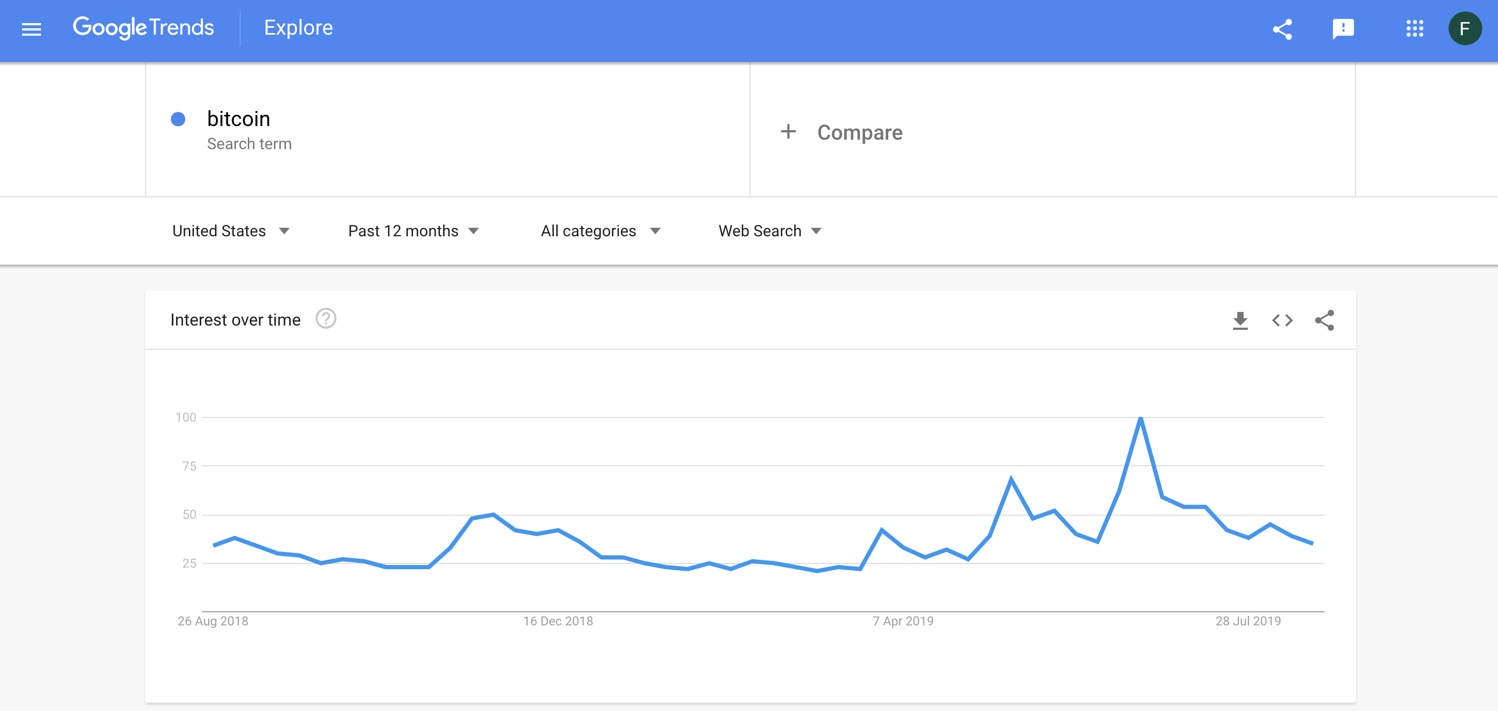
Appendix – Google Trends SVI

Slide 12
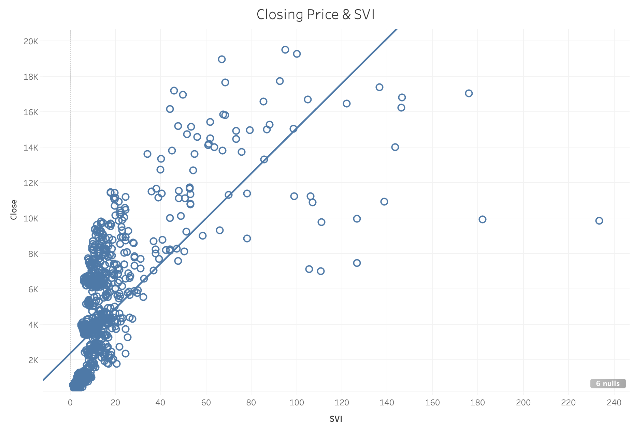
Appendix – Correlation: SVI & Bitcoin Price

Slide 13
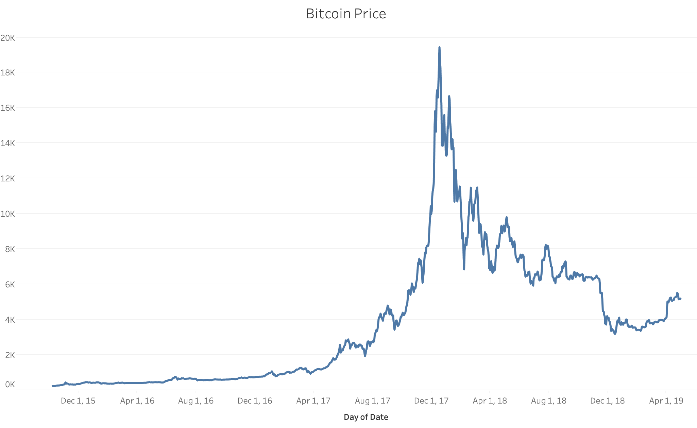
Appendix – Bitcoin Price

Slide 14
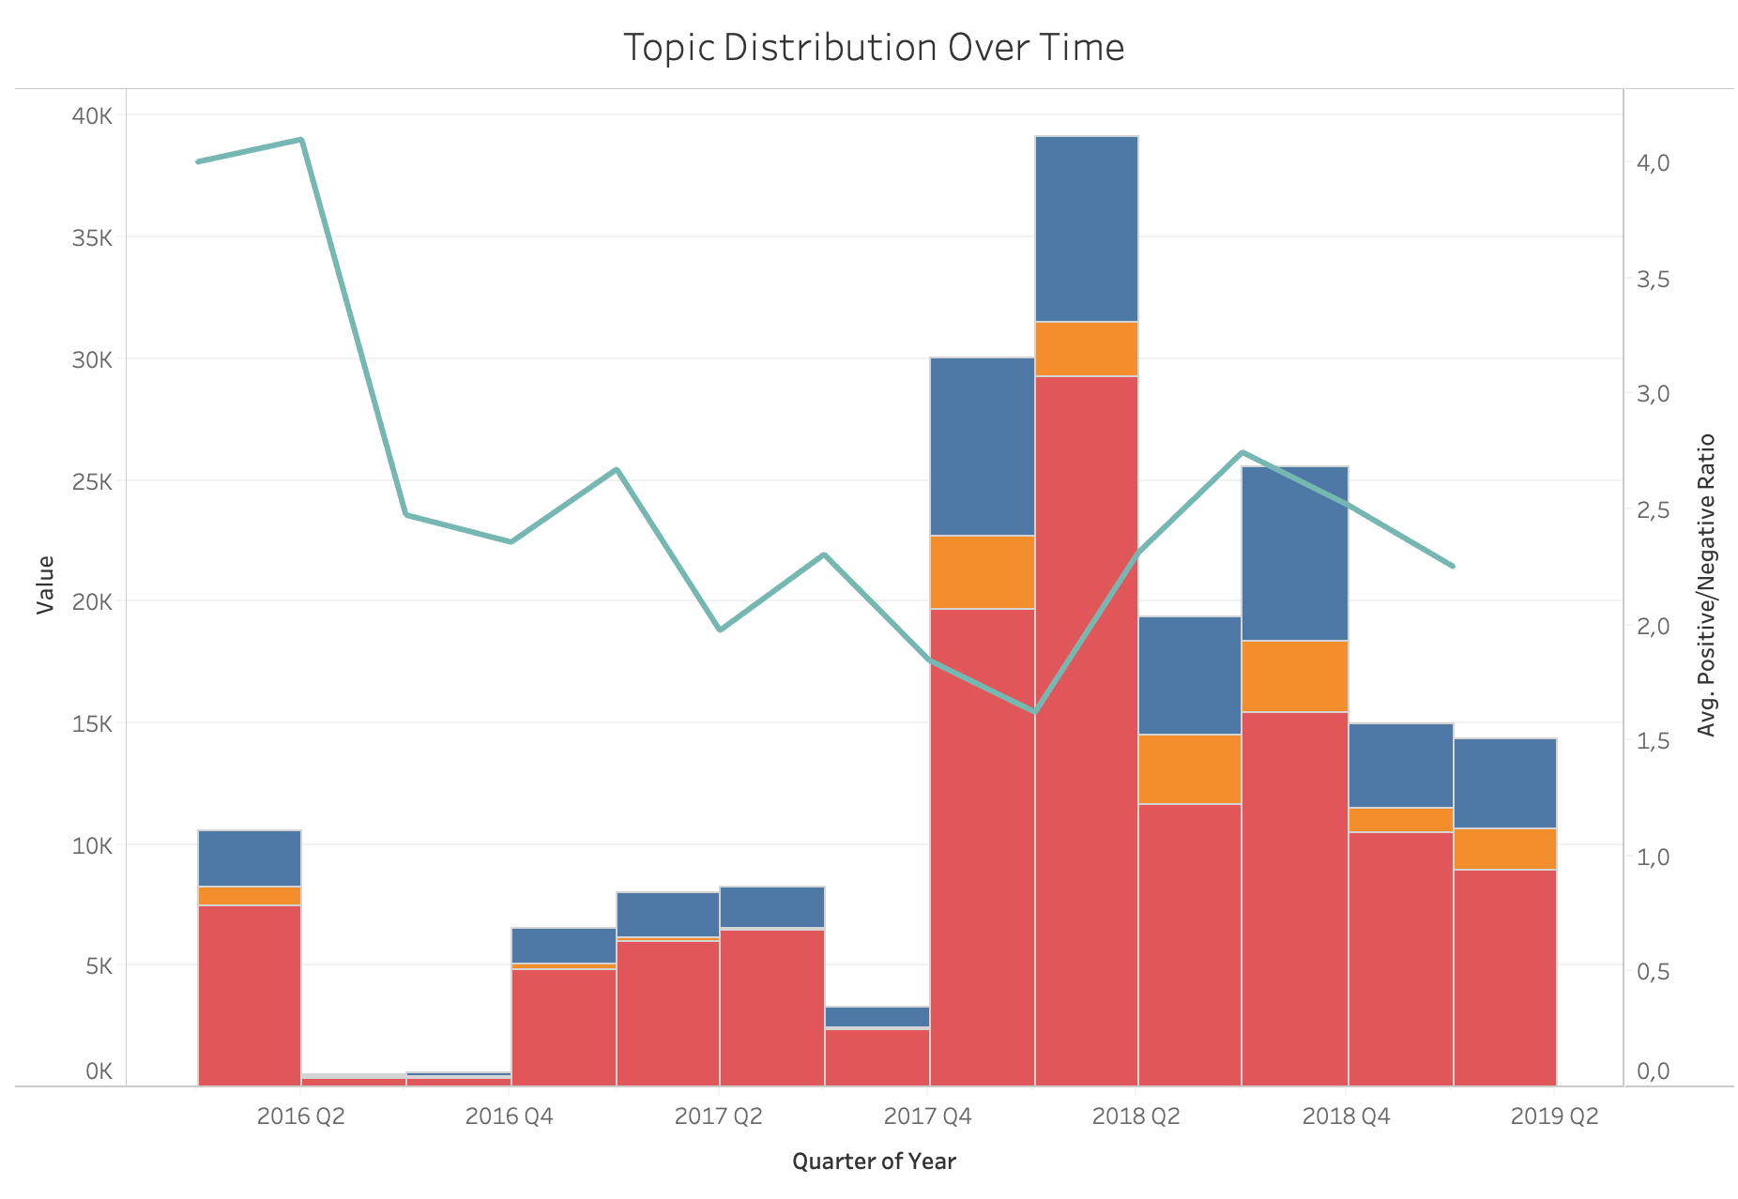
Appendix – Sentiment Analysis

Slide 15
Appendix – Future Considerations
More consistent Twitter data (daily)
Flask App
Automating model to purchase and sell Bitcoins on its own

