Slide 1
M6: Graphical Modeling Languages
Notes:
1

Slide 2
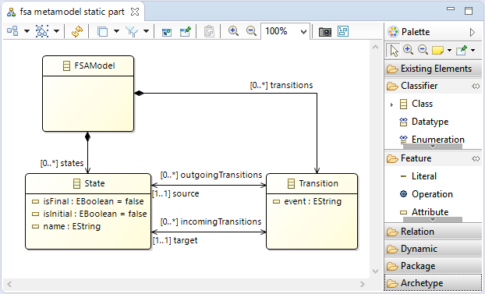
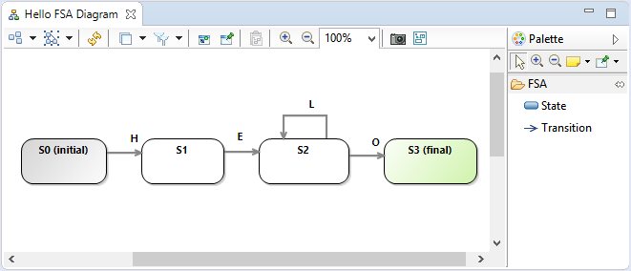
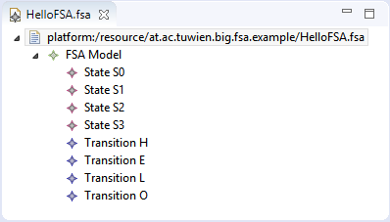
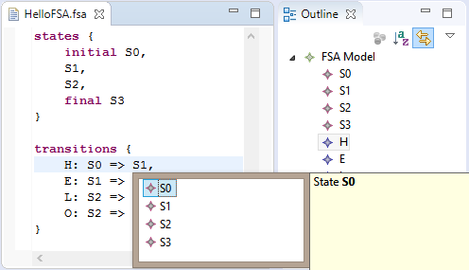
Recap
Metamodel
Defines Abstract Syntax
Graphical Editor
Follows Graphical Concrete Syntax
Textual Editor
Follows Textual Concrete Syntax
Generic EMF Tree Editor
Notes:
1

Slide 3
M7: Graphical Modeling Languages
Contents
Anatomy of Graphical Modeling Languages
Graphical Concrete Syntax Approaches
Mapping-based Approach
Annotation-based Approach
API-based Approach
Eclipse Sirius Framework
1
Notes:
1

Slide 4
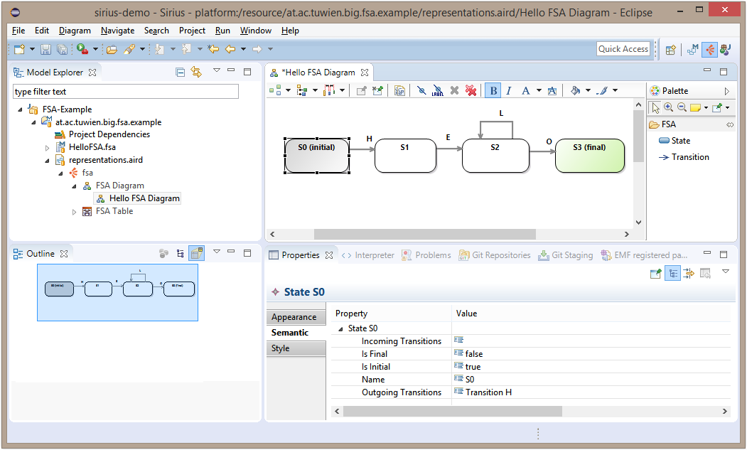
Graphical Modeling Editors
Components
Tool Palette
Tool Bar
Project Browser
Modeling Canvas
Outline View
Properties View
1
Notes:
1

Slide 5
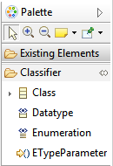


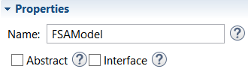
Graphical Modeling Editors
Specification
A graphical modeling editor requires the specification of two main components:
Graphical concrete syntax of the modeling language
Editing behavior specific to the modeling language
State
Transition
Class
Composition
Tool Palette
Action Bar
Connection Handlers
State
State
Filter
Properties View
1
Notes:
1

Slide 6
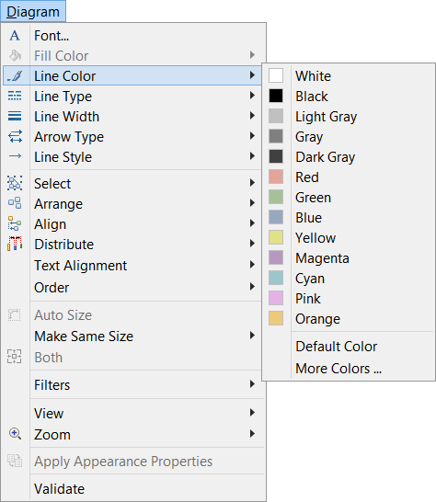
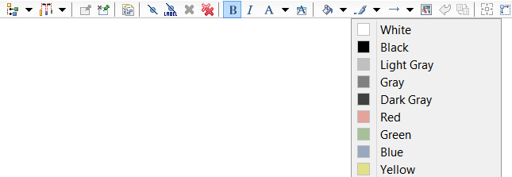
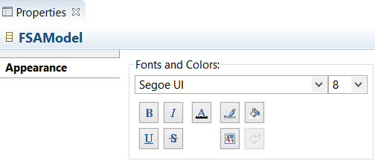
Graphical Modeling Editors
Generic Editing Features
Graphical modeling editors provide generic editing features for changing the appearance of diagrams and interacting with diagrams
Actions Menu
Actions Tool Bar
Appearance Properties
1
Notes:
1

Slide 7
Graphical Concrete Syntax
A Graphical Concrete Syntax (GCS) consists of
Graphical symbols
e.g., rectangles, circles, rounded rectangles
Compositional rules
e.g., nesting of elements in compartments, border nodes
Mapping between graphical symbols and abstract syntax elements
e.g., instances of a metaclass “State” are visualized by rounded rectangles
State
name : String
Mapping
«conformsTo»
S0 : State
name = “S0”
Mapping
S0
1
Notes:
1

Slide 8
Generic Metamodel for GCS
Class
Abstract Syntax
(AS)
Metamodel Element
Reference
1..1
1..1
Attribute
AS2CS Mapping
Mapping
Concrete Syntax
(CS)
1..*
1..1
1..1
Diagram
DiagramElement
Figure
1..*
Node
Edge
Line
Shape
Compound Figure
Compartment
Rectangle
Ellipse
…
1
Notes:
1

Slide 9
M7: Graphical Modeling Languages
Contents
Anatomy of Graphical Modeling Languages
Graphical Concrete Syntax Approaches
Mapping-based Approach
Annotation-based Approach
API-based Approach
Eclipse Sirius Framework
1
Notes:
1

Slide 10
GCS Approaches
Mapping-based
Explicit mapping model between abstract syntax, i.e., the metamodel, and concrete syntax
Example: GMF, Sirius
Annotation-based
The metamodel is annotated with concrete syntax information
Example: Eugenia
API-based
Concrete syntax is described by a programming language using a dedicated API for graphical modeling editors
Example: Graphiti
Abstract Syntax
Concrete Syntax
AS2CS
Abstract Syntax
Concrete Syntax
Abstract Syntax
Metamodel API
Concrete Syntax
1
Notes:
1

Slide 11
Mapping-based Approach: GMF
http://www.eclipse.org/modeling/gmp/
EMF
M2T
Domain Model (Ecore)
CodeGen Model (EMF GenModel)
Java code
Domain Model (Ecore)
Generator Model (GMFGenModel)
M2T
GMF
Java code
Mapping (GMFMap)
Graphical Definition (GMFGraph)
Tool Definition (GMFTool)
1
Notes:
1

Slide 12
Annotation-based Approach: Eugenia
Ecore metamodels are annotated with GCS information
From the annotated metamodels, a generator produces GMF models
GMF generators are reused to produce the actual modeling editors
http://www.eclipse.org/epsilon/doc/eugenia/
1
Notes:
1

Slide 13
Annotation-based Approach: Eugenia
Eugenia Annotations (Excerpt)
Diagram
For marking the root class of the metamodel that directly or transitively contains all other classes
Represents the modeling canvas
Node
For marking classes that should be represented by nodes such as rectangles, circles, …
Link
For marking references or classes that should be visualized as lines between two nodes
Compartment
For marking elements that may be nested in their containers directly
Label
For marking attributes that should be shown in the diagram representation of the models
1
Notes:
1

Slide 14
Annotation-based Approach: Eugenia
Eugenia Example #1
Metamodel with EuGENia annotations
FSAModel
states
State
0..*
@gmf.diagram()
@gmf.compartment()
@gmf.node(
figure="rectangle")
Model fragment in AS
Model fragment in GCS
S0 : State
Modeling Canvas
S0
fsa : FSAModel
1
Notes:
1

Slide 15
API-based Approach: Graphiti
Powerful programming framework for developing graphical modeling editors
API hides complexity of GEF and Draw2D
API follows a programming model that is based on features
Incremental development using default implementations
Get first results fast using default implementations: Move, resize, delete, ... etc. work immediately for added elements
Add feature by feature through adding custom implementations
https://eclipse.org/graphiti
1
Notes:
1

Slide 16
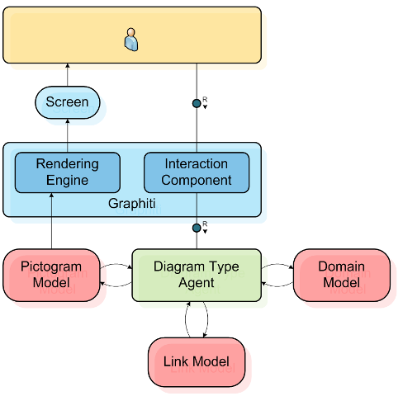
API-based Approach: Graphiti
Architecture
Domain Model
Contains the data to be visualized (i.e., the EMF-based model)
Pictogram Model
Describes the visualization and the hierarchy of concrete syntax elements
Link Model
Connects the domain model and the pictogram model
1
Notes:
1

Slide 17
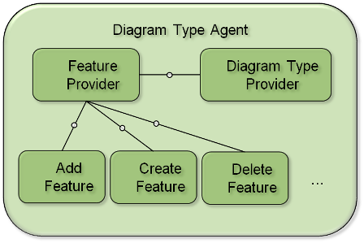
API-based Approach: Graphiti
Diagram Type Agent
Diagram Agent Type
Features manage (create, delete, ...) pictogram, link, and domain model elements
Features have to be implemented (by sub-classing base features) and added to the feature provider
1
Notes:
1

Slide 18
Graphical representation of initial node
API-based Approach: Graphiti
Graphiti Example
Example: Add feature for initial nodes of activity diagrams
Adds the graphical representation of an initial node to an activity diagram
public class AddInitialNodeFeature extends AbstractAddFeature {
@Override
public PictogramElement add(IAddContext context) {
Object initialNode = context.getNewObject();
ContainerShape targetContainer = (ContainerShape) context.getTargetContainer();
Shape initialNodeShape = getPeCreateService().createShape(targetContainer, true);
Ellipse initialNodeEllipse = getGaService().createEllipse(initialNodeShape);
getGaService().setLocationAndSize(initialNodeEllipse, context.getX(), context.getY(), INITIAL_NODE_SIZE, INITIAL_NODE_SIZE);
link(initialNodeShape, initialNode);
return initialNodeShape;
}
...
}
Retrieve model element for which a graphical representation should be added
Create the graphical representation
Map the graphical representation to the model element
1
Notes:
1

Slide 19
M7: Graphical Modeling Languages
Contents
Anatomy of Graphical Modeling Languages
Graphical Concrete Syntax Approaches
Mapping-based Approach
Annotation-based Approach
API-based Approach
Eclipse Sirius Framework
1
Notes:
1

Slide 20
Eclipse Sirius
Introduction
Mapping-based approach for defining the graphical concrete syntax of EMF-based modeling languages
Model-based approach, i.e., the graphical concrete syntax of a modeling language is defined in a model (Viewpoint Specification Model)
Viewpoint Specification Model defines
Graphical symbols (Styles)
Composition rules (Viewpoints, Representations, Container Mappings)
Mappings (Viewpoints, Representations, Container Mappings)
Editing behavior (Tools)
Viewpoint Specification Model is dynamically interpreted by the Sirius runtime
No code generation
Graphical representations are automatically updated in response to changes of the graphical concrete syntax
http://www.eclipse.org/sirius/
1

Slide 21
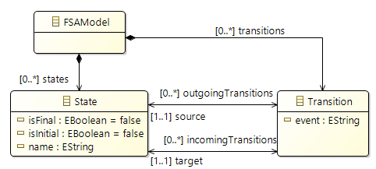




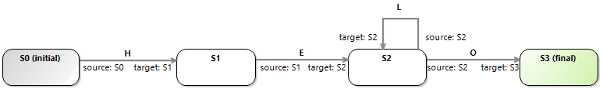
Example
Finite State Automata
Concrete Syntax Abstract Syntax
Model in Concrete Syntax
Concept
Notation
State
Initial State
Final State
Transition
1
Notes:
1

Slide 22
Overview
EMF
M2M
M2T
Metamodel (Ecore Model)
CodeGen Model (EMF GenModel)
Java Code
Sirius
Viewpoint Specification Model
Mapping
Representation
(Concrete Syntax)
Tools
… Mapping
… Transformation
M2M … Model-to-Model Transformation
M2T … Model-to-Text Transformation
1
Notes:
1

Slide 23



Overview
Example
EMF
M2M
M2T
Metamodel (Ecore Model)
CodeGen Model (EMF GenModel)
Java Code
Example
Sirius
Viewpoint Specification Model
Mapping
Example
Representation
(Concrete Syntax)
Example
Tools
… Mapping
… Transformation
M2M … Model-to-Model Transformation
M2T … Model-to-Text Transformation
1
Notes:
1

Slide 24

Architecture
Sirius runtime: Interprets viewpoint specification model and produces representation model for a user model
Representation model: Defines the concrete representation of a user model according to the definitions in the viewpoint specification model (representation)
Graphical editor: Shows the representation model
Enables interactions with user model as defined in viewpoint specification model (tools)
Interactions may trigger modifications of user model and representation model
Graphical editor is incrementally refreshed when user model, representation model, or viewpoint specification model is modified
Metamodel (Ecore Model)
Viewpoint Specification Model
Java Code
Model
(Ecore Model Instance)
Sirius
Runtime
Representation Model
Sirius
Graphical Editor
1
Notes:
1

Slide 25
Viewpoint Specification Model
Definitions in a viewpoint specification model
Viewpoint: Set of related representations intended for a certain use case (e.g., different view points for different stakeholders)
Representation: Concrete representation of a model defining the structure and appearance of the model, and the possible interactions with the model (e.g., diagram representations)
Mapping: Selection of model elements that should be shown in a representation (e.g., mapping of model elements to diagram nodes)
Style: Visual appearance of model elements selected by a mapping (e.g., visualization of diagram nodes as rounded rectangles)
Tool: Defines interactions with the model that are possible in a representation (e.g., creation tools available in tool palette for creating new model elements via diagrams)
1
Notes:
1

Slide 26
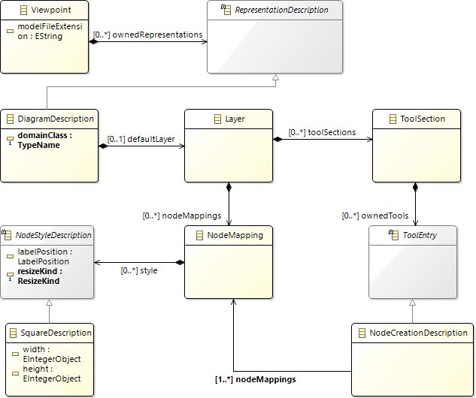
Viewpoint Specification Model
Metamodel
Viewpoint
Representation
Diagram
Representation
Tool for Creating Diagram Nodes
Style of Diagram Node Mappings
Mapping for
Diagram Nodes
1
Notes:
1

Slide 27
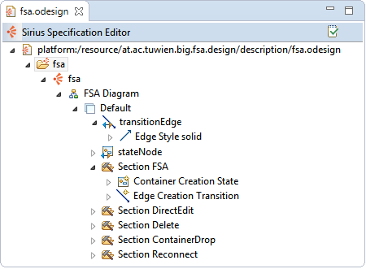
Viewpoint Specification Model
Example
File extension: .odesign
Group
Viewpoint
Diagram Representation
Layer
Edge Mapping
Edge Style
Node Mapping
Node Creation Tool
Tool Sections
Edge Creation Tool
1
Notes:
1

Slide 28
Groups and Viewpoints
Group
Top-level element serving as container
Features:
Name: Never change the name because it is part of the identification of all contained elements (representation models will break)
Viewpoint
Defines a particular viewpoint on a model
A viewpoint is associated with a particular type of model, i.e., a model conforming to a particular metamodel
Features:
Model File Extension: Associates the viewpoint with model files having a particular file extension and, thus, with models conforming to a certain metamodel (“*” for any)
Common features for viewpoints and contained elements:
Id: Mandatory identifier of the element; never change the identifier because it breaks existing representation models
Label: Label used to display the element in the editor
1
Notes:
1

Slide 29
Groups and Viewpoints
Example
Group
Name: fsa
Viewpoint
Id: fsa
Label: fsa
Model File Extension: fsa
1
Notes:
1

Slide 30
Representations
Representation Description and Diagram Description
Representation Description
Defines a concrete representation of a model
Supported representations: diagram, table, cross-table, tree, sequence diagram
Diagram Description
Defines a diagrammatic representation of a model
A diagram is always associated with a certain model element, which is usually the top-level element of your model serving as root container
Features:
Domain Class: Metaclass that is the type of the model element to be associated with the diagram
Components of a diagram description:
Layers defining diagram elements that should be shown
Tool sections
Validation rules and quick fixes
Filters of model elements to be shown on the diagram
Diagram style customizations
Emphasis of this lecture
1
Notes:
1

Slide 31
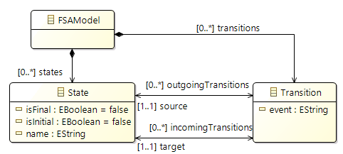
Representations
Diagram Description: Example
Diagram Description
Id: FSADiagram
Domain Class: fsa.FSAModel
1
Notes:
1

Slide 32
Diagram Descriptions
Layers and Mappings
Layer
All diagram elements and tools are part of a layer
A diagram always has a default layer, which is always shown in the editor
Additional layers can be enabled and disabled in the editor by the user
Mapping
Selects the elements to be shown on the diagram (“diagram element”) and their graphical notation
Supported mappings:
Diagram nodes
Node: Simple node
Container: Node that may contain sub nodes, bordered nodes or other containers
Diagram edges
Relation based edge: Edge for representing an EReference
Element based edge: Edge for representing a relationship expressed by a metaclass (EClass)
1
Notes:
1

Slide 33
Diagram Descriptions
Layers and Mappings: Example
Layer (Default)
Id: Default
Edge
Node
1
Notes:
1

Slide 34






Diagram Elements
Nodes
Features of Nodes
Domain Class: Type of the model elements (metaclass) for which the node defines the graphical notation (maps the concrete syntax to the abstract syntax)
Semantic Candidate Expression: Further restricts the model elements that should be associated with the node
Example: Only the states of one particular FSA model should be displayed on the diagram
Nodes Styles
(Simple) Node
▪ Basic Shape:
Square Stroke Triangle Dot Ring
▪ Square:
▪ Dot:
▪ Note:
▪ Diamond:
▪ Ellipse:
▪ Gauge
▪ Image
▪ Custom Style (Java implementation)
1
Notes:
1

Slide 35




Diagram Elements
Nodes
Node Styles
Container
Gradient ▪ Parallelogram ▪ Image
Sub Node
Is a (simple) node within a container
Arrangement of nodes: free form, list
Bordered Node
Is a (simple) node shown on the borders of a (simple) node or container
1
Notes:
1

Slide 36

Diagram Elements
Nodes: Example
Container
Id: stateNode
Domain Class: fsa.State
Semantic Candidate Expression: feature:states
Node is used for displaying only states of the FSA model shown in the diagram
Gradient Style
Background Color: white
Foreground Color: white
...
1
Notes:
1

Slide 37
Diagram Elements
Edges
Element Based Edge
Used when a model element should be displayed as an edge, i.e., if a metaclass in the metamodel represents a connection between model elements
Example:
Features:
Source Mapping, Target Mapping: Node mappings for the source node and the target node to be connected by the edge
Domain Class: Type of the model element (metaclass) which defines a relationship to be represented by the edge
Semantic Candidate Expression: Further restricts the model elements associated with the edge
Source Finder Expression, Target Finder Expression: Expression for retrieving the model elements being the source element and target element to be connected by the edge
source
State
Transition
target
1
Notes:
1

Slide 38
Diagram Elements
Element Based Edges: Example
Element Based Edge
Id: transitionEdge
Source Mapping: stateNode
Target Mapping: stateNode
Domain Class: fsa.Transition
Semantic Candidate Expression: feature:transitions
Edge is used for displaying only transitions of the FSA model shown in the diagram
Source Finder Expression: feature:source
EReference Transition.source
Target Finder Expression: feature:target
EReference Transition.source
1
Notes:
1

Slide 39
Diagram Elements
Edges
Relation Based Edge
Used when a reference between two model element should be displayed as an edge, i.e., if a reference (EReference) in the metamodel represents a connection between model elements
Example:
Features:
Source Mapping, Target Mapping: Node mappings for the source node and the target node to be connected by the edge
Target Finder Expression: Reference (EReference) represented by the edge
superClass
Class
1
Notes:
1

Slide 40
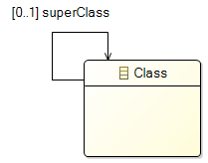
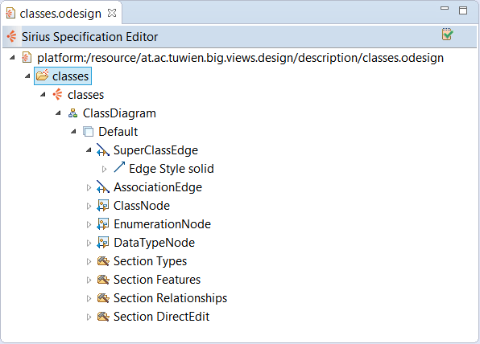
Diagram Elements
Relation Based Edges: Example
Relation Based Edge
Id: SuperClassEdge
Source Mapping: ClassNode
Target Mapping: ClassNode
Target Finder Expression: feature:superClass
EReference Class.superClass
1
Notes:
1

Slide 41
Diagram Elements
Edges
Edge Style
Features:
Line style: solid, dash, dot, dash_dot
Routing style: straight, manhattan (angles), tree (joins edges with same target)
Decorators: source arrow and target arrow
…
1
Notes:
1

Slide 42

Diagram Elements
Edges: Example
Edge Style
Line Style: solid
Source Arrow: NoDecoration
Target Arrow: InputArrow
Stroke Color: gray
Routing style: Straigth
...
1
Notes:
1

Slide 43
Diagram Elements
Conditional Styles
Conditional Styles
Styles for nodes and edges that are applied if a certain condition is fulfilled for the represented model element
Features:
Predicate Expression: Condition on the model element under which the conditional style is applied
1
Notes:
1

Slide 44
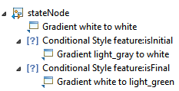


Diagram Elements
Conditional Style: Example
Conditional Style
Predicate Expression: feature:isInital
Conditional Style
Predicate Expression: feature:isFinal
1
Notes:
1

Slide 45
Diagram Elements
Labels
Labels
Node styles and edge styles define labels that display attribute values of the represented model elements
Features:
Label Expression: Retrieves the String to be displayed as label
Label Size
Label Format: bold italic, underline, strike through
Label Alignment: left, center, right
Icon Path (in Advanced properties): Path to the icon to be displayed next to the label
Show Icon: Whether or not an icon should be shown
…
1
Notes:
1

Slide 46
Diagram Elements
Node Labels: Example
Gradient
Label Expression: feature:name
Gradient
Label Expression: [self.name + ' (initial)')/]
Gradient
Label Expression: [self.name + ‘ ' (final)')/]
1
Notes:
1

Slide 47

Diagram Elements
Edge Labels: Example
Begin Label
Label Expression: ['source: ' + self.source.name/]
Edge Example
Center Label
Label Expression: feature:event
End Label
Label Expression: ['target: ' + self.target.name/]
1
Notes:
1

Slide 48
Interpreted Expressions
Many parts of a viewpoint specification model require the definition of interpreted expressions
Examples:
Node mappings: Semantic Candidate Expression
Edge mappings: Source / Target Finder Expression, Semantic Candidate Expression
Conditional style: Predicate expression
Label: Label expression
Sirius provides three specialized interpreters for handling simple expressions very efficiently
For complex expressions the Acceleo Expression Language can be used
1
Notes:
1

Slide 49

Interpreted Expressions
Simple Expressions
feature:
Provides direct access to named features of the context element
Example
feature:name
var:
Provides direct access to available variables
Example
var:self returns the current context element
service:
Enables direct invocations of service methods implemented with Java
context element is the Transition instance mapped to the transition edge
Center Label
Label Expression: feature:event
1
Notes:
1

Slide 50
Interpreted Expressions
Acceleo Expression Language
Acceleo expressions are enclosed with [ /]
Available expressions
OCL expressions
Example: Retrieve the outgoing transition of a state (context) that processes the event ‘H’
[self.outgoingTransitions -> select(t | t.event = ' H ') -> asSequence() -> first().event /]
EMF operations
Example: Retrieve the FSAModel that contains a transitions (context)
[self.eContainer()/]
Control flow statements
If: [(if (conditionExp) then Exp else Exp endif) /]
Example: Compute the label of a state (context)
[self.name + (if (self.isInitial) then ' (initial)' else (if (self.isFinal) then ' (final)' else '' endif) endif) /]
1
Notes:
1

Slide 51
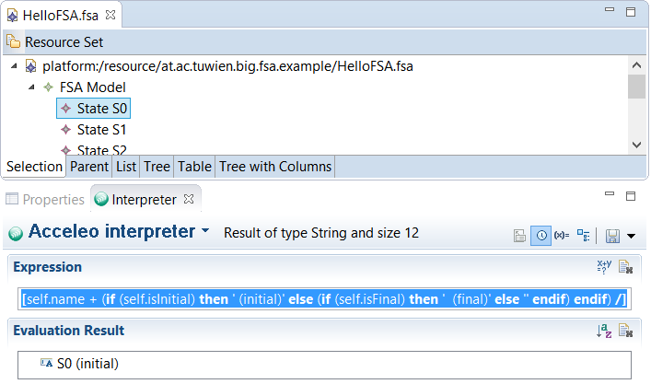
Interpreted Expressions
Acceleo Interpreter
The Acceleo interpreter lets you test Acceleo expressions
TIP: Test your expressions with the Acceleo interpreter before you add them to your viewpoint specification model
1
Notes:
1

Slide 52
Tools
Tool
Defines interactions with the model that are possible in a representation
Tools are organized in tool sections
For diagrams, tool sections are defined within a layer
Tool Types
Element creation: Creation of nodes, containers, and edges
Direct edit label: Direct editing of labels
Delete element: Deletion of elements
Reconnect edge: Reconnection of edges
Container drop: Drag’n’drop operations
Double click: Behavior of double clicking on elements
Selection wizard: Wizards for selecting elements and applying operations on them
Paste: Behavior for pasting elements onto the representation
Representation creation: Creation of diagrams, trees, and tables
1
Notes:
1

Slide 53
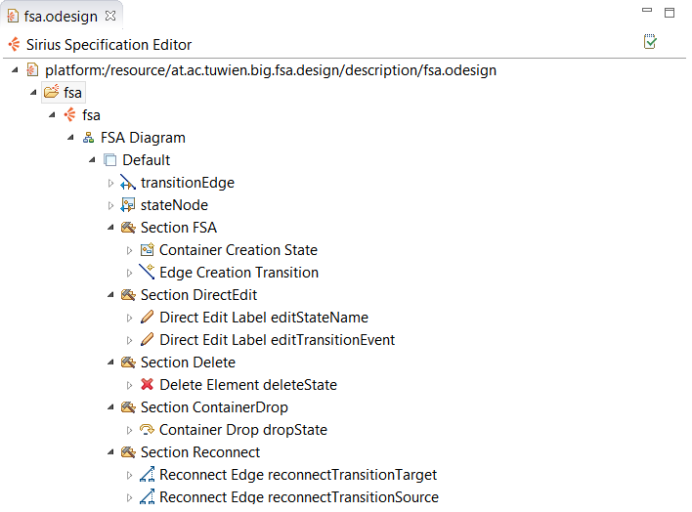
Tools
Example
Container Creation Tool
Edge Creation Tool
Direct Edit Label Tools
Tool Sections
Delete Element Tool
Container Drop Tool
Reconnect Edge Tools
1
Notes:
1

Slide 54
Tools
Tool Definitions
Tool Definition Contents
Features: Tool-specific features
Example: Node Creation Tool
Node Mappings: Node to be created
Variables: Tool-specific variables for accessing elements of the user model or elements of the representation model
Example: Node Creation Tool
Node Creation Variable container: The element of the user model mapped to the container to which the new node shall be added
Container View Variable containerView: The graphical element representing the container to which the new node shall be added
Model Operations: Operations to be applied on the user model or the representation model
Flow control operations
Representation operations
Model change operations
Java extension: Invocation of Java code
1
Notes:
1

Slide 55
Tools
Model Operations
Flow Control Operations
Begin: Entry point to a tool’s behavior
Change Context:
Every model operation is executed in the context of a specific element
The default context is the element of the user model on which the tool is applied
With the change context operation, the context can be changed to an element selected with an interpreted expression
Features
Browse Expression: Selects the new context element
If, Switch/Case, For: Control flow statements
1
Notes:
1

Slide 56
Tools
Model Operations
Model Change Operations
Create Instance: Create elements in the user model
Features
Type Name: Type (metaclass) to be instantiated
Reference Name: Name of the containment reference used for adding the new element to the current context element (container)
Set, Unset: Set / unset a feature value of the context element
Features
Feature Name: Name of the attribute or reference to be set / unset
Value Expression: Calculates the value to be set / unset
Remove: Remove the context element
Move: Move the context element into a new container
Features
New Container Expression: Retrieves the new container element
Feature Name: Name of the containment reference used for adding the element to the new container element
1
Notes:
1

Slide 57
Tools
Model Operations
Representation Operations
Create View: Create a node for the context element
Features
Mapping: Node mapping to be created
Container View Expression: Retrieves the container view to which the new node shall be added
Create Edge View: Create an edge for the context element
Features
Mapping, Container View Expression
Source Expression, Target Expression: Elements of the user model that are the source and target elements connected by the new edge
Delete View: Remove a node or edge from the diagram without deleting the mapped user model element
Navigation: Navigate to another diagram that represent the context element
1
Notes:
1

Slide 58
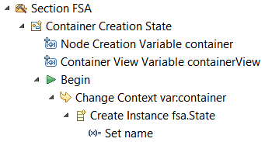
Tools
Model Operations: Example 1
Container Creation Tool
Container Mappings: stateNode
Change Context Operation
Browse Expression: var:container
Switches to the container in which the diagram elements was created (FSAModel instance)
Create Instance Operation
Type Name: fsa.State
Reference Name: states
Creates a new State instance and adds it to the container FSAModel using the containment reference FSAModel.states
Set Operation
Feature Name: name
Value Expression: [‘state’/] Initializes name of new State instance
1
Notes:
1

Slide 59
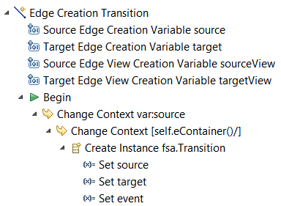
Tools
Model Operations: Example 2
Edge Creation Tool
Edge Mappings: transitionEdge
Change Context Operation
Browse Expression: var:source
Switches to source of drawn edge, i.e., source State of Transition
Change Context Operation
Browse Expression: [self.eContainer()] Switches to container of source State (FSAModel instance)
Create Instance Operation
Type Name: fsa.Transition
Reference Name: transitions
Set Operation
Feature Name: source
Value Expression: var:source
1
Notes:
1

Slide 60
Further Features
Further representations:
Sequence diagrams
Tables
Trees
Validation rules and quick fixes: Specify validation rules for user models and quick fix operations that can be applied if rules are violated
Filters: Filter shown model elements that fulfill certain conditions
Properties views: Specify properties views customized to modeling languages (generic properties view is provided out-of-the-box)
1
Notes:
1

Slide 61
Demo
Step 1: Prepare your workspace
Projects required in your Eclipse workspace:
Model project
Edit project (.edit)
Editor project (.editor)
Step 2: Start a new Eclipse instance (Runtime Eclipse)
Switch into the Sirius perspective
Step 3: Create or import an example model
Create a new project: File → New → Sirius / Modeling Project
Create a new model: File → New → Other → Example EMF Model Creation Wizards / Fsa Model
1
Notes:
1

Slide 62
Demo
Step 4: Create a viewpoint specification project
File → New → Sirius / Viewpoint Specification Project
Contains viewpoint specification model (*.odesign)
Step 5: Define your graphical editor
Add a viewpoint, diagram, mappings, and tools to the viewpoint specification model
1
Notes:
1

Slide 63
Demo
Step 6: Test your graphical editor
Select the defined viewpoint: Right click on the example modeling project → Viewpoints Selection → Select viewpoint fsa
Create a diagram:
Expand the example model in the Model Explorer
Right-click on FSAModel element → New representation → new FSA diagram
Nodes and edges corresponding to your defined mappings will be automatically created for existing model elements
TIP: Iterate between step 5 and 6, i.e., build your graphical editor incrementally and test it iteratively
1
Notes:
<number>

Slide 64
Literature
Sirius
Project Website: http://www.eclipse.org/sirius/
Documentation: http://www.eclipse.org/sirius/doc/
Tutorials: https://wiki.eclipse.org/Sirius/Tutorials/StarterTutorial https://wiki.eclipse.org/Sirius/Tutorials/AdvancedTutorial
Examples: https://www.eclipse.org/sirius/gallery.html
Acceleo Expression Language
http://help.eclipse.org/oxygen/topic/org.eclipse.acceleo.doc/pages/reference/operations.html?cp=5_3_2
1
Notes:
<number>

