Slide 1
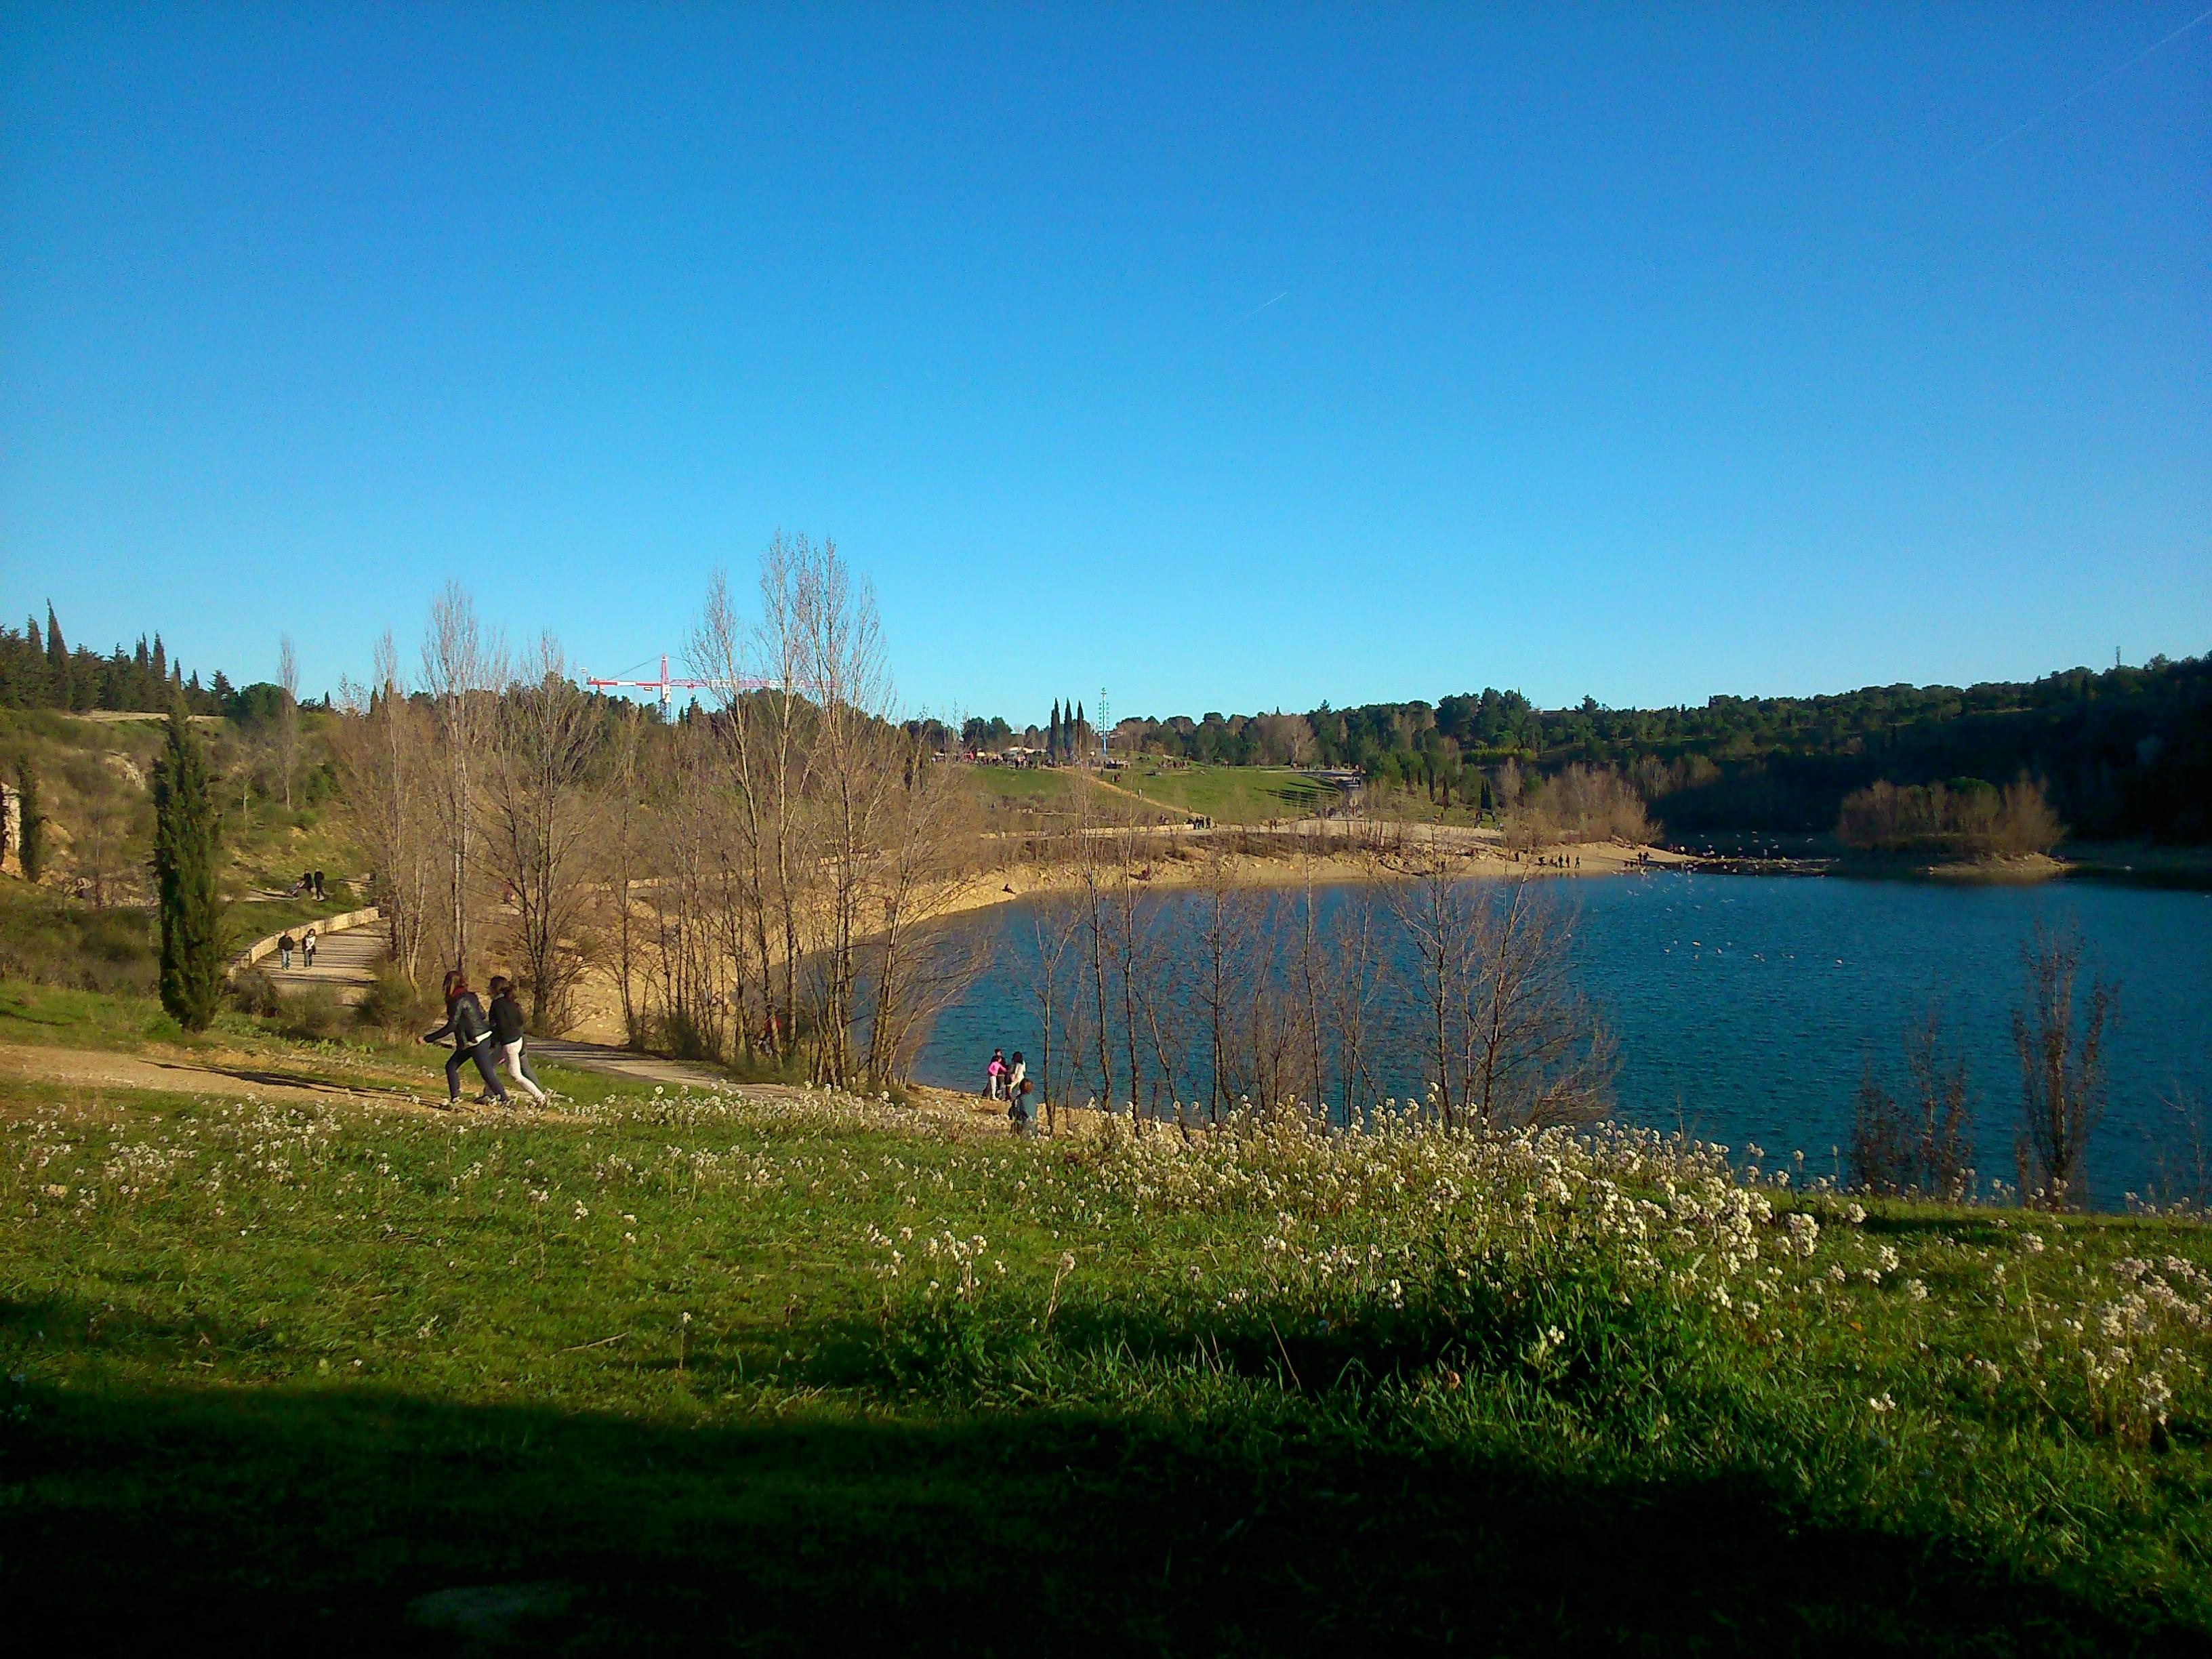
Git
Jenkins
Maven/Tycho
Scrum
Kanban
Eclipse RCP
Model-Driven Engineering
EMF
Xtext
EMF Forms
Java
Python
AIRBUS 2 years 4 people
PerfoRevolution : A Workbench for Performance Studies
comeone
guys
you can
comeone
guys
comeone
guys
you can
do it

