Slide 1
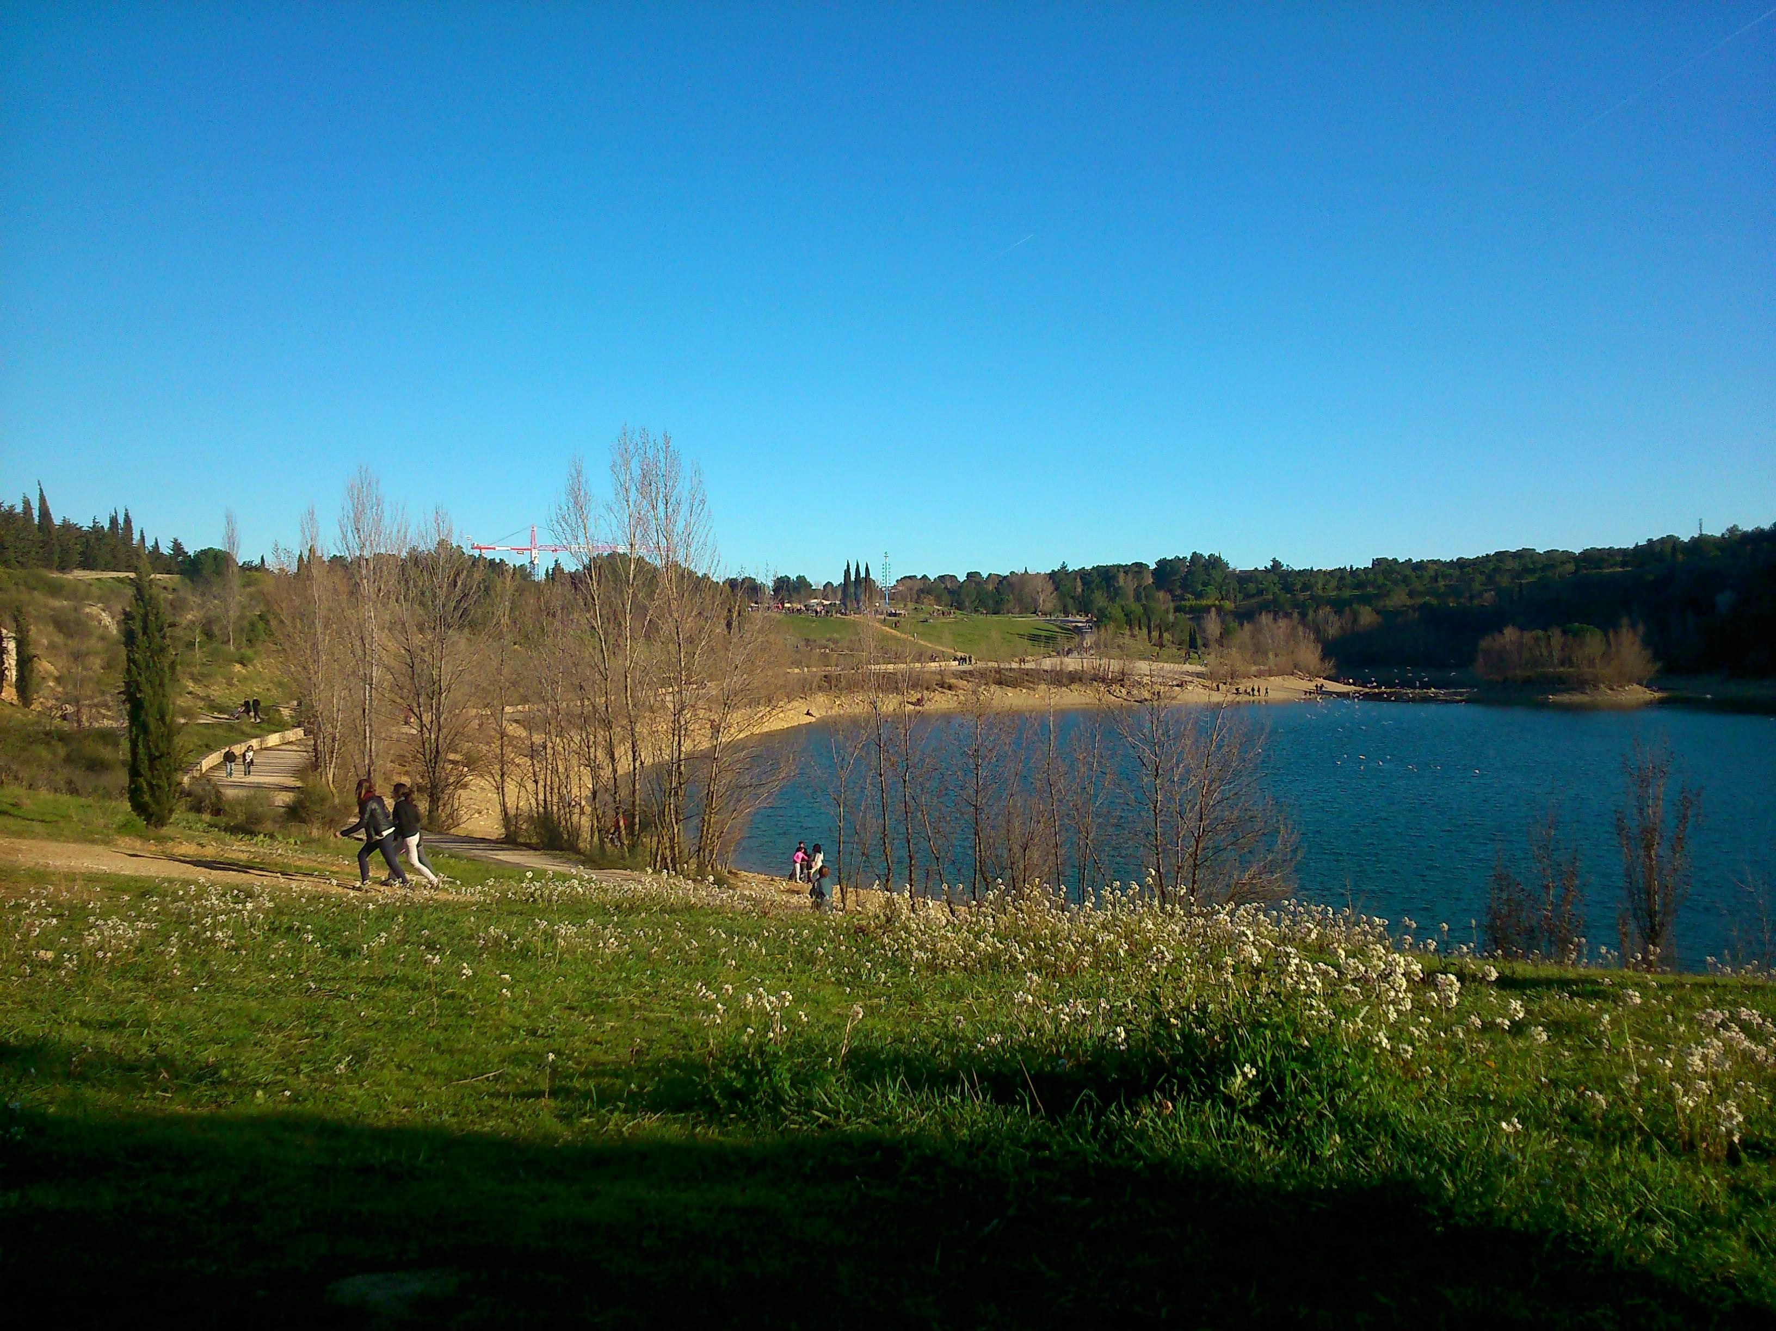
Eclipse RCP
Model-Driven Engineering
EMF
Xtext
EMF Forms
Git
Jenkins
Maven/Tycho
Scrum
Kanban
Java
Python
AIRBUS 2 years 4
PerfoRevolution : A Workbench for Performance Studies
comeone
guys
you can
comeone
guys
comeone
guys
you can
do it

