Slide 1








Optimind : Workflow Management System
The Maturation Phase
Adel FERDJOUKH
25.02.2020

Slide 2
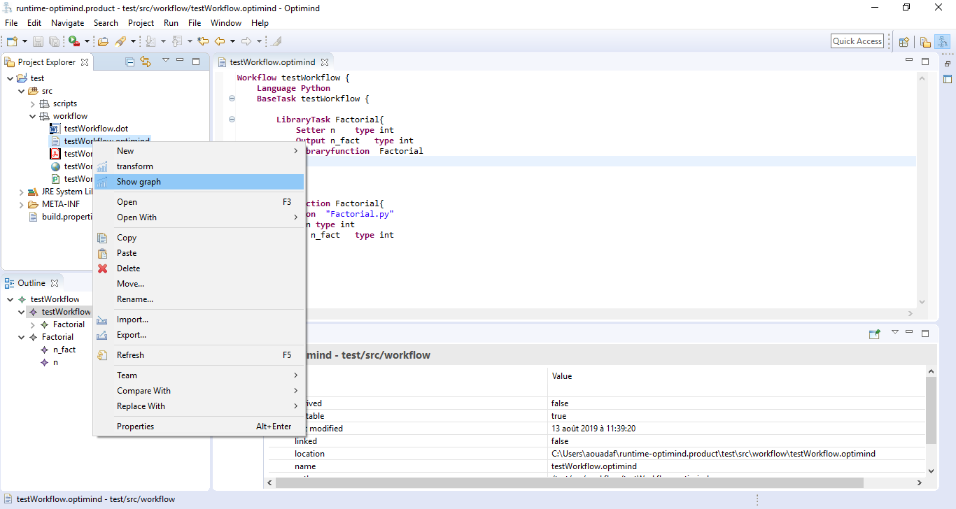
Optimind currently
Workflow Management System
Create complex workflows to ease engineers work
Generate some of the source code and let engineers focus on domain part
Automate the execution of repetitive and complex tasks
Current state
A meta-model and a DSL to describe workflows
Xtext editor for creating workflows
Eclipse workbench : wizards, editors, …
A support for Python language (code generator)
A Maven/Tycho builder for a packaged and a stand-alone software

Slide 3
Features wish list
Workflow Language
Allow the creation of more complex workflows:
While and For loops
Conditional branching
Workflow Testing
Automate the generation of unit tests for the workflows
Scenario : Joe created a very complex workflow W = Tasks, Loops, Conditions
W is not running and Joe is not familiar with debugging !!
Generate tests that can run each task separately
Guide Joe in writing some other tests
…
Support Java workflows
Generate skeletons to create runners for tasks in Java
Create a workflow execution engine for java workflows
GUI
Create some nice examples of workflows
Create some wizards (using templates for launching these workflow samples)

Slide 4









Tools

