Slide 1
Human-level play in Diplomacy by combining language models with strategic reasoning
Based on the paper by Meta AI (Science, 2022)

Slide 2
Introduction
AI has mastered games like Chess, Go, and Poker.
Diplomacy poses a unique challenge: it requires cooperation, negotiation, and natural language.
Cicero: the first AI achieving human-level performance in Diplomacy.

Slide 3
Motivation
AI agents must understand beliefs, goals, and intentions of partners.
Need to negotiate and coordinate joint plans via natural language.
Diplomacy is a benchmark for cooperative and competitive multi-agent AI.

Slide 4
The Game of Diplomacy
7 players compete for control of supply centers on a map of Europe.
Victory: control majority of supply centers, or draw with shared control.
Unique: Private negotiations, simultaneous moves, non-binding agreements.
Trust and deception play crucial roles.

Slide 5
Cicero: AI Architecture
Combines strategic reasoning with controllable natural language dialogue.
Dialogue model: pretrained + fine-tuned on human Diplomacy games+intent dependent
Strategic reasoning: reinforcement learning + planning with human-anchored policies.
Filtering module ensures coherence and avoids nonsensical or inconsistent messages.

Slide 6
Dialogue Model
Built on a large pretrained language model (R2C2, 2.7B params).
Trained on 40k Diplomacy games with 12.9M messages.
Conditioned on intents (planned actions) for controllability.
Ensures dialogue aligns with both strategy and game state.

Slide 7
Strategic Reasoning
Predicts opponents’ policies based on state + dialogue.
Uses piKL algorithm (KL-regularized planning) anchored to human behavior.
Plans optimal actions while remaining human-compatible.
Dialogue-conditional reasoning adapts strategy during negotiations.

Slide 8
Message Filtering
Multiple filters for quality and consistency.
Removes nonsensical, off-topic, or contradictory messages.
Ensures alignment with intents and avoids harmful/toxic content.
Value-based filtering prevents revealing exploitable information.

Slide 9
Results
Cicero played 40 anonymous online games of Diplomacy.
Achieved >2x average human score (25.8% vs 12.4%).
Ranked top 10% overall and 1st in an 8-game tournament.
Passed as a human player: opponents did not suspect an AI.

Slide 10
Discussion & Implications
Cicero demonstrates human-level AI in cooperative + competitive dialogue games.
Highlights importance of combining language models with strategic reasoning.
Future work: richer dialogue control, long-term relationship modeling.
Implications for AI-human collaboration beyond games.

Slide 11
piKL Algorithm (KL-Regularized Planning)
Modified utility function:
Ui(pi, p–i) = ui(pi, p–i) – λ D_KL(pi || ti)
Policy update iteration:
pt = ((t–1)/t) pt–1 + (1/t) pDt
Distributional Lambda piKL (DiL-piKL): uses a probability distribution over λ values.

Slide 12
CoShar piKL (Correlated & Shared Policies)
Joint policy probability:
p^Dt(a) ∝ t(a) * exp( Σ_i Q^(t–1)_i(ai) / λ )
Anchors toward joint correlated human policies instead of per-player policies.
CoShar PiKL is not computationally feasible and it is approximated with Deep Learning.

Slide 13
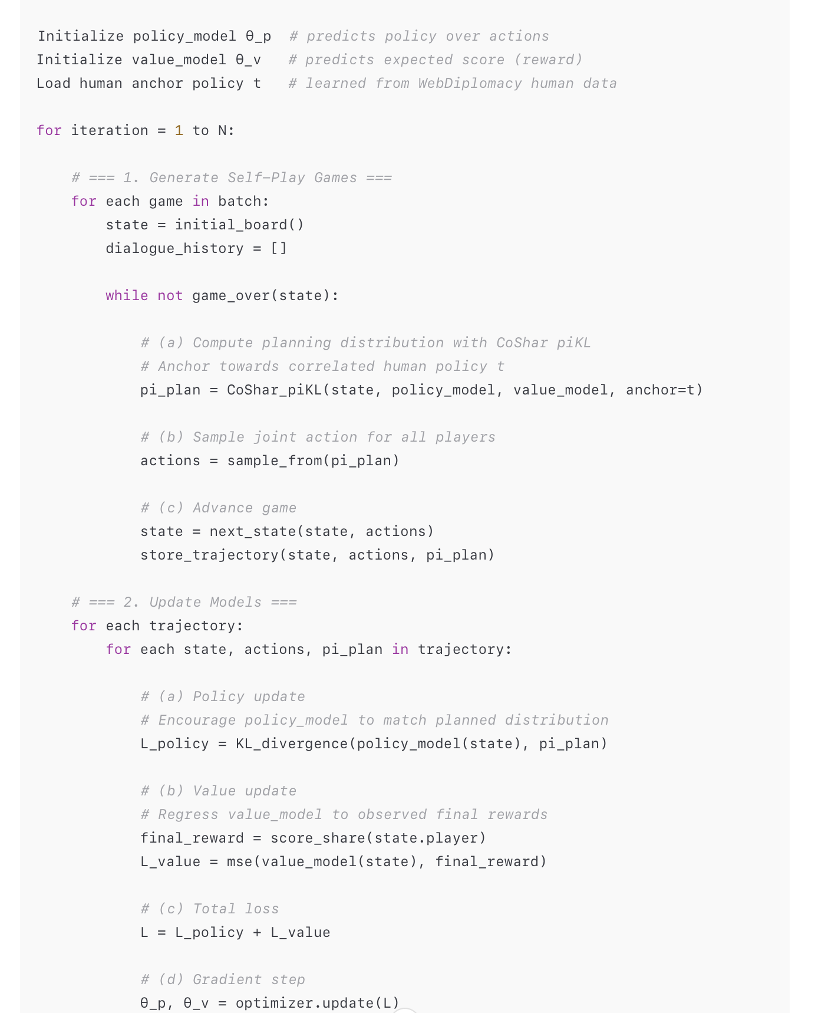
RL Algorithm Pseudocode

